Slide 1

Weekly Operational Reports Complaints Module
December, 2017
Notes:
Total time required
Small group: Approx. 1-1.5 hrs
Individual: Approx. 1 hr
Materials Required
“Live it Fully Pledge” Cards (1 per participant)
Purpose
The intent of this session plan is to orient all new Sienna Team Members to the company and help them feel like part of the team. The session covers the company’s Vision, Mission and Values, provides an overview of our growth strategy, as well as an introduction to the role of Support Services. Facilitators can use this session plan when there is no opportunity to include new team members in the full Welcome to the Community Onboarding Workshop (e.g. time limitation, availability of upcoming workshop). Please note that this session does not replace the full Workshop. All new team members should participate in the workshop as soon as it can be available to them.

Slide 2
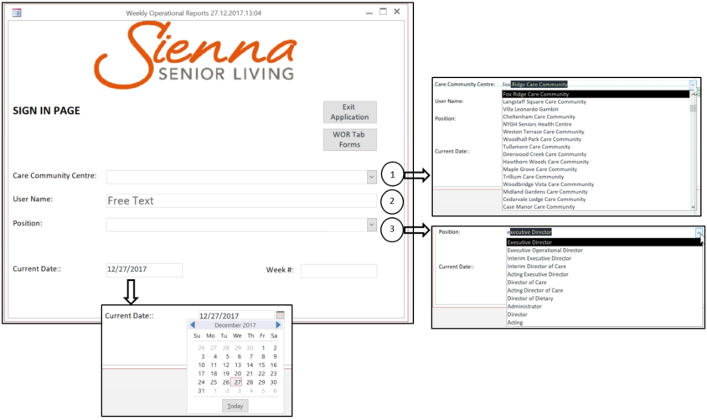
Sign In
The form collects the information similar to that in “Sign In” tab of WOR Excel Spreadsheet. The navigation also allowed by “Enter” key.
1. Select “Care Community Centre” – drop down list with autocomplete feature
2. Type “User Name” – free text field (empty value cannot be accepted)
3. Select “Position” - drop down list with autocomplete feature (empty value cannot be accepted)
4. “Current Date” – today’s date automatic value when form opens – can be changed using calendar or by typing
5. “Week #” – calculated automatically based on the date chosen in “Current Date” field.
6. “WOR Tab Forms” – Care Community related password has to be provided
2
Notes:
3-5 mins
SAY SOMETHING LIKE:
To help our residents live fully every day, we offer a variety of programs and opportunities following the Leisure Well-Being Model. This model emphasises the variety aspects of well-being, related to leisure opportunities and experiences.
We ask each of our lifestyle consultants to offer a wide variety of opportunities including fitness classes, educational seminars and lecture series, community outings and special events.
At (Insert CC/RR name) we offer…. (share some examples of activities specific to your CC/RR)
Additionally, throughout Sienna, through community relationships and building professional partnerships, we are lucky enough to offer many innovative and exciting experiences to our residents. From cruises, to hiking in the beautiful British Columbia forests, to wine tours in Niagara Falls, our residents continually have experiences with meaning and depth, while helping them realize their full potential. Aging does not stop the participation in life, but enhances the experiences through life long learning.
We are proud to offer strong partnerships with a large number of Universities and Colleges which have helped in the development of research based programs. Our Signature Programs, Cyber Seniors & Live it Fit Everyday (LIFE), take evidence from research initiatives to offer technological and physical programs to continue enhancing experiences.
Sienna continually enhances partnerships and works towards new and innovative programs; we are currently working on a project with Seneca College & the CNIB to enhance life of seniors living in retirement homes, and the Sheridan College Centre for Elder Research to enhancing technological links and highlight lifelong learning through the Community of Learners project. Each of our properties also offer a wide variety of spiritual programming dependent on resident interest, such as Yoga, Tai Chi, Meditation and Zen Colouring, while also putting a strong focus on religious observations through church services, bible studies, and devotionals.
NOTE: Take an opportunity to ask participants about the types of programs offered at their RR/CC. Ask if they may like to try any of these activities, and have them share any success stories they’ve experienced.

Slide 3
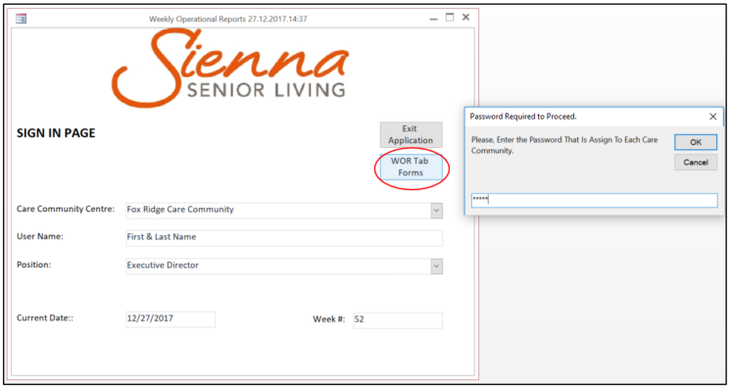
Sign In - Continuing
When all fields completed, please, press “WOR Tab Forms” button. The system will ask the password that is unique to each Care Community.
Note, the password is encoded in order to make it secure at the entry moment.
Please, enter the password and press OK.
3
Notes:
3-5 mins
SAY SOMETHING LIKE:
To help our residents live fully every day, we offer a variety of programs and opportunities following the Leisure Well-Being Model. This model emphasises the variety aspects of well-being, related to leisure opportunities and experiences.
We ask each of our lifestyle consultants to offer a wide variety of opportunities including fitness classes, educational seminars and lecture series, community outings and special events.
At (Insert CC/RR name) we offer…. (share some examples of activities specific to your CC/RR)
Additionally, throughout Sienna, through community relationships and building professional partnerships, we are lucky enough to offer many innovative and exciting experiences to our residents. From cruises, to hiking in the beautiful British Columbia forests, to wine tours in Niagara Falls, our residents continually have experiences with meaning and depth, while helping them realize their full potential. Aging does not stop the participation in life, but enhances the experiences through life long learning.
We are proud to offer strong partnerships with a large number of Universities and Colleges which have helped in the development of research based programs. Our Signature Programs, Cyber Seniors & Live it Fit Everyday (LIFE), take evidence from research initiatives to offer technological and physical programs to continue enhancing experiences.
Sienna continually enhances partnerships and works towards new and innovative programs; we are currently working on a project with Seneca College & the CNIB to enhance life of seniors living in retirement homes, and the Sheridan College Centre for Elder Research to enhancing technological links and highlight lifelong learning through the Community of Learners project. Each of our properties also offer a wide variety of spiritual programming dependent on resident interest, such as Yoga, Tai Chi, Meditation and Zen Colouring, while also putting a strong focus on religious observations through church services, bible studies, and devotionals.
NOTE: Take an opportunity to ask participants about the types of programs offered at their RR/CC. Ask if they may like to try any of these activities, and have them share any success stories they’ve experienced.

Slide 4
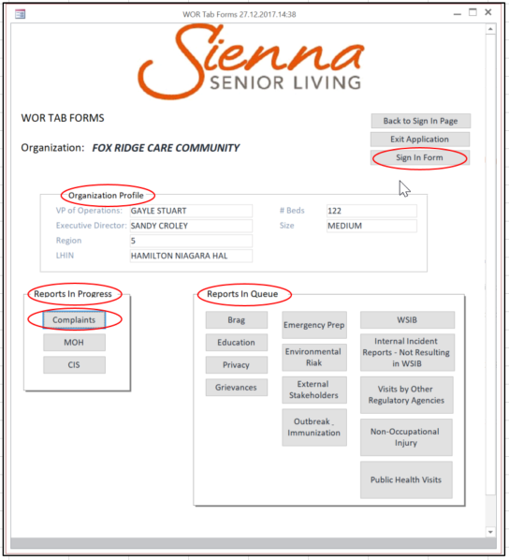
WOR Tab Forms
The form contains:
Care Community profile
Sign In Form – shows when/who logged in (report view)
“Back to Sign In Page” – open “Sign In” form
“Exit Application” – close the application
Note, the buttons grouped into two categories: “Reports in Progress” (under development) and “Reports in Queue” (outstanding).
Currently, only “Complaints” is available.
4
Notes:
3-5 mins
SAY SOMETHING LIKE:
To help our residents live fully every day, we offer a variety of programs and opportunities following the Leisure Well-Being Model. This model emphasises the variety aspects of well-being, related to leisure opportunities and experiences.
We ask each of our lifestyle consultants to offer a wide variety of opportunities including fitness classes, educational seminars and lecture series, community outings and special events.
At (Insert CC/RR name) we offer…. (share some examples of activities specific to your CC/RR)
Additionally, throughout Sienna, through community relationships and building professional partnerships, we are lucky enough to offer many innovative and exciting experiences to our residents. From cruises, to hiking in the beautiful British Columbia forests, to wine tours in Niagara Falls, our residents continually have experiences with meaning and depth, while helping them realize their full potential. Aging does not stop the participation in life, but enhances the experiences through life long learning.
We are proud to offer strong partnerships with a large number of Universities and Colleges which have helped in the development of research based programs. Our Signature Programs, Cyber Seniors & Live it Fit Everyday (LIFE), take evidence from research initiatives to offer technological and physical programs to continue enhancing experiences.
Sienna continually enhances partnerships and works towards new and innovative programs; we are currently working on a project with Seneca College & the CNIB to enhance life of seniors living in retirement homes, and the Sheridan College Centre for Elder Research to enhancing technological links and highlight lifelong learning through the Community of Learners project. Each of our properties also offer a wide variety of spiritual programming dependent on resident interest, such as Yoga, Tai Chi, Meditation and Zen Colouring, while also putting a strong focus on religious observations through church services, bible studies, and devotionals.
NOTE: Take an opportunity to ask participants about the types of programs offered at their RR/CC. Ask if they may like to try any of these activities, and have them share any success stories they’ve experienced.

Slide 5
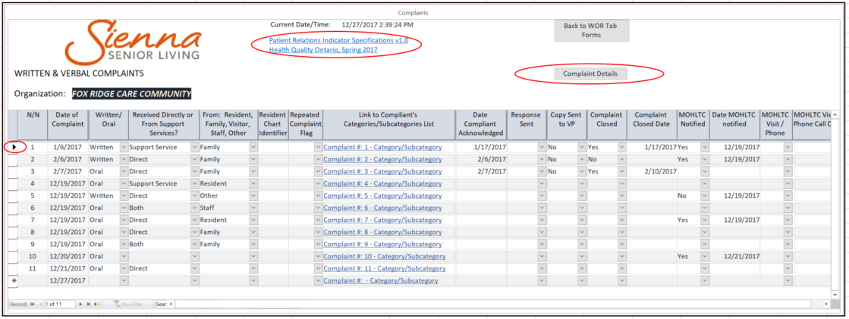
Written & Verbal Complaints
The form contains all complaints entered for the specific Community & period of time. Also, new complaint can be added.
The features are:
- All date fields have calendar attached and text fields have drop down list of choices
On the top of the form there is a hyperlink to the MOH LTC regulatory document “Patient Relations Indicator Specifications”
Click on button “Compliant Details” while the compliant of interest is chosen (the record selection on the left) that opens the specific details for the selected complaint
“Link to Complaint's Categories/Subcategories List” contains hyperlink to the Categories/Subcategories form.
8
Notes:
Optional Slide – use if relevant
1- 2 mins
SAY SOMETHING LIKE: Sienna's Farm to Table program promotes serving local food at our residences, preferably through direct supply from producers (Farm, Winery, Fishery) and even from our own community garden.
Our residents know where the food is coming from, our chef prepare the dishes with pride and from scratch, providing education and being connected to our local communities.
Chef's Tables - Our private dining rooms or chef's table in the restaurant is reserved exclusively for our residents and family. Not only does the Head Chef offer the freshest, seasonal menu choices but the sommelier will also make suggestions of local wines from which to choose.
Culinary Development Program - Sienna's culinary development program is designed to provide those talents with the skills and experience to deliver Farm To Table experiences to our residents. We can also add value to the profession through qualifications, defines career paths and internal mentoring.

Slide 6
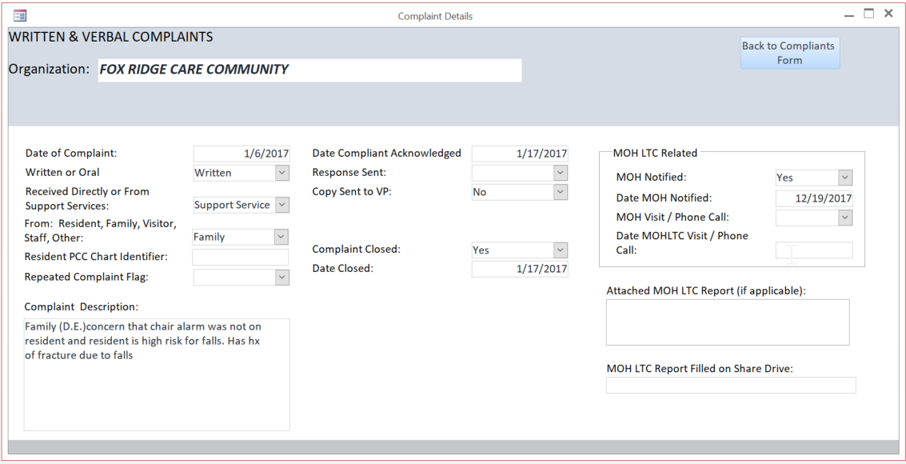
Written & Verbal Complaint Details
The form contains the same features as previous form but the information displayed per complaint.
The business rule included:
If chosen “Written” in the field “Written or Oral”, the fields “MOH Notified” and “MOH Notified Date” should be completed.
Additional fields are:
“Attached MOH LTC Report” - allow attached document(s)
“MOH LTC Report Filled on Share Drive” – hyperlink to the document
9
Notes:
Optional Slide – use if relevant
1- 2 mins
SAY SOMETHING LIKE: Sienna's Farm to Table program promotes serving local food at our residences, preferably through direct supply from producers (Farm, Winery, Fishery) and even from our own community garden.
Our residents know where the food is coming from, our chef prepare the dishes with pride and from scratch, providing education and being connected to our local communities.
Chef's Tables - Our private dining rooms or chef's table in the restaurant is reserved exclusively for our residents and family. Not only does the Head Chef offer the freshest, seasonal menu choices but the sommelier will also make suggestions of local wines from which to choose.
Culinary Development Program - Sienna's culinary development program is designed to provide those talents with the skills and experience to deliver Farm To Table experiences to our residents. We can also add value to the profession through qualifications, defines career paths and internal mentoring.

Slide 7
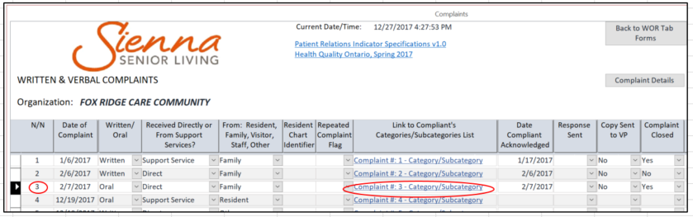
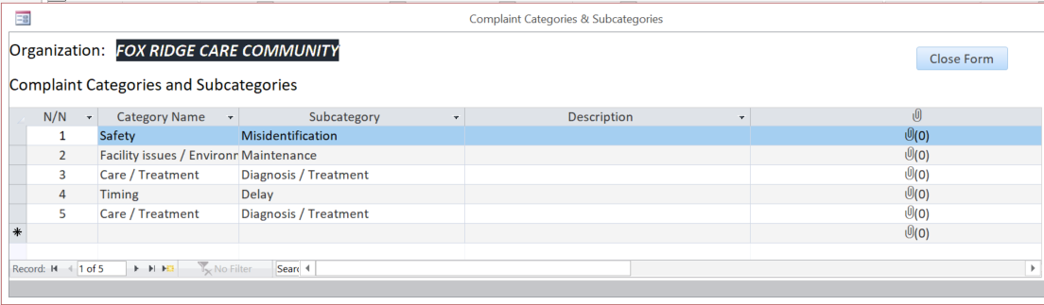
Category/Subcategory
There are two alternative ways to open “Category/Subcategory” form - by clicking on the specific complaint number under “N/N” column or by clicking on “Link to Complaint’s Categories/Subcategories List”.
10
Notes:
Optional Slide – use if relevant
1- 2 mins
SAY SOMETHING LIKE: Sienna's Farm to Table program promotes serving local food at our residences, preferably through direct supply from producers (Farm, Winery, Fishery) and even from our own community garden.
Our residents know where the food is coming from, our chef prepare the dishes with pride and from scratch, providing education and being connected to our local communities.
Chef's Tables - Our private dining rooms or chef's table in the restaurant is reserved exclusively for our residents and family. Not only does the Head Chef offer the freshest, seasonal menu choices but the sommelier will also make suggestions of local wines from which to choose.
Culinary Development Program - Sienna's culinary development program is designed to provide those talents with the skills and experience to deliver Farm To Table experiences to our residents. We can also add value to the profession through qualifications, defines career paths and internal mentoring.

Slide 8
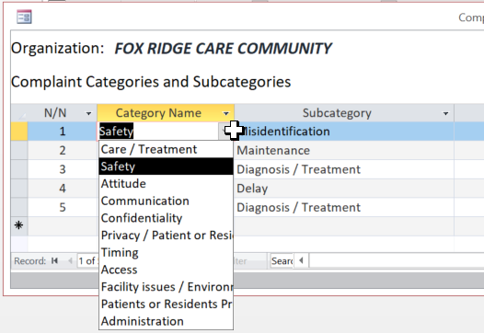
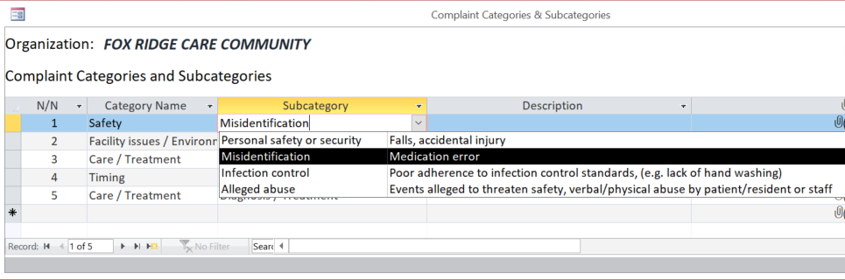
Category/Subcategory - Continued
In “Complaint Categories & Subcategories” form, “Category Name” and “Subcategory” fields have drop down lists. In total, eleven categories are available in the choice list. Each category have its specific list of subcategories in the drop own list that updated dynamically once the new category entered or updated.
In total, eleven categories are available in the choice list.
Each category have its specific list of subcategories in the drop own list that updated dynamically once the new category entered or updated.
11
Notes:
Optional Slide – use if relevant
1- 2 mins
SAY SOMETHING LIKE: Sienna's Farm to Table program promotes serving local food at our residences, preferably through direct supply from producers (Farm, Winery, Fishery) and even from our own community garden.
Our residents know where the food is coming from, our chef prepare the dishes with pride and from scratch, providing education and being connected to our local communities.
Chef's Tables - Our private dining rooms or chef's table in the restaurant is reserved exclusively for our residents and family. Not only does the Head Chef offer the freshest, seasonal menu choices but the sommelier will also make suggestions of local wines from which to choose.
Culinary Development Program - Sienna's culinary development program is designed to provide those talents with the skills and experience to deliver Farm To Table experiences to our residents. We can also add value to the profession through qualifications, defines career paths and internal mentoring.

Slide 9
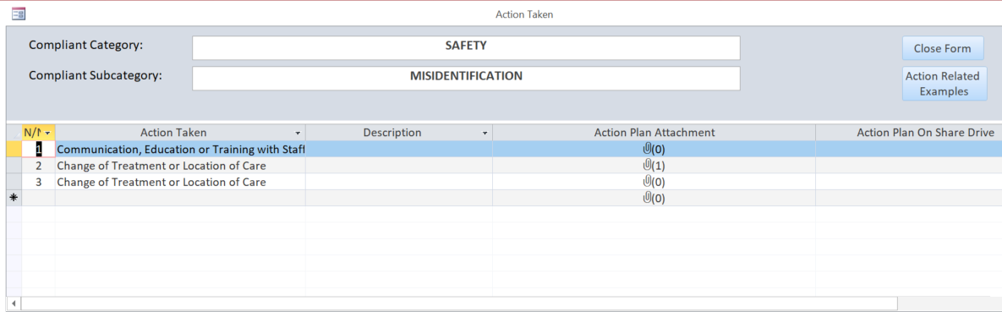
Action Taken
“Action Taken” form can be opened by clicking on the specific category/subcategory number under “N/N” column.
Once another category/subcategory selected, the list of actions changed dynamically in accordance.
In case if another complaint selected in “Complaints” from, the “Action Taken” form is closed and “Categories/Subcategories” form updated accordingly.
There is a drop down list of seven actions that can be selected for each category/subcategory. The list of examples for each action can be viewed by clicking on the button “Action Related Examples”.
12
Notes:
Optional Slide – use if relevant
1- 2 mins
SAY SOMETHING LIKE: Sienna's Farm to Table program promotes serving local food at our residences, preferably through direct supply from producers (Farm, Winery, Fishery) and even from our own community garden.
Our residents know where the food is coming from, our chef prepare the dishes with pride and from scratch, providing education and being connected to our local communities.
Chef's Tables - Our private dining rooms or chef's table in the restaurant is reserved exclusively for our residents and family. Not only does the Head Chef offer the freshest, seasonal menu choices but the sommelier will also make suggestions of local wines from which to choose.
Culinary Development Program - Sienna's culinary development program is designed to provide those talents with the skills and experience to deliver Farm To Table experiences to our residents. We can also add value to the profession through qualifications, defines career paths and internal mentoring.

Slide 10
We look forward to working with you on further suggestions/recommendations!
Thank You!

