Slide 1

Prediction of Adult Income CISC 6930:Data Mining
Submitted by:

Slide 2
Preliminary Exploration
Missing Values
Unbalanced Data

Slide 3
Missing Values
Missing values and unbalanced data for both training and test data

Slide 4
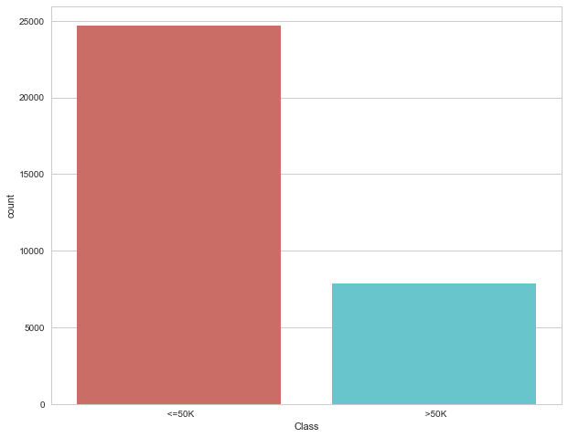
Unbalanced Data
Unbalanced Data

Slide 5
Ensemble Mode
We built and tested three different ensemble classifiers
Each model consisted of different odd-number combinations of the following five classifier algorithms (Supervised Learning)
K-Nearest Neighbors
Logistic Regression
Random Forest
Support Vector Machines
Naïve Bayes
Ensemble A: KNN, Random Forest, Logistic Regression
Highest performing models
Ensemble B: KNN, Random Forest, Naïve Bayes
Uncorrelated
Ensemble C: All
All

Slide 6
Trial Run
Encoding
Dropna
Sklearn.ensemble.baggingclassifier
Processing our data for our ensemble classifier
Trial run without missing values and ignoring unbalanced nature of data
We also address the unbalanced nature with sklearn.ensmeble’s bagging

Slide 7
Imputation
Mode
KNN
RANDOM FOREST

Slide 8
Encoding

Slide 9
Bagging

Slide 10
Normalization: Z-score
Generated huge improvement for recall and precision
Just for continuous variables (5)

Slide 11
Parameter Optimization
We found the best parameters for the algorithms in each ensemble classifier for each data set

Slide 12
Feature Selection
Including all features generated the best results
Plot Big Correlation

Slide 13
Winning Algirthm
Random Forest Imputation
Ensemble C
Bagging
Z score normalized
Parameters Optimized

Slide 14
Future recommendation and Q & A

