Slide 1

Prediction of Adult Income CISC 6930:Data Mining
Submitted by: Vaibhav Dixit
Matias Berretta
Rohini Mandge

Slide 2
Preliminary Exploration
Types of variables
Missing Values
Unbalanced Data
Correlation of data

Slide 3
Types of Variables
The census data contains 15 variables of three distinct kinds.
Continuous
Categorical
Ordinal
Education and education_num
The education_num variable translates the values of education variable into their corresponding integer values.
We deleted the original variables education and use education_num variable as an ordinal variable. Since it consist of integers whose orders are determined by level education

Slide 4
Missing Values
Missing values and unbalanced data for both training and test data
Notes:
Missing completely at random (MCAR)
Missing at random (MAR)
Not missing at random (NMAR)

Slide 5
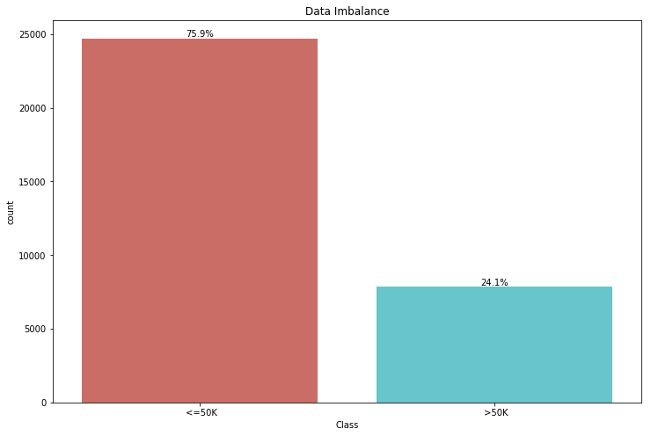
Unbalanced Data
Unbalanced Data
Negative
75.9%
Positive
24.1 %

Slide 6
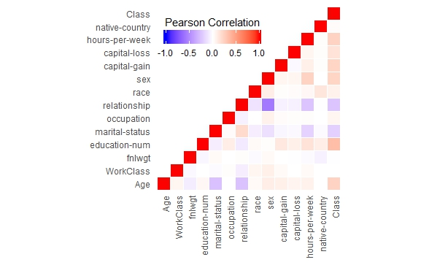
Correlation
Correlation between features and class variable.
Notes:
Correlation measures the relationship between two variables. If two variables are highly correlated they kind of explain each other to the point that one variable can predict value of another variable. Lower triangle of correlation matrix.

Slide 7
Ensemble Model
We built and tested three different ensemble classifiers
Each model consisted of different odd-number combinations of the following five classifier algorithms (Supervised Learning)
K-Nearest Neighbors
Logistic Regression
Random Forest
Support Vector Machines
Naïve Bayes
Ensemble A: K-Nearest Neighbors, Random Forest and Logistic Regression
Highest performing models
Ensemble B: K-Nearest Neighbors, Random Forest and Naïve Bayes
Uncorrelated
Ensemble C: All
All 5 : K-Nearest Neighbors, Random Forest, Naïve Bayes, SVM and Logistic Regression

Slide 8
Trial Run
Processing our data for our ensemble classifier
For our trial run we took the simplest approach to preprocessing
We dropped all rows containing missing values (DropNA) ; this leads to a reduction of 7.37% of our training data (2399 samples)
We ignored the unbalanced nature of our data
We encoded our multiclass variables with dummy encoding
The purpose of our trial run was to unit test our code
Data | Ensemble | Accuracy | Precision | Recall | F1-score
DropNa | A | 86.26% | 48.04% | 93.69% | 63.51%
DropNa | B | 86.55% | 50.12% | 92.32% | 64.97%
DropNa | C | 86.31% | 48.14% | 93.87% | 63.64%

Slide 9
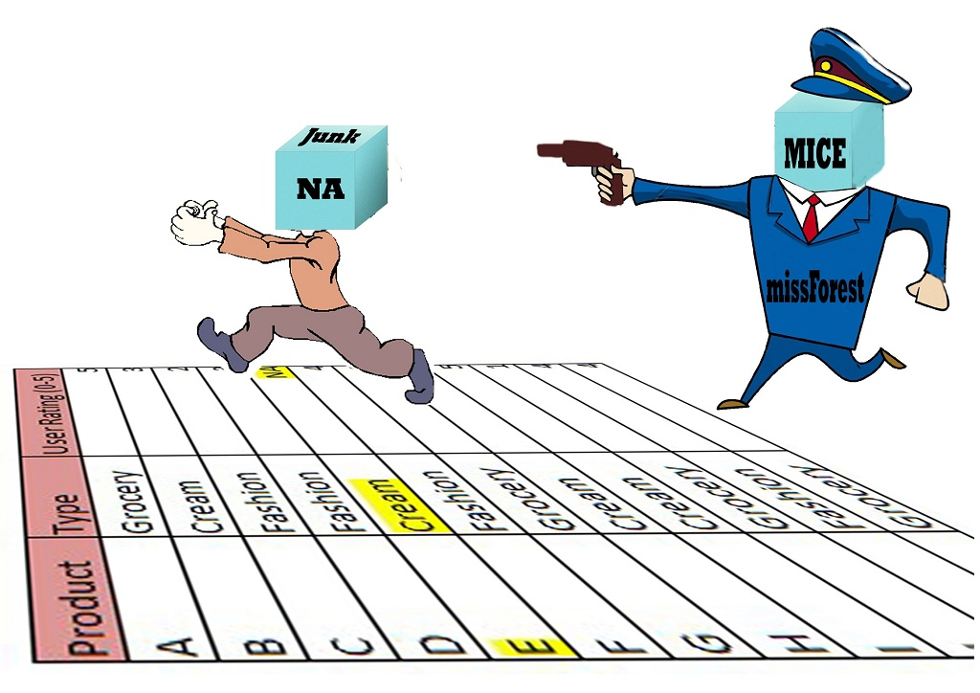
Imputation

Slide 10
Imputation
Non-Model Based Approach :- Decrease variance , Increase bias
Mode – Fills in most frequent data for the missing features.
Model Based Approach :- Decrease variance , Decrease bias
KNN
Grower’s similarity coefficient to find the K nearest neighbor
Aggregation of the K values to impute the missing values
Aggregation is based on most frequent occurrences.
Random Forest
Build random forest for each individual missing value feature
Generalize ensembles of D-trees through bagging
Performs iterations to reduce Out-Of-Bag error

Slide 11
Encoding
“Curse Of Dimensionality” – An important factor to keep in mind while feature encoding
Many different approaches to Encode but there is no best
One-Hot, Ordinal, Binary, Backward Difference, BaseN, Hashing, Helmert, Leave-One-Out, Polynomial, Sum encoding and default dummy encoding.
Built logistic regression model (with cross-validation) to test the trade-offs and potential impact of each encoding approach.

Slide 12
Bagging and Normalization
Bagging
To improve the stability and accuracy of our models we used bagging technique
Normalization
Z-score normalization
Generated huge improvement for recall and precision
Just for continuous variables (5)

Slide 13
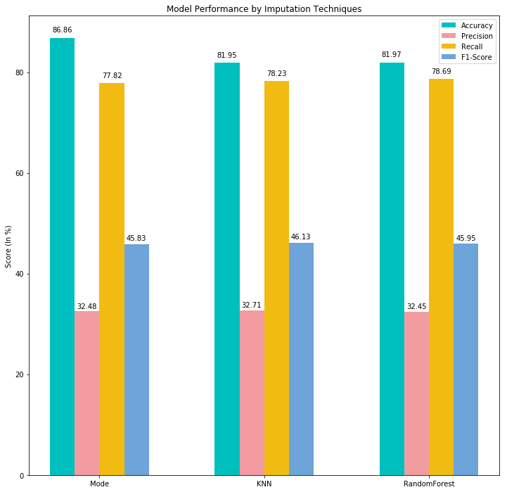
Before Normalization

Slide 14
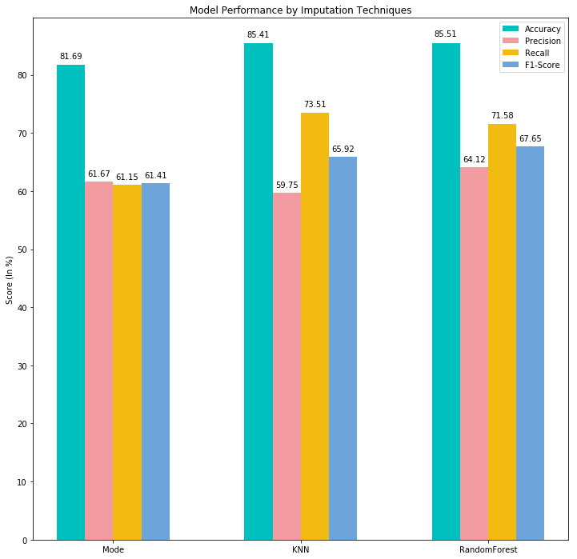
After Normalization

Slide 15
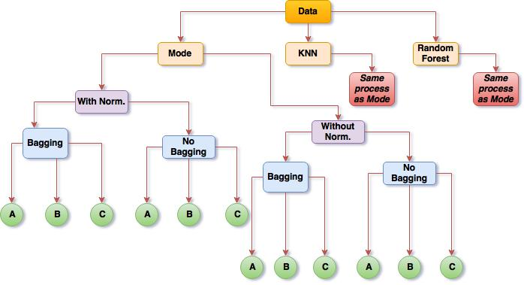
Imputation Techniques
Ensemble Classifiers
Notes:
Flow chart

Slide 16
Parameter Optimization
We found the best parameters for the algorithms in each ensemble classifier for each data set
Ensemble | Data | KNN | Random Forest | Logistic Regression | SVM | Naïve Bayes
B | Mode | n_neighbors = 30 | n_estimators = 50 | N/A | N/A | N/A
B | KNN | n_neighbors = 50 | n_estimators = 90 | N/A | N/A | N/A
C | RF | n_neighbors = 15 | n_estimators = 90 | C = 10 | C = 10, gamma = 0.1, kernel = 'rbf' | N/A

Slide 17
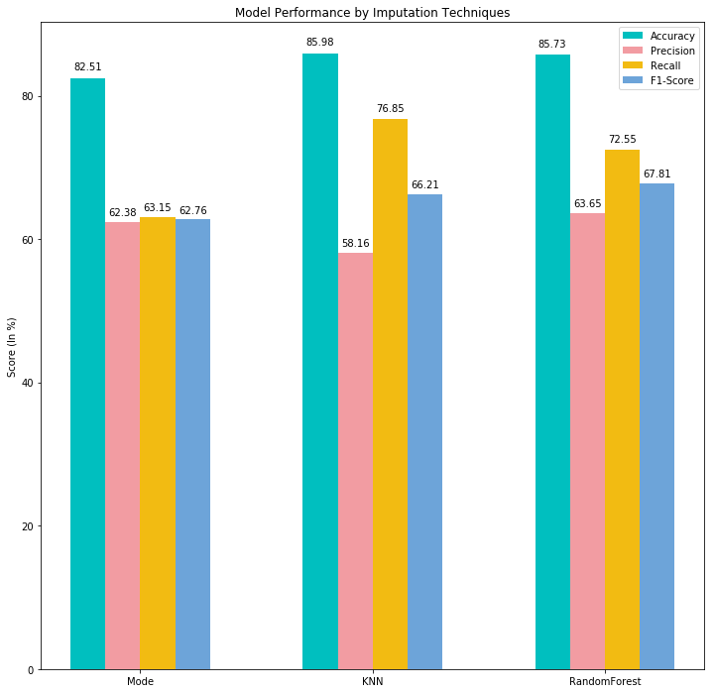
Parameter Optimization

Slide 18
Feature Selection
Filter Method: We ran each of our optimized models with three different set amounts of features:
first 20 most correlated features
first 40 most correlated features
first 60 correlated features
Results
Including all features generated the best results
Reducing the number of features only improved the performance for the KNN Data and Ensemble B pairing, with the optimal feature number being 60.

Slide 19
Result table after performing Feature Selection
Data | Method | Features | Accuracy | Precision | Recall | F1-score
Mode | Filter | 20 | 81.59% | 58.09% | 61.71% | 59.84%
Mode | Filter | 40 | 82.48% | 63.13% | 62.87% | 63.00%
Mode | Filter | 60 | 82.38% | 63.21% | 62.59% | 62.90%
Mode | Regular | All | 82.51% | 62.38% | 63.15% | 62.76%
KNN | Filter | 20 | 85.19% | 66.54% | 69.48% | 67.98%
KNN | Filter | 40 | 84.98% | 67.86% | 68.34% | 68.10%
KNN | Filter | 60 | 84.91% | 68.54% | 67.89% | 68.21%
KNN | Regular | All | 85.98% | 58.16% | 76.85% | 66.21%
Random Forest | Filter | 20 | 85.34% | 61.78% | 72.17% | 66.57%
Random Forest | Filter | 40 | 83.42% | 14.54% | 20.92% | 17.16%
Random Forest | Filter | 60 | 85.41% | 63.83% | 71.39% | 67.40%
Random Forest | Regular | All | 85.73% | 63.65% | 72.55% | 67.81%
Feature Selection

Slide 20
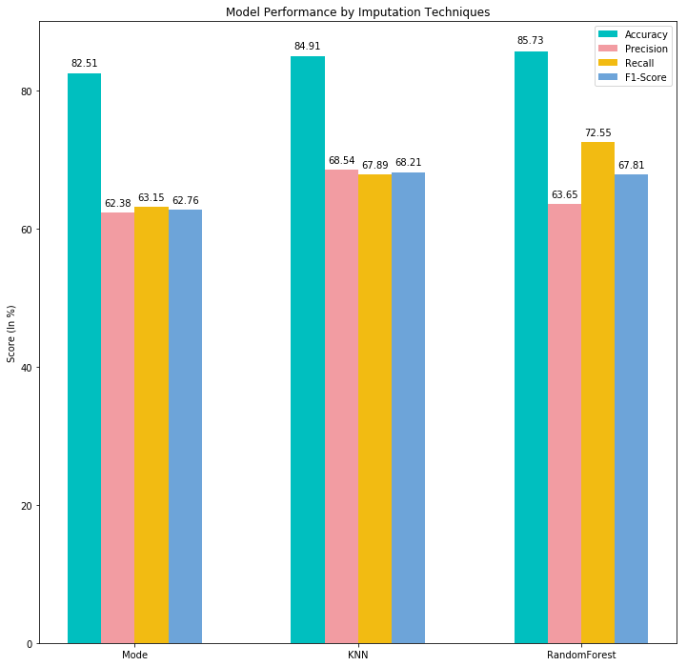
Feature Selection

Slide 21
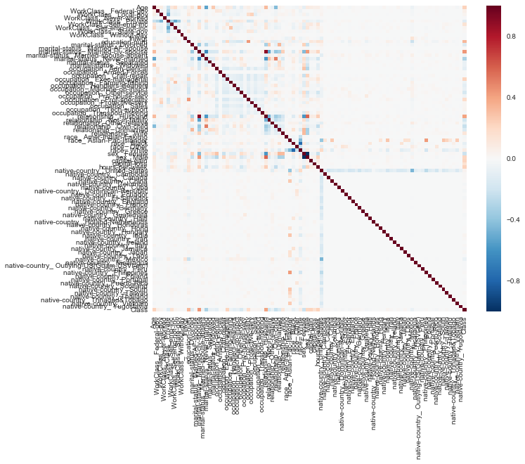

Slide 22
Optimal Algorithm
Random Forest Imputation
Ensemble C
With Bagging
Z score Normalized
Parameters Optimized
Data | Stages | Ensemble | Bagged | Accuracy | Precision | Recall | F1-score
Mode | Feature Selection: All | Ensemble B | Yes | 82.51% | 62.38% | 63.15% | 62.76%
KNN | Feature Selection: 60 | Ensemble B | Yes | 84.91% | 68.54% | 67.89% | 68.21%
Random Forest | Feature Selection: All | Ensemble C | Yes | 85.73% | 63.65% | 72.55% | 67.81%

Slide 23
Future Recommendation and Q & A
Future Work
B(L)agging: blagging.py(Balanced Bagging)
Neural Networks
Wrapper Method of Feature selection

