Slide 1

CTR of an Email Campaign Predictor
Vasu Devan
Notes:
Good After noon Everyone
Im VasuDevan today we are going to Bulid a model to Predict whether the Customer will default on his loan or not

Slide 2
EDA on Data
MODEL Selection
Recommendation
Problem Overview
Pre-processing Data
MODEL Evaluation
Overview of the Presentation

Slide 3

Problem Overview
What is the Business problem?
To Predict Click Rate of the Email
Using insights in the business domain

Slide 4
Objective
Preforming EDA
Identifying the Key Variables influencing the Problem
Selecting the best Fit Model
Suggesting ways to Improve the CTR

Slide 5




Solution Process
Model Validation
Model Performance measure on
Testing data set using R2_score
The Data set from email campaign that has Details of Emails attributes like subject and body length, no. of CTA ,etc.
By Following the Steps we would provide the Click rate of the email.
STEP
04
Model Preparation
We teach the model
Using Training dataset
STEP
03
Analytical approach
Scaling the Data, Selecting Model: Random Forest, XG Booster, Ada Booster
STEP
02
Analyse Data
Exploratory Data Analysis, Label & One-Hot Encoding, Missing Values Treatment
STEP
01

Slide 6
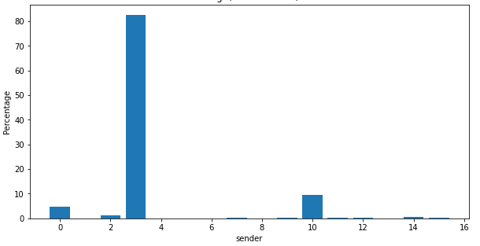
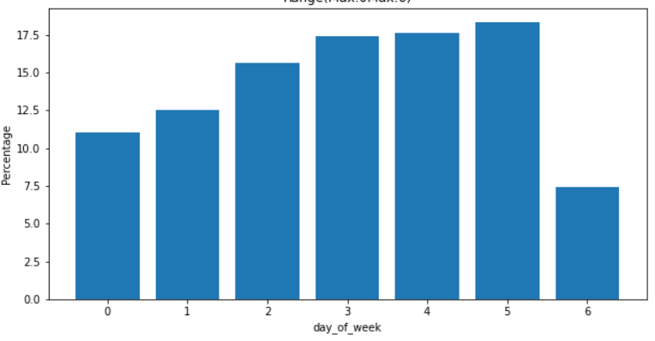
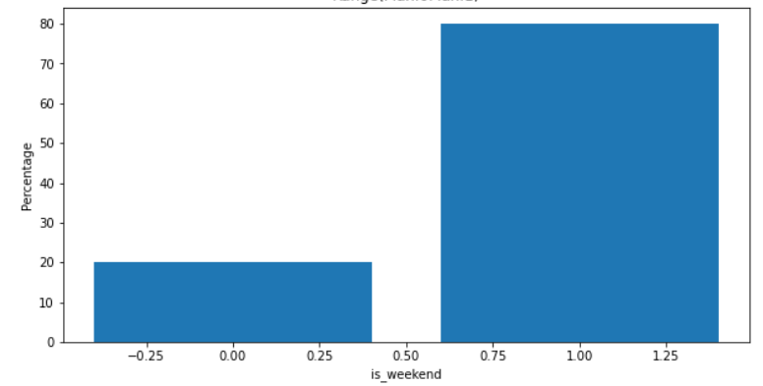
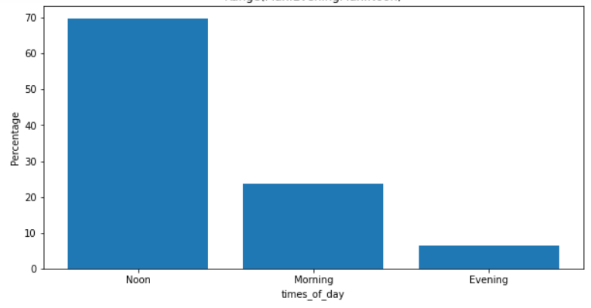
EDA - Univariate Analysis - Categorical
Detailed Analysis and Explanation in Notebook

Slide 7
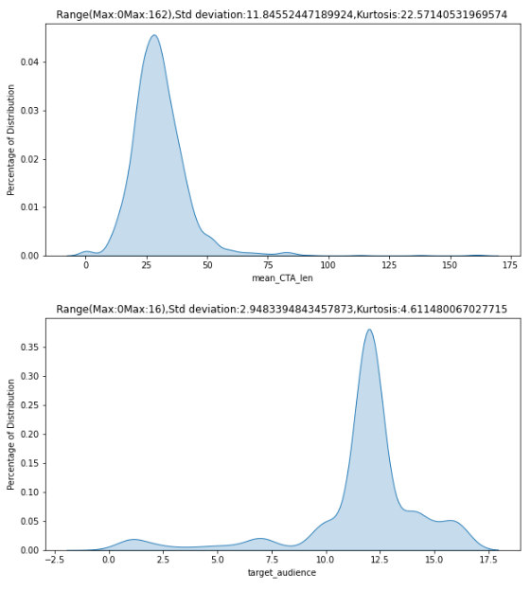
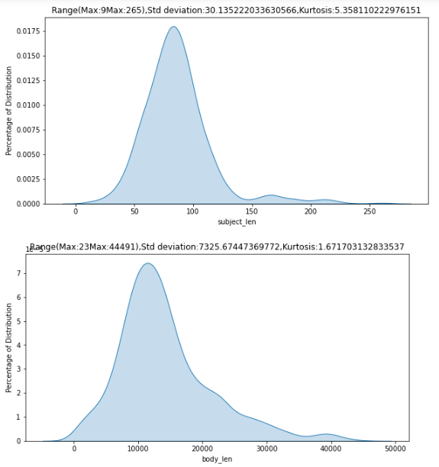
Univariate Analysis - Numerical
Detailed Analysis and Explanation in Notebook

Slide 8
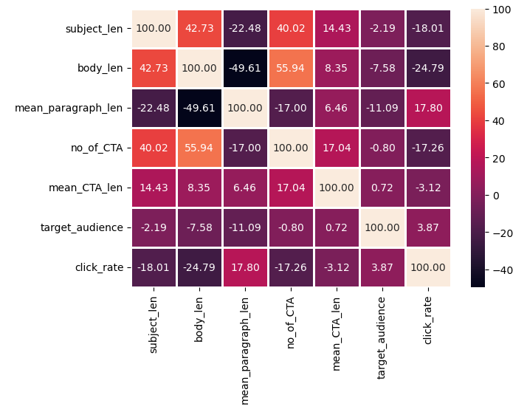
Bivariate Analysis : Numerical-Numerical
Detailed Analysis and Explanation in Notebook

Slide 9
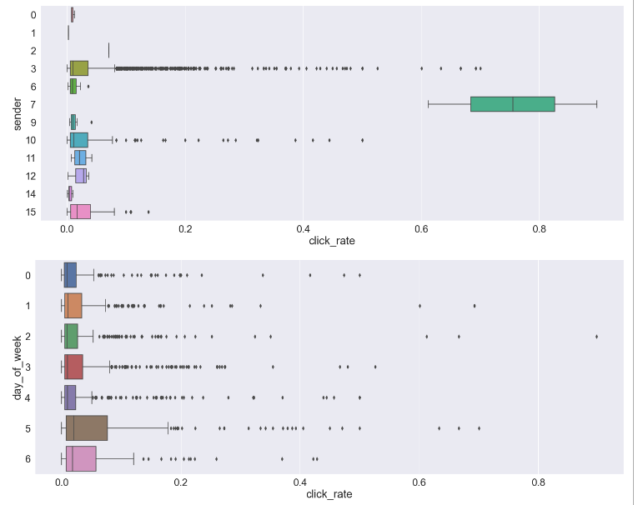
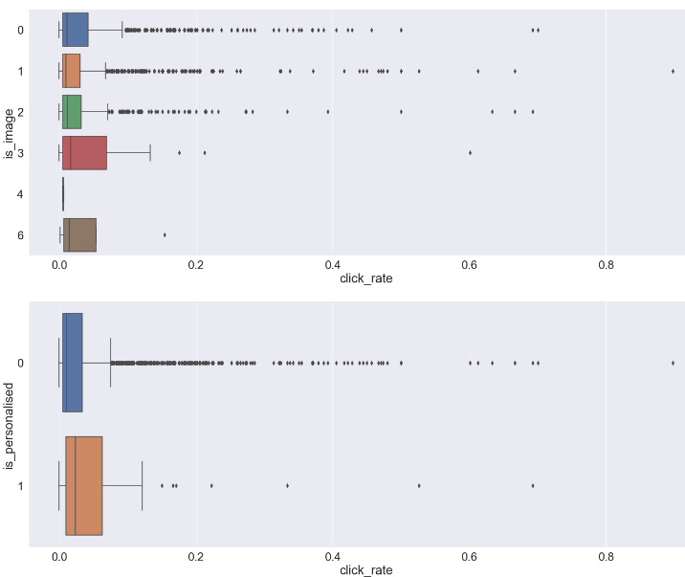
Bivariate Analysis: Categorical to Numerical
Detailed Analysis and Explanation in Notebook

Slide 10
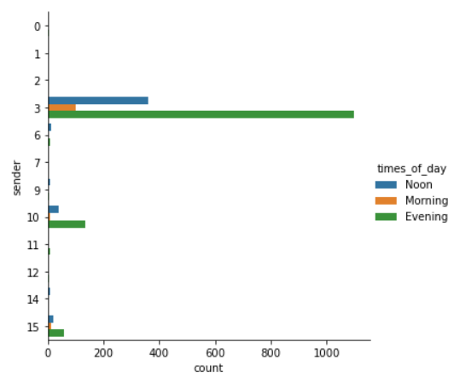
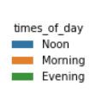
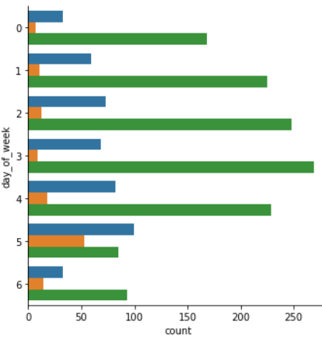
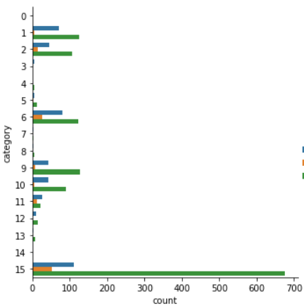
Bivariate Analysis : Categorical-Categorical
Detailed Analysis and Explanation in Notebook

Slide 11
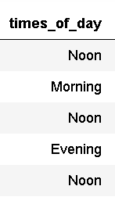
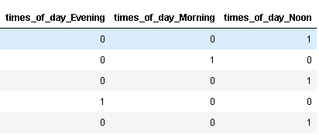
One – Hot Encoding the Categorical column
Using the Code - train=pd.get_dummies(train)

Slide 12
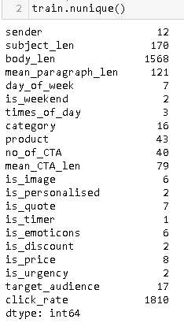
Converting the Columns to Boolean flag
Changed image column to Boolean to Check only if there is a image or not in a Email
Changed Quote column to Boolean to Check only if there is a Quote or not in a Email
Changed Emoticons column to Boolean to Check only if there is a Emoticons or not in a Email
Changed Price column to Boolean to Check only if there is a Price or not in a Email
Influence of the Change has impacted great on Predication
-Major thing is this about feature has max of ‘0’ class so Converted to Boolean

Slide 13
Dropped Unwanted Features :
Dropped Is_timer because the class only consist of only one class ‘0’ so dropped Is_timer from the data
Dropped Is_weekend Because that is Correlated to column and week of the Day .

Slide 14
Splitting the Data- Training and Validation set
Using train_test_split from sklearn library
Splitting the Training Data to 75% as Training set and 25% as Validation set
Metrics used to for Evaluation
Using r2_score from sklearn library

Slide 15
Model Selection - Approach
Selecting a XG Booster model
Then using the XG Booster as a Base model in AdaBoost Model
Tuning parameters of AdaBoost model manually for Better Results
Finally the AdaBoost Model Provided with
R2 Score of Training set as 0.9964
R2 Score of Validation set as 0.6912

Slide 16
Recommendations
Effective Email
Category-7 has High Click Rate
Mail with image are having higher click Rate
Subject Length Should between 50 to 100
Body Length should be 600-1200
mean Length of Paragraph should be 10-40.
Notes:
Note

Slide 17
What should your subject line look like?
Subject line Should shorter than 100 letter and greater than 50 letters
What should be the length of the email?
The length of the Mail should be 1250 letters including the Subject
Do you need images in your email template?
The Click Rate is High with Images

Slide 18
Thank you

