Slide 1
Weekly Demand on Food Order
View in Power BI
Last data refresh:
4/30/2022 6:12:54 AM UTC
Downloaded at:
4/30/2022 6:14:28 AM UTC

Slide 2
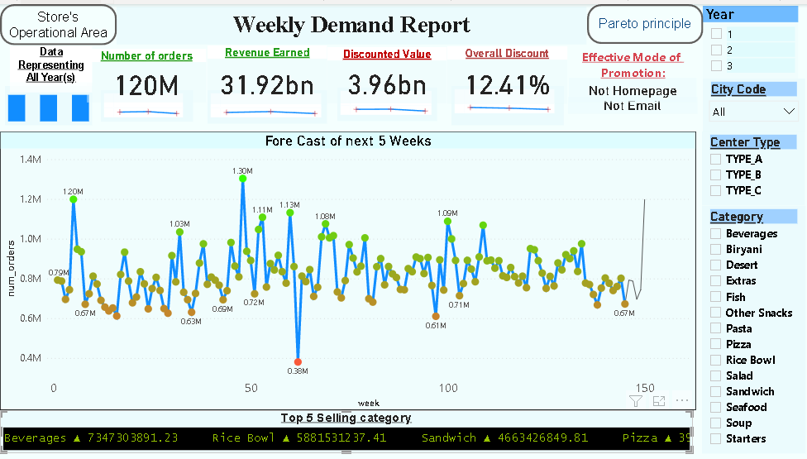

Slide 3
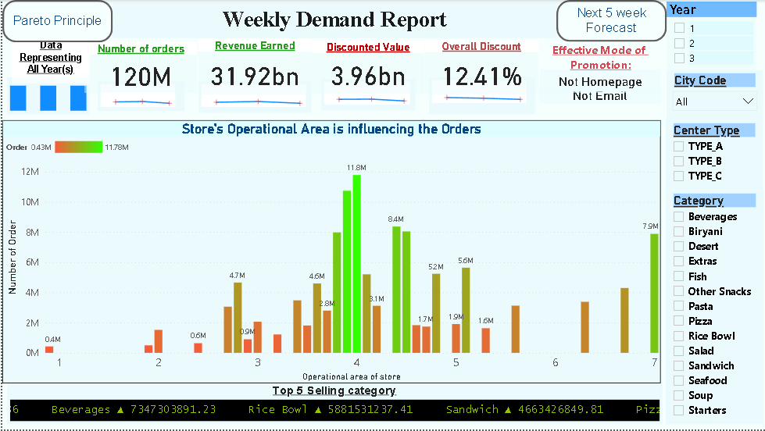
Dash Board
Notes:
Year
No alt text provided
Number of orders
No alt text provided
pivotTable
No alt text provided
Revenue Earned
No alt text provided
Discounted Value
No alt text provided
Overall Discount
No alt text provided
card
No alt text provided
textbox
No alt text provided
card
No alt text provided
Data Representing All Year(s)
No alt text provided
Store's Operational Area is influencing the Orders
No alt text provided
actionButton
No alt text provided
actionButton
No alt text provided
slicer
No alt text provided
slicer
No alt text provided
slicer
No alt text provided
Top 5 Selling category
No alt text provided
textbox
No alt text provided
pivotTable
No alt text provided
pivotTable
No alt text provided
pivotTable
No alt text provided
columnChart
No alt text provided
lineChart
No alt text provided
lineStackedColumnComboChart
No alt text provided
actionButton
No alt text provided
actionButton
No alt text provided

Slide 4
