Slide 1
Fundamentals of Machine Learning
A Step-by-Step Teaching Curriculum & Core Models Guide
Instructor Slide Deck • Supervised, Unsupervised, Ensembles & LLMs

Slide 2
MODULE 1: INTRODUCTION TO ML
The Paradigm Shift: Rules vs. Data
Traditional Software Engineering
• Human developer codes logical rules explicitly.
• System applies rules directly to inputs to yield answers.
• Highly deterministic but difficult to scale for complex patterns like vision or natural language.
• Example: If 'free' and 'money' in text: mark as spam.
Machine Learning Paradigm
• Algorithm accepts raw data paired with historical outcomes.
• Model self-optimizes internal parameters to map X to y.
• Excels at multi-variable high-dimensional datasets that defy simple rule creation.
• Example: Analyze millions of emails to extract probabilistic spam indicators automatically.

Slide 3
MODULE 2: LEARNING PARADIGMS
The Four Machine Learning Paradigms
Supervised
Labeled data drives training. Target labels (y) are paired with features (X).
Example Use Case:
Credit Scoring, Pricing
Unsupervised
Unlabeled data. Discovers hidden structural groupings directly from features (X).
Example Use Case:
Customer Clustering
Semi-Supervised
Leverages small labeled dataset + huge unlabeled pool to reduce annotation costs.
Example Use Case:
Image Annotation
Reinforcement
Interactive trial-and-error. Agent optimizes policy using environment rewards.
Example Use Case:
Autonomous Driving

Slide 4
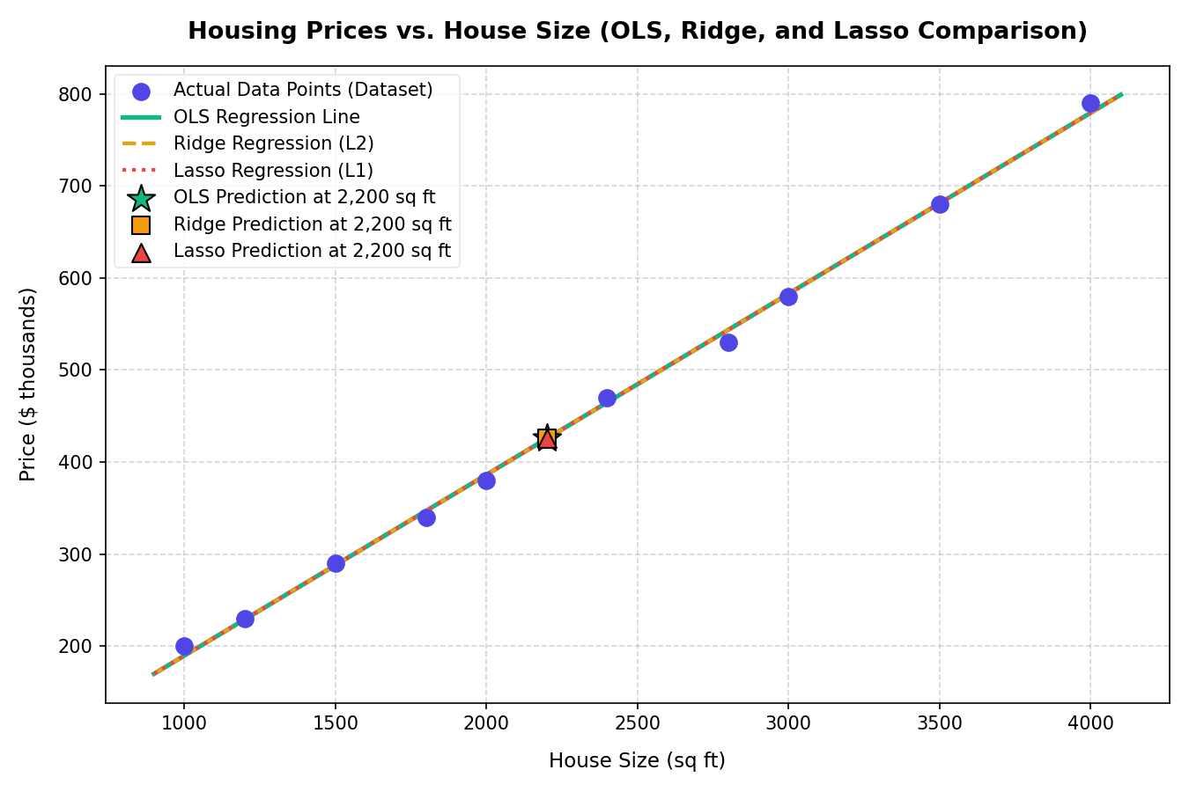
MODULE 3: SUPERVISED REGRESSION
Regression: Predicting Continuous Targets
Continuous Model Formulation
Ordinary Least Squares (OLS): Fits a linear equation: y_hat = theta_0 + theta_1 * x_1 + ...
Cost Function: Minimizes Mean Squared Error (MSE) to align the regression line.
L2 Regularization (Ridge): Adds penalty lambda * sum(theta^2). Shrinks weights close to zero, decreasing variance.
L1 Regularization (Lasso): Adds penalty lambda * sum(|theta|). Drives coefficients to exactly zero (Soft-Thresholding), doing automatic feature selection.
Visual: Framework OLS vs. Ridge vs. Lasso on housing per-sq-ft.

Slide 5
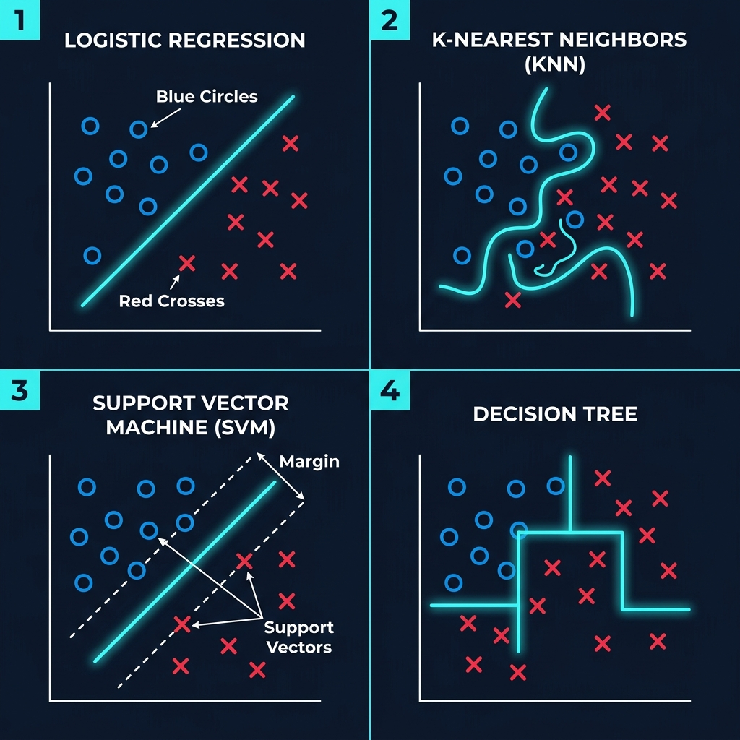
MODULE 4: SUPERVISED CLASSIFICATION
Classification: Categorizing Observations
Decision Boundary Approaches
Logistic Regression: Maps inputs to probabilities using the Sigmoid function: 1 / (1 + e^-z).
K-Nearest Neighbors (KNN): Non-parametric model. Classifies a query point based on distance-weighted votes of its K closest neighbors.
Support Vector Machines (SVM): Finds a hyperplane that maximizes the margin between classes. Employs the Kernel Trick for non-linear boundaries.
Naive Bayes: Probabilistic classifier based on Bayes Theorem. Assumes strong conditional independence among features.
Visual: Multi-class decision boundaries of Scikit-Learn models on the Iris dataset.

Slide 6
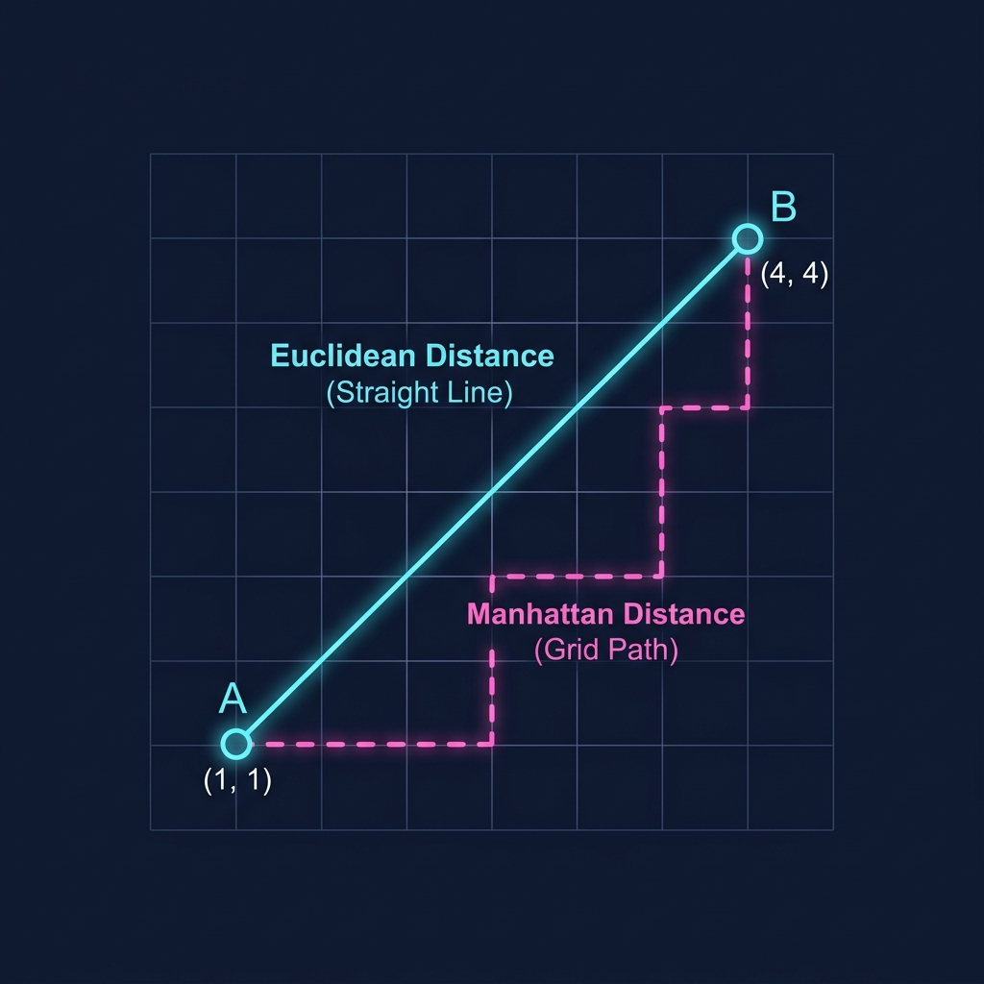
MODULE 4: SUPERVISED CLASSIFICATION
Distance Metrics & Vector Spatial Relations
Quantifying Geometric Closeness
Euclidean Distance: Straight-line (L2 norm) distance. Sensitive to large coordinate deviations.
Manhattan Distance: Grid-based (L1 norm) distance. Sum of absolute differences along coordinate axes.
Cosine Similarity: Measures the angular alignment between two vectors. Independent of vector magnitude (widely used in text/embeddings).
Chebyshev Distance: Maximum absolute coordinate difference (L-infinity norm).
Visual: Distance metric bounds (Circle, Diamond, Square) in a 2D coordinate space.

Slide 7
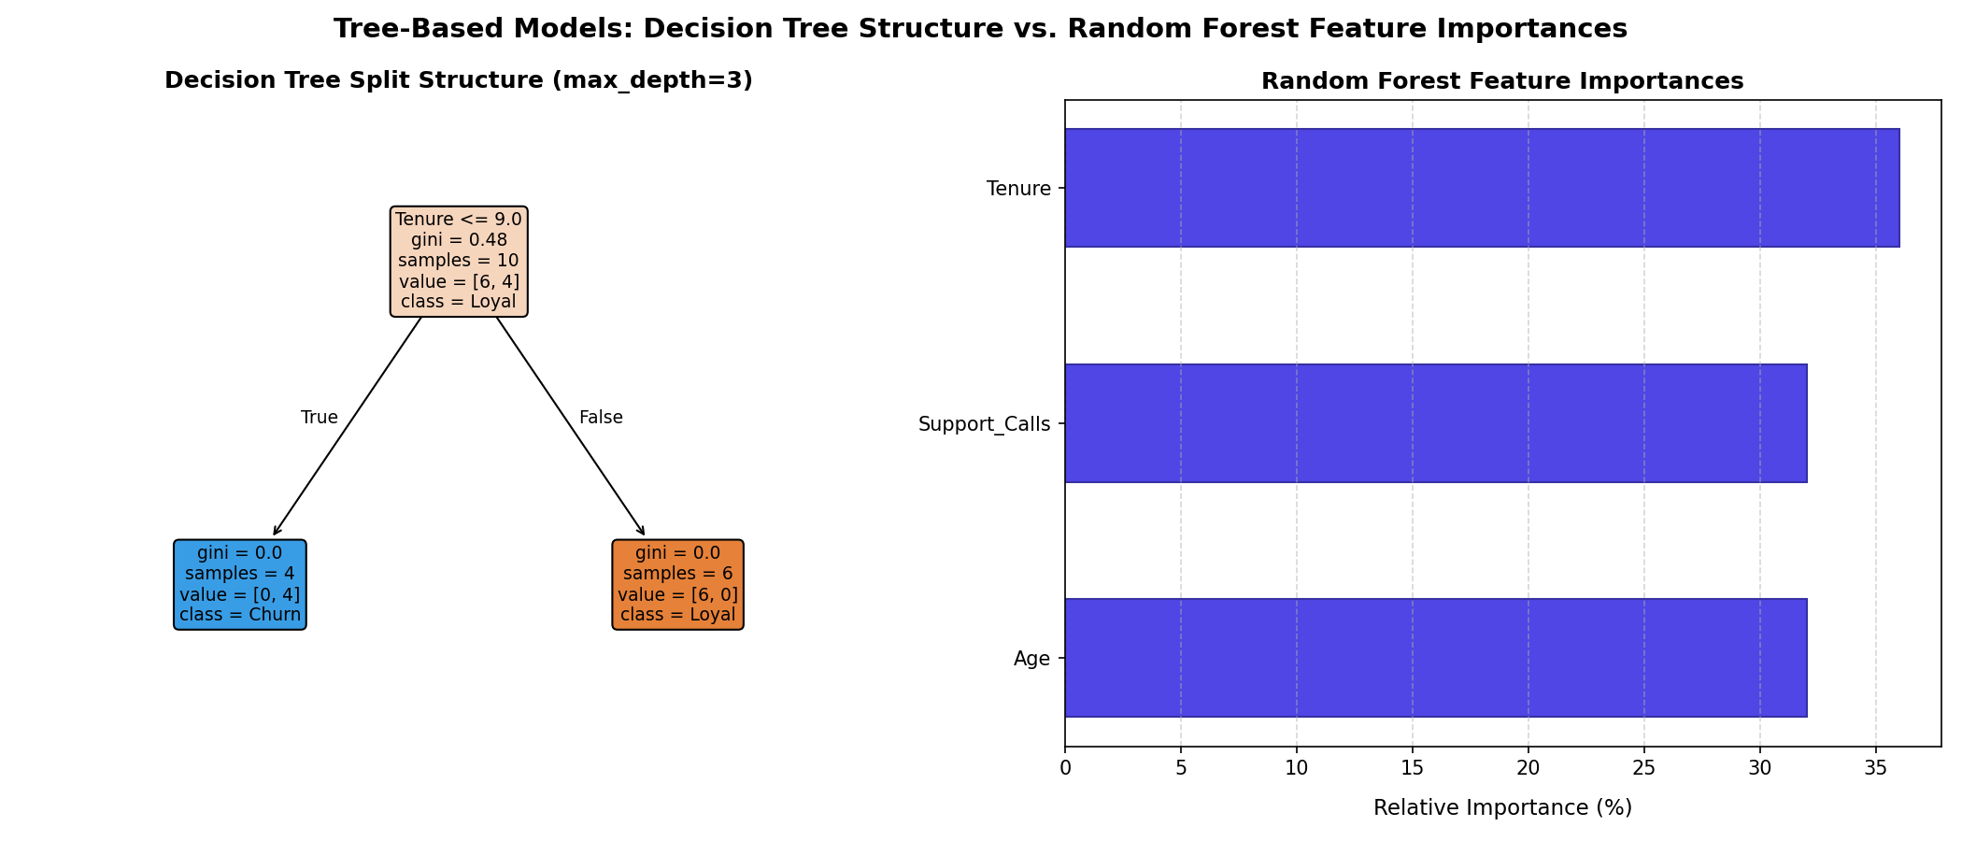
MODULE 4: SUPERVISED CLASSIFICATION
Tree-Based Models & Bagging Ensembles
Recursive Splits & Forest Aggregation
Decision Trees: Splits features recursively to maximize sample purity.
Purity Metrics: Evaluated using Gini Impurity or Entropy (Information Gain). Highly prone to overfitting.
Random Forest Ensemble: Trains multiple independent trees in parallel.
Bootstrapping: Each tree is trained on a random subset of rows (drawn with replacement).
Feature Subspacing: Selects a random subset of features (e.g. sqrt(D)) at each split to decorrelate tree errors.
Visual: Decision Tree splits vs. Random Forest averaged boundary.

Slide 8
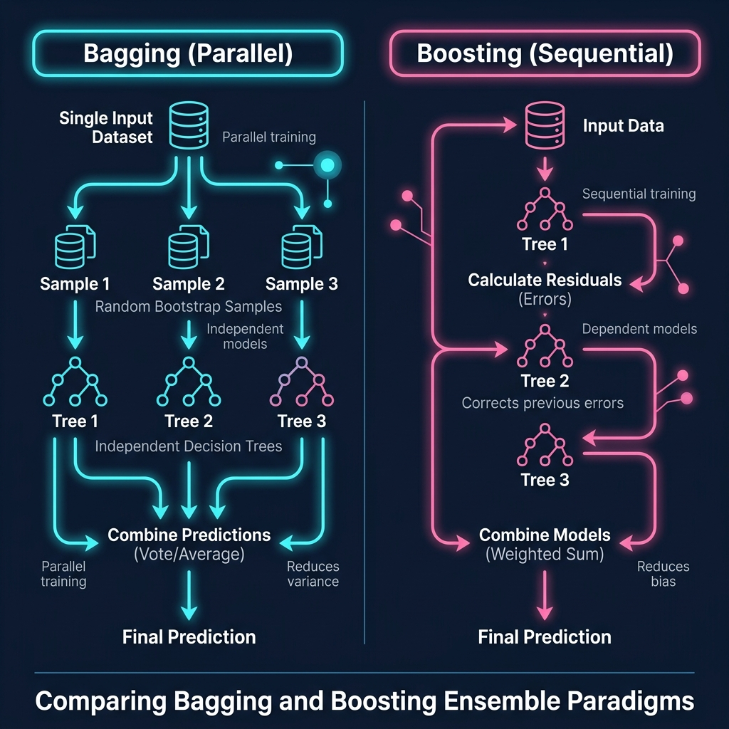
MODULE 5: ENSEMBLE LEARNING & XGBOOST
Boosting Paradigms & XGBoost
Sequential Optimization
Sequential Learning: Weak learners (e.g. shallow decision trees) are trained sequentially rather than in parallel.
Residual Fitting: Each successive tree is trained to predict the residual errors (gradients) of the cumulative ensemble.
XGBoost (Extreme Gradient Boosting): Highly optimized library.
Regularized Objective: Incorporates L1 & L2 parameter constraints directly into the split objective.
Implementation: Employs parallel split searches, block structures, and handles missing/sparse data automatically.

Slide 9
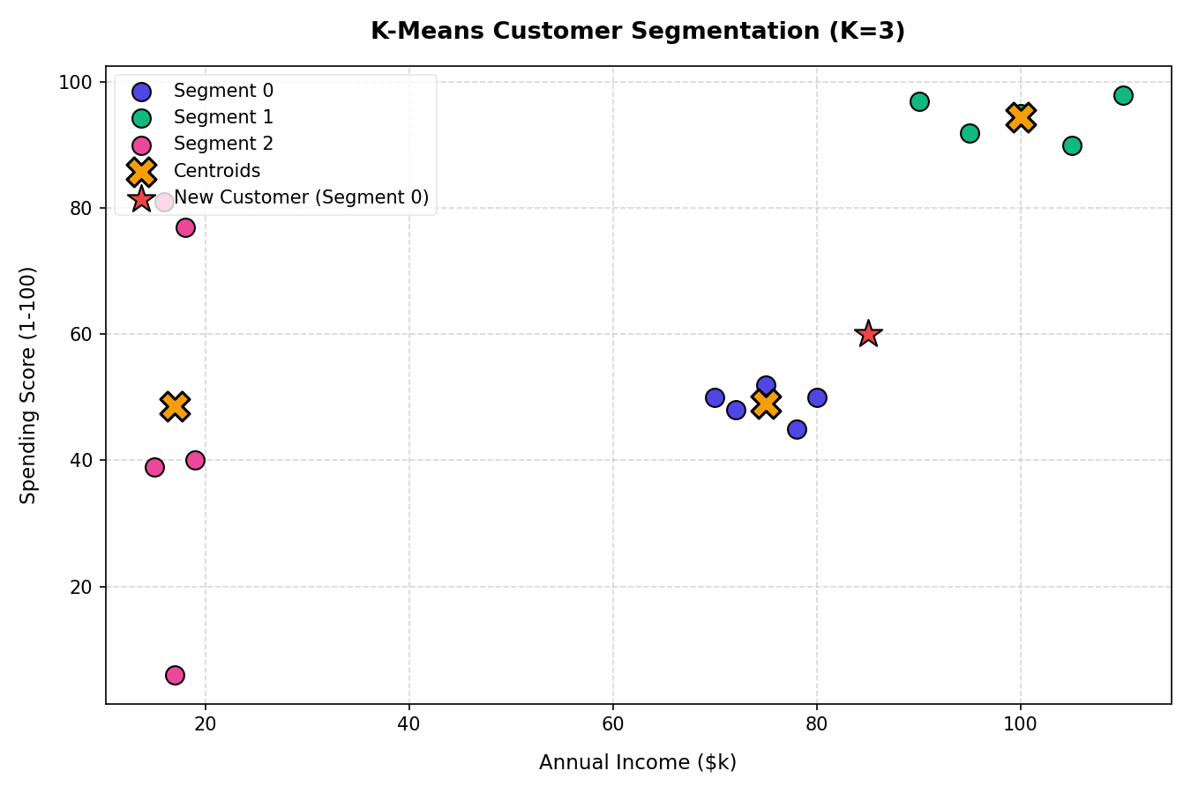
MODULE 6: UNSUPERVISED LEARNING
Clustering: Grouping Unlabeled Points
Unsupervised Spatial Grouping
K-Means: Partitions data into K clusters. Iteratively updates cluster centroids to minimize within-cluster sum of squares (Inertia).
Hierarchical Clustering: Builds nested tree structures (dendrograms) via agglomerative (bottom-up) merges.
DBSCAN: Density-based algorithm. Groups core points within radius Eps having min_samples. Isolates outliers as noise.
Visual: Scikit-Learn K-Means customer segmentation showing centroids and color-mapped clusters.

Slide 10
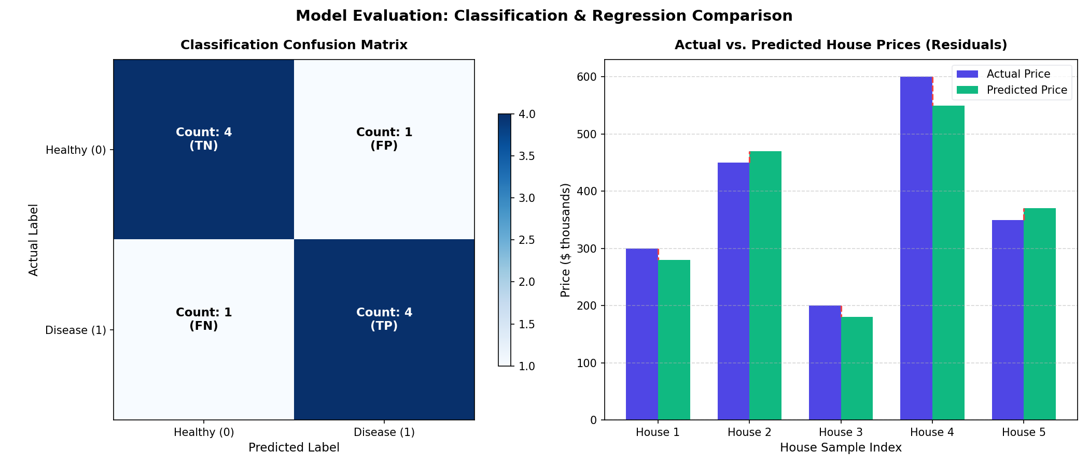
MODULE 7: EVALUATION & VALIDATION
Model Evaluation & Generalization
Validation & Performance Metrics
Bias-Variance Tradeoff: Underfitting (High Bias) vs. Overfitting (High Variance). Goal is minimizing total test error.
K-Fold Cross-Validation: Splits data into K folds, cycling train/test roles to obtain robust performance bounds.
Classification Metrics: Derived from the Confusion Matrix.
- Precision: TP / (TP + FP) (Quality of positive predictions).
- Recall: TP / (TP + FN) (Coverage of actual positive samples).
- F1-Score: Harmonic mean of Precision and Recall.
- ROC-AUC: True Positive vs. False Positive rate probability area.

Slide 11
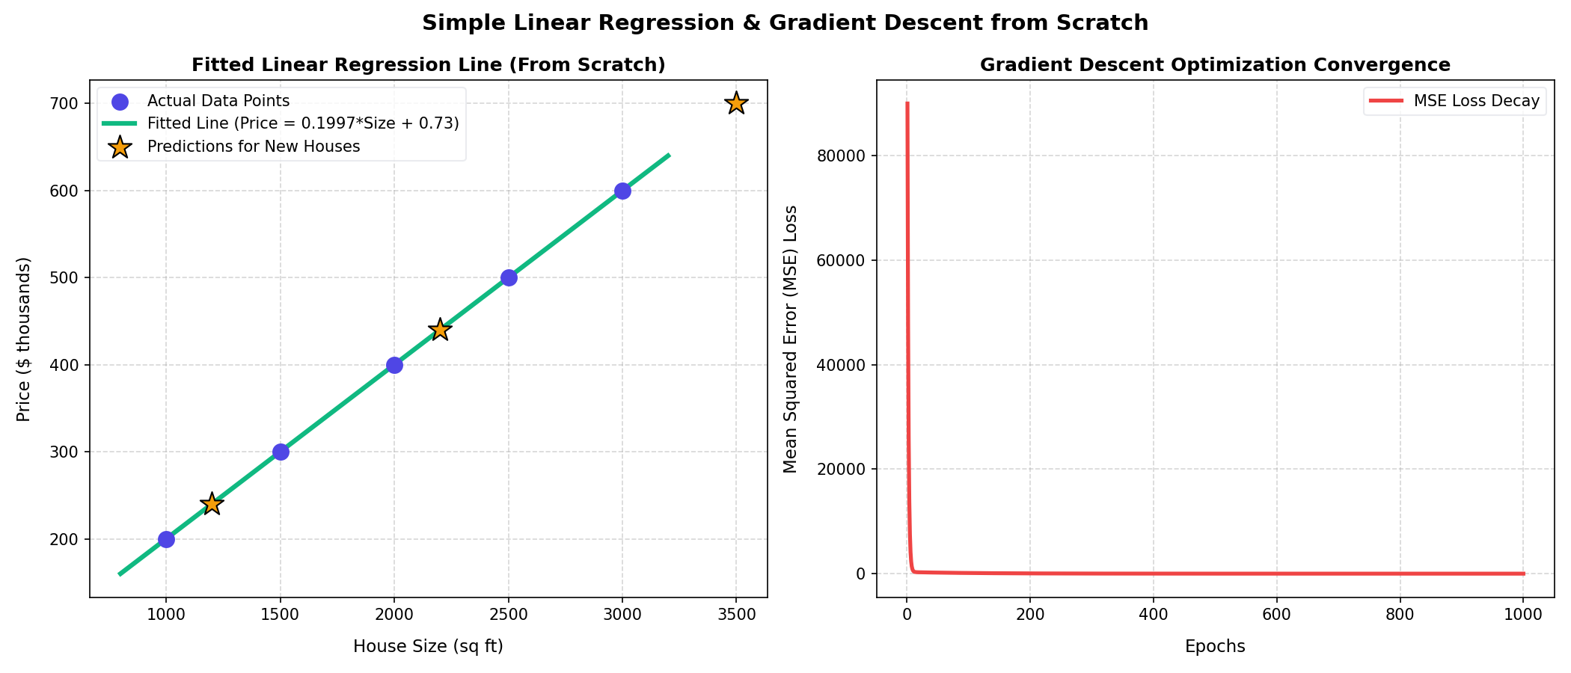
MODULE 8: CODE WALKTHROUGHS
Framework vs. From-Scratch Algorithms
Pedagogical Implementation Strategy
Dual-Path Curriculum: Every algorithm is explored via two implementations: Scikit-Learn and Pure Python.
Framework Path: Teaches APIs, hyperparameter tuning, pipelines, and industry best practices.
From-Scratch Path: Avoids libraries. Uses standard lists and math functions to write loops, gradients, and Gini calculations.
De-mystifying the 'Black Box': Solidifies mathematical equations directly into concrete, readable code.
Visual: Pure Python Gradient Descent line-fitting convergence over epochs.

Slide 12
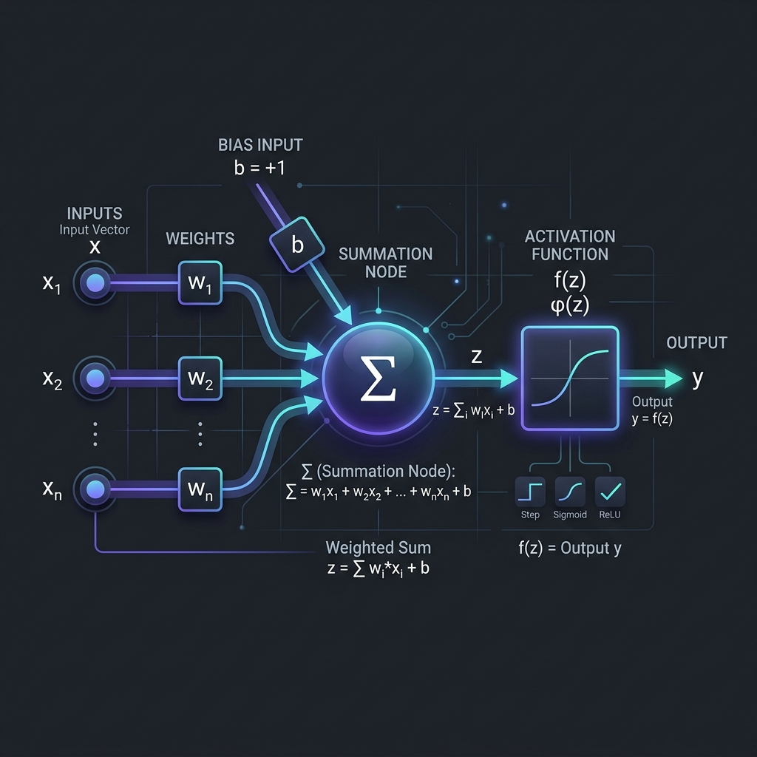
MODULE 9: DEEP LEARNING FOUNDATIONS
The Artificial Neuron (Perceptron)
Single Neuron Computation
Perceptron Concept: Mimics a biological neuron by summing weighted inputs and passing the result to an activation function.
Mathematical Formulation:
- Pre-activation sum: z = Σ (w_i * x_i) + b = w^T * x + b
- Activation output: y = φ(z) = φ(w^T * x + b)
- Where w represents connection weights, and b is the bias.
AND Logic Gate Example (Linear Decision Boundary):
- Parameters: w_1 = 1.0, w_2 = 1.0, b = -1.5
- Activation φ(z): Step function (1 if z >= 0, else 0)
- Query [0, 0] -> z = -1.5 -> y = 0
- Query [1, 0] -> z = -0.5 -> y = 0
- Query [1, 1] -> z = +0.5 -> y = 1 (AND logic holds)

Slide 13
MODULE 9: DEEP LEARNING FOUNDATIONS
Activation Functions & Non-Linearity
Sigmoid
φ(z) = 1 / (1 + e^-z)
• Range: (0, 1)
• φ'(z) = φ(z)(1 - φ(z))
• Outputs represent probabilities.
• Cons: Vanishing gradients.
Tanh
φ(z) = tanh(z)
• Range: (-1, 1)
• φ'(z) = 1 - φ(z)^2
• Zero-centered outputs help stabilize deep networks.
• Cons: Vanishing gradients.
ReLU
φ(z) = max(0, z)
• Range: [0, ∞)
• φ'(z) = 1 (z > 0), else 0
• Computationally cheap; resolves vanishing gradient.
• Cons: Dying ReLU problem.
Leaky ReLU
φ(z) = max(αz, z)
• Range: (-∞, ∞)
• φ'(z) = 1 (z > 0), else α
• Prevents dead neurons by keeping a small gradient.
• Cons: Extra parameter α.
Softmax
P_i = e^z_i / Σ e^z_j
• Range: (0, 1) (sums to 1)
• Derivative: P_i(δ_ij - P_j)
• Outputs normalized probabilities for classification.
• Usage: Final output layer.

Slide 14
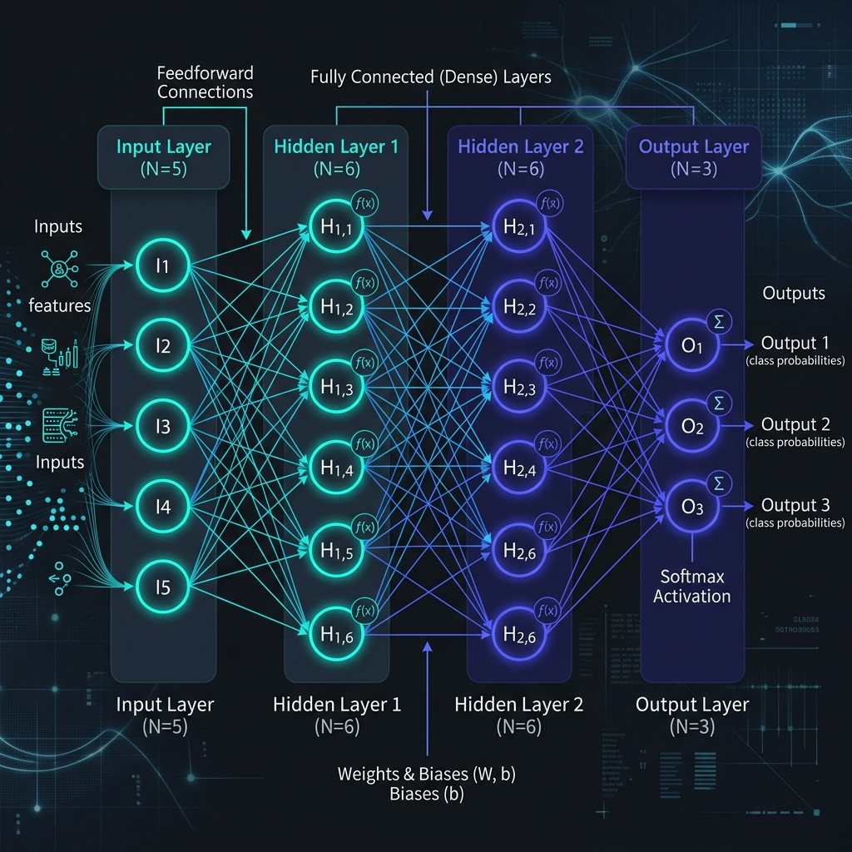
MODULE 9: DEEP LEARNING FOUNDATIONS
Deep Neural Networks (ANN / DNN)
Layered Feedforward Architecture
Multi-Layer Perceptron (MLP): Stacks layers of neurons together. Information flows forward from input, through hidden layers, to output.
Forward Propagation Equations (Layer l):
- Pre-activation: z^[l] = W^[l] * a^[l-1] + b^[l]
- Activation: a^[l] = g^[l](z^[l])
- Where a^[0] = x (the raw input features).
- W^[l] is the weight matrix of shape (n^[l] x n^[l-1]).
- b^[l] is the bias vector of shape (n^[l] x 1).
- g^[l] is the layer's activation function.
Universal Approximation Theorem: A feedforward network with a single hidden layer and non-linear activations can approximate any continuous function.

Slide 15
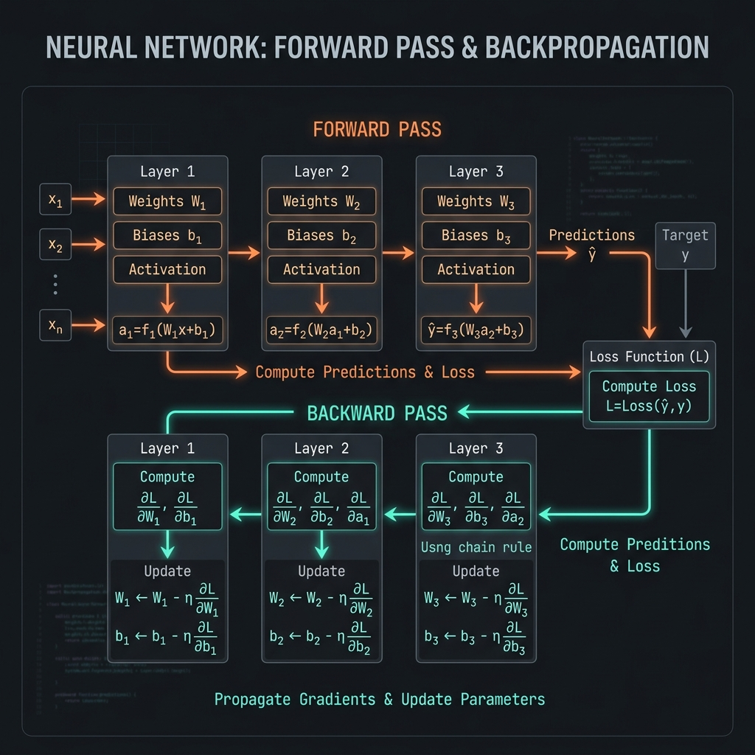
MODULE 9: DEEP LEARNING FOUNDATIONS
Backpropagation: Gradient Flow via Chain Rule
Backward Error Propagation
Training Objective: Find weights and biases that minimize a loss function L(y, y_hat).
The Chain Rule: Calculates the sensitivity of loss to a specific weight:
- ∂L / ∂w_ij^[l] = (∂L / ∂a_i^[l]) * (∂a_i^[l] / ∂z_i^[l]) * (∂z_i^[l] / ∂w_ij^[l])
Error Term definition: δ_i^[l] = ∂L / ∂z_i^[l]
1. Output Layer Error (Layer L):
- δ_i^[L] = (∂L / ∂a_i^[L]) * g'^[L](z_i^[L])
2. Hidden Layer Error (Layer l) propagated backward:
- δ_j^[l] = (Σ (δ_k^[l+1] * w_kj^[l+1])) * g'^[l](z_j^[l])
3. Gradients calculation:
- ∂L / ∂w_ji^[l] = δ_j^[l] * a_i^[l-1]
- ∂L / ∂b_j^[l] = δ_j^[l]

Slide 16
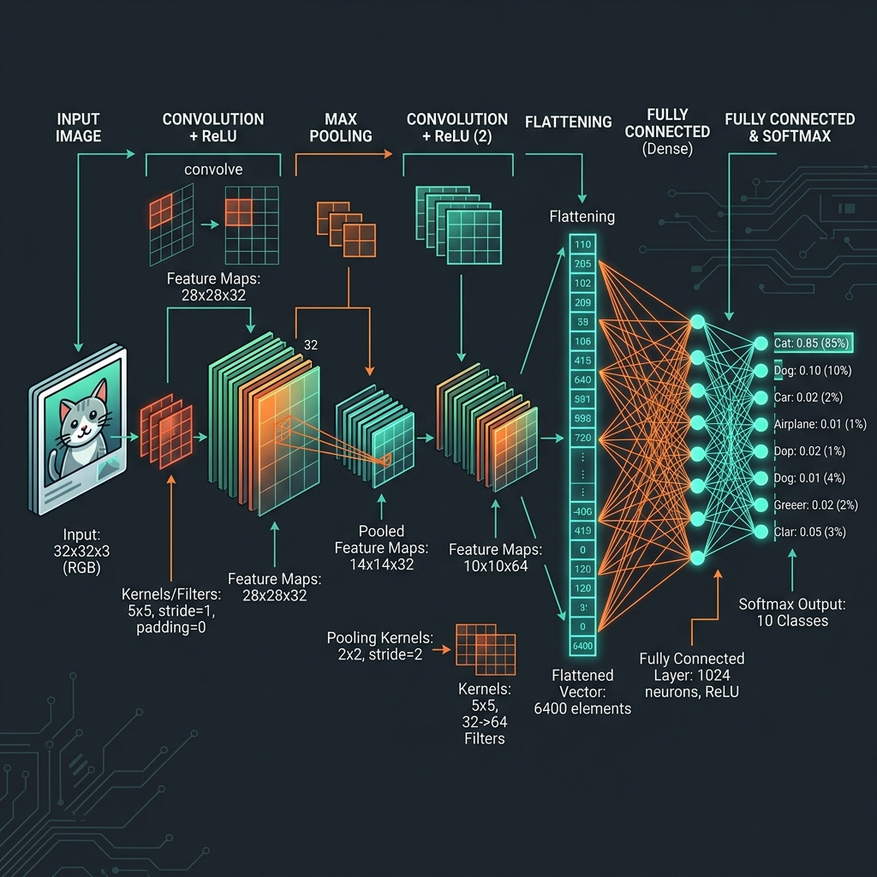
MODULE 9: DEEP LEARNING FOUNDATIONS
Convolutional Neural Networks (CNN)
Spatial Features & Translation Invariance
Overfitting Challenge: Fully connected networks do not scale well to images. A 1000x1000 RGB image requires 3M inputs per neuron.
CNN Architectural Solutions:
1. Local Connectivity: Neurons connect only to small local patches.
2. Shared Weights: Kernels scan the entire input, sharing parameters.
Output Size Formula for Convolutional Layer:
- O = floor((W - K + 2P) / S) + 1
- W = input size, K = kernel size, P = padding, S = stride.
Pooling Layer: Reduces representation size and introduces invariance.
- Max Pooling: Extracts the maximum value in a window.
- Average Pooling: Computes the mean of the window.

Slide 17
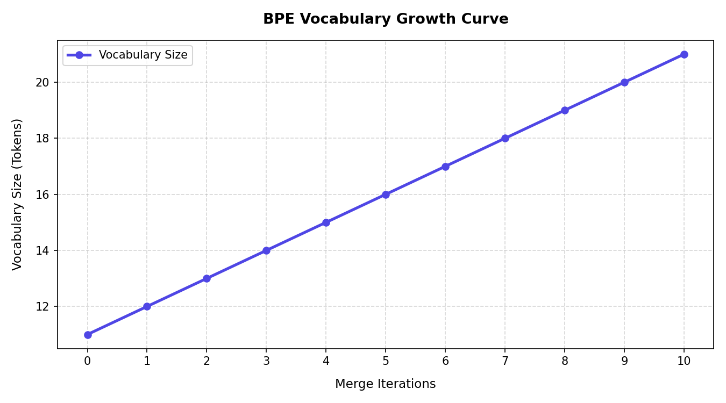
MODULE 10: LLMS & TRANSFORMERS
Tokenization: Byte Pair Encoding (BPE)
Subword Text Segmentation
Flaws of Word/Char Tokenizers: Massive vocabulary sizes (memory heavy) or inability to handle unseen out-of-vocabulary (OOV) words.
BPE Concept: Dynamically merges the most frequent adjacent byte/character pairs into new subword units.
Algorithm Steps:
1. Initialize vocabulary with individual characters + '</w>' marker.
2. Count frequencies of adjacent token pairs (bigrams) in the corpus.
3. Merge the most frequent bigram and add it to the vocabulary.
4. Repeat for N merge iterations.
Visual: Vocabulary size growth vs. BPE merge rules application.

Slide 18
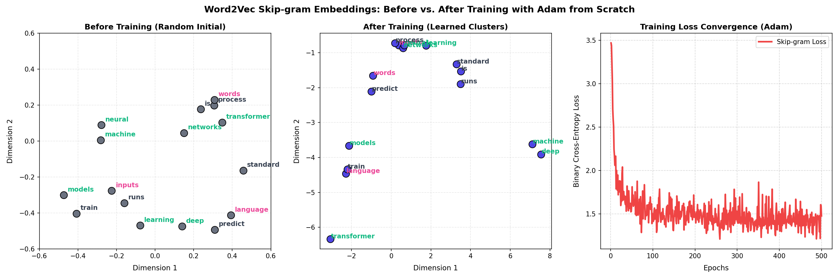
MODULE 10: LLMS & TRANSFORMERS
Vector Semantics: Word Embeddings
Continuous Word Semantics
Embedding Concept: Maps raw strings to dense, low-dimensional continuous vectors where geometric closeness represents semantic meaning.
Word2Vec Skip-gram: Neural network trained to predict context words given a target input word.
Negative Sampling Loss: Avoids expensive full softmax by training a binary classifier on positive context pairs vs. random negative pairs.
Optimization: Trained using the Adam optimizer implemented from scratch. Uses adaptive learning rates for faster, more stable coordinate updates.
Visual: Trained 2D Word2Vec scatter plot showing semantic clusters.

Slide 19
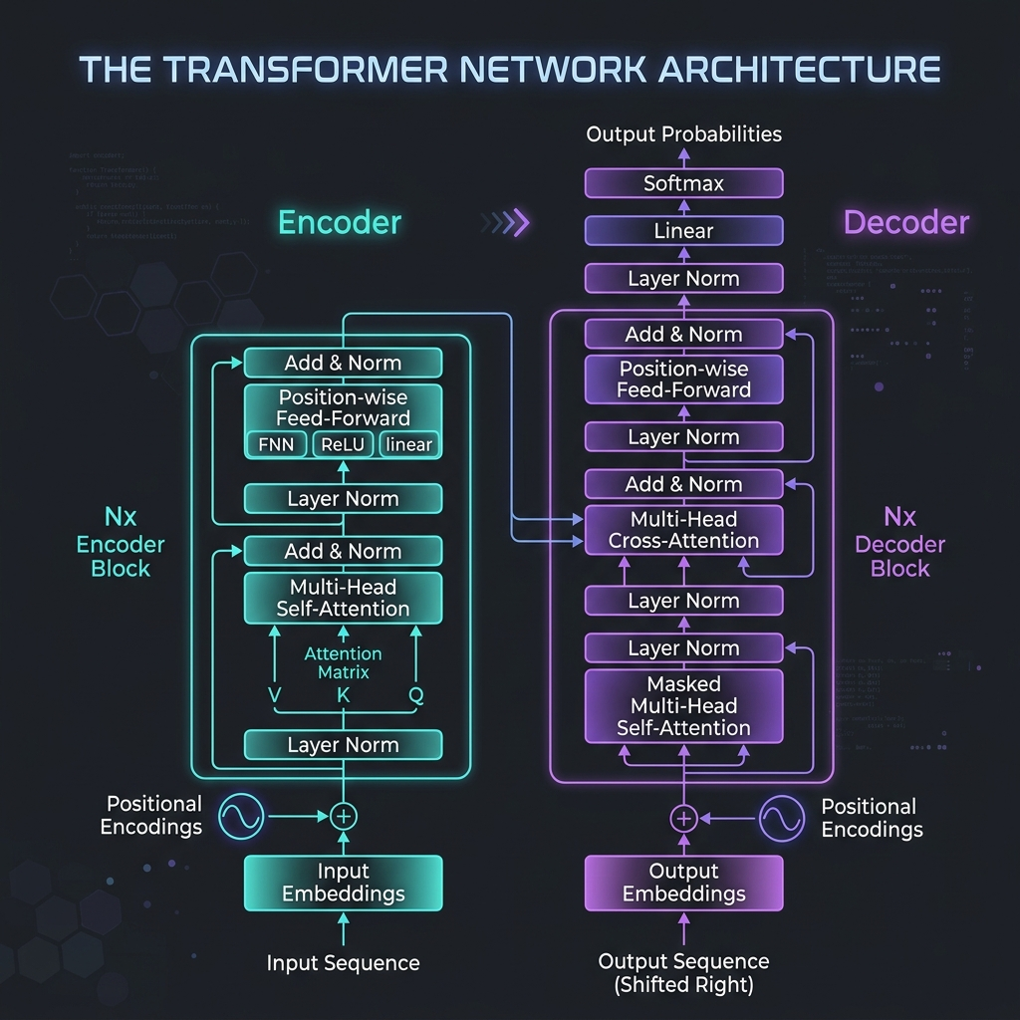
MODULE 10: LLMS & TRANSFORMERS
The Transformer Network Architecture
Attention-Based Sequence Processing
Parallelization Breakthrough: Eliminates recurrence loops of RNNs/LSTMs. Processes all tokens simultaneously.
Core Encoder-Decoder Structure:
- Encoder: Learns bidirectional contextual representations of the input sequence.
- Decoder: Autoregressively generates output tokens, querying encoder keys and values.
Key Mechanisms:
- Multi-Head Attention (MHA): Integrates multiple parallel self-attention views to capture complex context relations.
- Residual Connections & LayerNorm: Stabilize gradient flow in deep stacks.
- Feed-Forward Networks (FFN): Applied pointwise to each token position.

Slide 20
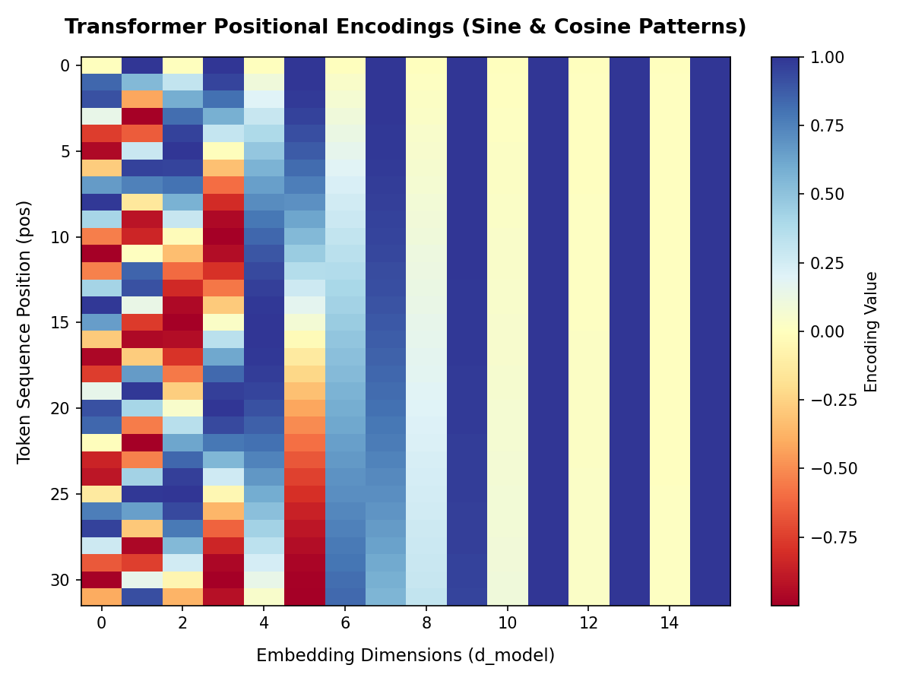
MODULE 10: LLMS & TRANSFORMERS
The Encoder: Self-Attention & Positional Encoding
Parallel Contextual Encoding
Positional Encoding: Adds sine/cosine wave patterns to input embeddings to preserve token sequence order.
Scaled Dot-Product Self-Attention: Projects input matrices into Query (Q), Key (K), and Value (V) representations.
Alignment Formula: Attention(Q, K, V) = Softmax(Q K^T / sqrt(d_k)) V. Scales by sqrt(d_k) to prevent gradient vanishing.
Context Resolution: Dynamically shifts a word's vector representation based on surrounding tokens (e.g. 'bank' of river vs. money).
Visual: Sinusoidal Positional Encoding matrix heatmap.

Slide 21
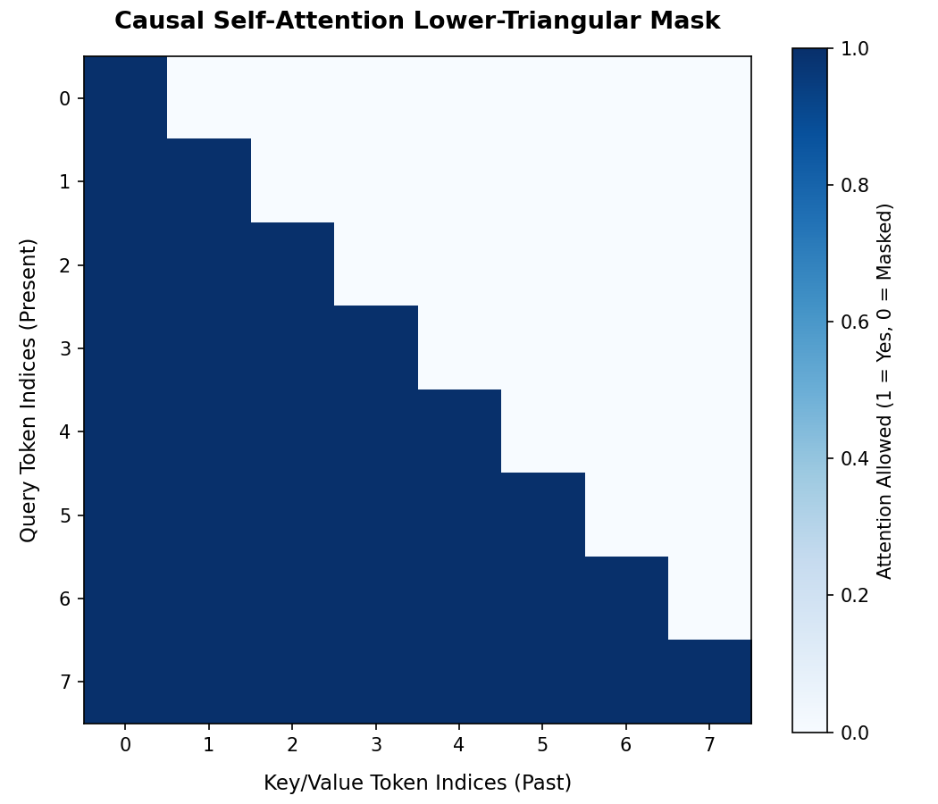
MODULE 10: LLMS & TRANSFORMERS
The Decoder: Causal Masking & Cross-Attention
Autoregressive Target Generation
Autoregressive Generation: Predicts tokens sequentially, appending prior outputs as inputs for successive steps.
Causal Masking: Adds a lower-triangular mask (-infinity for future positions) to attention scores prior to softmax.
Look-Ahead Prevention: Mathematically sets attention weights to future tokens to exactly 0, preventing future-leakage.
Encoder-Decoder Cross-Attention: Decoder queries (Q) attend to Encoder keys (K) and values (V), linking target to source.
Visual: Decoder Causal Mask lower-triangular attention boundaries.

Slide 22
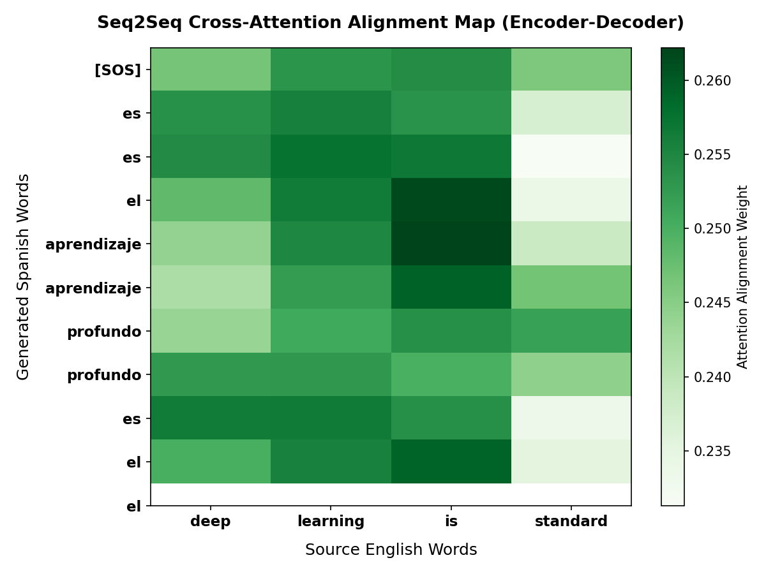
MODULE 10: LLMS & TRANSFORMERS
End-to-End Seq2Seq Transformer Model
Bilingual Machine Translation Model
Seq2Seq Architecture: Couples an Encoder (source comprehension) with a Decoder (target autoregressive generation).
Pure Python Implementation: Standard tokenizer, embeddings, encoder self-attention, and decoder cross-attention blocks.
Greedy Decoding Loop: Iterates forward passes, selecting the token with the maximum probability until a stop token is reached.
Teacher Forcing: Feed actual ground truth targets into the decoder during training to stabilize parameters.
Visual: Attention alignment weights mapping English to Spanish.

Slide 23
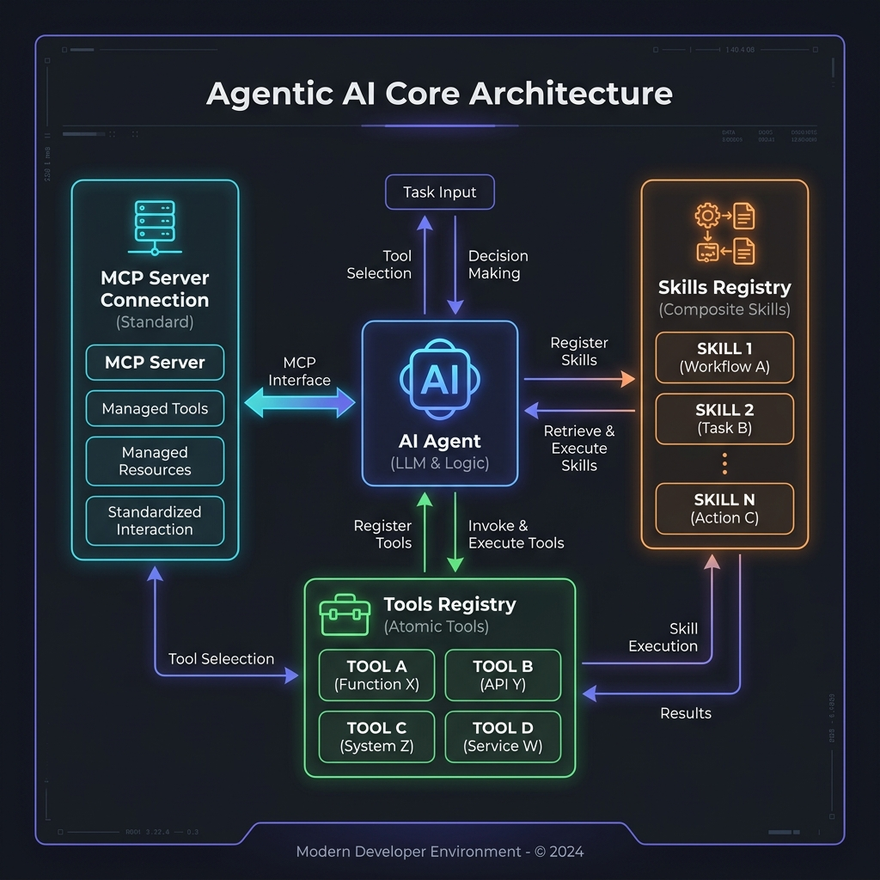
MODULE 11: AGENTIC AI SYSTEMS
Agentic AI: Core Concepts & Architecture
Autonomous Reasoning Loops
Paradigm Shift: Moves from static text responses to dynamic reasoning agents acting as computer systems operators.
Core Components:
- AI Agent: The controller managing history (memory) and execution loops.
- Thought-Action-Observation Loop: The reasoning cycle (e.g. ReAct).
- Atomic Tool: Low-level executable Python function or command.
- Composite Skill: Orchestrated multi-step workflow in code.
- Model Context Protocol (MCP): Open-standard communication layer.
Function Calling: Structured JSON exchange between Agent and LLM.

Slide 24
MODULE 11: AGENTIC AI SYSTEMS
Runtime Introspection & Tool Schemas
Automated Schema Registration
• Introspection Concept: Instead of manually writing error-prone JSON declarations, agent registries inspect code at runtime.
• Docstring Parsing: Scans descriptions using regular expressions to extract functional details and argument documentation.
• Signature Analysis: inspect.signature() inspects type annotations (e.g. str -> STRING, int -> INTEGER).
• Required vs Optional: Detects arguments lacking defaults to mark them as 'required' in the schema definition.
Decorated Code to Schema Output
# Python Function Definition: @tool def get_weather(city: str) -> str: """Fetches weather. Args: city: Target city""" return f"Weather in {city}: 18°C" # Generated JSON Tool Schema: { "name": "get_weather", "description": "Fetches weather...", "parameters": { "type": "OBJECT", "properties": { "city": {"type": "STRING", "description": "Target city"} }, "required": ["city"] } }

Slide 25
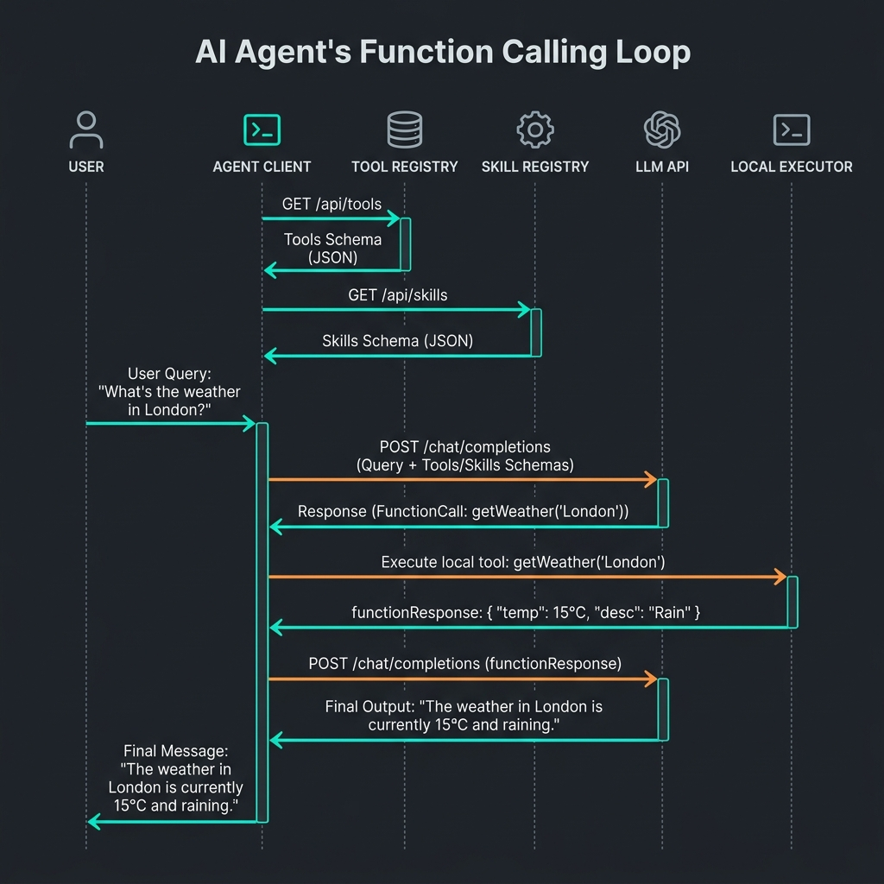
MODULE 11: AGENTIC AI SYSTEMS
Composite Skills & Dynamic Execution
Encapsulating Local Workflows
Composite Skill Concept: Packages complex multi-step tasks to run locally, avoiding multiple remote network API roundtrips.
Skill Package Directory Layout:
- Directory name maps to skill (e.g. skills/research_city/).
- SKILL.md: YAML metadata defining schema parameters + instructions.
- script.py: Local Python execution orchestrating underlying tools.
Dynamic Execution via exec():
- Load script.py contents at runtime.
- Inject local tools and kwargs into exec_globals/locals namespaces.
- exec(script_code, globals, locals) runs code dynamically.
- Capture and return the resulting value via result variable.

Slide 26
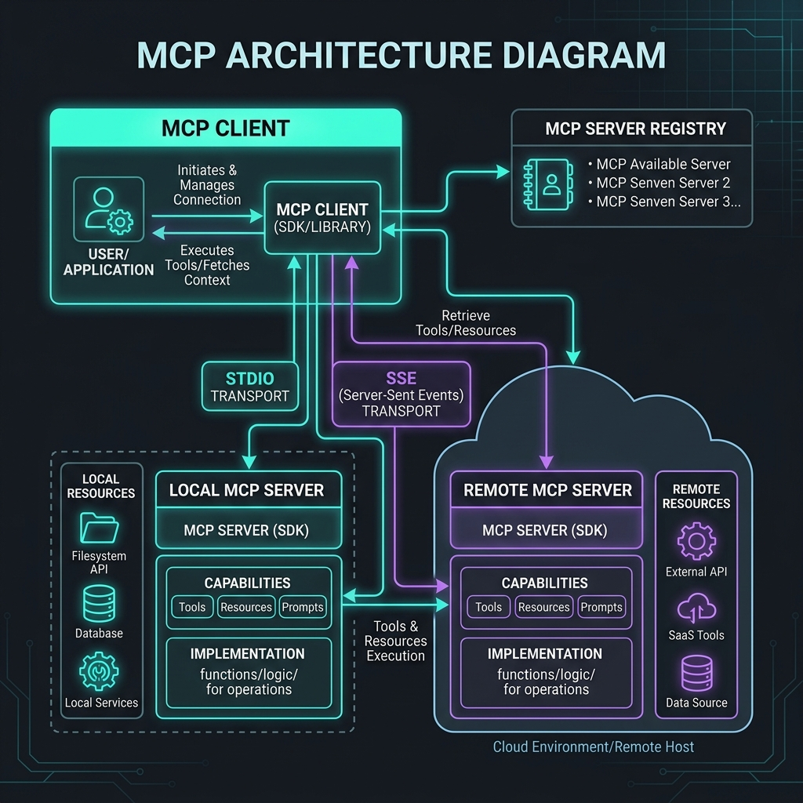
MODULE 11: AGENTIC AI SYSTEMS
Model Context Protocol (MCP) Architecture
Standardizing Tool Integration Interfaces
MCP Architecture: Open standard that decouples tools providers (servers) from AI applications (clients).
Three Core Actors in the Protocol:
1. MCP Client: Protocol consumer (e.g. IDE, AI agent host).
2. MCP Host: Runs the client session and orchestrates context.
3. MCP Server: Provides tools, resources, and prompt templates.
Standardized Transport Mechanisms:
- Stdio Transport: JSON-RPC over stdin/stdout (same-machine).
- SSE Transport: Server-Sent Events stream + POST requests (network).
Benefits: Single protocol connects any agent to files, DBs, and APIs.

Slide 27
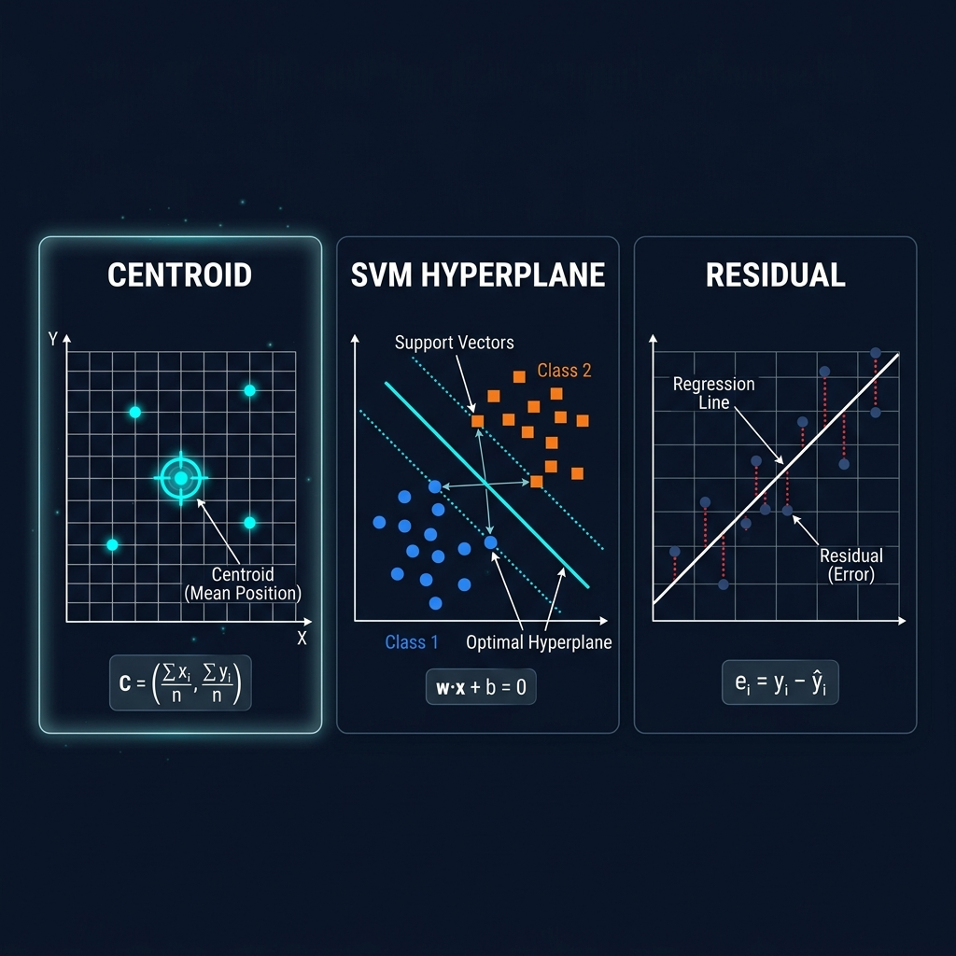
APPENDIX: GLOSSARY
Appendix: Centroid, Hyperplane & Residuals
Mathematical Fundamentals
Centroid: The geometric center of a cluster of coordinates. Computed as the mean vector: mu = 1/N * sum(x_i).
Hyperplane: A linear boundary of dimension D-1 that separates a D-dimensional space: w^T * x + b = 0.
Margin: The distance between separating hyperplane and the closest support vectors: 2 / ||w||.
Residual: The difference between actual and predicted target values: e_i = y_i - y_hat_i.
Visual: Side-by-side plots of Centroid coordinate mean, SVM margins/support-vectors, and OLS regression residuals.

Slide 28
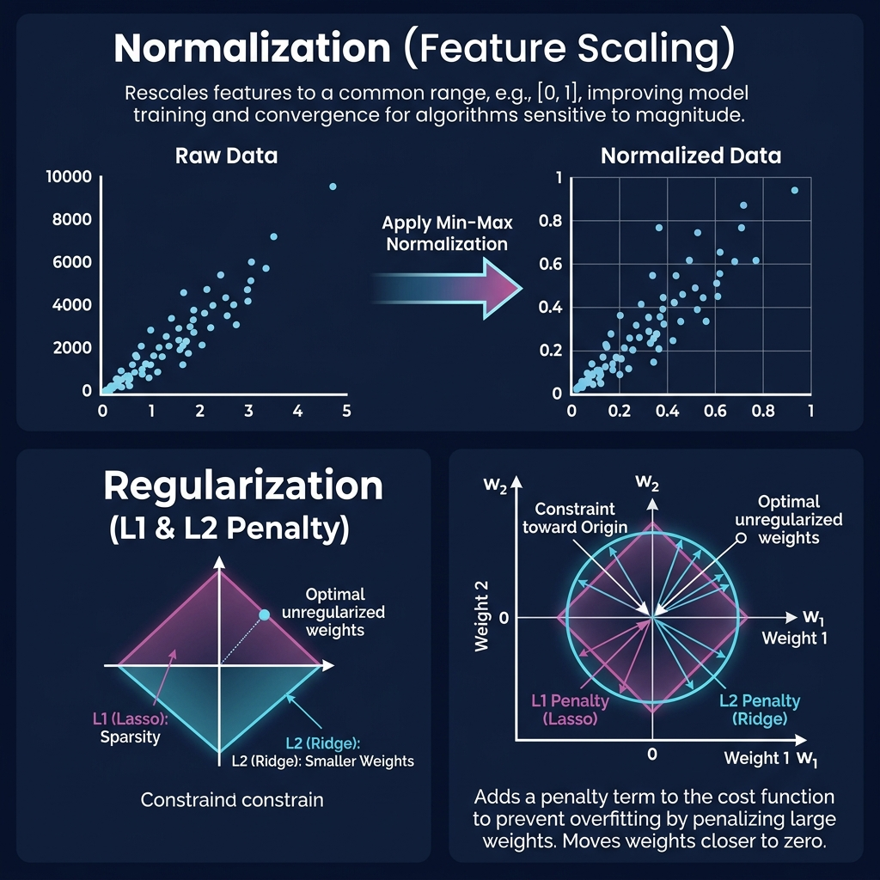
APPENDIX: GLOSSARY
Appendix: Normalization & Regularization
Scaling and Penalty Geometry
Normalization: Rescaling features to a shared coordinate bounds.
- Min-Max Scaling: Maps features to a fixed [0, 1] range.
- Standardization: Transforms features to have mean=0 and std=1.
Regularization: Constrains model parameter magnitudes to prevent overfitting.
- Lasso (L1): Adds absolute weight penalty. Creates diamond-shaped boundaries that drive weights to exactly 0 (sparsity).
- Ridge (L2): Adds squared weight penalty. Circular boundaries that shrink weights close to 0 but keep all features active.

Slide 29
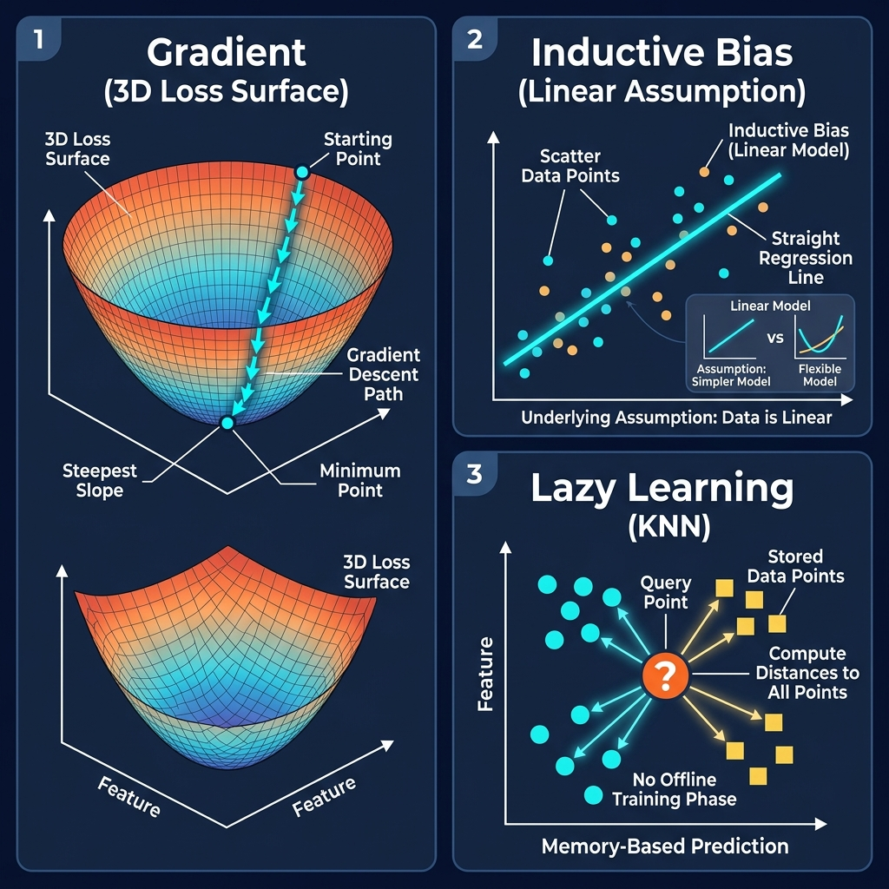
APPENDIX: GLOSSARY
Appendix: Optimization & Bias
Gradients and Algorithmic Assumptions
Gradient: Vector of partial derivatives pointing in the direction of steepest rate of function increase: [df/dw_1, ..., df/dw_D].
Gradient Descent: Updates weights along negative gradient: w = w - eta * grad.
Adam Optimizer: Computes adaptive learning rates using first moment (momentum) and second moment (gradient variance). Scales updates per coordinate.
Inductive Bias: Mathematical assumptions a model makes to generalize to unseen inputs (e.g., linear vs. locality bias).
Lazy Learning: Defers generalization until query time (e.g. KNN). Features zero training time but slow prediction.
Visual: Gradient 3D valley, linear/locality boundaries, KNN distance query.

Slide 30
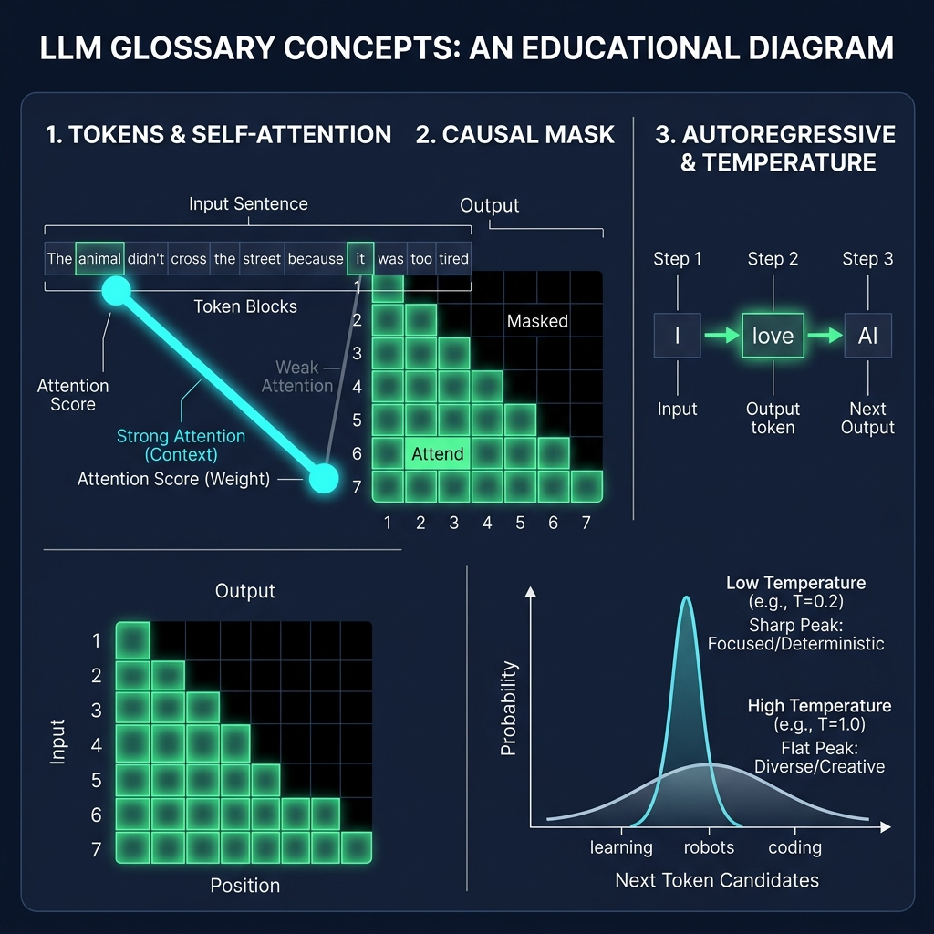
APPENDIX: GLOSSARY
Appendix: LLM Core Terminology
Transformer Building Blocks
Token: The basic subword unit mapping to vocabulary IDs.
Self-Attention: Maps query (Q) alignments to keys (K) to weight values (V).
Causal Mask: Restricts attention to past positions.
Autoregressive Decoding: Appends output tokens back to input sequence.
Temperature: Scaling factor applied to logits before softmax.
- Low Temp (T -> 0): Peakier probabilities, deterministic generation.
- High Temp (T -> infinity): Uniform probabilities, highly random/creative.
Visual: Token IDs, Self-Attention nodes, Mask heatmap, and Temperature curves.

Slide 31
COURSE CONCLUSION
Teaching Strategy & Lecture Structure
Recommended Lecture Structure
1. Start with Paradigms: Make students classify everyday examples manually.
2. Regression vs. Classification: Differentiate numeric forecasting vs. discrete categorization.
3. Mathematics to Code: Show the formulas (Lasso, Logistic) side-by-side with scikit-learn models.
4. Emphasize Evaluation: A model scoring 99% accuracy on training data is almost always overfit.
5. Hands-on labs: Have students tune K-Means centroids or Random Forest depths on standard datasets (Iris/Titanic).
6. Introduce Generative AI: Transition from embeddings (Word2Vec) to sequential comprehension (Transformers).
7. Explain Autonomous systems: Focus on reasoning loops (thought/action/observation) and standardized tooling interfaces (MCP).

