Slide 1
Кейс Вода

Slide 2
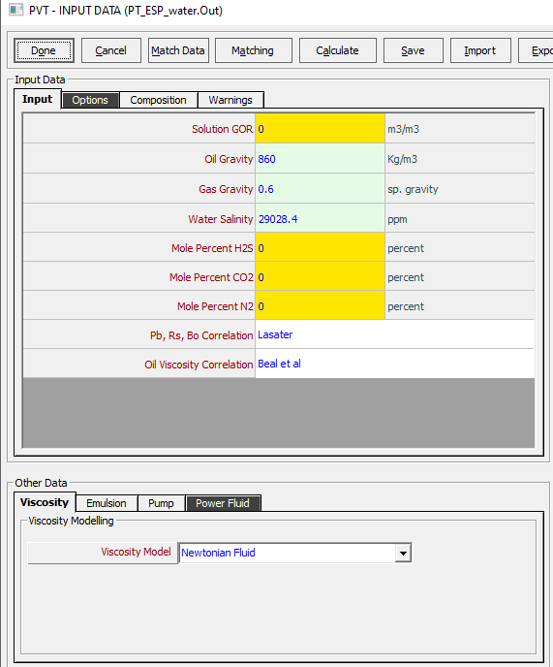
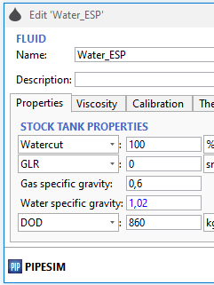
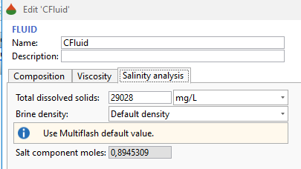
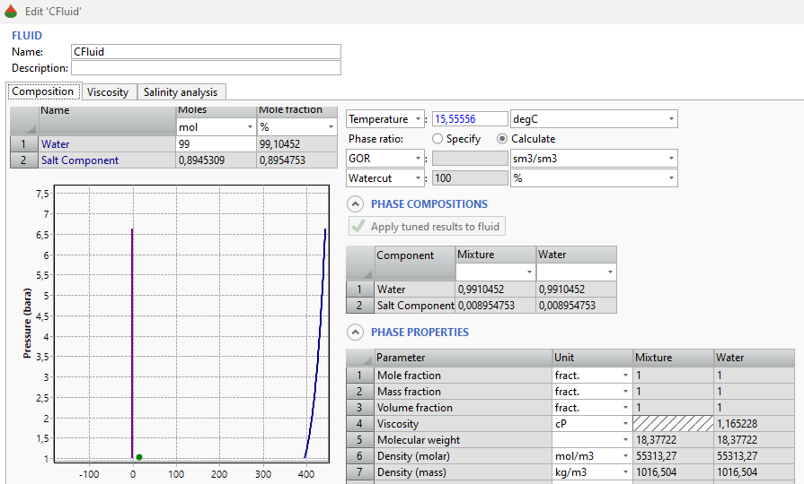
PVT вода
T = 80 C
water sp gr = 1016/998 = 1.018
Stock tank cond ?
?

Slide 3
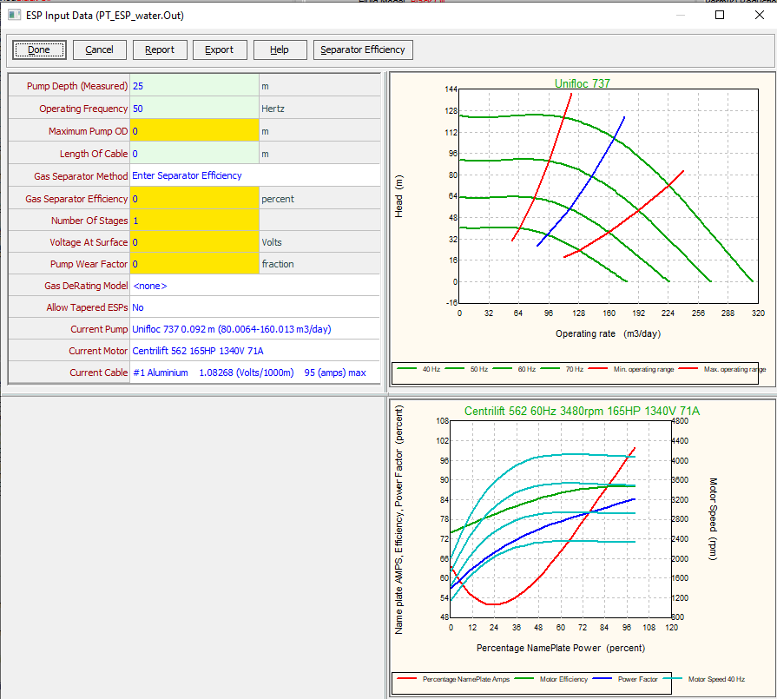
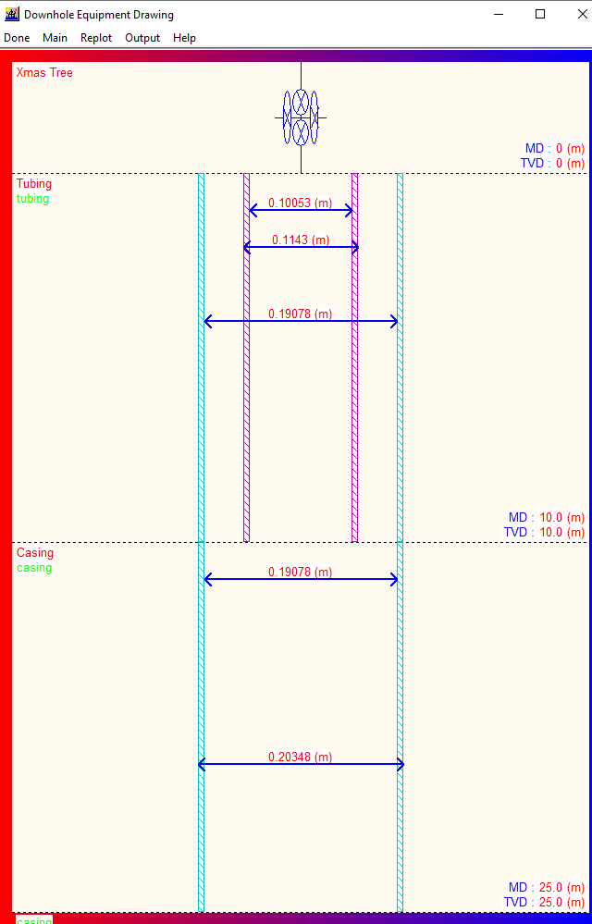
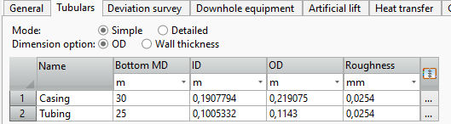
ESP INPUT 1/3
T = 80 C
?
?

Slide 4
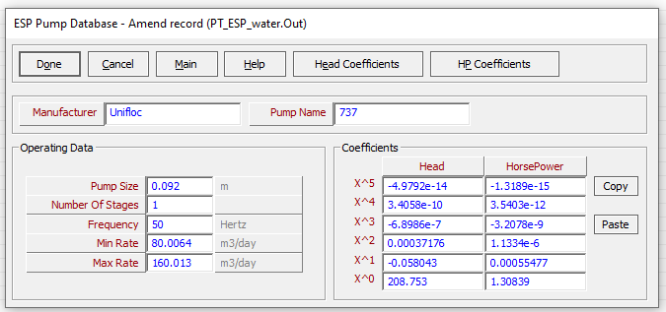
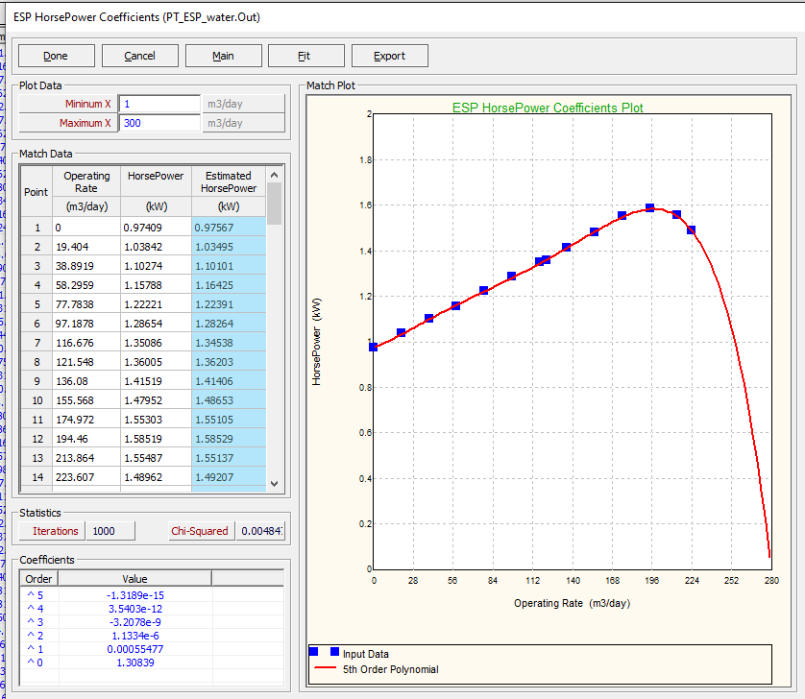
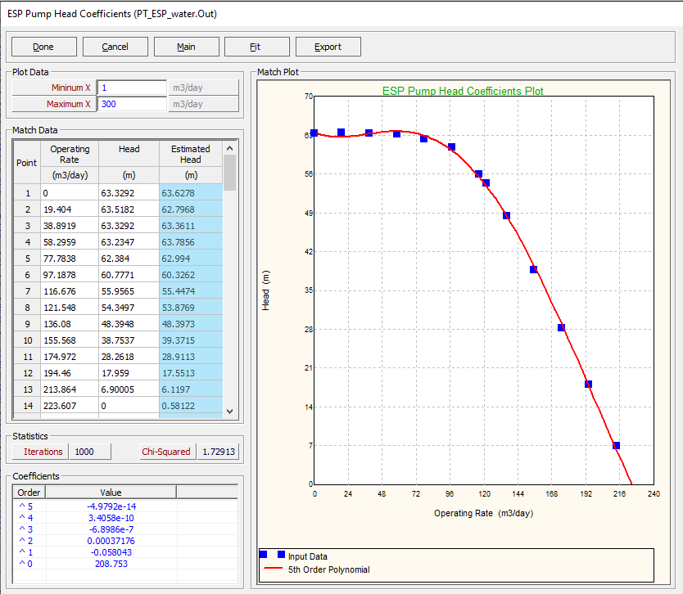
ESP INPUT 2/3

Slide 5
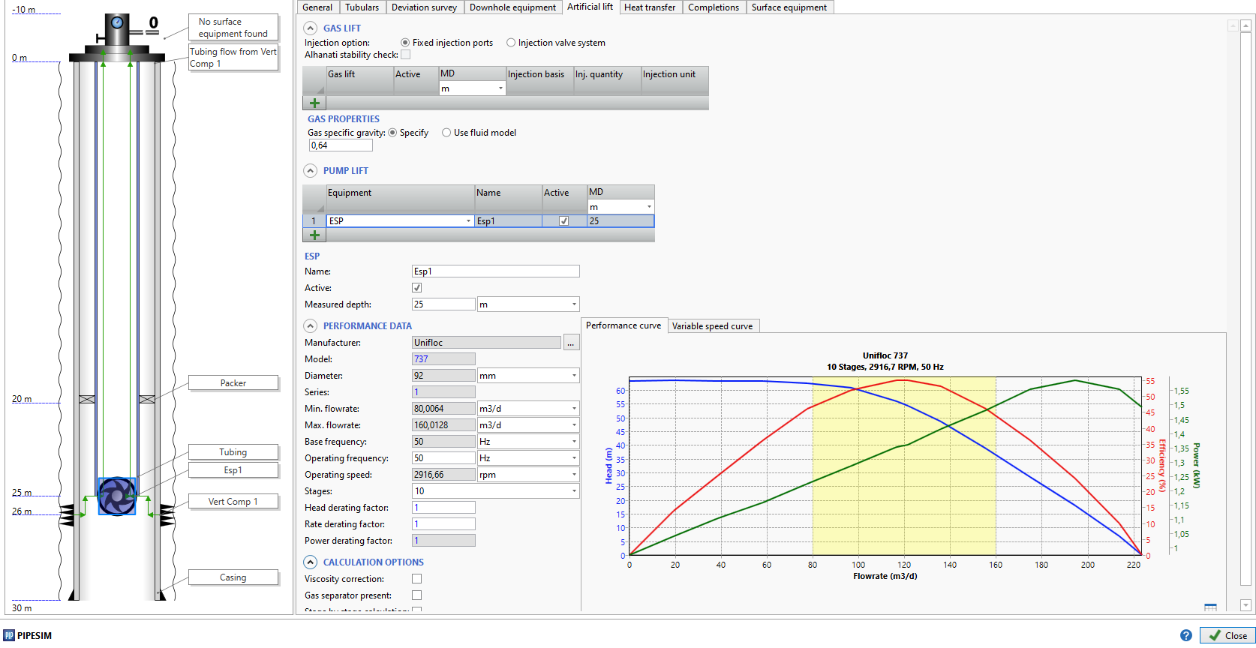
ESP INPUT 3/3

Slide 6
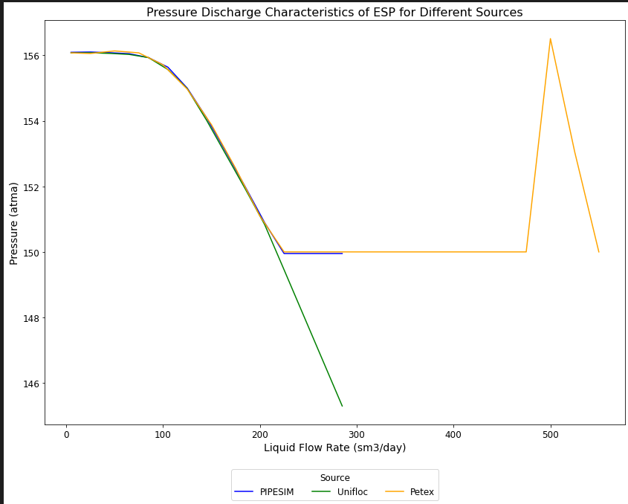
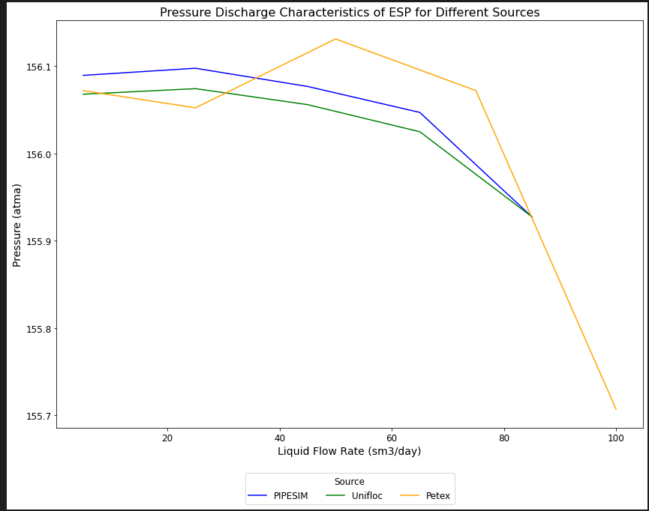
Pdis
BHP = 150 atma

Slide 7
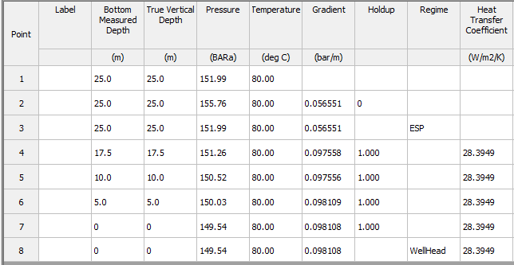
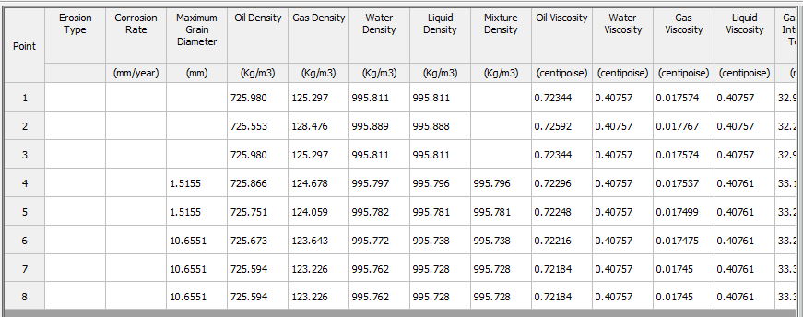
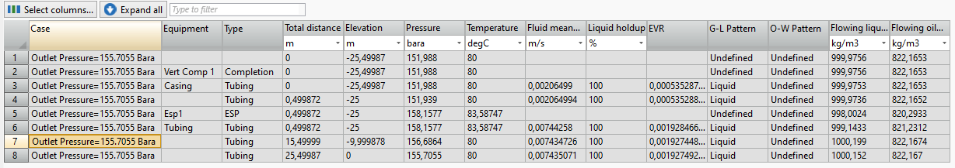
Liq Density
?

Slide 8
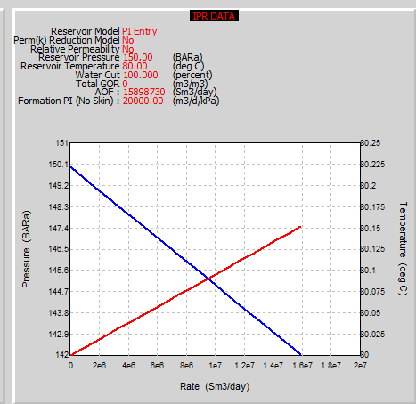
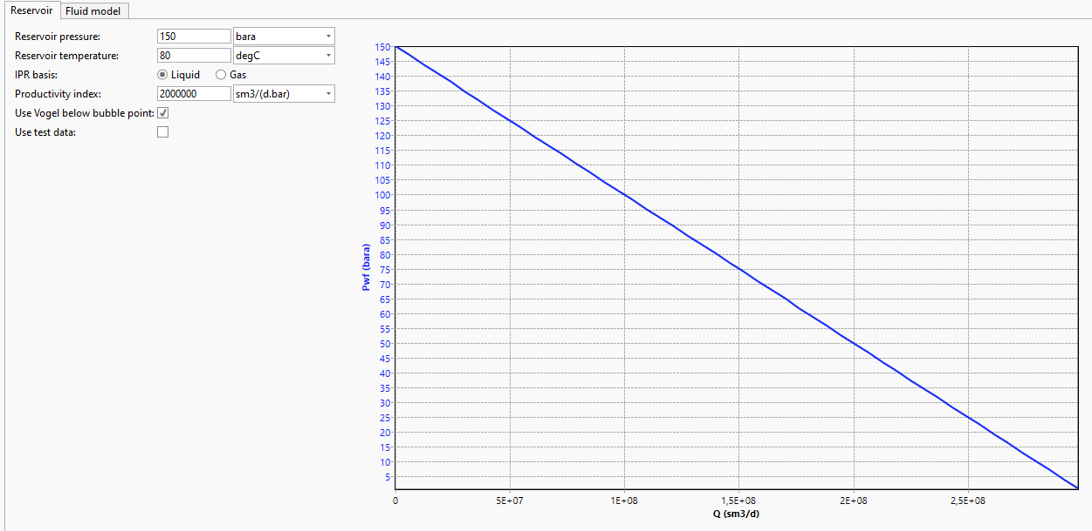
IPR Data
?

Slide 9
Кейс Нефть

Slide 10
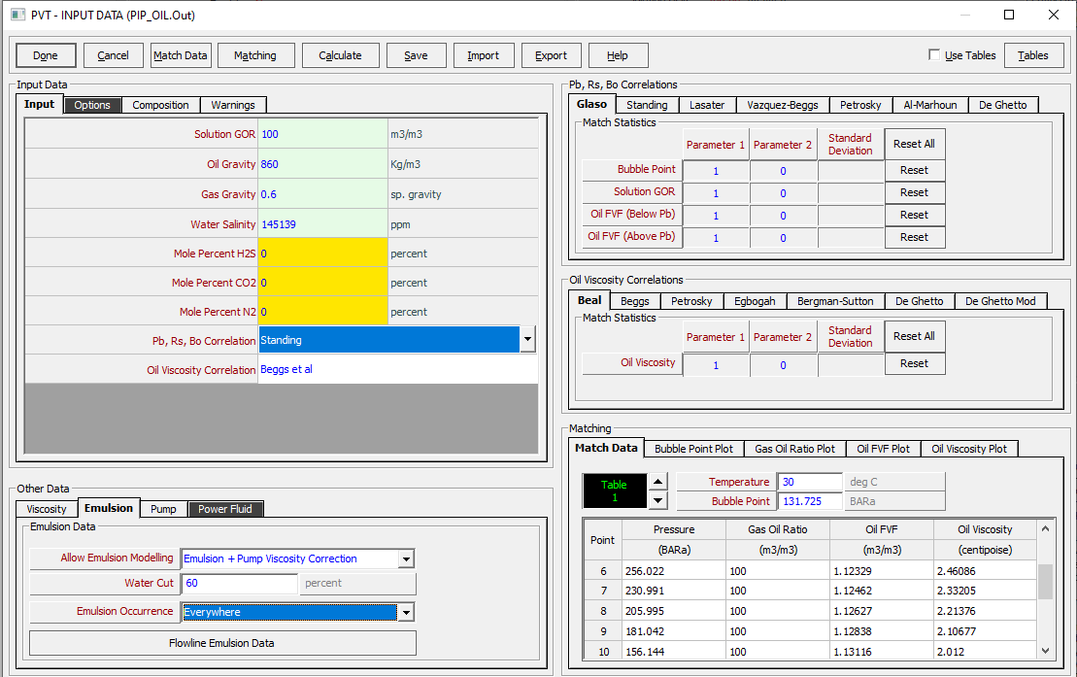
PVT Input 1/3
в PIP вязкость эмульсия учитывается в НАСОСЕ?
If a pump is enabled in the main Options screen, a viscosity correction for emulsions can be enabled. The user has the option to select where the emulsion viscosity corrections will be considered (e.g. everywhere or just in the pump etc.).

Slide 11
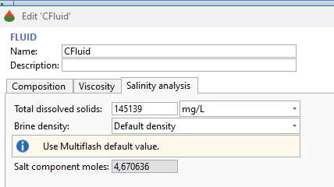
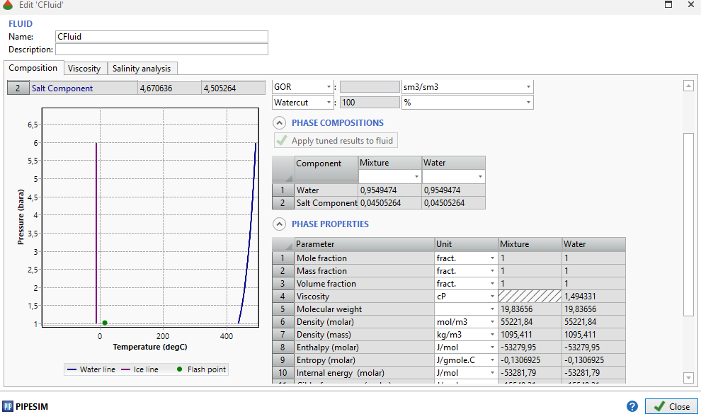
PVT Input 2/3
~ water sp gr = 1.1
PETEX: Water salinity
Salinity of water, expressed as NaCl equivalent.

Slide 12
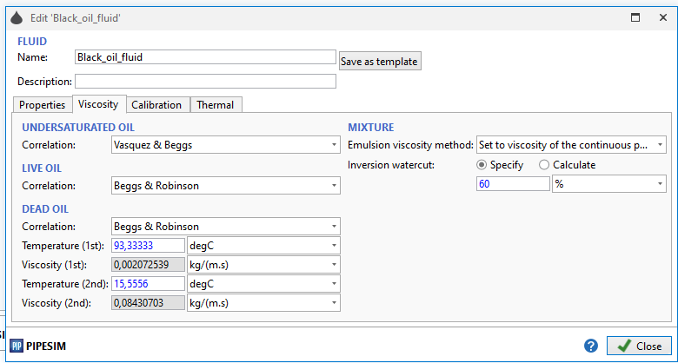
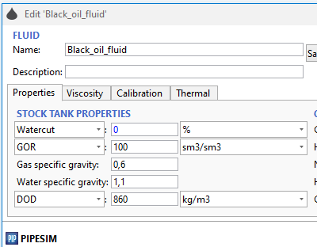
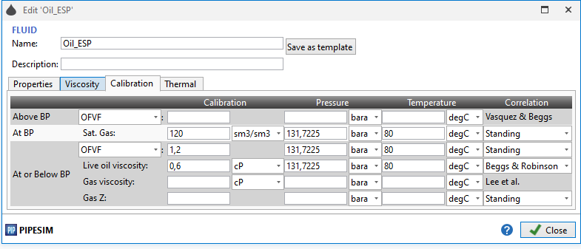
PVT Input 3/3

Slide 13
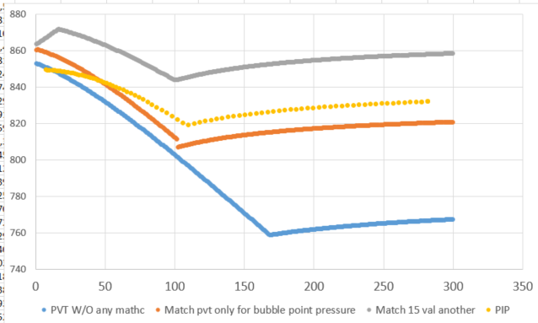
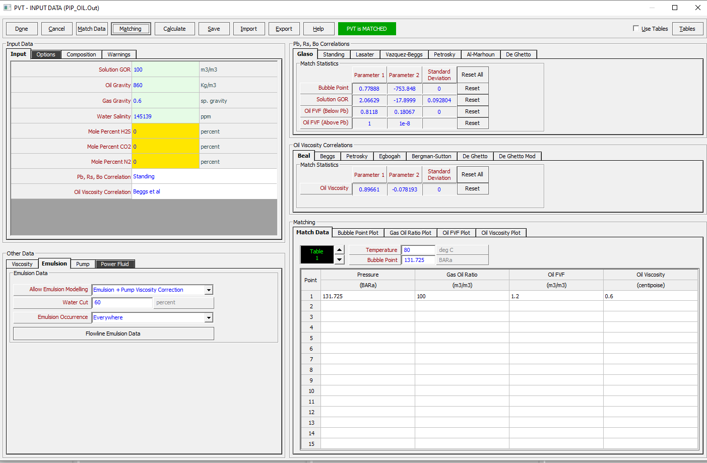
Density
Pb = 102,624
T = 30 C
Pb = 131.725 BARA
Pb = 109

Slide 14
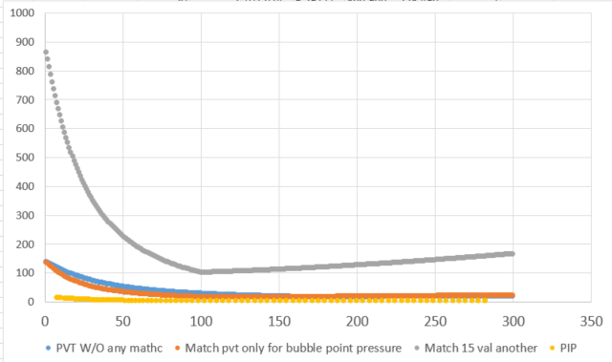
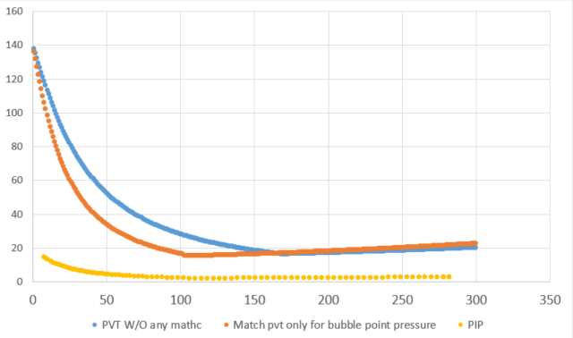
Visc
T = 30 C
Pb = 131.725 BARA

Slide 15
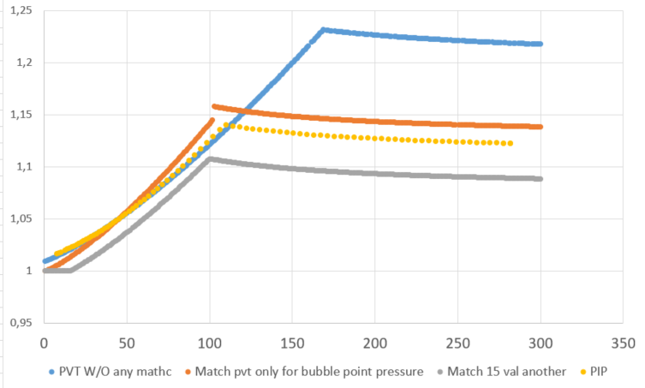
OFVF
T = 30 C
Pb = 131.725 BARA

Slide 16
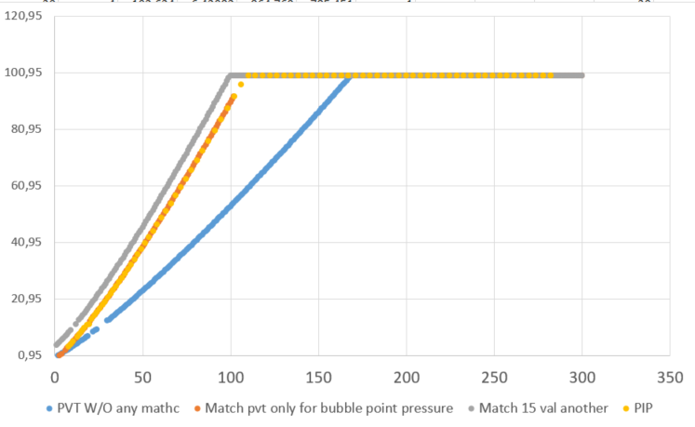
GOR
T = 30 C
Pb = 131.725 BARA

Slide 17
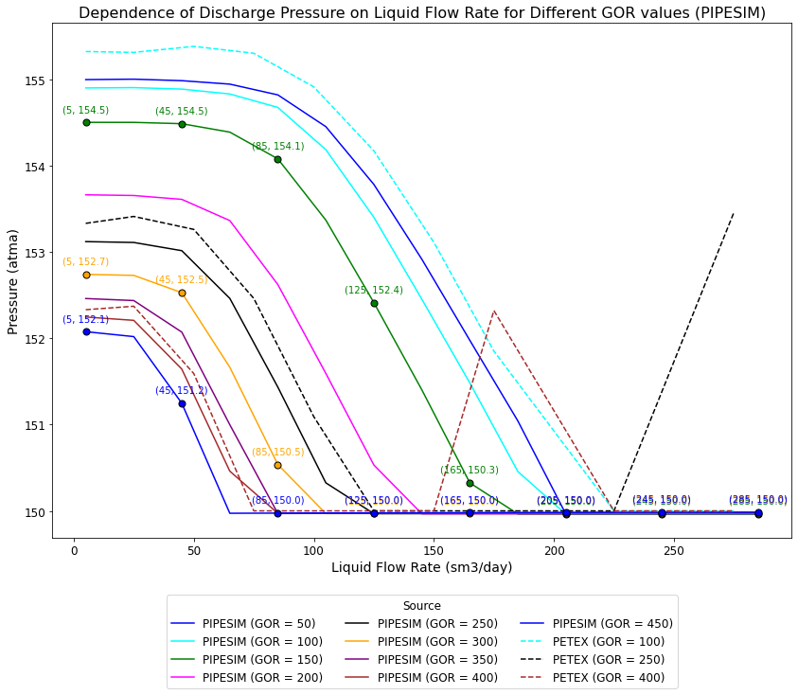
Pdis

Slide 18
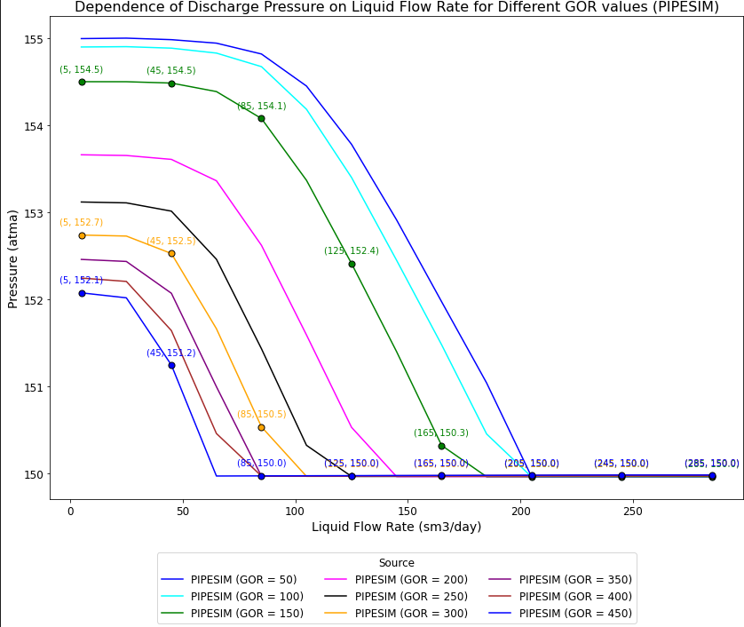
Pdis pip only

Slide 19
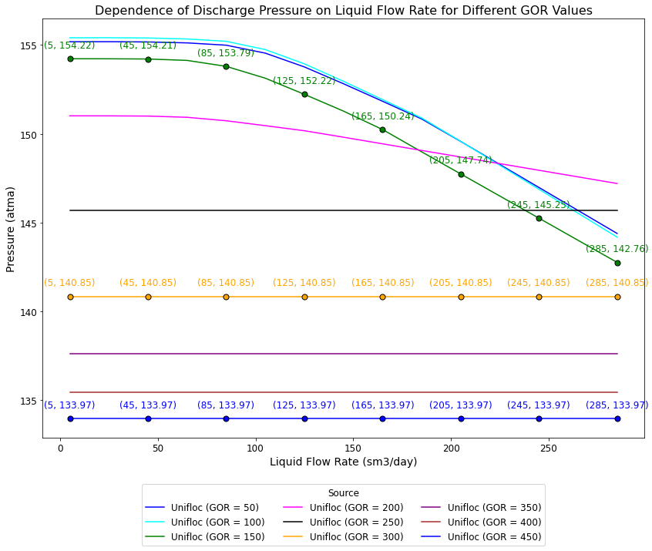
Unifloc pip only
?

Slide 20
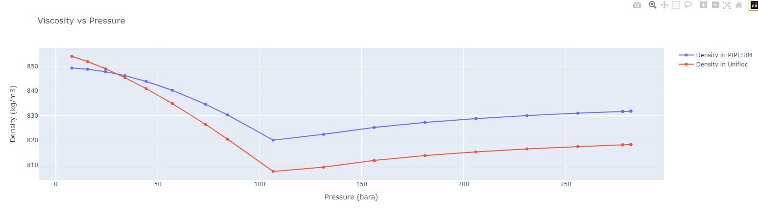
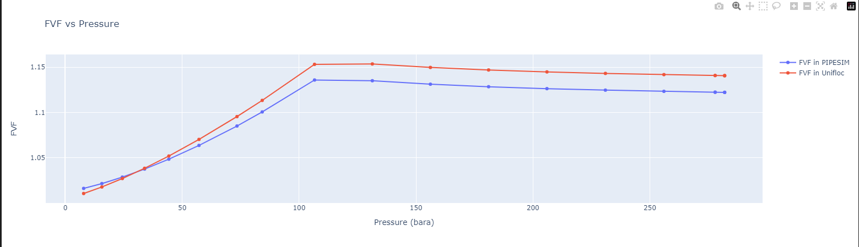
Unifloc pip only

Slide 21
