Slide 1

Intro to Practical Stats with R
Notes:
INTRODUCTIONS
Our approach

Slide 2
Safety & Comfort
Locate the exits. The nearest exit might be behind you.
The closest restrooms are across the hall. Accessible restrooms are in the lobby, by the front door.
Coffee, tea, and water are provided. Please help yourselves.
Take breaks as needed.
Please wash your hands often.

Slide 3
Special Information for Virus Season
Follow the CDC guidelines: wash your hands, cover coughs, etc.
Please be aware of your own health. We’re trusting you to know if you’re getting sick.
If you start to feel sick, please let the instructors know before you leave.
Try not to make assumptions about the level of risk that others are comfortable with.
If someone decides to leave to manage their risk, they don’t owe anyone an explanation.
Sniffle shaming is not ok.
If you have any concerns, please speak with the instructors privately.

Slide 4
 |  |  |  | Details
 | Start | End | Lesson Topic | Stats | R
Morning 1 | 8:30 | 10:30 | Introduction to R Summarizing data | ° Descriptive statistics ° Data visualization - appropriate plots for different kinds of data | ° Basic data handling ° summary() and various plotting functions ° Help functions & resources ° Reading data into R
Break | 10:30 | 10:45
Morning 2 | 10:45 | 12:30 | Probability | ° Introduction to probability ° Common distributions
Lunch | 12:30 | 1:30
Afternoon 1 | 1:30 | 3:15 | Statistical Tests | ° Hypothesis tests ° Estimation methods | ° Functions for statistical tests
Break | 3:15 | 3:30
Afternoon 2 | 3:30 | 5:30 | Linear Models | ° Introduction ° Assumptions ° Diagnostics ° AIC | ° Model fitting functions & their syntax ° Diagnostic plots & summaries
Notes:
Structure
Introduction
Code along
Lab/challenge exercises
Times: we originally taught this class starting at 8:00. I just shifted the times. We’ll try to go to lunch closer to 12:00 than 12:30.

Slide 5

Community Standards
Notes:
R users are a community. We encourage collaboration and a welcoming environment.
R and stats aren’t something you learn in one class, they’re something you practice throughout your career. Use it or lose it kind of deal.
AFS code of professional behavior: https://afstws2019.org/professional-behavior/
Basically, it boils down to “don’t be a jerk”

Slide 6

We’re all here to learn.
Notes:
Everyone starts with a different level of experience.
Everyone learns at a different speed.
No one knows everything about R. Literally no one.

Slide 7

Be present and try your best.

Slide 8
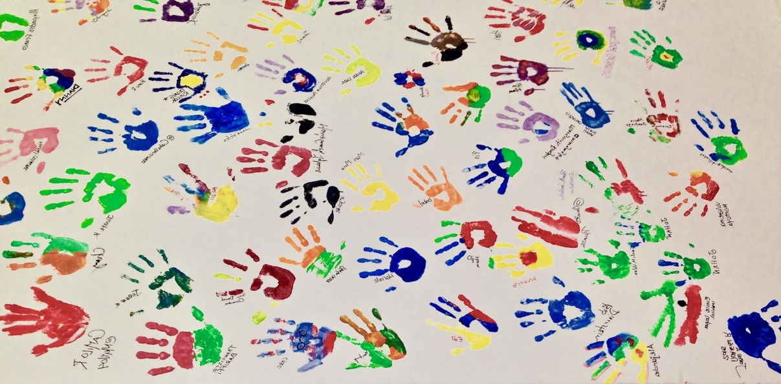
Use inclusive, respectful language.
Notes:
Obviously, please be respectful of others.
Also, be kind to yourself.

Slide 9

You will probably get stuck. Don’t panic.
Notes:
Here’s a secret: we all get stuck.
Try to be patient with yourself.
If you get frustrated, it’s ok to take a break.

Slide 10

Ask for help. Help your neighbor if they ask.
Notes:
Use the sticky notes. It’s ok to put up a sticky while you keep trying to solve the problem.
There is magic in having someone stand behind you. Also in explaining the problem.

Slide 11

Have fun!
Want evidence that making mistakes in R can be fun?
Check out @accidental_aRt on twitter!
Notes:
Most importantly- have fun with it.
Celebrate success! Laugh at unexpected results!

Slide 13
There are two really frustrating things about R:
It does exactly what you tell it to do.
There are many ways to do just about anything you can think of.

Slide 14
Our approach to R
YOU CAN use R to make a publishable product
R is not “easy” but it’s so useful that it’s worth putting in the time to learn how to use it. Same with statistics.
Product =
Dataset
Stats results
Graph
We want to give you the tools to reproduce the things you see in articles and report
Examples
Resources
How to get started

Slide 15
Our approach to introducing statistics
You’re not going to learn everything you ever need today
No one knows everything about stats.
You are going to get a foundation that you can build on
Learn vocabulary → what to look up in the future
Get some resources → where to go for answers
Practice some things you can come back to when you need to remember
Today we’re focusing on things you’ll use
Common stats things
Things you might need to understand or reproduce

Slide 16
 |  |  |  | Details
 | Start | End | Lesson Topic | Stats | R | Duration
Morning 1 | 8:00 | 10:00 | Summarizing data | ° Data visalization - appropriate plots for different kinds of data ° Descriptive statistics | ° Reading data into R ° Basic data handling ° summary() and various plotting functions ° Help functions & resources | 2:00
Break | 10:00 | 10:15 |  |  |  | 0:15
Morning 2 | 10:15 | 12:00 | Probability | ° Introduction to probability ° Common distirbutions (e.g., normal, Poisson, binomial) | ° Distribution functions: e.g., rnorm, dnorm | 1:45
Lunch | 12:00 | 13:00 |  |  |  | 1:00
Afternoon 1 | 13:00 | 14:45 | Inference | ° Maximum Likelihood ° Bayesian |  | 1:45
Break | 14:45 | 15:00 |  |  |  | 0:15
Afternoon 2 | 15:00 | 17:30 | Linear Models | ° Introduction ° Assumptions ° Diagnostics ° AIC ° Categorical variables ° Simulations | ° Model fitting functions & their syntax ° Diagnostic plots & summaries | 2:30
 |  |  |  |  | Contact Hours: | 8:00

Slide 17
Stuff in my browser tabs
http://www.bcfoltz.com/blog/stats-101/
https://statquest.org/
https://www.khanacademy.org/math/statistics-probability
https://brohrer.github.io/stats_resources.html
https://datacarpentry.org/R-ecology-lesson/00-before-we-start.html

