Slide 1

WEEKLY SHARING
BASIC AI CHESS GAME
PRG: Nguyen Van Duc
Team: Disney Mornash
Notes:
Hello everybody, thank you all very much for coming today. My name is vu and here is my partner Duc, We very happy to be here and tell you about our senior project with the name build Application for Human Characteristics Analysis.

Slide 2
AGENDA
Introduction
Process
Evaluate System
Minimax and Alpha-beta prune
Conclusion
Conclusion
Notes:
Our talking is divided into 4 part like this: The first, we would like introduction our project, the idea, solution v.v .
After that we will talking about how can we develop our project.
The third is the demonstration and finally is the conclusion.
Ok, let begin with the first part, introduction

Slide 3
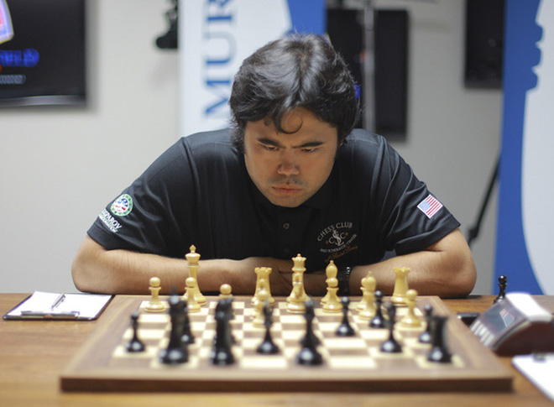

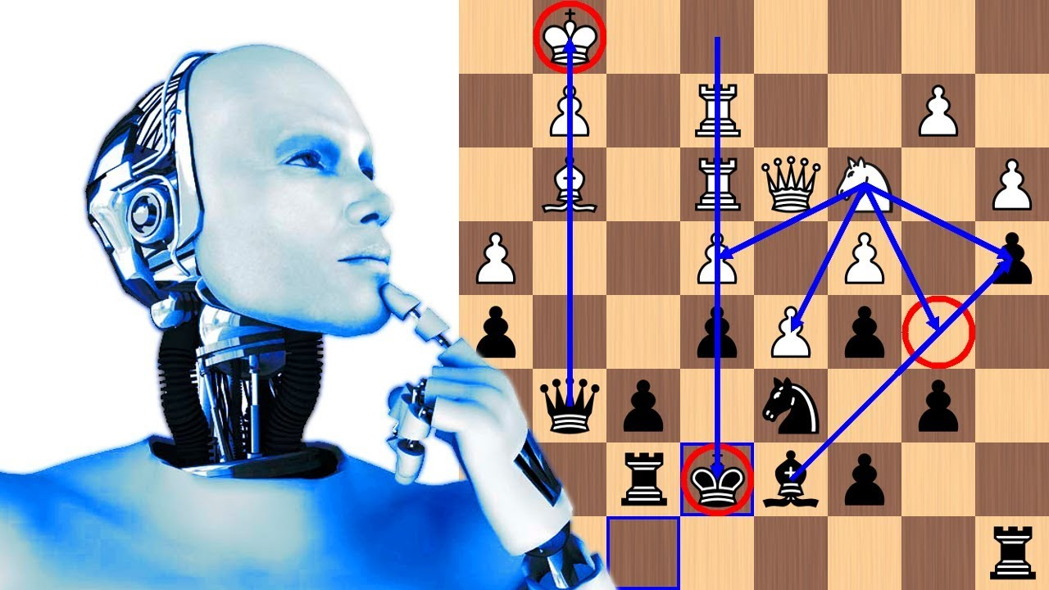
INTRODUCTION
Where is the idea from?
Feeling alone when you can't find anyone like a worthy competitor.
Notes:
In our life, we usually have the same case need to know the personality of some people. The example in the job interview, business, relationship. If you know that you can easily get the best employer in the job interview, get the contract in business.

Slide 4
PROCESS
Make a board and apply pieces
Generate moves
Make windows (History, Dead Pieces, Promotion)
Integrate Minimax

Slide 5
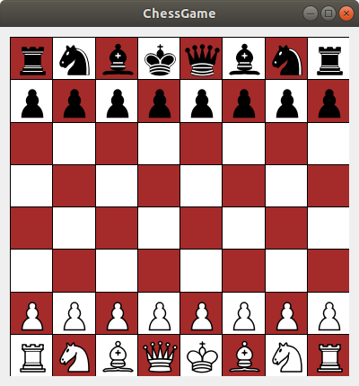
PROCESS
Render, Apply pieces on Board

Slide 6
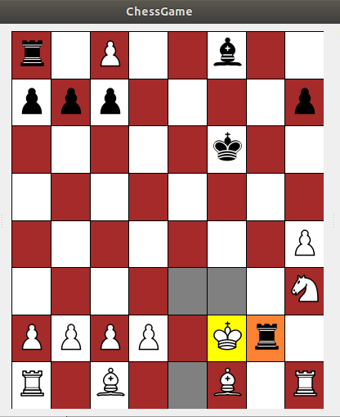
PROCESS
Make move and check legal moves

Slide 7
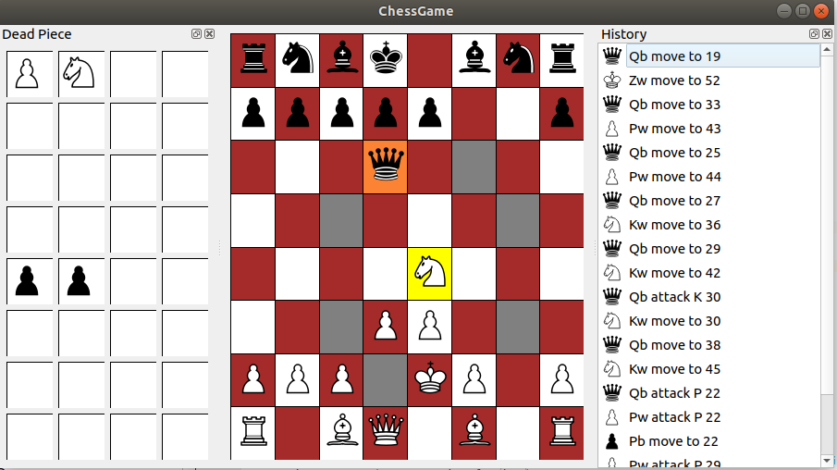
PROCESS
Dead Piece Windows, History Windows (Command Pattern)

Slide 8
PROCESS
Update Board Game and History Windows (Notify pattern)
void HistoryWnd::Update()
{
…
clear();
MoveMgr* mgr = MoveMgr::GetInstance();
for (int i = count - 1; i >= 0; i--)
{
QListWidgetItem* item = new QListWidgetItem();
Move* move = mgr->GetMove(i);
QString name = move->GetDescription();
item->setData(Qt::DisplayRole, name);
QIcon icon = MainWnd::LoadIcon( QString(move->GetTypePieceMove()) + QString(move->GetAlliancePieceMove()) );
item->setData(Qt::DecorationRole, icon);
if (m_cmdIdx <= i)
item->setFlags(item->flags() & ~Qt::ItemIsEnabled);
addItem(item);
}
}

Slide 9
PROCESS
Update Board Game and History Windows (Notify pattern)
void MoveMgr::Do(Move *move)
{
...
Message hitoryMsg(HistoryWnd::k_msgType, msg::HISTORY_UPDATE);
Send(hitoryMsg);
Message boardGameMsg(BoardGameWnd::k_msgType, msg::BOARD_CHANGED);
Send(boardGameMsg);
...
}
void HistoryWnd::OnMessageReceived(const Message &msg)
{
if(msg.Is(msg::HISTORY_UPDATE))
{
Update();
}
}
void BoardGameWnd::OnMessageReceived(const Message &msg)
{
if(msg.Is(msg::BOARD_CHANGED))
{
repaint();
}
}

Slide 10
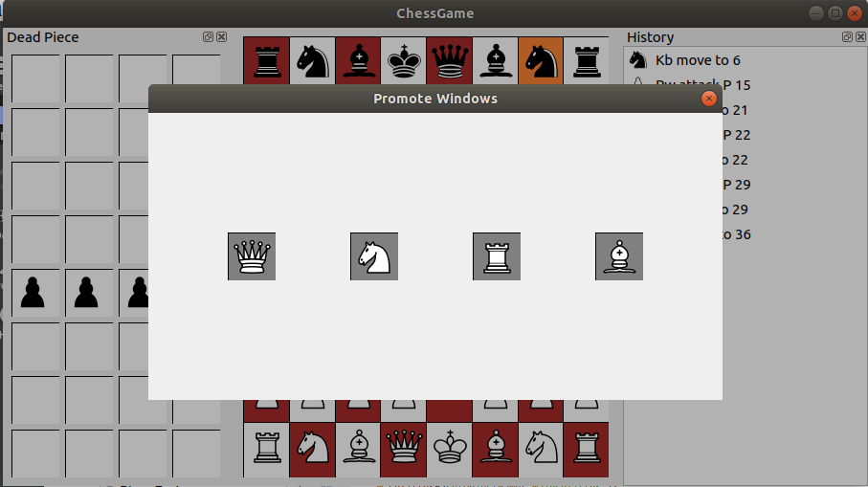
PROCESS
Promote Function

Slide 11
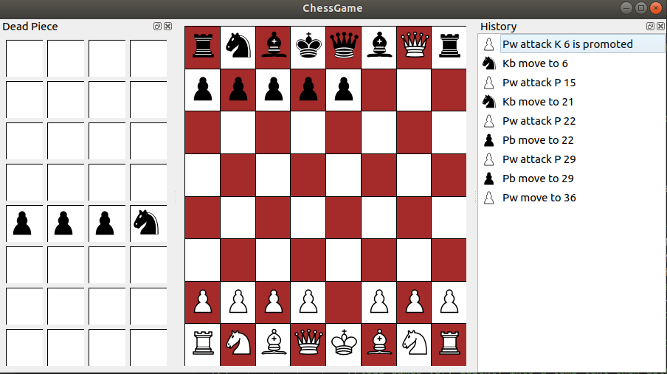
PROCESS
After select Queen the Pawn will be promoted to be Queen
AI will choose Queen piece like a default

Slide 12
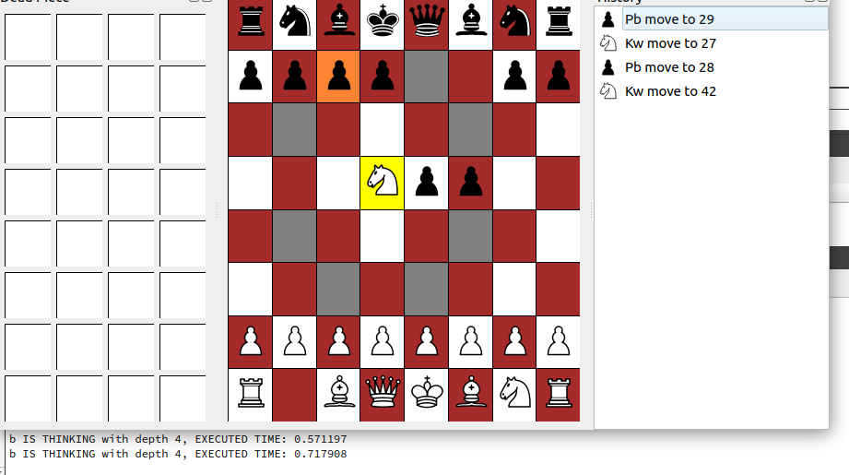
PROCESS
Ingrate Minimax and Alpha-beta prune

Slide 13












EVALUATE SYSTEM
Build Evaluate Piece value and Position value
Piece
Value
Pawn
Pawn
100
Bishop
350
Knight
320
320
Rook
500
Queen
900
King
20000

Slide 14
EVALUATE SYSTEM
Build Evaluate Piece value and Position value
const int BonusSystem::WHITE_PAWN_PREFERRED_COORDINATES[] =
{
0, 0, 0, 0, 0, 0, 0, 0,
75, 75, 75, 75, 75, 75, 75, 75,
25, 25, 29, 29, 29, 29, 25, 25,
5, 5, 10, 25, 25, 10, 5, 5,
0, 0, 0, 20, 20, 0, 0, 0,
5, -5, -10, 0, 0, -10, -5, 5,
5, 10, 10, -20, -20, 10, 10, 5,
0, 0, 0, 0, 0, 0, 0, 0
};
const int BonusSystem::BLACK_PAWN_PREFERRED_COORDINATES[] =
{
0, 0, 0, 0, 0, 0, 0, 0,
5, 10, 10, - 20, -20, 10, 10, 5,
5, -5, -10, 0, 0, -10, -5, 5,
0, 0, 0, 20, 20, 0, 0, 0,
5, 5, 10, 25, 25, 10, 5, 5,
25, 25, 29, 29, 29, 29, 25, 25,
75, 75, 75, 75, 75, 75, 75, 75,
0, 0, 0, 0, 0, 0, 0, 0
};
...
Notes:
Special in the real life have some way to know that, for example, do you know him, the fortune teller, he can give you some your information character just looking your face. But if your not him, you cannot read a character from the face, so how can we know? We have the solution for you.

Slide 15
Complexity of a Chess Game
Complexity of a Chess Game
20 possible start moves, 20 possible replies, etc.
400 possible positions after 2 ply (half moves)
197 281 positions after 4ply
713 positions after 10 ply (5 White moves and 5 Black moves)
Notes:
Special in the real life have some way to know that, for example, do you know him, the fortune teller, he can give you some your information character just looking your face. But if your not him, you cannot read a character from the face, so how can we know? We have the solution for you.

Slide 16
DEMONSTRATION
Link demo:

Slide 17


CONCLUSION
Machine learning
Teamwork
Using English to work
Application work stable
Advantage
Prepare the dataset
Evaluating dataset
Extracting features involve human characteristics
Disadvantage

Slide 18
Feature work
Optimize the accuracy of the model
Recognizing age and gender.
Detect and recognize on the internet.

Slide 19

1
THANKS FOR ATTENTION

