Slide 1

WEEKLY SHARING
BASIC AI CHESS GAME
PRG: Nguyen Van Duc
Team: Disney Mornash
Notes:
Hello everybody, thank you all very much for coming today. My name is vu and here is my partner Duc, We very happy to be here and tell you about our senior project with the name build Application for Human Characteristics Analysis.

Slide 2
AGENDA
Introduction
Process
Evaluate System
Minimax and Alpha-Beta prune
Conclusion
Conclusion
Notes:
Our talking is divided into 4 part like this: The first, we would like introduction our project, the idea, solution v.v .
After that we will talking about how can we develop our project.
The third is the demonstration and finally is the conclusion.
Ok, let begin with the first part, introduction

Slide 3
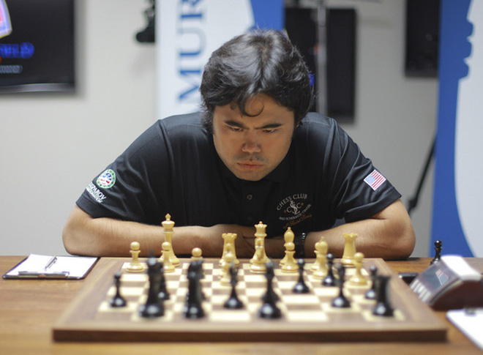

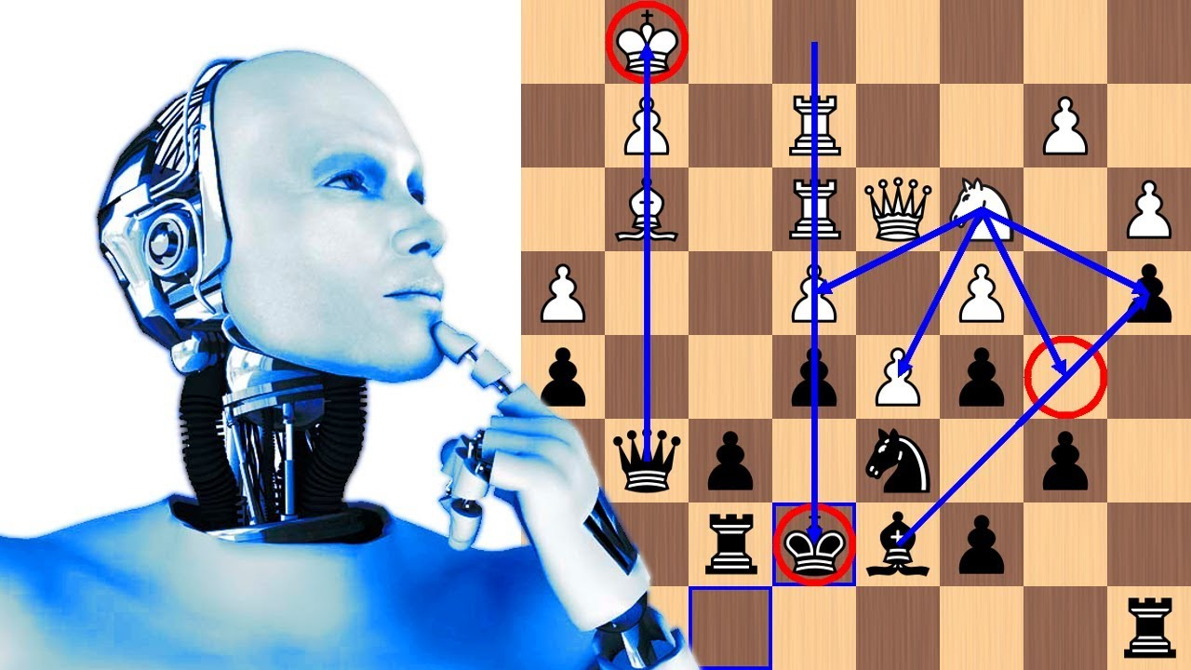
INTRODUCTION
Where is the idea from?
Feeling alone when you can't find anyone like a worthy competitor.
Notes:
In our life, we usually have the same case need to know the personality of some people. The example in the job interview, business, relationship. If you know that you can easily get the best employer in the job interview, get the contract in business.

Slide 4
PROCESS
Make a board and apply pieces
Generate moves
Make windows (History, Dead Pieces, Promotion)
Integrate Minimax

Slide 5
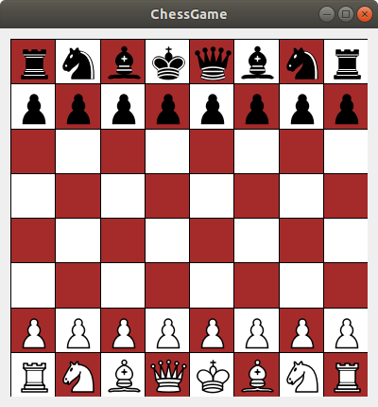
PROCESS
Render, Apply pieces on Board

Slide 6
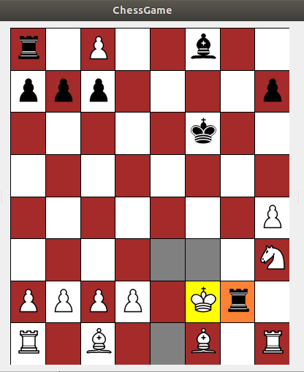
PROCESS
Make move and check legal moves

Slide 7
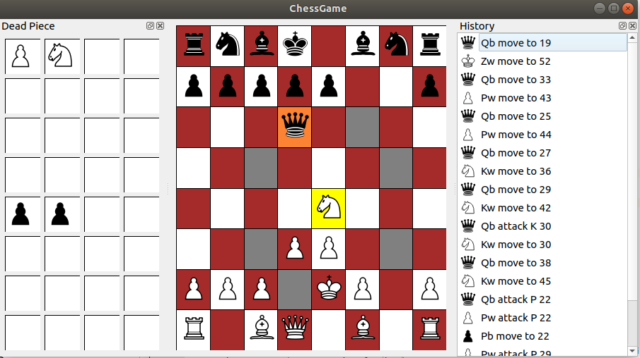
PROCESS
Dead Piece Windows, History Windows (Command Pattern)

Slide 8
PROCESS
Update Board Game and History Windows (Notify pattern)
void HistoryWnd::Update()
{
…
clear();
MoveMgr* mgr = MoveMgr::GetInstance();
for (int i = count - 1; i >= 0; i--)
{
QListWidgetItem* item = new QListWidgetItem();
Move* move = mgr->GetMove(i);
QString name = move->GetDescription();
item->setData(Qt::DisplayRole, name);
QIcon icon = MainWnd::LoadIcon( QString(move->GetTypePieceMove()) + QString(move->GetAlliancePieceMove()) );
item->setData(Qt::DecorationRole, icon);
if (m_cmdIdx <= i)
item->setFlags(item->flags() & ~Qt::ItemIsEnabled);
addItem(item);
}
}

Slide 9
PROCESS
Update Board Game and History Windows (Notify pattern)
void MoveMgr::Do(Move *move)
{
...
Message hitoryMsg(HistoryWnd::k_msgType, msg::HISTORY_UPDATE);
Send(hitoryMsg);
Message boardGameMsg(BoardGameWnd::k_msgType, msg::BOARD_CHANGED);
Send(boardGameMsg);
...
}
void HistoryWnd::OnMessageReceived(const Message &msg)
{
if(msg.Is(msg::HISTORY_UPDATE))
{
Update();
}
}
void BoardGameWnd::OnMessageReceived(const Message &msg)
{
if(msg.Is(msg::BOARD_CHANGED))
{
repaint();
}
}

Slide 10
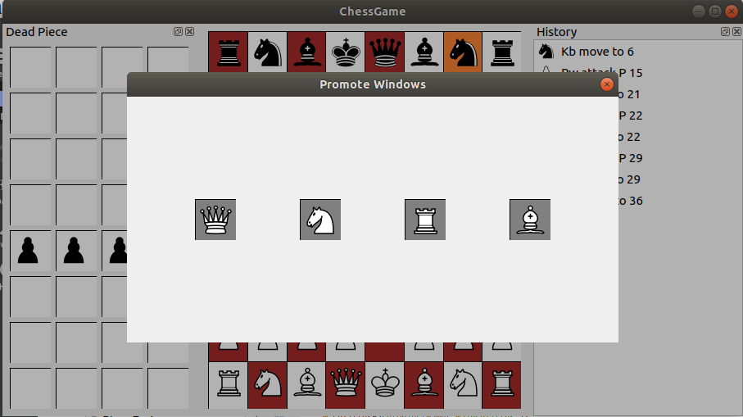
PROCESS
Promote Function

Slide 11
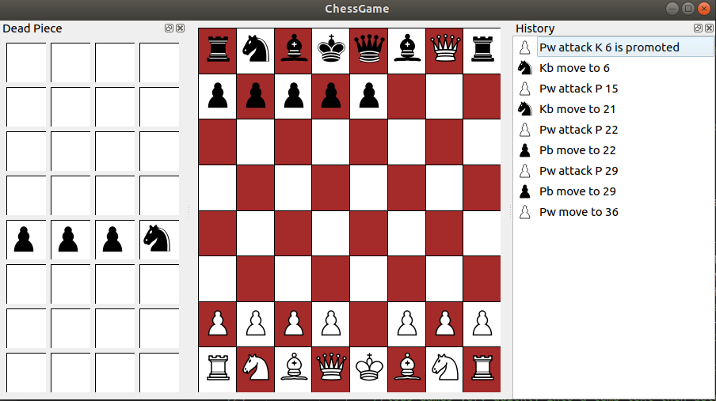
PROCESS
After select Queen the Pawn will be promoted to be Queen
AI will choose Queen piece like a default

Slide 12
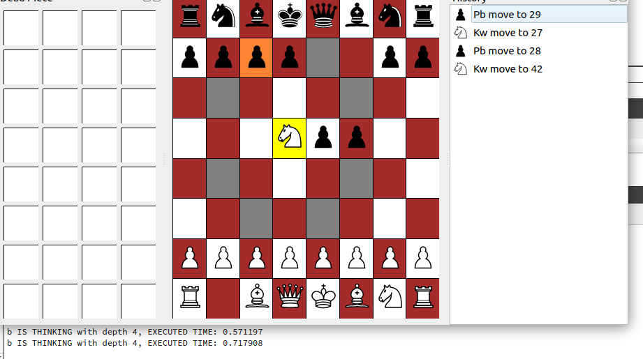
PROCESS
Ingrate Minimax and Alpha-beta prune

Slide 13












EVALUATE SYSTEM
Build Evaluate Piece value and Position value
Piece
Value
Pawn
Pawn
100
Bishop
350
Knight
320
320
Rook
500
Queen
900
King
20000

Slide 14
EVALUATE SYSTEM
Build Evaluate Piece value and Position value
const int BonusSystem::WHITE_PAWN_PREFERRED_COORDINATES[] =
{
0, 0, 0, 0, 0, 0, 0, 0,
75, 75, 75, 75, 75, 75, 75, 75,
25, 25, 29, 29, 29, 29, 25, 25,
5, 5, 10, 25, 25, 10, 5, 5,
0, 0, 0, 20, 20, 0, 0, 0,
5, -5, -10, 0, 0, -10, -5, 5,
5, 10, 10, -20, -20, 10, 10, 5,
0, 0, 0, 0, 0, 0, 0, 0
};
const int BonusSystem::BLACK_PAWN_PREFERRED_COORDINATES[] =
{
0, 0, 0, 0, 0, 0, 0, 0,
5, 10, 10, - 20, -20, 10, 10, 5,
5, -5, -10, 0, 0, -10, -5, 5,
0, 0, 0, 20, 20, 0, 0, 0,
5, 5, 10, 25, 25, 10, 5, 5,
25, 25, 29, 29, 29, 29, 25, 25,
75, 75, 75, 75, 75, 75, 75, 75,
0, 0, 0, 0, 0, 0, 0, 0
};
...
Notes:
Special in the real life have some way to know that, for example, do you know him, the fortune teller, he can give you some your information character just looking your face. But if your not him, you cannot read a character from the face, so how can we know? We have the solution for you.

Slide 15
EVALUATE SYSTEM
Mobility
King Threat
King Castle
Player Score
King Safety
Attack Move
Piece Evaluation
Depth Bonus
Notes:
Special in the real life have some way to know that, for example, do you know him, the fortune teller, he can give you some your information character just looking your face. But if your not him, you cannot read a character from the face, so how can we know? We have the solution for you.

Slide 16
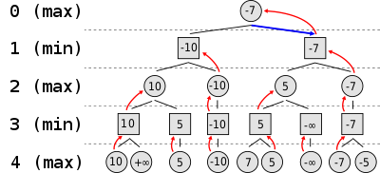
MINIMAX
evaluateValue = transitionBoard.playerTurn == Alliance::WHITE ? min(transitionBoard, m_searchDepth - 1): max(transitionBoard, m_searchDepth - 1);
Notes:
Special in the real life have some way to know that, for example, do you know him, the fortune teller, he can give you some your information character just looking your face. But if your not him, you cannot read a character from the face, so how can we know? We have the solution for you.

Slide 17
MINIMAX
function minimax(node, depth, maximizingPlayer) is
if depth = 0 or node is a terminal node then
return the heuristic value of node
if maximizingPlayer then
value := −∞
for each child of node do
value := max(value, minimax(child, depth − 1, FALSE))
return value
else (* minimizing player *)
value := +∞
for each child of node do
value := min(value, minimax(child, depth − 1, TRUE))
return value
(* Initial call *)
minimax(origin, depth, TRUE)
Notes:
Special in the real life have some way to know that, for example, do you know him, the fortune teller, he can give you some your information character just looking your face. But if your not him, you cannot read a character from the face, so how can we know? We have the solution for you.

Slide 18
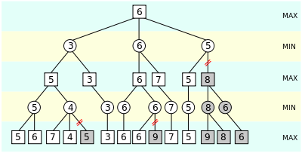
Alpha-Beta prune
Notes:
Special in the real life have some way to know that, for example, do you know him, the fortune teller, he can give you some your information character just looking your face. But if your not him, you cannot read a character from the face, so how can we know? We have the solution for you.

Slide 19
Alpha-Beta prune
function alphabeta(node, depth, α, β, maximizingPlayer) is
if depth = 0 or node is a terminal node then
return the heuristic value of node
if maximizingPlayer then
value := −∞
for each child of node do
value := max(value, alphabeta(child, depth − 1, α, β, FALSE))
α := max(α, value)
if α ≥ β then
break (* β cut-off *)
return value
else
value := +∞
for each child of node do
value := min(value, alphabeta(child, depth − 1, α, β, TRUE))
β := min(β, value)
if α ≥ β then
break (* α cut-off *)
return value
(* Initial call *)
alphabeta(origin, depth, −∞, +∞, TRUE)
Notes:
Special in the real life have some way to know that, for example, do you know him, the fortune teller, he can give you some your information character just looking your face. But if your not him, you cannot read a character from the face, so how can we know? We have the solution for you.

Slide 20
Complexity of a Chess Game
Complexity of a Chess Game
20 possible start moves, 20 possible replies, etc.
400 possible positions after 2 ply (half moves)
197 281 positions after 4ply
713 positions after 10 ply (5 White moves and 5 Black moves)
More and more :((
Notes:
Special in the real life have some way to know that, for example, do you know him, the fortune teller, he can give you some your information character just looking your face. But if your not him, you cannot read a character from the face, so how can we know? We have the solution for you.

Slide 21
DEMONSTRATION

Slide 22


CONCLUSION
Implement design pattern
Chess Game Structure
Integrate AI in Game
Advantage
Application work not stable and not complete yet
Evaluate System is still basic.
Disadvantage

Slide 23
Feature work
Make game faster and smarter.
Ensure game run stable.
Make new online mode for 2 player people.

Slide 24

<number>
THANKS FOR ATTENTION

