Slide 1
Name Trends Analysis in the United States Using BigQuery
Course: CMPE 138
Team: Van Duong, Stephen Shao, Andy Neidhart
Professor: Dr. Gheorghi Guzun

Slide 2
Problem and Why We Need This Query Program
Why this project?
Names reflect social, cultural, and generational shifts.
Analyzing names over time reveals trends in gender, influence, and region.
Manual tracking is not scalable
SQL-based automation is essential.
Goal: Extract meaningful insights from 100+ years of U.S. baby name data.

Slide 3
Dataset Used and Main Features
Dataset: bigquery-public-data.usa_names.usa_1910_current
Fields: state, gender, year, name, number
Main Features Queried:
Most popular names by decade (Van)
Gender-neutral names (Van)
States with most unique names (Stephen)
Fastest rising names after 1990 (Stephen)
Celebrity name spike – 'Kobe' (Andy)
Stable names across decades (Andy)

Slide 4
Query Optimization
Why optimize?
BigQuery charges based on the amount of data scanned.
Faster queries = lower cost and quicker performance.
Especially important when working with large datasets like 100+ years of name records.
Techniques used:
Added a WHERE clause to limit by decade (year BETWEEN 1990 AND 1999)
Avoided scanning all years in the dataset.
Used GROUP BY to efficiently aggregate name totals.

Slide 5
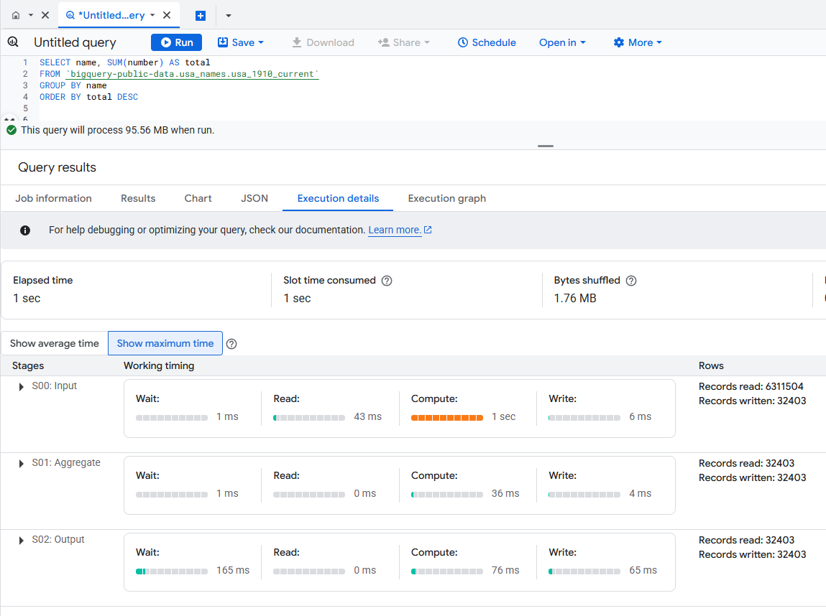
Query Optimization (Unoptimized)

Slide 6
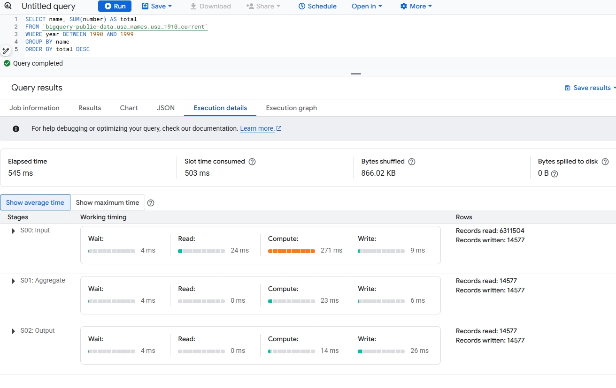
Query Optimization (Optimized)

Slide 7
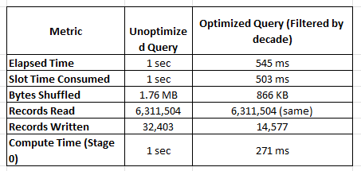
Query Optimization
Result?
T

Slide 8
Lessons Learned
Takeaways from the project:
- SQL alone is powerful for trend analysis
- Query optimization matters for large datasets
- Cultural, regional, and gender trends emerge clearly from names
Future Improvements:
- Create Google Data Studio dashboards
- Add real-time API or front-end interface

Slide 9
Demo Plan
Demo Steps:
- Van: Show most popular and gender-neutral queries
- Stephen: Show unique names by state & fast-rising names
- Andy: Show 'Kobe' trend and stable name query
Highlight SQL structure, result visuals, and performance impact

