Slide 1
Applying Fairness to Transport Planning
Operationalising Equitable Transport Planning for the City of Rotterdam

Slide 2
Some Background
2016
2017
2018
Master of Science in Transport, Infrastructure & Logistics (129 EC)
Thesis (30 EC)

Slide 3
Problem
Solution
Application
Notes:
Problem
Solution
Implementation

Slide 4
Transport Planning
decision-making process that leads to policy and investments in infrastructure and transportation
Notes:
E.g. metro E
No “best” way
Various considerations in this decision

Slide 5
Transport Planning
capacity
new roads
new housing
more buses
Notes:
Since it is a decision making process,
The considerations on the left determine the outcomes on the right

Slide 6
“in evaluations of transport projects and policies, equity issues are often ignored”
Notes:
-> equity should also be a consideration

Slide 7
Equity in Transportation
a fair distribution of the benefits of transport planning
Notes:
Who needs it the most?

Slide 8
Transport Planning
equity
rechtvaardigheid
Notes:
So the problem is that equity isn’t being used as a consideration enough.
The biggest reason is that it hasn’t been

Slide 9
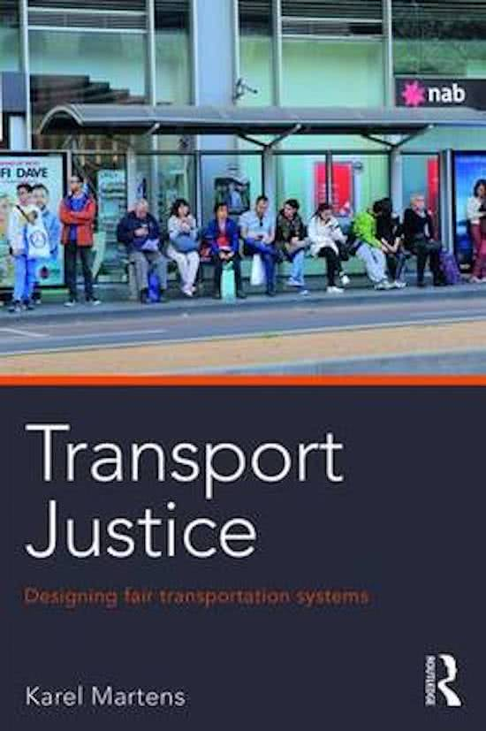
☑ Well-thought out theory and proposed methodology ☒ Not developed enough ☒ Not defined & formalised ☒ Not applied to a real case

Slide 10
Research question
How can an equity-based approach to transport planning be operationalized
and which important considerations, benefits and issues arise when this approach is applied to a case?
Notes:
The result is a methodology

Slide 11
Solution
Measure Accessibility (bereikbaarheid)
Set a Threshold Value (drempelwaarde)
Calculate “Unfairness” based on this value

Slide 12
1. Measure Accessibility
Edge of City
City Center

Slide 13
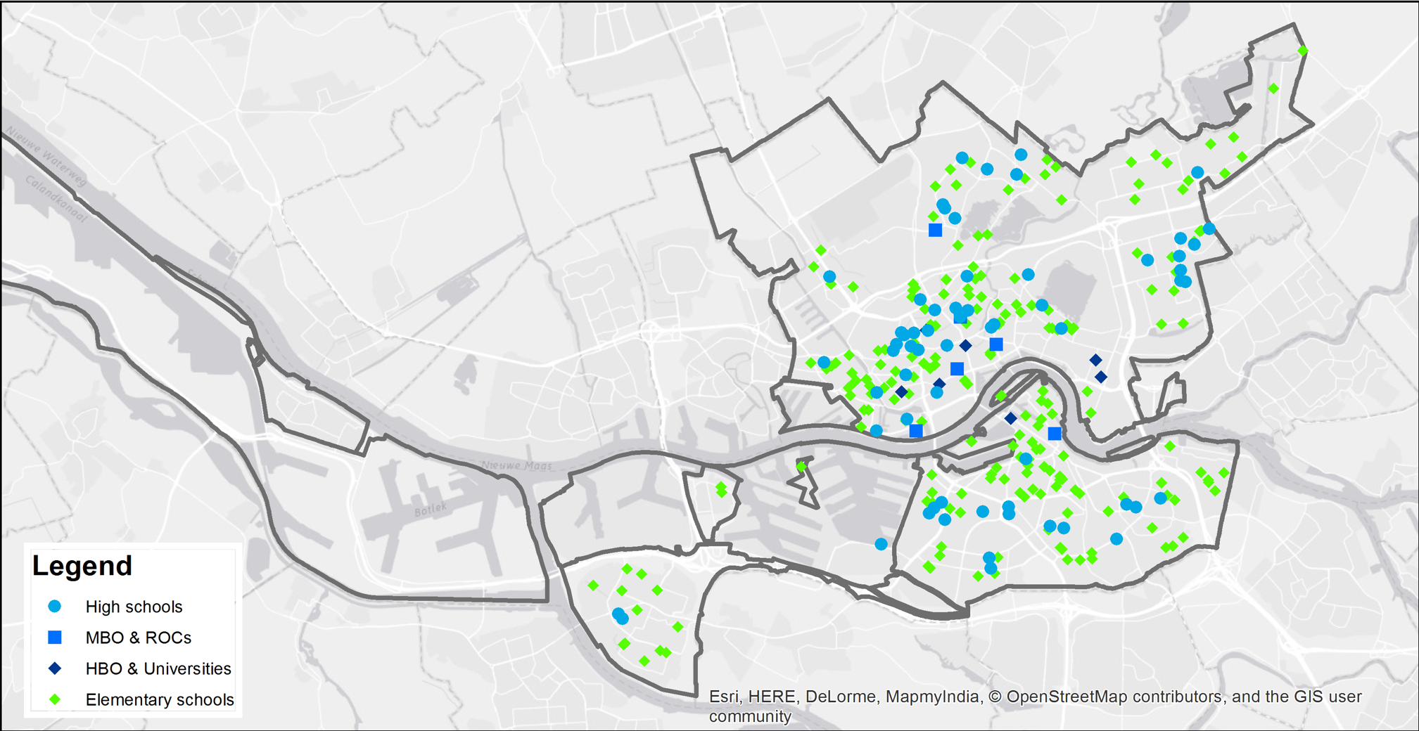

Slide 14
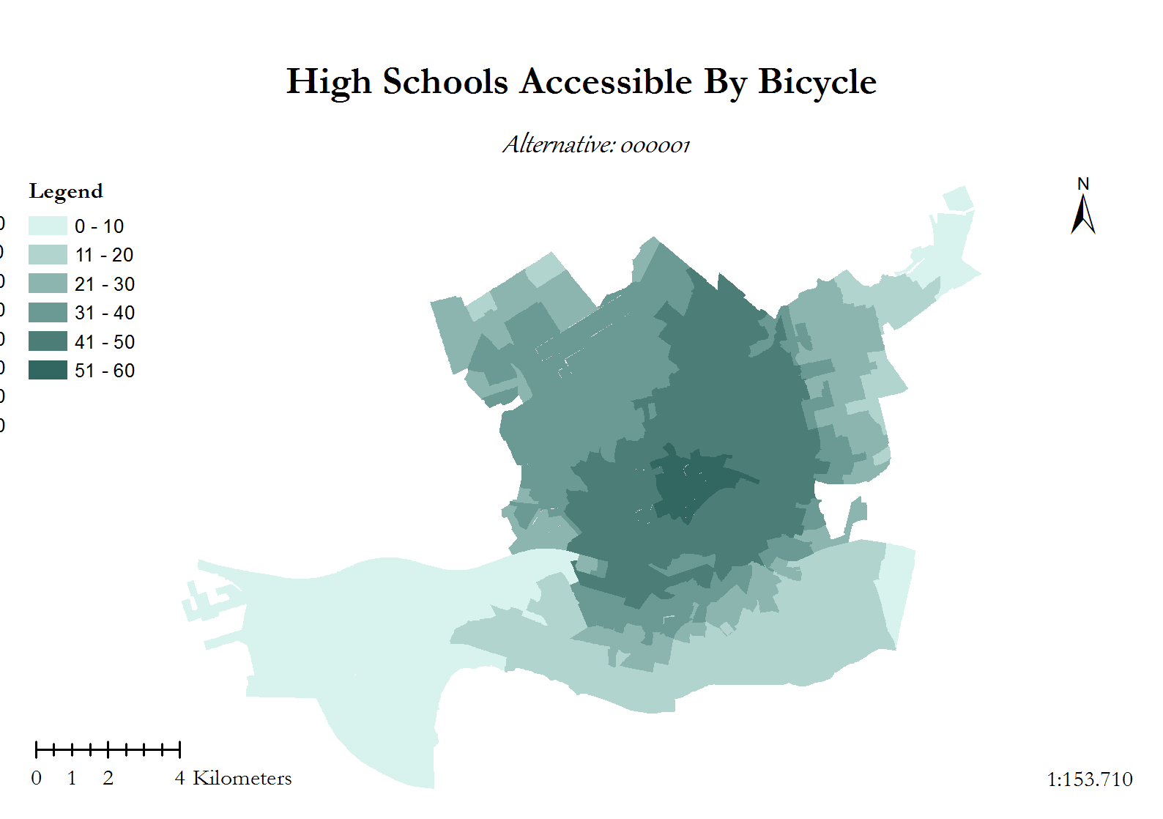

Slide 15
A transport network is fair if everyone has sufficient accessibility Een vervoersnetwerk is eerlijk als iedereen genoeg bereikbaarheid heeft
Notes:
Je hebt hiermee die vier te pakken

Slide 16
What is sufficient?
Bad
Good
Notes:
Depends on the location and on what people want
Difficult to determine but not impossible
Could say: we think the lowest 25% of people probably don’t have enough
ONCE YOU HAVE THAT, you can

Slide 17
3. Quantify Equity Issues
First, identify which people in which neighborhoods have insufficient accessibility
Bad
Good

Slide 18
3. Quantify Equity Issues
Then, consider how far they fall below the threshold
Bad
Good

Slide 19
3. Quantify Equity Issues
Multiply this by the number of people
x50
x200
Bad
Good
x1000

Slide 20
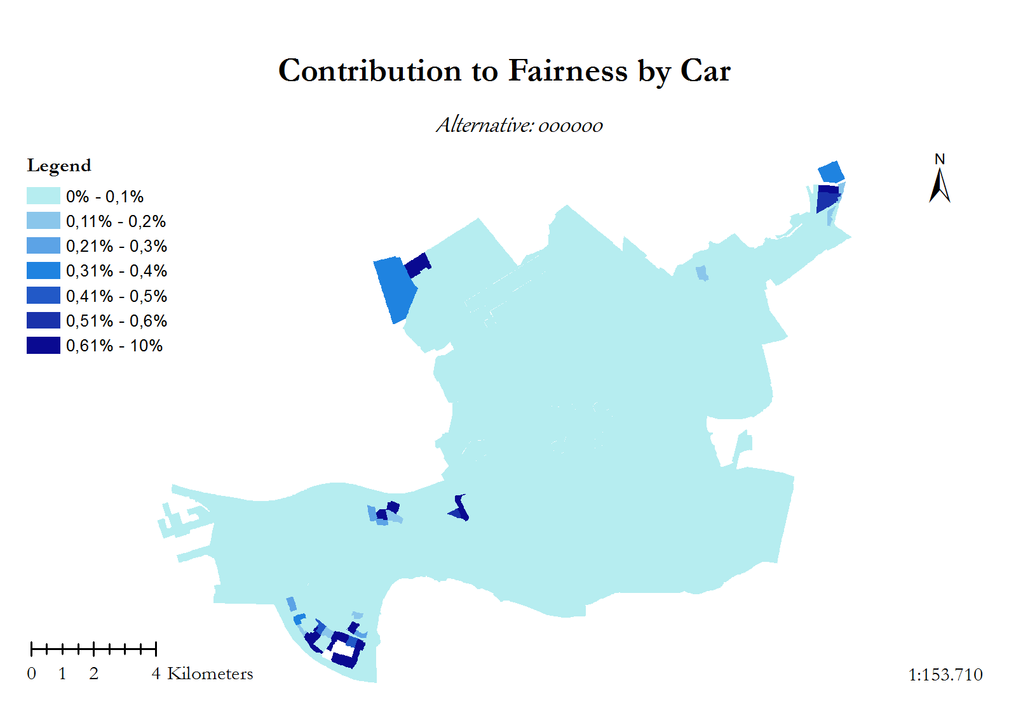

Slide 21
Applying this to the City of Rotterdam
Created and formalised the methodology
Assessed fairness for
1192 zip codes
3 modes
to 18 destinations

Slide 22
Transport Planning
equity
rechtvaardigheid
Notes:
So the problem is that equity isn’t being used as a consideration enough.
The biggest reason is that it hasn’t been

Slide 23
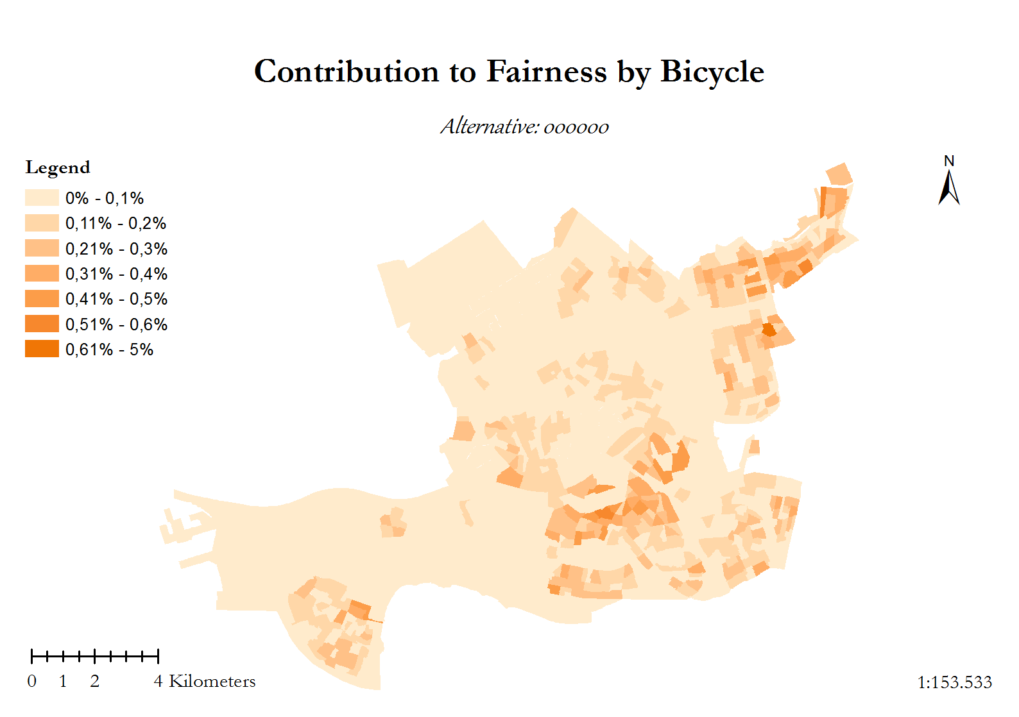

Slide 25
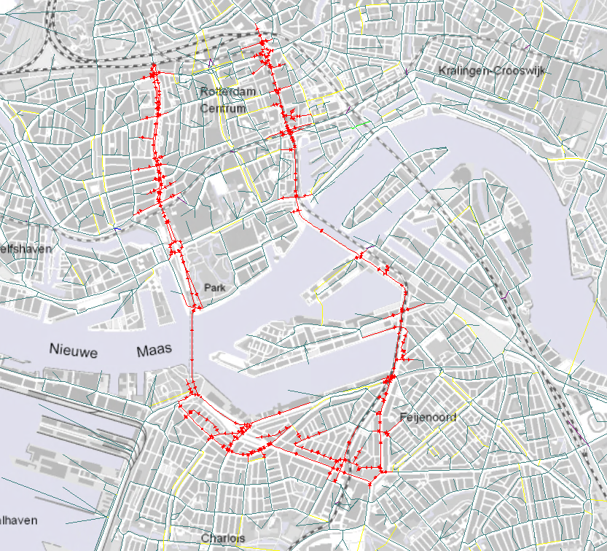
Bicycle Highway Test
17,5 km/u instead of 15 in the model
More than 50 zip codes pushed above the threshold
Decrease of 14.8% “unfairness”

Slide 26
Conclusions
The methodology is
Makes equity issues concrete
Useful to decision makers
Can adapt to various policy topics (health,…)
Can be done for specific groups (elderly,…)

Slide 27
Conclusions
Considerations and issues
Methodology is inherently subjective
Robustness of the methodology needs improvement

