Slide 1
CLIENT REPORT
Development & Maintenance
Confidential
Progress Report
Period: Nov 2025 — May 2026
Backend engineering,
database, infrastructure
and product delivery
A transparent summary of the engineering, infrastructure
and maintenance work delivered on the salon platform —
much of it invisible from the user interface, but essential
to the product's stability, scalability and growth.
186
75
57
7
Commits
Pull Requests
DB Migrations
Months Active

Slide 2
CONTENTS
What this report covers
01
06
Project overview
Maintenance & stability
Scope, team and engagement
The invisible engineering layer
02
07
Development timeline
Metrics & impact
Month-by-month delivery
Quantified output
03
08
Git activity
Technical context
Visible evidence of continuous work
How the pieces fit together
04
09
Backend & database
Conclusion
Foundations under the UI
Commitment going forward
05
Features delivered
What changed for users and the business
Salon Platform — Development Progress Report
Page 2

Slide 3
01 · PROJECT OVERVIEW
A platform under continuous engineering
The salon platform is a multi-tenant booking and management system serving customers, salon vendors, relationship managers and administrators. The backend, database, integrations and supporting infrastructure are all actively maintained — not as a one-time build, but as a living product.
Scope of work
Engagement
Team responsibilities
User-facing surfaces
Backend APIs (FastAPI)
Period: Nov 2025 – May 2026
Feature development
Customer mobile app
PostgreSQL via Supabase
Approx. 7 months active
Bug fixing & hotfixes
Salon admin panel
Payments (Razorpay)
Continuous PR-based delivery
Database migrations
RM (relationship manager) tools
Storage & uploads
Staging + production environments
Deployment & operations
Admin / internal panel
Email & OTP services
Security & access control
Salon Platform — Development Progress Report
Page 3

Slide 4
02 · DEVELOPMENT TIMELINE
Continuous delivery, month by month
51
Each marker represents a phase of work. Commit volume varies by month, but engineering effort remained continuous throughout.
38
Commit volume by month
30
28
Bar height = commits in that month
22
12
4
Nov 2025
Dec 2025
Jan 2026
Feb 2026
Mar 2026
Apr 2026
May 2026
Foundation
Stabilisation
Auth & Ops
Compliance
Vendor
Features
B2B
• Production schema
• Auth & RM flows
• Storage setup
• Career applications
• Career APIs
• Document uploads
• Activity logs
• Token validity
• Profiler & locust
• CI pipeline
• Test coverage
• Agreement uploads
• Payment reminders
• Business hours
• Email reliability
• Outlet & GST
• OTP service
• Vendor approvals
• Facilities
• Gender categories
• Reviews
• Favourites
• Discounts
• Products module
• Cart & checkout
• B2B pricing
• Subcategories
• CORS hardening
Salon Platform — Development Progress Report
Page 4

Slide 5
03 · GIT ACTIVITY & CONTRIBUTION
Each commit is a unit of engineering work
What a commit represents
Commit heatmap (illustrative)
Software maintenance often happens behind the scenes. While the user interface may appear similar between releases, continuous engineering work is required to improve stability, scalability, security and performance.
Each commit on the right may include any combination of:
Less
More
Multiple file updates
Bug fixes and hotfixes
Backend logic improvements
Refactoring of existing code
Database schema changes
Performance optimisations
Contributors (commits)
New feature code
Security & access-control changes
ve-sca-via
85
Safdar Ali Niazi
40
safdaraliniazi
37
Your Name
31
Salon Platform — Development Progress Report
Page 5

Slide 6
04 · BACKEND & DATABASE WORK
Foundations that sit beneath every screen
Most of the engineering effort lives below the UI. These are the categories of backend and database work delivered during the engagement.
Database structure
APIs & business logic
57 versioned migrations applied
16 API modules covering vendors, salons, RM, admin, payments
New tables: products, orders, carts, OTPs, activity logs, email logs, careers
Booking, products, cart and checkout flows
Service subcategories, gender categories, facilities, business hours
Review system, favourites, discounts, B2B pricing
Authentication & security
Reliability & ops
Custom JWT + Supabase auth flow consolidated
Database client singleton & refresh logic
Token validity timestamps & forced logout-all
Email delivery hardening + email_logs table
OTP service (MessageCentral) with rate limiting and lockouts
Activity logging for admin visibility
Password reset / forgot-password flows
CORS preflight fixes & deployment configuration
Role-based access (admin / RM / vendor / customer)
Locust load profile & profiler integration
Storage bucket policies & private agreement uploads
CI pipeline for safer deployments
Salon Platform — Development Progress Report
Page 6

Slide 7
05 · NEW FEATURES DELIVERED
Capabilities added during this period
B2B Products & Wholesale
Hierarchical Service Categories
Reviews & Favourites
PROBLEM
PROBLEM
PROBLEM
Salons could only sell services. No path to sell or buy products.
Flat category list limited how services could be organised.
No social proof, no way for users to save salons.
DELIVERED
DELIVERED
DELIVERED
Full products module with cart, checkout, payment, and B2B (wholesale) pricing for regular buyers.
Subcategories with vendor & RM support — better browsing and admin control.
Customers can review salons and favourite ones they like.
TECHNICAL WORK
TECHNICAL WORK
TECHNICAL WORK
Database tables, APIs, payment flow, B2B price logic, admin order management.
service_subcategories table, CRUD APIs, vendor & RM integration.
Reviews schema & APIs, favourites table, customer endpoints.
Vendor Onboarding (facilities, GST, outlets)
OTP Login (MessageCentral)
Career Applications
PROBLEM
PROBLEM
PROBLEM
Vendor data captured only minimal information.
Email-only login restricted some user segments.
No structured way to receive applications.
DELIVERED
DELIVERED
DELIVERED
Richer vendor profiles for compliance and discoverability.
Phone-based OTP login with rate limiting and lockouts.
End-to-end career application capture with document uploads.
TECHNICAL WORK
TECHNICAL WORK
TECHNICAL WORK
JSONB facilities, gender categories, outlet & GST fields, approval logic.
otp_service, otp_attempts table, send/verify endpoints, security hardening.
Schema, status flow, Cloudinary integration, status update API.
Salon Platform — Development Progress Report
Page 7

Slide 8
06 · MAINTENANCE & STABILITY
The work users don't see
An analogy
Like maintaining a car engine, many important improvements happen internally and may not change the exterior appearance. The vehicle still looks the same — but it starts more reliably, runs more efficiently, and is safer to drive.
1
Bug fixing
2
Downtime prevention
3
Performance optimisation
4
Dependency updates
22 explicit fix commits, plus inline corrections in feature PRs.
Email reliability, payment idempotency, retry-safe order flows.
LRU cache for Razorpay credentials, geocoding cache, query tuning.
Python runtime pinned, Pillow/SDK updates, deployment config cleanup.
5
Security patches
6
Refactoring
7
Scalability
8
Monitoring & logs
Token rotation, storage policies, OTP rate limits, CORS hardening.
Auth flow consolidation, duplicate code removal, sync supabase client.
Locust load tests, profiler instrumentation, async-safe payment flow.
Activity logs, email logs, structured rich logging.
Salon Platform — Development Progress Report
Page 8

Slide 9
07 · METRICS & IMPACT
Quantified output, drawn directly from the repository
186
75
57
16
24
~115K
Commits
Pull requests merged
Database migrations
API modules
Service modules
Lines added
Individual code changes shipped
Reviewed change sets
Versioned schema changes
Backend feature areas
Business-logic layers
Code authored across the period
Commits per month
Work distribution (commits)
Salon Platform — Development Progress Report
Page 9

Slide 10
08 · TECHNICAL CONTEXT, SIMPLIFIED
How UI, backend and data fit together
User Interfaces
Why this matters
Mobile app · Salon admin · RM tools · Admin panel
UI is the tip of the iceberg.
Every screen depends on dozens of API endpoints, services and database tables.
API Layer (FastAPI)
Authentication · Bookings · Products · Payments · RM · Vendors · Admin
Maintenance is structural.
Schema changes, auth hardening and payment integrity have no visible UI — but the platform cannot function safely without them.
Services & Business Logic
Orders · Pricing · OTP · Email · Activity logs · Geocoding · Storage
Data flows are bidirectional.
A simple action (e.g. booking) touches auth, services, salons, payments, storage and logs.
Data & Infrastructure
PostgreSQL (Supabase) · Storage buckets · Razorpay · Cloudinary · MessageCentral
Changes compound.
Each improvement to a lower layer benefits every feature built above it.
Salon Platform — Development Progress Report
Page 10

Slide 11
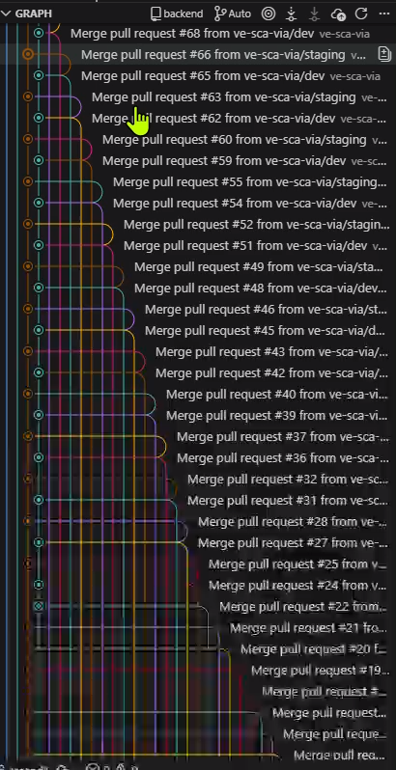
09 ·Commits
These all are Git commits
It includes all the activity.
Salon Platform — Development Progress Report
Page 11

Slide 12
09 · CONCLUSION
Continuous engineering, transparent reporting.
A summary of the commitments going forward.
1
2
3
Stability first
Scalability & performance
Transparent collaboration
Continued investment in monitoring, logging, automated tests and load profiling so issues are detected and resolved early — often before users encounter them.
Ongoing refinement of database queries, caching, and async paths so the platform absorbs growth in traffic, vendors and product orders without degradation.
Every change is reviewed, versioned and deployable. This report format can be repeated on a regular cadence so progress remains visible and measurable.
Thank you.
We remain committed to maintaining and improving the platform — both the visible product and the engineering foundation it depends on.

