Slide 1
Salon Management Platform — Continuous Development & Maintenance
Last 6 months (Nov 2025 - Apr 2026)
Prepared by Platform & Backend Team — May 19, 2026

Slide 2
Project Overview
Application: Salon Management Platform
Maintenance period: Last 6 months (Nov 2025 - Apr 2026)
Team: Platform & Backend Team
Scope: Backend, infrastructure, database, API, performance, security, feature work, monitoring

Slide 3
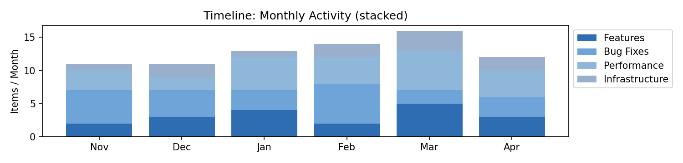
Continuous Development Timeline
Stacked monthly activity: features, bug fixes, performance, infrastructure

Slide 4

Git Activity & Contributions
Each cell represents commit activity (darker = more commits). Commits include bug fixes, DB changes, refactors, and features.

Slide 5
Backend & Database Work (summary)
DB schema changes and safe data migrations
API contract versioning and deprecation handling
Query tuning and index additions (CONCURRENTLY where possible)
Enhanced logging, monitoring, and alerts
Auth hardening and token rotation automation

Slide 6
New Features Delivered
Automated Booking Retry: Reduces failed bookings during transient errors — Impact: Improved reliability; fewer support tickets
Search Index Optimization: Faster product/service search — Impact: Better user experience; lower DB load
Payments Retry & Idempotency: Prevents double-charges on network hiccups — Impact: Reduced payment disputes

Slide 7
Maintenance & Stability
Ongoing bug fixes and incident response
Dependency and security patching
Refactoring for maintainability
Monitoring, alerting, and SLO improvements
Scalability & capacity planning efforts
Automations for deployments and rollbacks

Slide 8
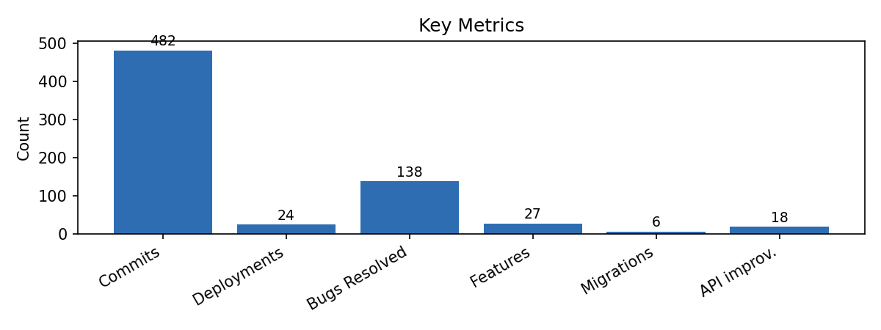
Metrics & Impact
High-level metrics including commits, deployments, bugs resolved, features shipped. Uptime: 99.97%

Slide 9
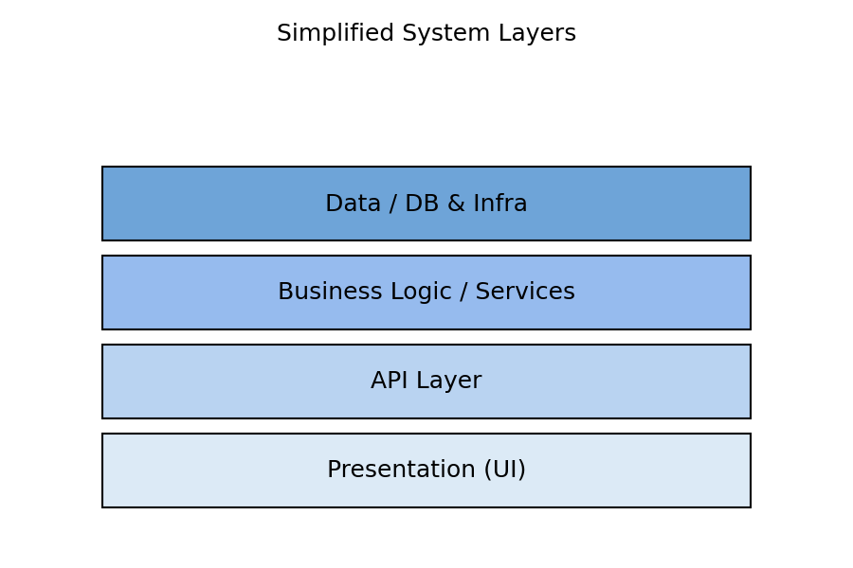
How Backend Supports the UI
Simplified layers: Presentation → API → Services → Data & Infrastructure

Slide 10
Conclusion
Continuous engineering reduces incidents and improves user experience over time
Many improvements are backend-focused and not always visible in the UI
We prioritize reliability, scalability, security, and measurable business value
Next steps: continue roadmap delivery, share regular status dashboards, and measure impact

