Slide 1

LARAVEL
C2-S2 – PRACTICE - ROUTING

Slide 2
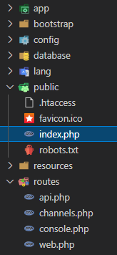
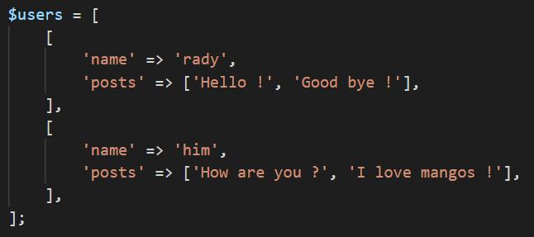
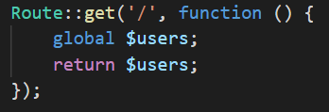
In this file we define an array of users:
Create a new Laravel project
Replace the file /public/index.php by the one you got from google classroom
You can access this variable in your routes with the global keyword:

Slide 3
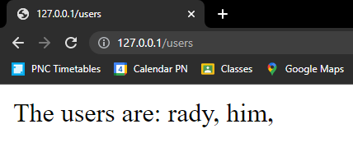
Mission 1: WEB route
Define a WEB ROUTE :
HTTP method: GET
Path: /users
Response: The name of all the users

Slide 4
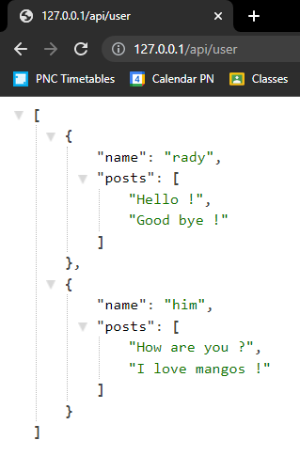
Mission 2: Get all users
Define a API ROUTE :
HTTP method: GET
Path: /api/user
Response: The list of all users

Slide 5
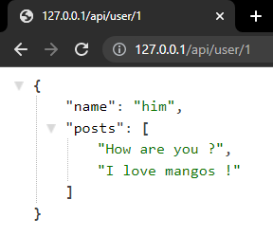
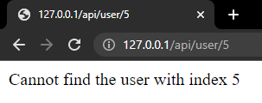
Mission 3: Get user by index
Define a API ROUTE :
HTTP method: GET
Path: /api/user/{userIndex}
Parameters: userIndex = an integer
Response:
The user of index userIndex
If cannot find this user, display an error

Slide 6
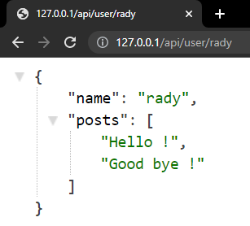
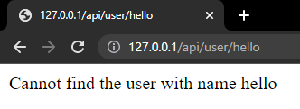
Mission 4: Get user by name
Define a API ROUTE :
HTTP method: GET
Path: /api/user/{userName}
Parameters: userName = a string with only letters (no special characters or numbers)
Response:
The user of name userName
If cannot find this user, display an error

Slide 7
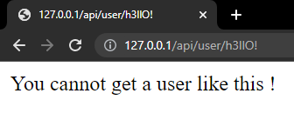
Mission 5: Group routes
Define a group of API routes with prefix “/user”
Move the routes from missions 2, 3 and 4 in this group
Inside the group, define a fallback route to display an error if the request is not correct

Slide 8
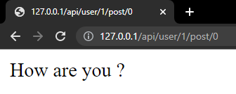
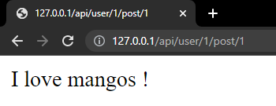
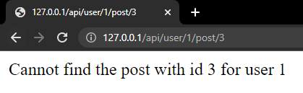
Mission 6: Get posts
Define a API ROUTE in the /user group :
HTTP method: GET
Path: /api/user/{userIndex}/post/{postIndex}
Parameters:
userIndex = an integer
postIndex = an integer
Response:
The post of index postIndex for the user userIndex
If cannot find this user or this post, display an error

Slide 9
When you submit, do not include the /vendor folder !

