Slide 1

LARAVEL
INSTALLATION
Notes:
le parsing json de la request et de la réponse (du coup ausi j'ai vu, c'est specifique aux POST/PUT)
req.body
accessoirement la gestion des erreur dans le catch

Slide 2


OBJECTIVES FOR TODAY
Understand what is a Web Framework
Understand composer and how it differs to npm
Create a Laravel project
Run a Laravel project

Slide 3










What is a Framework?
EXPLORE
10 MIN
Find a definition on the web
Discuss in team to understand it

Slide 4

What is a Framework?
EXPLAIN
05 MIN
CLASS
Web frameworks provide a standard way to build and deploy web applications
If you write code that obeys its rules, it will do things for you
(but you must follow its structure and patterns!)
They automate common activities:
Database access
Page templates
Session and user management (login etc)
Security
Configuration
…etc
They often promote code reuse

Slide 5
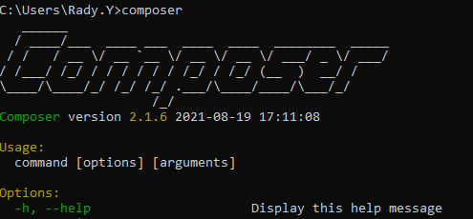
What is Composer ?
EXPLAIN
05 MIN
CLASS
Composer is a tool for dependency management in PHP.
It allows you to declare the libraries your project depends o
it will manage (install/update) them for you.

Slide 6
Install Composer
ACTIVITY
10 MIN
Step 1: https://getcomposer.org/download/
Step 2: Download and run Composer-Setup.exe
Step 3: Open Windows terminal and type: composer

Slide 7
What is Laravel ?
EXPLAIN
05 MIN
CLASS
Laravel is a back-end, PHP-based, open-source framework for building a wide range of custom web applications.
It’s a server-side framework that manages data
It is based on the Model-View-Controller (MVC) design

Slide 8
Install Laravel
ACTIVITY
10 MIN
Step 1: composer create-project laravel/laravel example-project --prefer-dist
Step 2: cd example-project
Step 3: php artisan serve --port 81
Step 4: http://127.0.0.1:81 (type on browser)

Slide 9
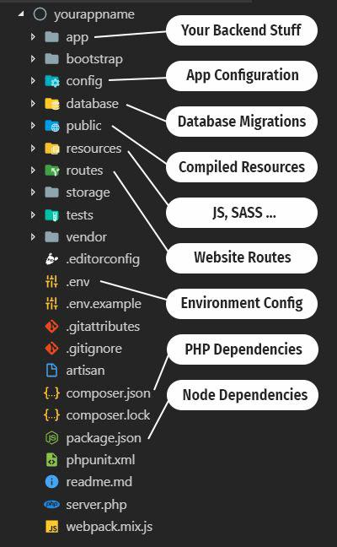
Laravel Folder Structure

Slide 10
Activity 2
1. Where are Node package modules stored in a Node.js project?
2. Which file in Node.js project are storing the dependencies information?
3. Where you can find packages on the web? (package repository)
4. Now compare Laravel vs. Node.js project for package and dependencies. Where are they?
Languages | Package | Dependencies | Package repository
Node.js | ? | ? | ?
Laravel | ? | ? | ?
Notes:
Node: https://www.npmjs.com/
PHP: https://packagist.org/

Slide 11
# Install package
composer require package-name
Example:
composer require laravel/passport
Notes:
Node: https://www.npmjs.com/
PHP: https://packagist.org/

