Slide 1

LARAVEL
Routing
Notes:
le parsing json de la request et de la réponse (du coup ausi j'ai vu, c'est specifique aux POST/PUT)
req.body
accessoirement la gestion des erreur dans le catch

Slide 2

OBJECTIVES FOR TODAY
Route
Define Route
Create route with name
Create route with parameter
Fallback route
Route prefix
API route

Slide 3


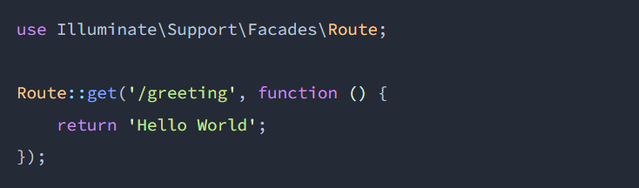
EXPLAIN
# Routing
05 MNI
Routing in Laravel allows you to route all your application requests to its appropriate controller.

Slide 4

PRACTICE
Activity1
10 MIN
INDIV
# Route
1. Create request teachers from URL
2. On browser type: localhost:8000/teachers
3. Result: “Good morning teacher”

Slide 5
EXPLAIN
# Route Parameters
10 MNI
Route::get(‘/request-1/{parameter1}/request-2/{parameter2} …, function($param1, $param2) {
// code …
});
Example
Route::get(‘/students/{id}/age/{age}, function($id, $age) {
return “Student id: “. $id . “and student age: “ . $age;
});

Slide 6
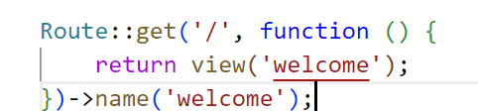
EXPLAIN
# Route Name
10 MNI
This is route with name

Slide 7
EXPLAIN
# Route Name
10 MNI
Route::get('/', function () {
return view('welcome');
})->name('welcome');
Create this route and have file facebook.blade.php
Route::get('/facebook', function () {
return view('facebook');
});
Facebook.blade.php
<h1>Hello facebook</h1>
<a href="{{route(‘welcome')}}">Link to Home Page</a>
I use route name welcome

Slide 8
# Route Parameters
Example 1
Route::get(‘/task/{title}, function($task) {
return “Task title: “. $task;
});
Example 2
Route::get(‘/post/{post}/comment/{comment}, function($postId, $commentId) {
return “Post id: “. $postId . “and comment id: “ . $commentId;
});
Example 3
Route::get(‘/students/{id}/age/{age}/province/{province}, function($id, $age, $province) {
return “Student id: “. $id . “and student age: “ . $age . “ the province is : “ . $province;
});

Slide 9
# Route Parameters
# Optional Parameters
Route::get(‘/request/{param?}, function($param = value) {
…..
});
Example 1
Route::get(‘/task/{title?}, function($task = null) {
return “Task title: “. $task;
});
Example 2
Route::get(‘/task/{title?}, function($task = “Homework”) {
return “Task title: “. $task;
});

Slide 10
PRACTICE
Activity2
10 MIN
INDIV
# Route parameters
1. Create request items name and price from URL
2. On browser type: localhost:8000/items/Book/price/30
3. Result: Item name is: Book and its price is: 30$
# Optional Parameters
1. Create request post title and author (optional) from URL
2. On browser type:
- (1) localhost:8000/Post/phka-Sropon/author/Rady
- (2) localhost:8000/Post/phka-Sropon
3. Result:
(1) Post name is: Phka-Sropon and author is: Rady
(2) Post name is: Phka-Sropon and author is:

Slide 11
# Route Parameters
# Regular Expression Constraints
Route::get(‘/request/{param}, function($param) {
…..
})->where(‘parameter’, ‘expression’);
Example 1
Route::get(‘/task/{title}, function($task) {
return “Task title: “. $task;
})->where(‘title’, ‘[A-Za-z]+’);
Example 2
Route::get(‘/task/{id}, function($id) {
return “Task id: “. $id;
})->where(‘id’, ‘[0-9]+’);

Slide 12
PRACTICE
Activity3
10 MIN
INDIV
# Regular Expression Constraints
1. Create request books name only allow for a-z from URL
2. On browser type: localhost:8000/book/tom-teav
3. Result: book name is: tom-teav
1. Create request books id only allow for 0-9 from URL
2. On browser type: localhost:8000/book/20
3. Result: book id is: 20

Slide 13
EXPLAIN
# Fallback Route
05 MNI
# Fallback Routes
Typically, unhandled requests will automatically render a "404" page via your application's exception handler.
Route::fallback( function() {
…..
});
Example
Route::fallback(function() {
return “404 page not found”;
});

Slide 14
EXPLAIN
# Route Prefixes
05 MNI
The prefix method may be used to prefix each route in the group with a given URI. For example, you may want to prefix all route URIs within the group with admin
Route::prefix( ‘request’)->group(function () {
…..
});
Example
Route::prefix( ‘admin’)->group(function () {
// example: on Browser: localhost:8000/admin/users
Route::get(‘/users’, function () { return “I am user”; });
// example: on Browser: localhost:8000/admin/products
Route::get(‘/products’, function () { return “This is products”; });
});

Slide 15
PRACTICE
Activity 4
10 MIN
INDIV
# Fallback route
1. Create request products name
2. On browser type: localhost:8000/products/tv
3. Result: book name is: tv
4. Try to request with the wrong request. For example, localhost:8000/pro/apple
# Prefix route
1. We have 3 requests and each request start with “students”
Request: - students/age
- students/province
- students/score
3. Use prefix to make the route more clean

Slide 16

EXPLAIN
# Web VS API Routes
05 MNI
localhost:80/candy
localhost:80/api/candy
/routes/web.php
/routes/api.php
Route::get( ‘candy’, function () {
return “<h1>the best candies</h1>”;
});
Route::get( ‘candy’, function () {
return [‘name’ => ‘chocolate’];
});
Web routes usually return HTML views
API routes usually return data

Slide 17
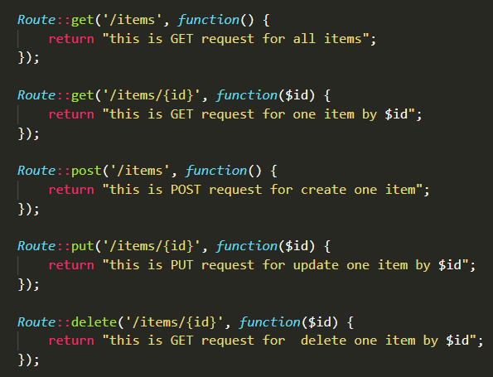
# API Route
Example

Slide 18
PRACTICE
Activity 5
10 MIN
INDIV
# API ROUTE
Request:
- GET: all students
- GET: one student
- POST: create one student
- PUT: update one students
- DELETE: delete on student
2. Use Thunder Client to test all requests.

