Slide 1
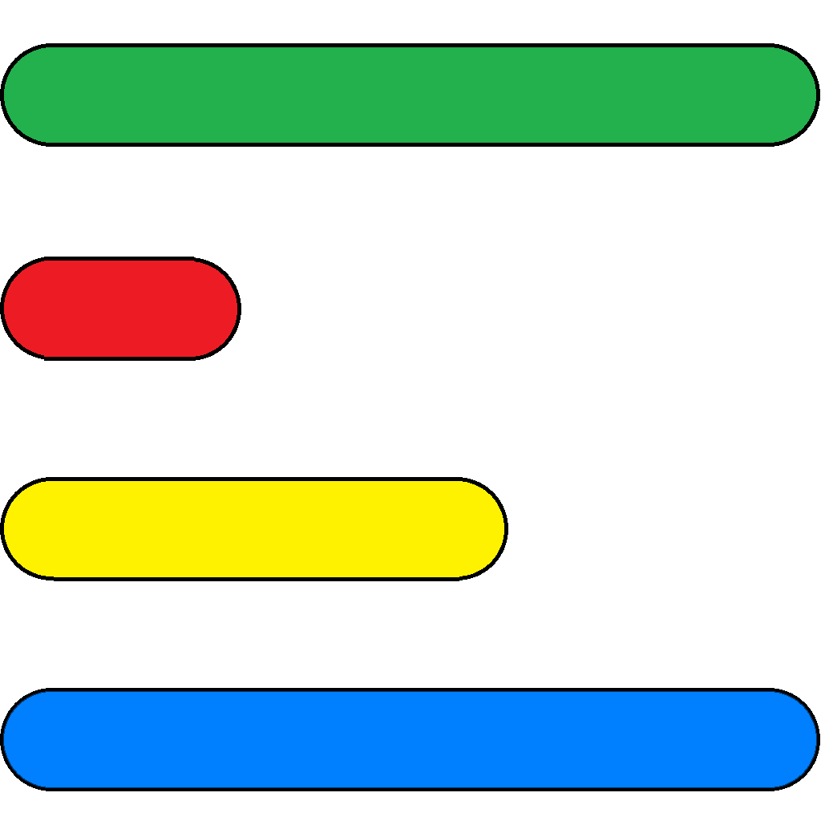
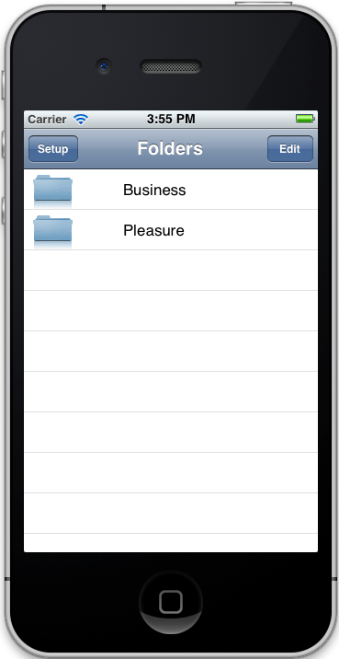
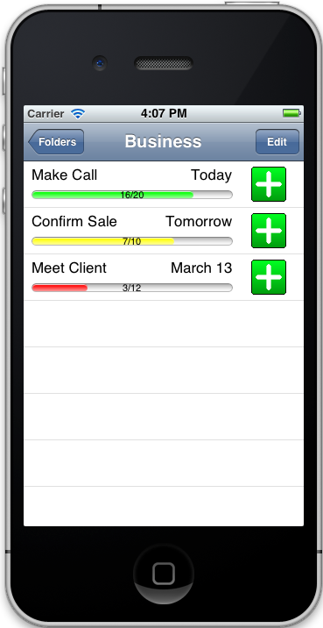
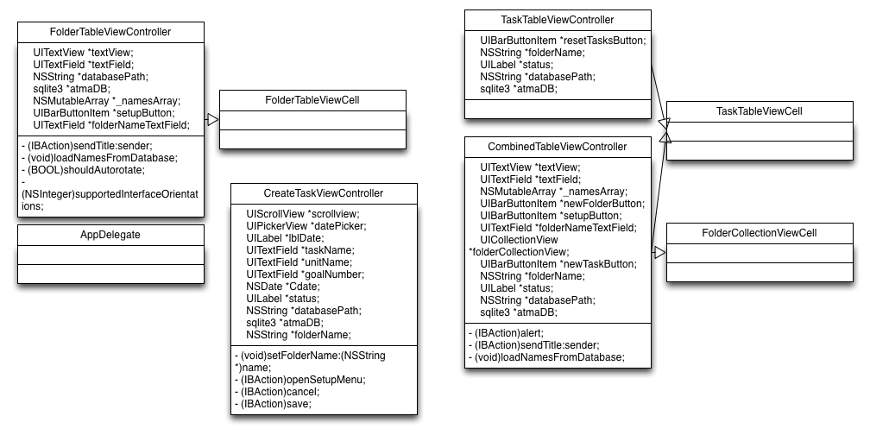
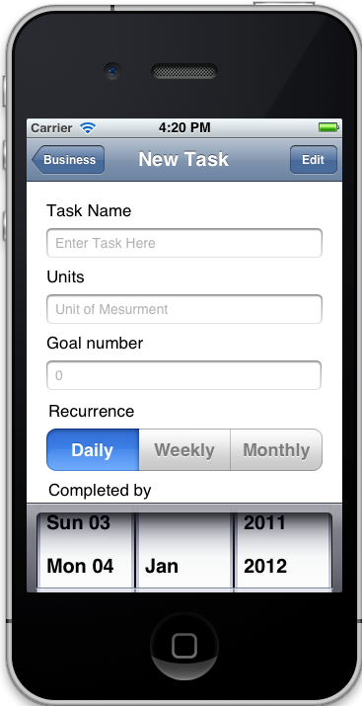
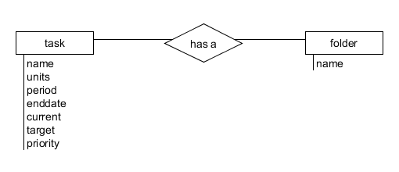
ATMA
Problem Statement
There is a dearth of mobile applications that allow the user to track their progress in discrete, repetitive, recurring tasks, such as a daily requirement of letters sent, meetings attended, or calls made. The program, developed for the iPhone, will aim to meet these requirements. These tasks may have wildly different units (amount of money made vs. meetings attended, for example) or time scales (calls made in a day vs. trips made in a month), and will need to be able to be reset individually. Metrics should be recorded and tracked over time.
This project was inspired by our client’s dissatisfaction with existing mobile applications found on Apple’s application store. Two applications were deemed unsuccessful by the client. With regards to the first application, each goal took up more than one line and had tiny numbers. There was a lack of general control for managing and organizing goals,the look and feel was bland, and the real estate wasn’t used wisely on both the iPhone and iPad.
In the second application, the main problem was the number of touches needed and high difficulty required to changed the number on a task. There was no way display of goal number and progress number in the bar. Just like the first application, there was a lack of control for managing and organizing goals, the look and feel was bland, and it did not have an optimized layout for the iPad.
On the support and documentation side, the team will be responsible for marketing, technical support, and distribution of the application. With this in mind, the layout of the application will need to be coherently organized and must be simple for less technically proficient customers to use. Documentation will also be the team’s responsibility.
Features
Add and remove tasks
Multiple time periods
Period and task reset
Save tasks and information
Multicolor progress bar
Increment tasks with one button click
Organize tasks (manual, time period, etc.)
Different units for tasks
Update arbitrary progress
Task Groups (Create, Delete, Modify)
UML Diagram
ER Diagram (SQLite)

