Slide 1


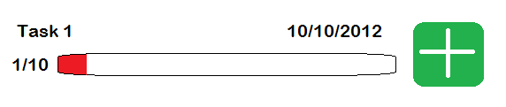
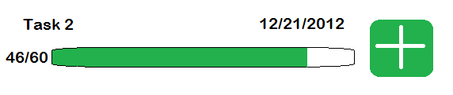
Business

Slide 2
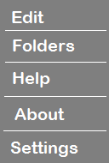
Tasks - Menu Screen
Business

Slide 3
New Task Screen
Business
New Task
Task:
Your new task
Recurrence:
Weekly
Beginning on:
Wed., Nov. 7, 2012
Create Task
Cancel

Slide 4
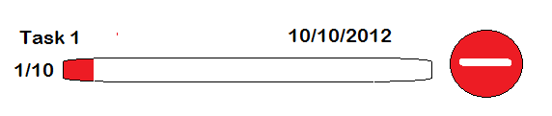
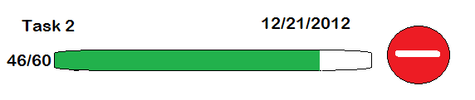
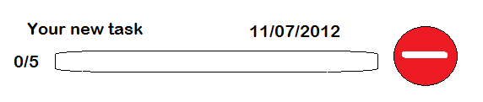
Tasks – Edit Screen
Business
Done

Slide 5

Tasks – New Task Added
Business

Slide 6
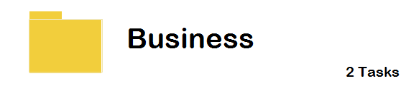
Folder Screen
Folders

Slide 7
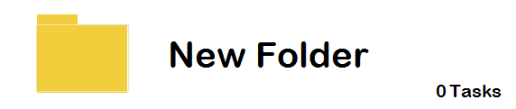
Folders – New Folder
Folders

Slide 8
New Folder Screen
Folders
New Folder
Folder Name:
New Folder
Create Folder
Cancel

