Slide 1
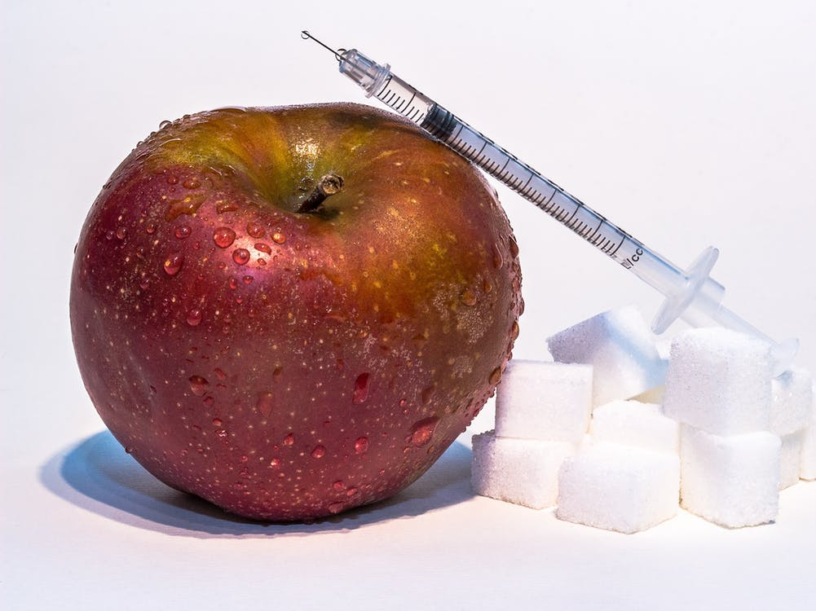
Klassifikasjon av diabetes

Slide 2
Oppgaven
Use different methods to analyze the data. In particular use one method from each of Modules
Classification
Tree-based methods
Support vector machines
Neural Networks

Slide 3
Oppgaven
For each method you
clearly write out the model and model assumptions for the method
explain how any tuning parameters are chosen or model selection is performed
report (any) insight into the interpretation of the fitted model
evaluate the model using the test data, and report misclassification rate (cut-off 0.5 on probability) and plot ROC-curves and give the AUC (for method where class probabilities are given).

Slide 4
Datasettet
8 kovariater
532 målinger
Treningssett:
200 uten diabetes
100 med diabetes
300 totalt
Testsett:
155 uten diabetes
77 med diabetes
232 totalt

Slide 5
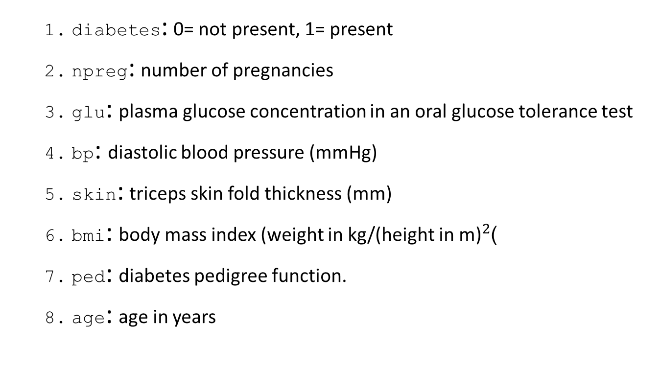
Datasettet
diabetes: 0= not present, 1= present
npreg: number of pregnancies
glu: plasma glucose concentration in an oral glucose tolerance test
bp: diastolic blood pressure (mmHg)
skin: triceps skin fold thickness (mm)
bmi: body mass index (weight in kg/(height in m)$​^{2}$)
ped: diabetes pedigree function.
age: age in years

Slide 6
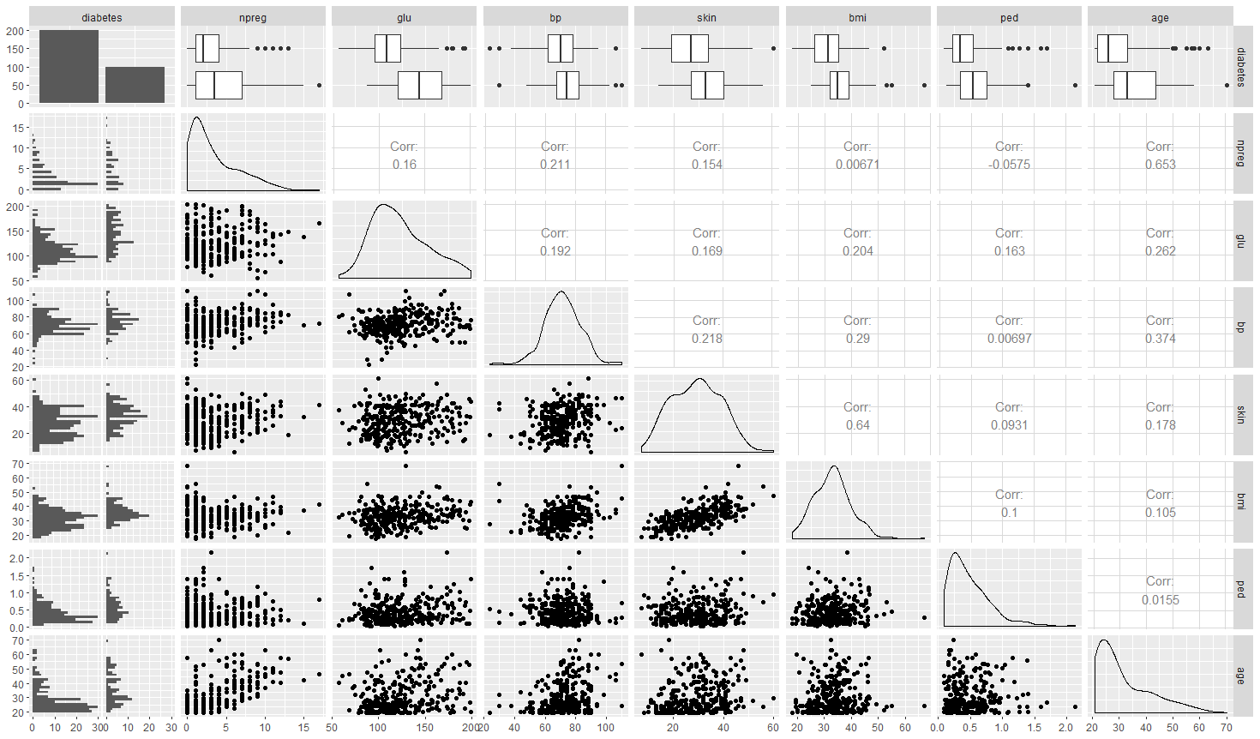

Slide 7
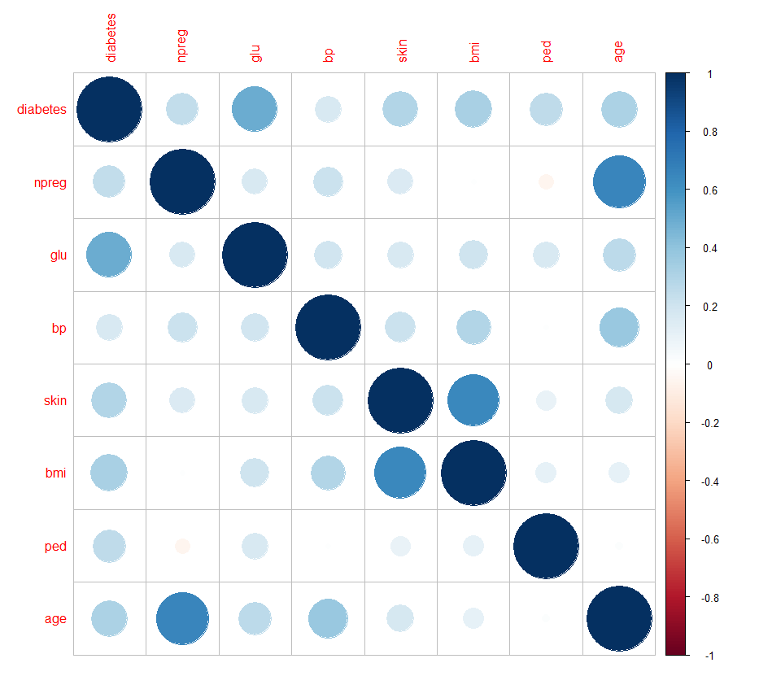

Slide 8
Skalering
Skalerer alle data basert på treningsdata:
mean <- apply(ctrain[,-1], 2, mean) std <- apply(ctrain[,-1], 2, sd) train.x <- data.frame(scale(ctrain[,-1], center = mean, scale = std)) test.x <- data.frame(scale(ctest[,-1], center = mean, scale = std))
Omgjør respons til en faktor i trenings- og testsett: train.y <- as.factor(ctrain[,1]) test.y <- as.factor(ctest[,1]) train.xy <- data.frame(train.x,diabetes=train.y) test.xy <- data.frame(test.x,diabetes=test.y)

Slide 9
K-Nearest-Neighbours
Valgte her bort logistisk regresjon og lineær diskriminant-analyse
Lett måte å gjøre kryssvalidering: train.control <- trainControl(method = "cv", number=5, classProbs=TRUE, summaryFunction = twoClassSummary)
Konsekvens 1:
knn.train.y <- factor(knn.train.y, labels=c("O","I")) knn.test.y <- factor(knn.test.y, labels=c("O", "I")) knn.train.xy <- data.frame(train.x,diabetes=knn.train.y) knn.test.xy <- data.frame

Slide 10
K-Nearest-Neighbours
Konsekvens 2:
knn.mod <- train(diabetes ~ ., data=knn.train.xy, "knn", trControl = train.control,tuneLength=50)
## Warning in train.default(x, y, weights = w, ...): ## The metric "Accuracy" was not in the result set. ## ROC will be used instead.
## k ROC Sens Spec ## 5 0.769000 0.845 0.53
## 21 0.836125 0.920 0.47 ## 69 0.842500 0.975 0.34 ## The final value used for the model was k = 69.

Slide 11
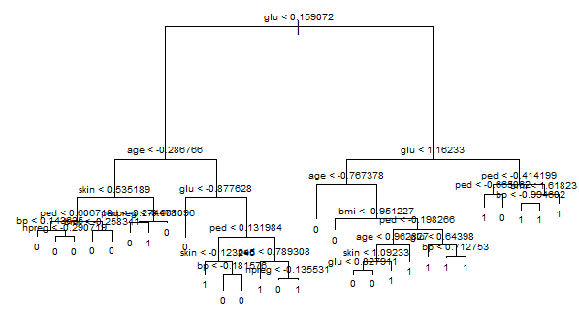
Klassifikasjonstre
tree.mod <- tree(diabetes ~ ., train.xy, split="gini") plot(tree.mod) text(tree.mod, pretty=1, cex=.6)

Slide 12
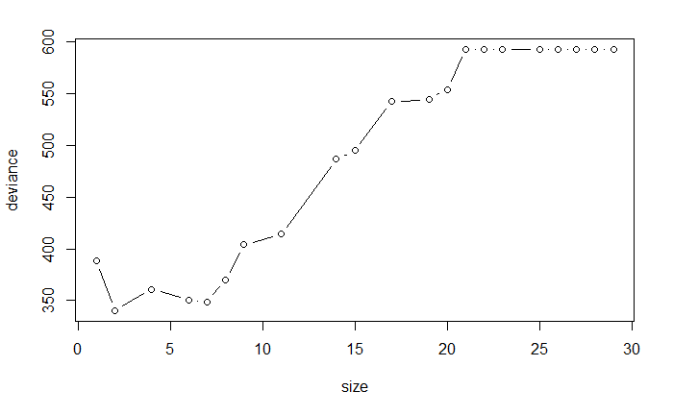
Klassifikasjonstre
Cross-validation for å finne optimalt antall grener i treet:
cv.fit=cv.tree(tree.mod) plot(cv.fit$size,cv.fit$dev,type='b')

Slide 13
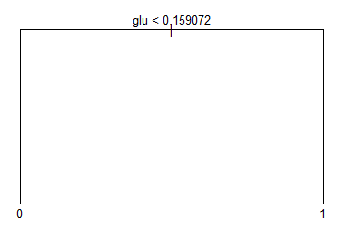
Klassifikasjonstre
best=cv.fit$size[which.min(cv.fit$dev)] pruned.mod <- prune.tree(tree.mod, best = best) plot(pruned.mod) text(pruned.mod, pretty = 1, cex=0.8)
Burde brukt bagging og random forest
for å redusere varians i modellen

Slide 14
Neuralt nett
Smartere bruk av Cross-validation:
num.nodes <- c(5,10,15,20,25,30,50)
num.nodes <- c(0:10,15,20,25,30,50) k <- 5 indices <- sample(1:nrow(train.data)) folds <- cut(indices, breaks = k, labels=FALSE) mismat <- matrix(NA, ncol=k, nrow=length(num.nodes)) for (j in 1:k){ thistrain <- (1:dim(train.data)[1])[folds != j] thisvalid <- (1:dim(train.data)[1])[folds == j] mean <- apply(train.data[thistrain, ], 2, mean) std <- apply(train.data[thistrain, ], 2, sd) new = scale(train.data, center=mean, scale=std) for (i in 1:length(num.nodes)) { thissize = num.nodes[i] fit = nnet(formula=train.target ~ npreg+glu+bp+skin+bmi+ped+age, data=new, size=thissize, maxit=100, skip=TRUE) pred = predict(fit, newdata=new[thisvalid, ], type="class") misclass = table(pred, new[thisvalid, 1]) miss_rate = sum(diag(misclass))/sum(misclass) mismat[i,j] = miss_rate } }
average.misclass <- apply(mismat, 1, sum)/k

Slide 15
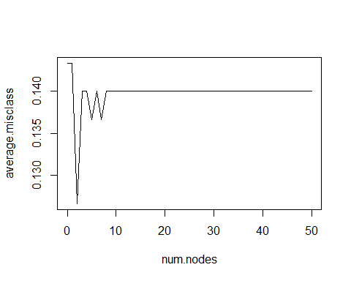
Neuralt nett
Likevel:
Problem: Lokale minima og overfitting

Slide 16
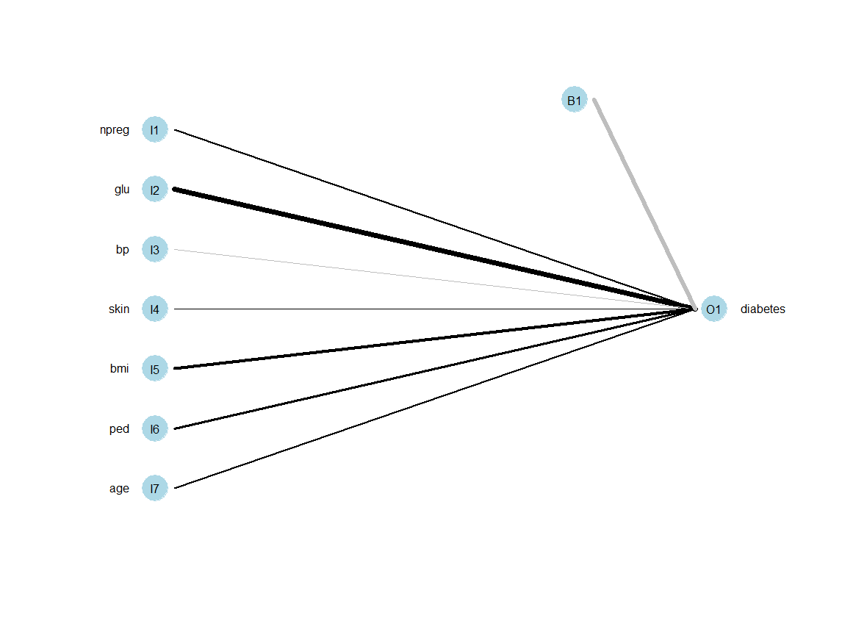
Neuralt nett
Ingen skjulte lag (=logistisk regresjon) ga best resultat

Slide 17
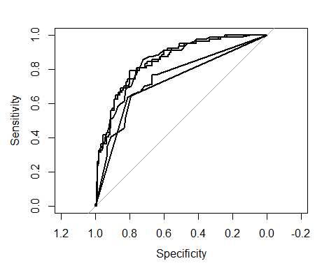
Sammenligning av modeller

Slide 18
Konklusjon
## Misclassification rate AUC ## K-Nearest-Neighbours 0.2413793 0.8467114 ## Linear discriminant analysis 0.2112069 0.8490155 ## Logistic regression 0.2025862 0.8450775 ## Classification tree 0.2715517 0.7475073 ## Pruned tree 0.2456897 0.7246334 ## Support vector classifier 0.2241379 NA ## Support vector machine 0.2241379 NA ## Neural network 0.2025862 0.8450775

