Slide 1
Diabetes classification

Slide 2
Oppgaven
Use different methods to analyse the data. In particular use one method from each of Modules 4 (Classification), 8 (Tree-based methods), 9 (Support vector machines) and 11 (Neural Networks). For each method you
clearly write out the model and model assumptions for the method
explain how any tuning parameters are chosen or model selection is performed
report (any) insight into the interpretation of the fitted model
evaluate the model using the test data, and report misclassifiation rate (cut-off 0.5 on probability) and plot ROC-curves and give the AUC (for method where class probabilities are given).

Slide 3
Dagens fokus
Hva ble gjort?
Hvordan burde det vært gjort?

Slide 4
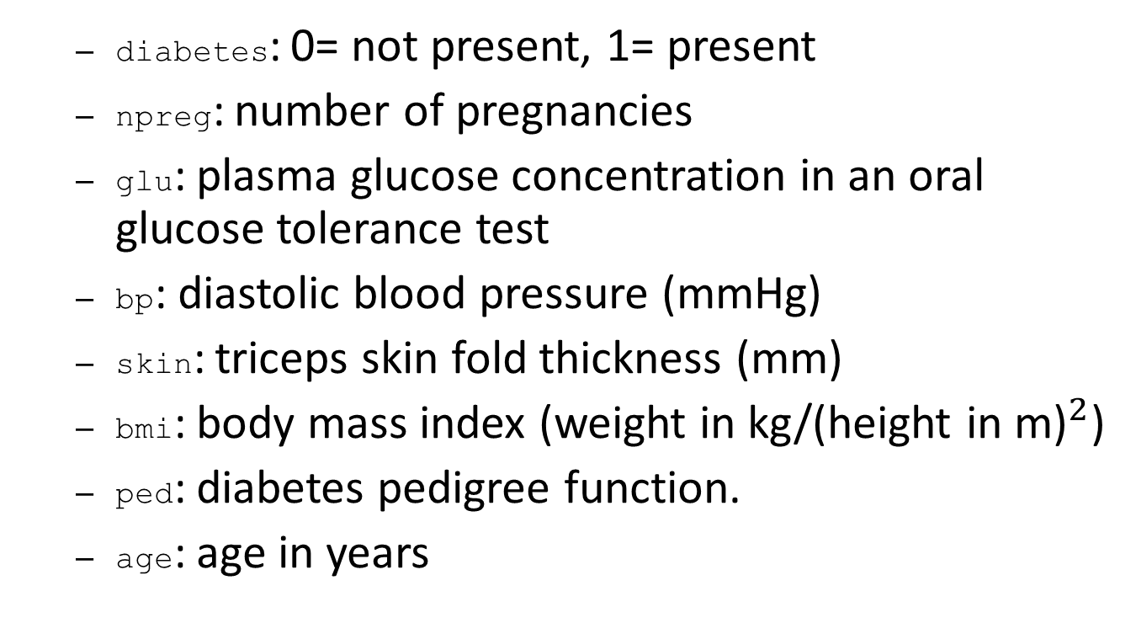
Generelt om datasettet
diabetes: 0= not present, 1= present
npreg: number of pregnancies
glu: plasma glucose concentration in an oral glucose tolerance test
bp: diastolic blood pressure (mmHg)
skin: triceps skin fold thickness (mm)
bmi: body mass index (weight in kg/(height in m)$​^{2}$)
ped: diabetes pedigree function.
age: age in years

Slide 5
summary(ctrain)
## diabetes npreg glu bp ## Min. :0.0000 Min. : 0.000 Min. : 57.0 Min. : 24.00 ## 1st Qu.:0.0000 1st Qu.: 1.000 1st Qu.:100.0 1st Qu.: 64.00 ## Median :0.0000 Median : 2.000 Median :117.0 Median : 70.00 ## Mean :0.3333 Mean : 3.437 Mean :122.7 Mean : 71.23 ## 3rd Qu.:1.0000 3rd Qu.: 5.000 3rd Qu.:143.0 3rd Qu.: 78.00 ## Max. :1.0000 Max. :17.000 Max. :199.0 Max. :110.00 ## skin bmi ped age ## Min. : 7.00 Min. :18.20 Min. :0.0850 Min. :21.00 ## 1st Qu.:21.00 1st Qu.:27.88 1st Qu.:0.2532 1st Qu.:23.00 ## Median :29.00 Median :32.90 Median :0.4075 Median :28.00 ## Mean :29.22 Mean :33.09 Mean :0.4789 Mean :31.48 ## 3rd Qu.:37.00 3rd Qu.:37.12 3rd Qu.:0.6525 3rd Qu.:37.25 ## Max. :60.00 Max. :67.10 Max. :2.1370 Max. :70.00

Slide 6
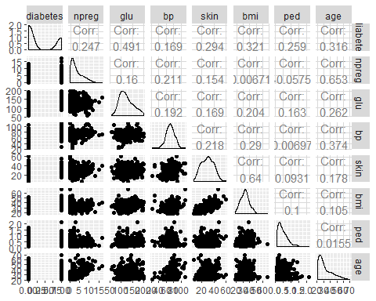

Slide 7
## Skalering
#Pæ¼ã¸µ forhæ¼ã¸µnd delt inn i treningssett og testsett mean <- apply(ctrain[,-1], 2, mean) std <- apply(ctrain[,-1], 2, sd) train.x <- data.frame(scale(ctrain[,-1], center = mean, scale = std)) test.x <- data.frame(scale(ctest[,-1], center = mean, scale = std)) train.y <- as.factor(ctrain[,1]) test.y <- as.factor(ctest[,1]) train.xy <- data.frame(train.x,diabetes=train.y) test.xy <- data.frame(test.x,diabetes=test.y)

Slide 8
K-Nearest-Neighbours
“Cross-validation er vanskelig. La oss google etter en enklere løsning.”
knn.train.y <- factor(knn.train.y,labels=c("O","I"))
knn.test.y <-
factor(knn.test.y, labels=c("O", "I"))

Slide 9
K-Nearest-Neighbours
knn.train.xy <- data.frame(train.x,diabetes=knn.train.y) knn.test.xy <- data.frame(test.x,diabetes=knn.test.y) #K nearest neighbours classification: set.seed(0) #Easy way to choose good K train.control <- trainControl(method = "cv", number=5, classProbs=TRUE, summaryFunction = twoClassSummary) #train knn model knn.mod <- train(diabetes ~ ., data=knn.train.xy, "knn", trControl = train.control,tuneLength=50)
## Warning in train.default(x, y, weights = w, ...): The metric "Accuracy" was ## not in the result set. ROC will be used instead.
print(knn.mod)
## k-Nearest Neighbors ## ## 300 samples ## 7 predictor ## 2 classes: 'O', 'I' ## ## No pre-processing ## Resampling: Cross-Validated (5 fold) ## Summary of sample sizes: 240, 240, 240, 240, 240 ## Resampling results across tuning parameters: ## ## k ROC Sens Spec ## 5 0.777000 0.830 0.52 ## 7 0.798000 0.845 0.45 ## 9 0.804375 0.850 0.48 ## 11 0.809500 0.855 0.47 ## 13 0.823625 0.865 0.44 ## 15 0.829750 0.880 0.45 ## 17 0.829250 0.890 0.44 ## 19 0.835750 0.910 0.46 ## 21 0.836125 0.920 0.47 ## 23 0.834875 0.910 0.46 ## 25 0.836000 0.925 0.47 ## 27 0.835875 0.925 0.43 ## 29 0.835250 0.940 0.46 ## 37 0.830250 0.950 0.39 ## 39 0.834125 0.950 0.41 ## 41 0.834375 0.955 0.38 ## 43 0.838375 0.950 0.36 ## 45 0.837000 0.940 0.36 ## 47 0.841125 0.950 0.37 ## 49 0.840625 0.960 0.35 ## 51 0.842000 0.965 0.36 ## 53 0.836750 0.965 0.36 ## 55 0.836750 0.960 0.38 ## 57 0.840500 0.970 0.39 ## 59 0.839625 0.970 0.34 ## 61 0.841000 0.960 0.34 ## 63 0.839625 0.965 0.36 ## 65 0.838875 0.970 0.35 ## 67 0.840875 0.970 0.32 ## 69 0.842500 0.975 0.34 ## 71 0.840750 0.965 0.33 ## 73 0.840875 0.965 0.34 ## 75 0.839375 0.965 0.30 ## 77 0.838375 0.965 0.29 ## 79 0.838500 0.970 0.32 ## 81 0.837250 0.965 0.31 ## 83 0.837750 0.965 0.31 ## 85 0.834250 0.965 0.30 ## 87 0.836000 0.970 0.30 ## 89 0.834625 0.975 0.28 ## 91 0.835875 0.980 0.28 ## 93 0.836625 0.980 0.27 ## 95 0.835125 0.980 0.24 ## 97 0.836750 0.985 0.24 ## 99 0.834750 0.990 0.24 ## 101 0.838375 0.985 0.24 ## 103 0.838500 0.985 0.23 ## ## ROC was used to select the optimal model using the largest value. ## The final value used for the model was k = 69.
#test with test data knn.res <- predict(knn.mod,newdata=test.x) knn.prob <- predict(knn.mod,newdata=test.x, type="prob") knn.conf <- confusionMatrix(knn.res,knn.test.y)$table knn.missrate <- 1 - sum(diag(knn.conf))/sum(knn.conf) #plot ROC knn.roc <- roc(knn.test.y, knn.prob[,2])
## Setting levels: control = O, case = I
## Setting direction: controls < cases
ggroc(knn.roc)+ggtitle("ROC curve - K-Nearest-Neighbours") + annotate("text", x = 0.25, y = 0.3, label = paste("AUC = ", as.character(round(auc(knn.roc), 4))))

Slide 10
