Slide 1
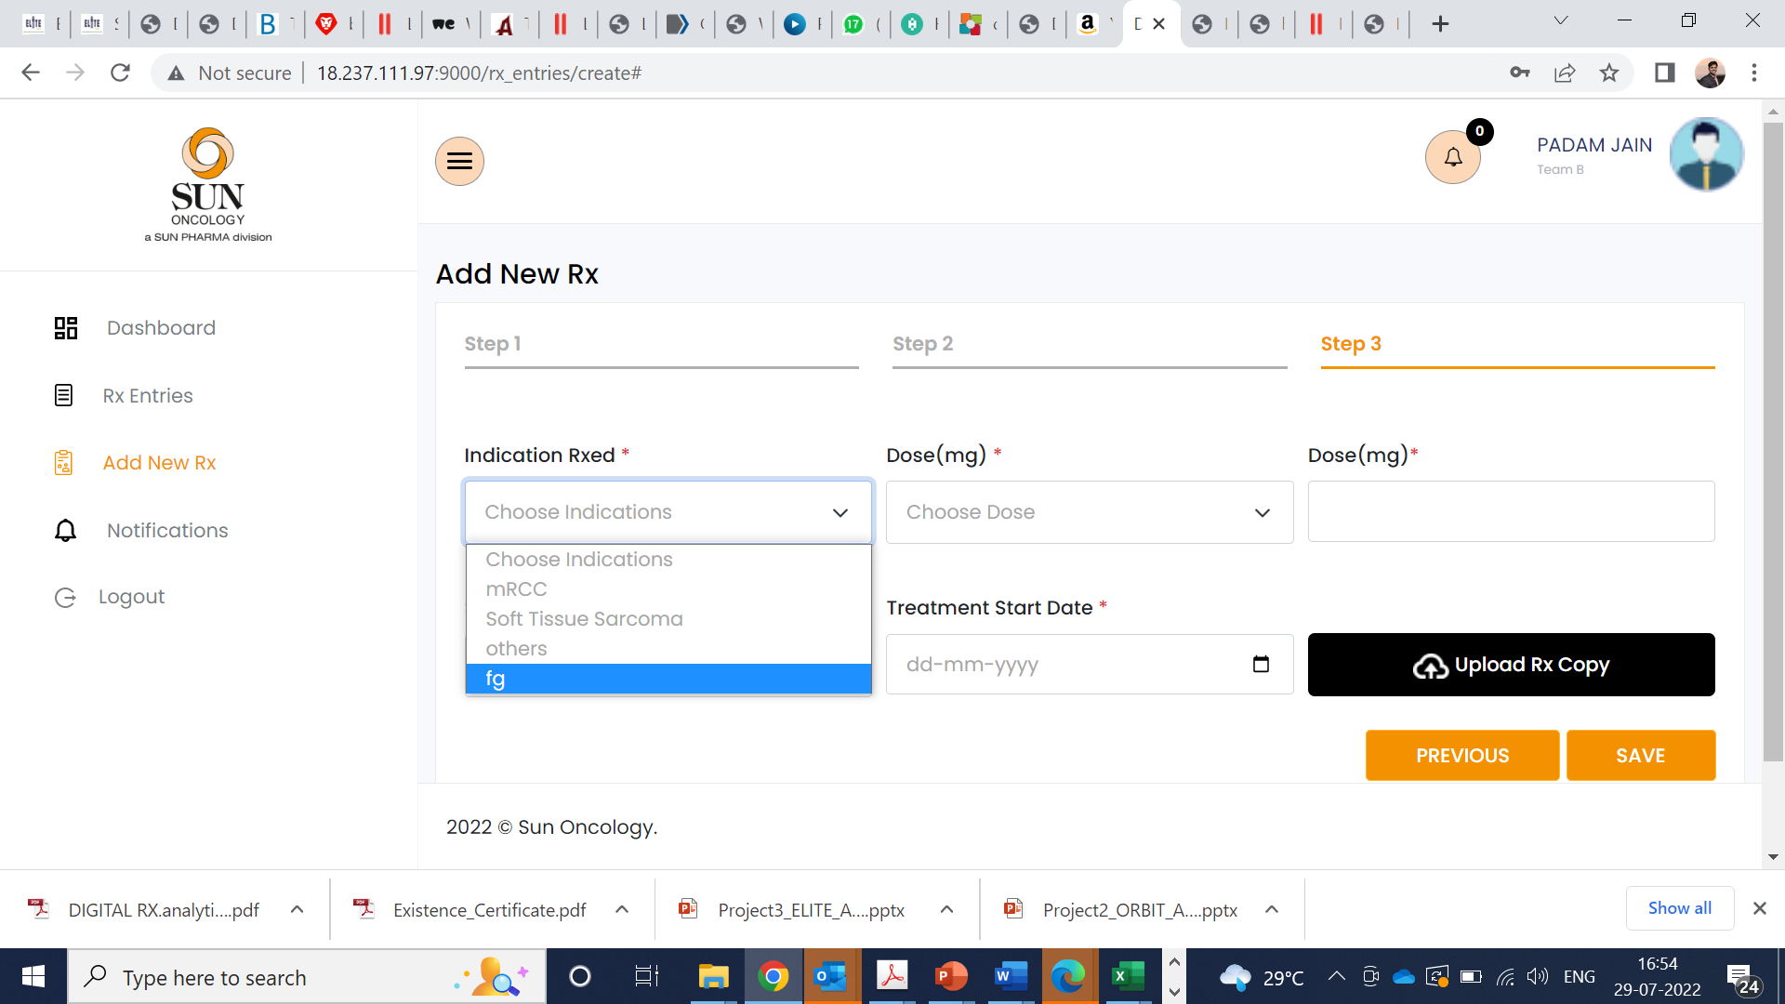
Common changes in the analytics
Rx upload non-mandatory. Please remove the “*”
Team A and Team B- under indication- Random letters are coming – like a,aa,b..check below one example

Slide 2
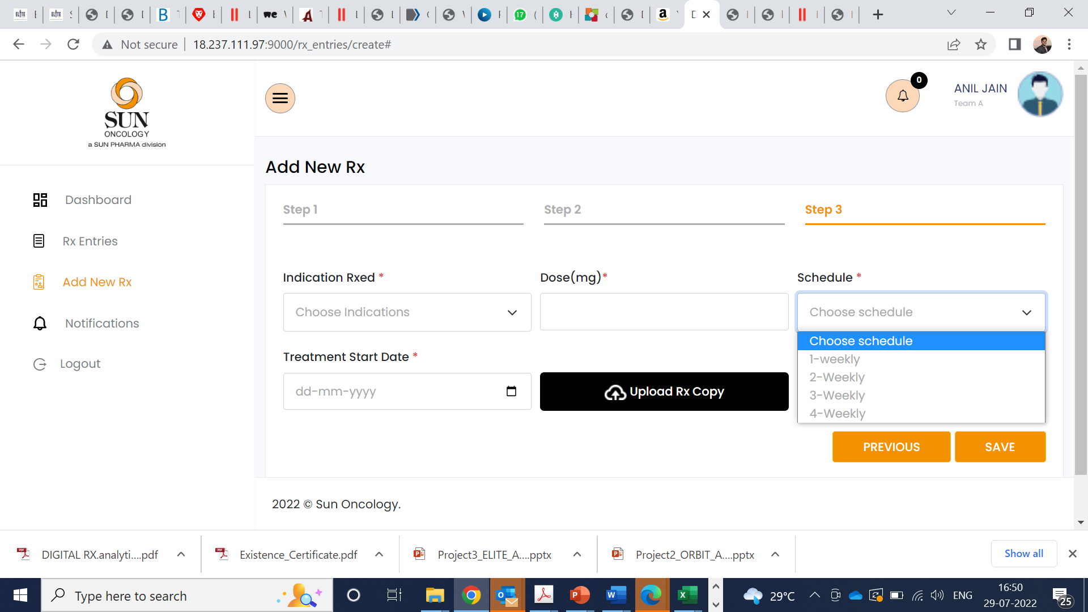
Team A> Lipodex> keep only 4-weekly, delete rest
4 weekly only

Slide 3
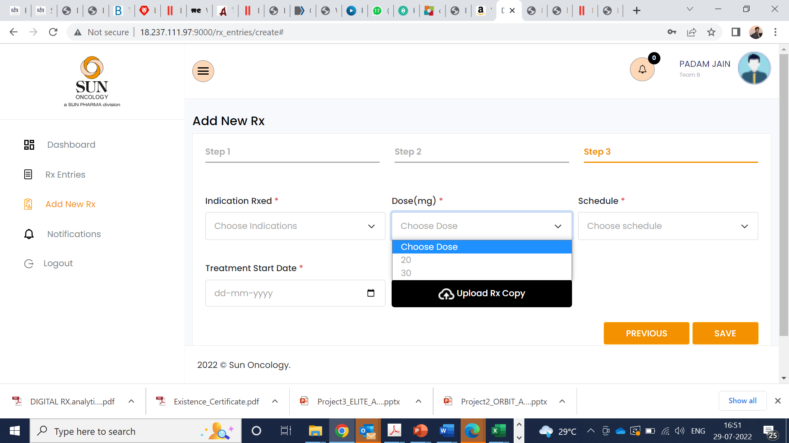
Keep empty

Slide 4
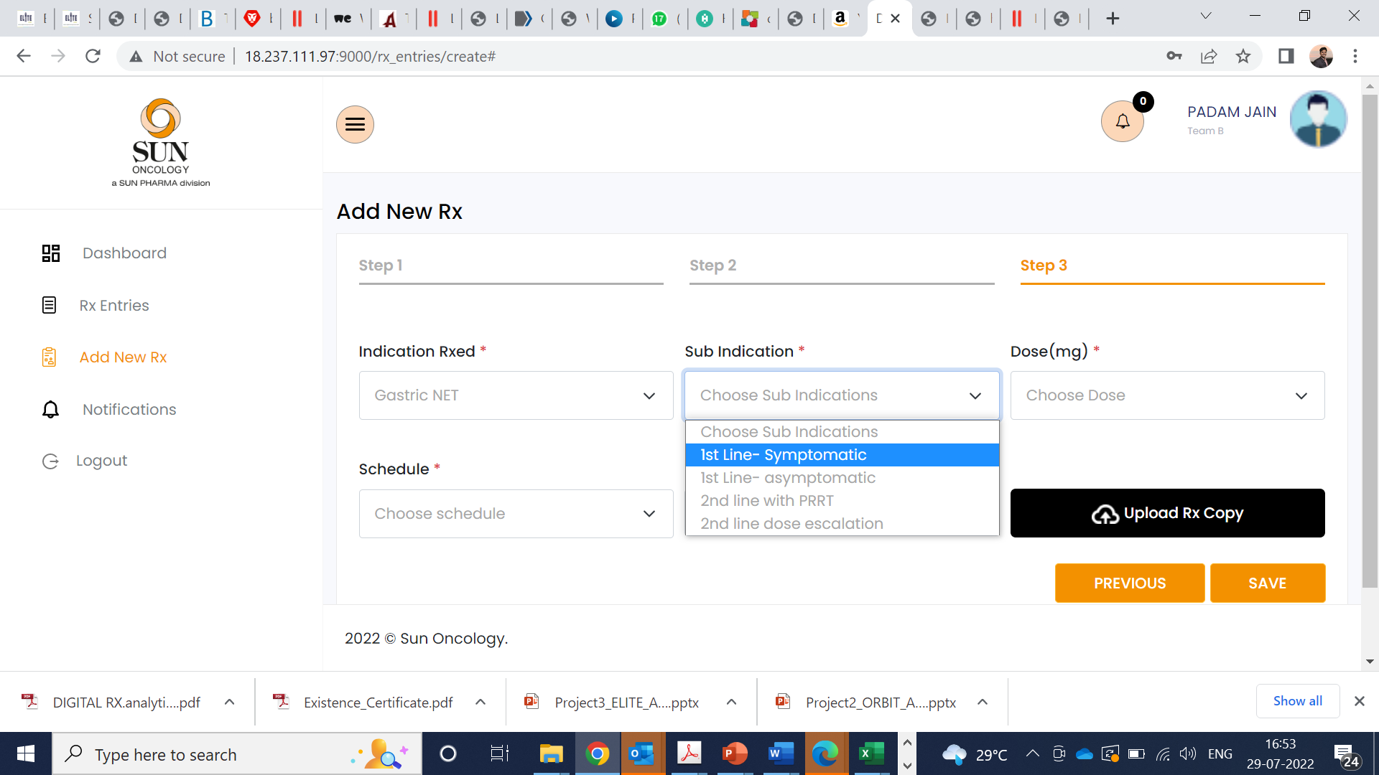
Include additional sub indication
2nd Line Octreotide + Everolimus

Slide 5
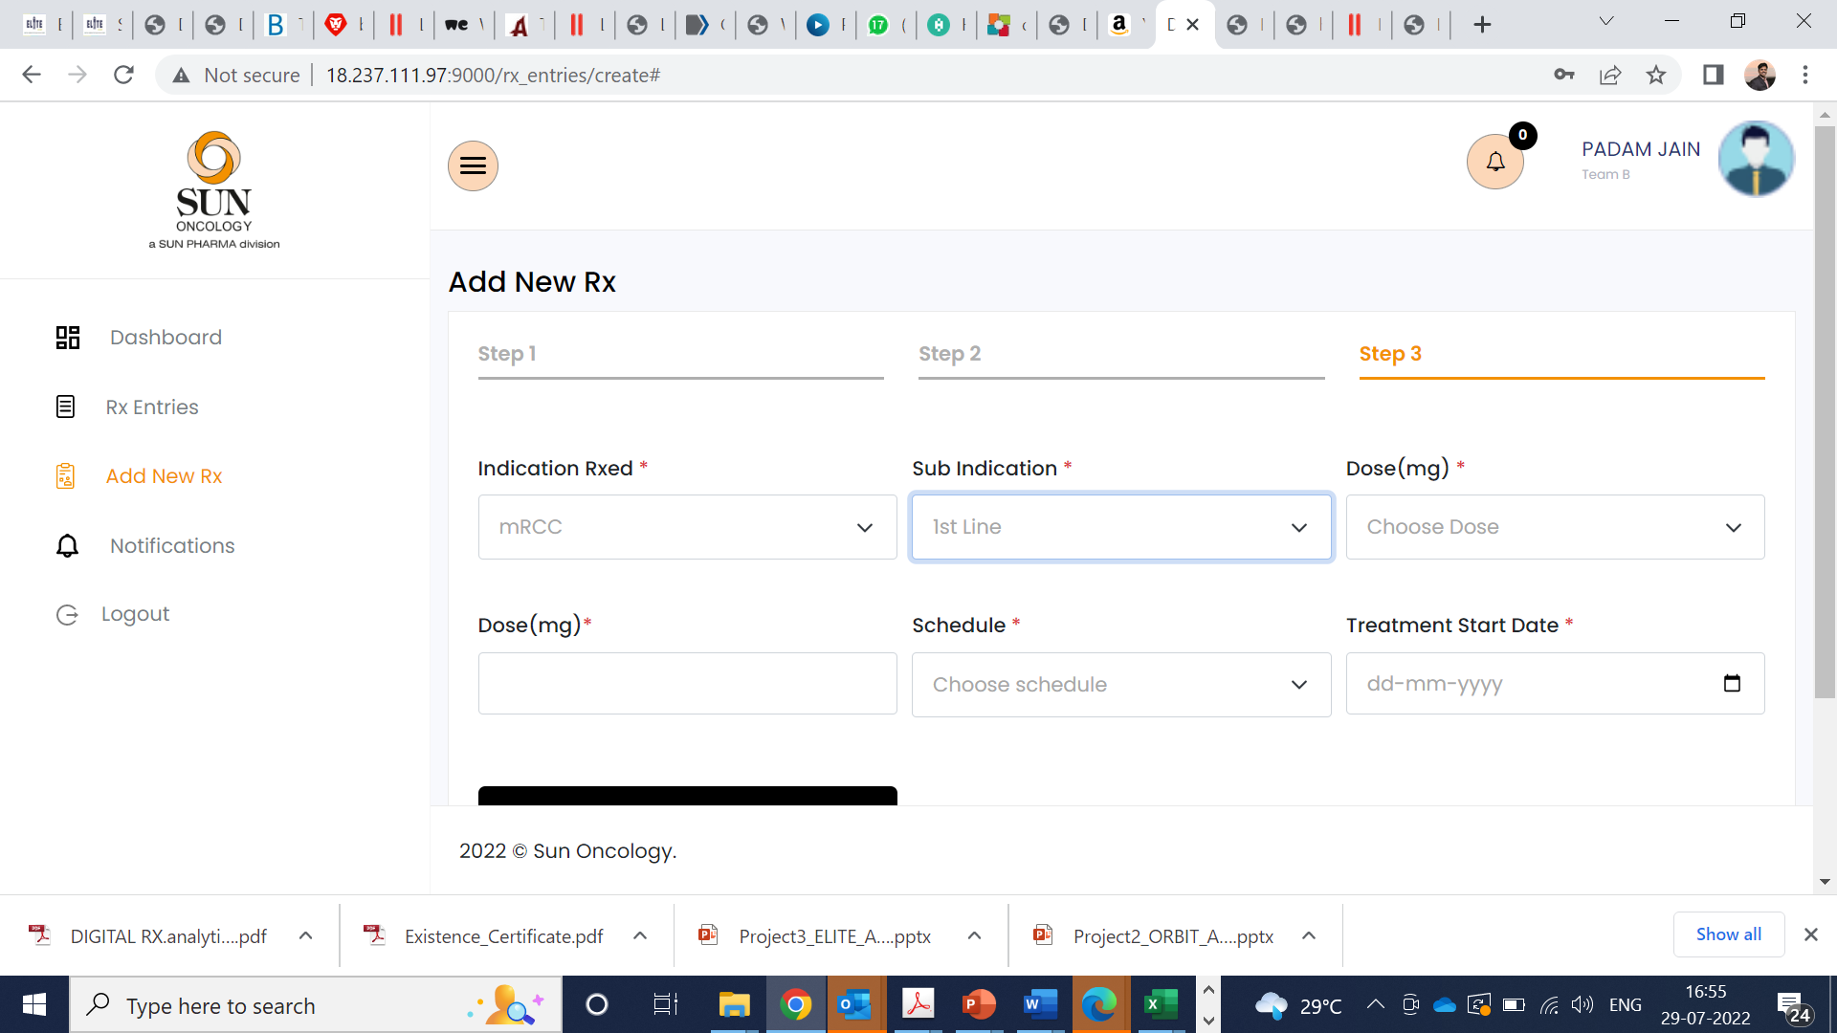
Team B> Pazolit
Delete the dose with mg it is duplicated check all

Slide 6
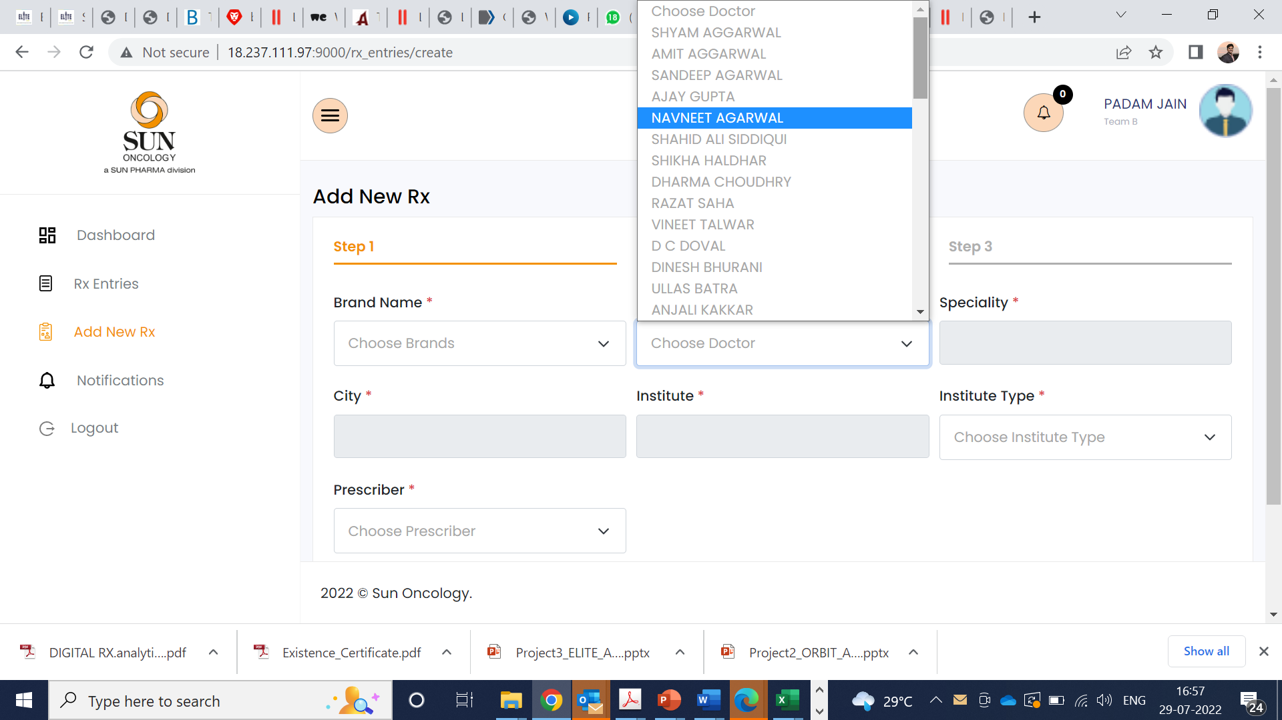
1. Add new doctor option is missing- Across all
2. The doctor list needs to come alphabetically

Slide 7
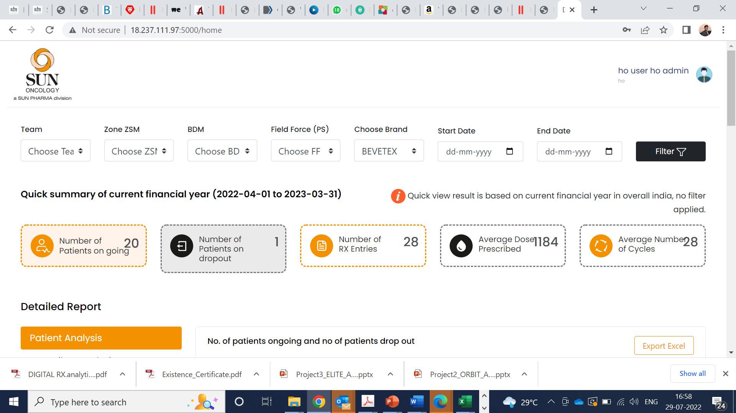
All India data missing (overall) for HO only. This should display by default
Separate login needed for Zone ZSM, BDM and PS level.
Select Brand
Select start data end data.

Slide 8
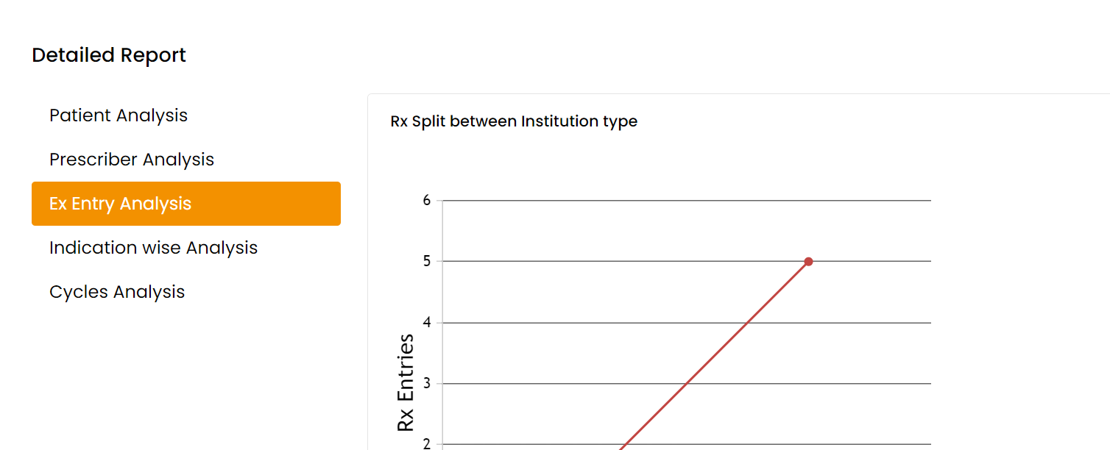
Rx Entry Analysis

