Slide 1
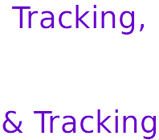


Slide 2


Slide 3
Three years ago, tried to explain tracking responsibility for webmasters and data managers...

Slide 4
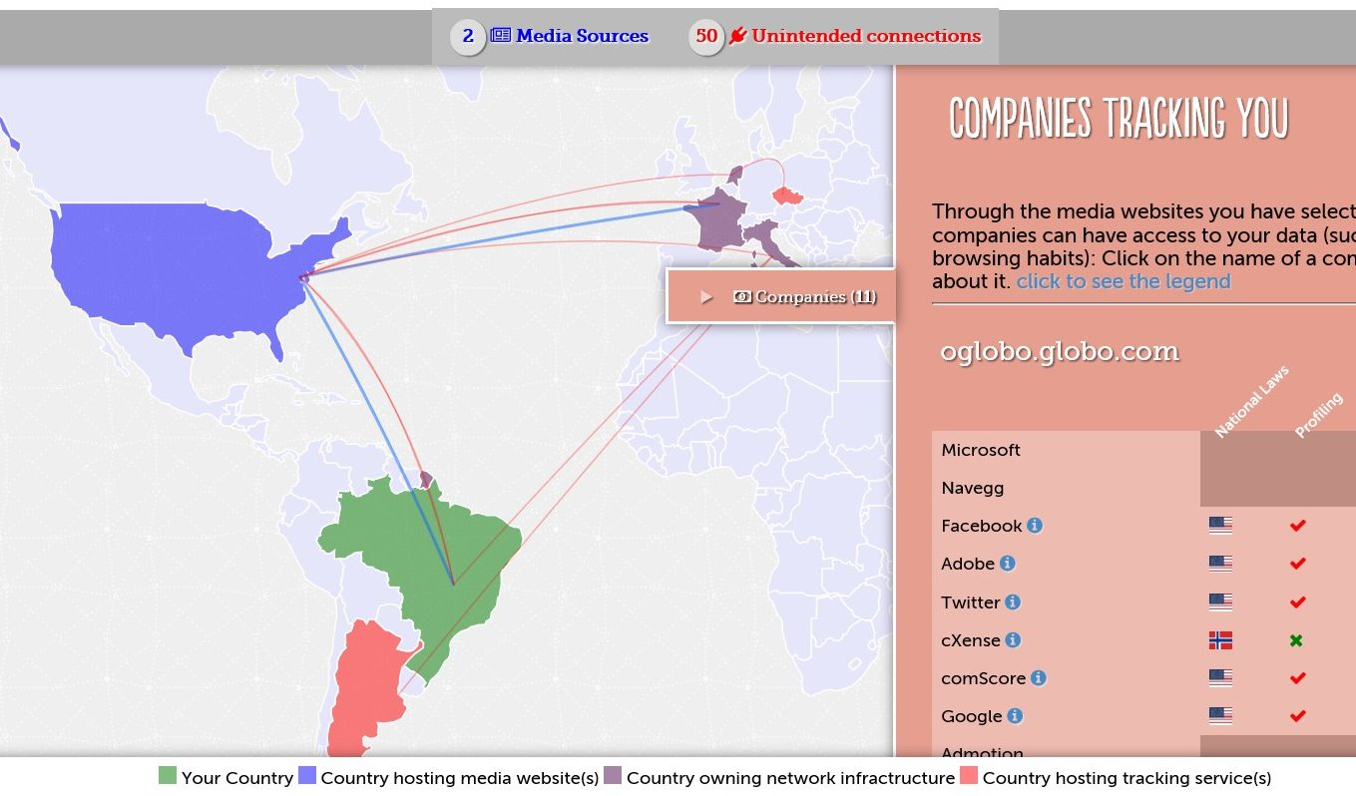
Three years ago, tried to explain tracking responsibility for webmasters and data managers...

Slide 5
Didn’t get the hoped results

Slide 6
Now we are experimenting changes in the approach and narrative...

Slide 7
Theory
Website who carelessly include third party trackers are exposing their users to data mining and the unforeseeable consequences
We hope to see website accountable, if not even shamed?
This is “Corporate responsibility”
To be fair, we apply the experiment only to business units which
do not depend on digital advertising

Slide 8
[ experiments in progress ]
Analyze the top 25 websites in a nation, it is intended to show how much the phenomena it is spread.
https://italian.tracking.exposed
Explain how third party trackers can be used to do registries of persons based on their religious belief, without even doing a registry
https://american.muslims.tracking.exposed

Slide 9


Slide 10


Slide 11

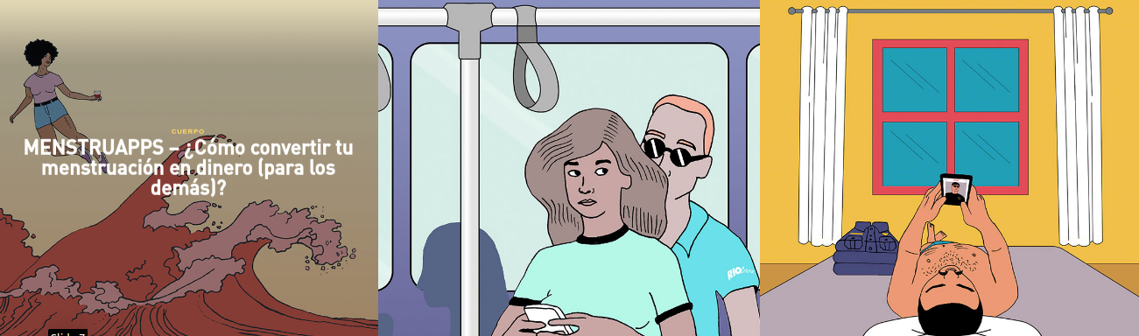

Slide 12
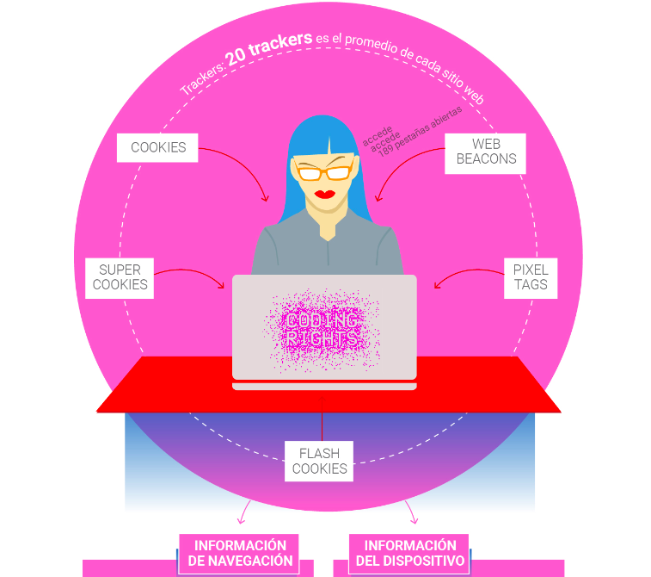


Slide 13
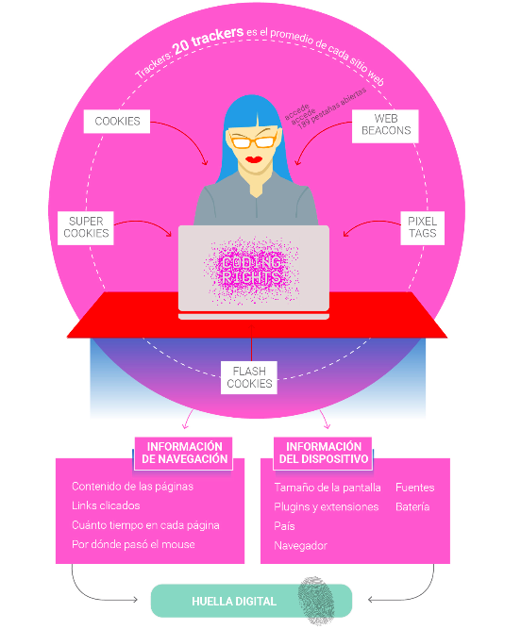


Slide 14
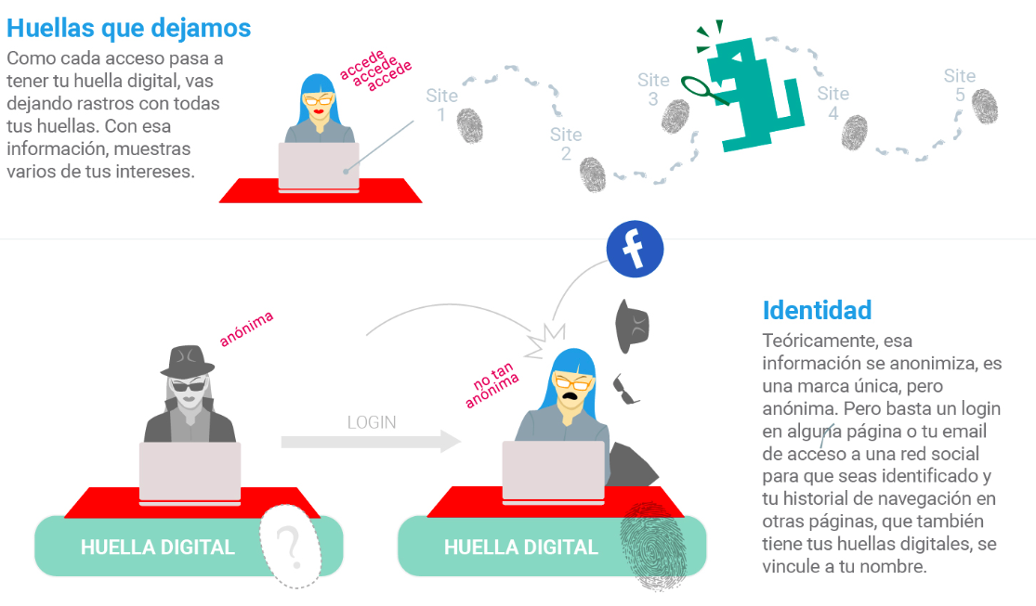

Slide 15
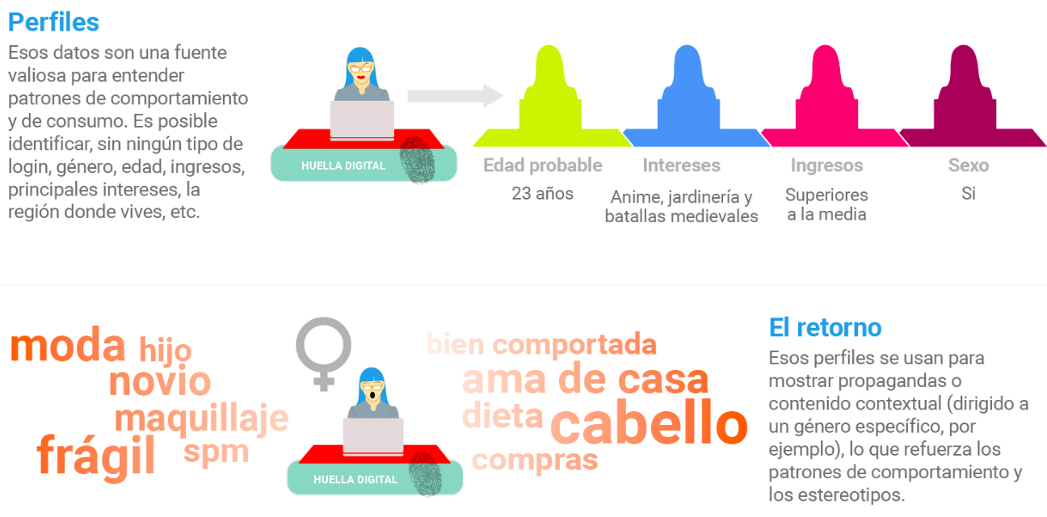

Slide 16


Slide 17


Slide 18
Tracking Medical Clinics and Health Test Labs

Slide 19
Preliminary results

Slide 20
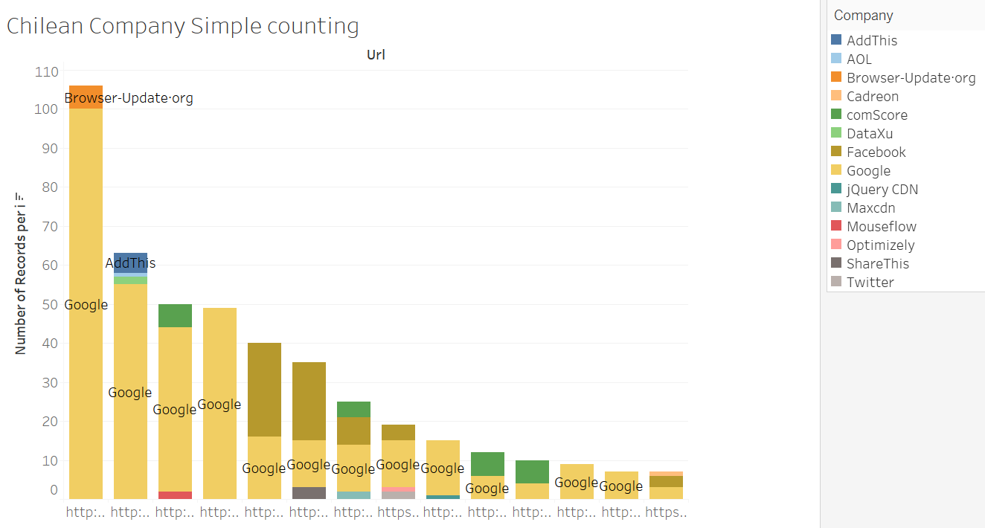

Slide 21
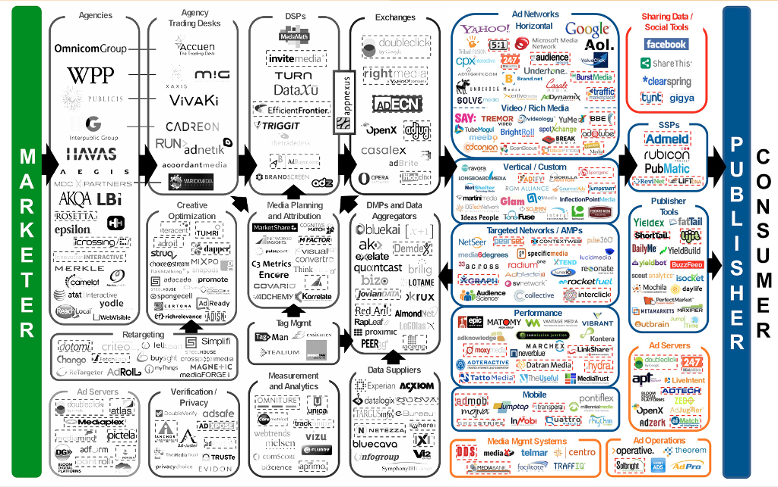

Slide 22
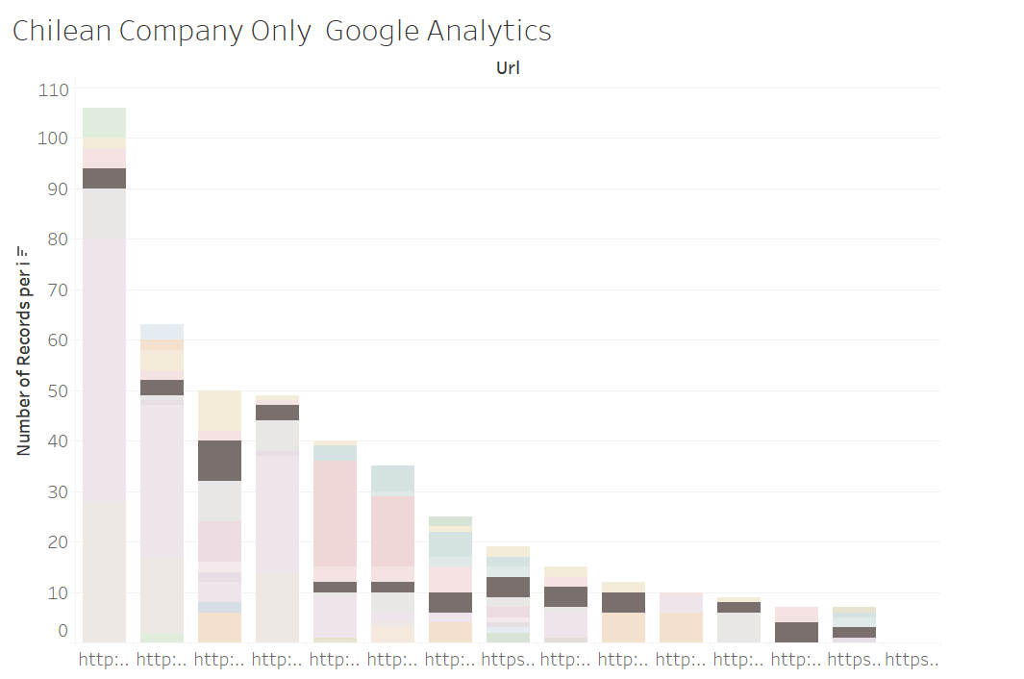

Slide 23
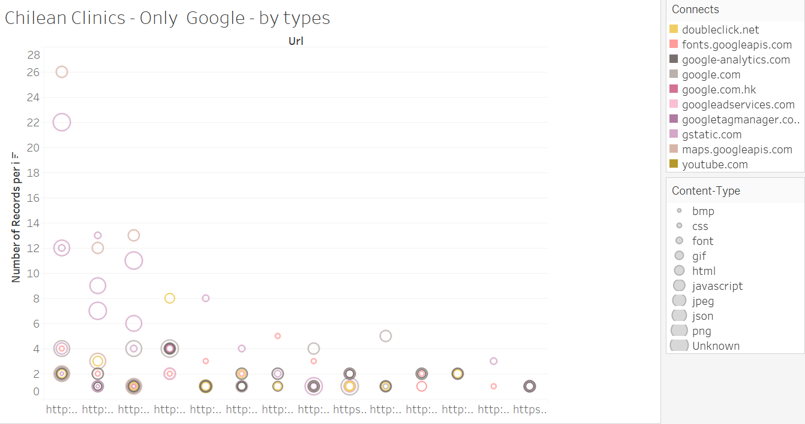

Slide 24
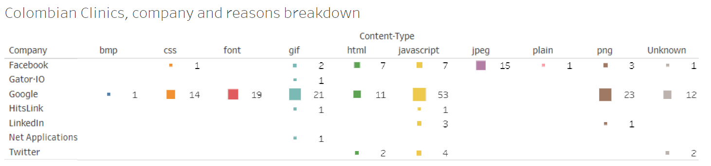

Slide 25
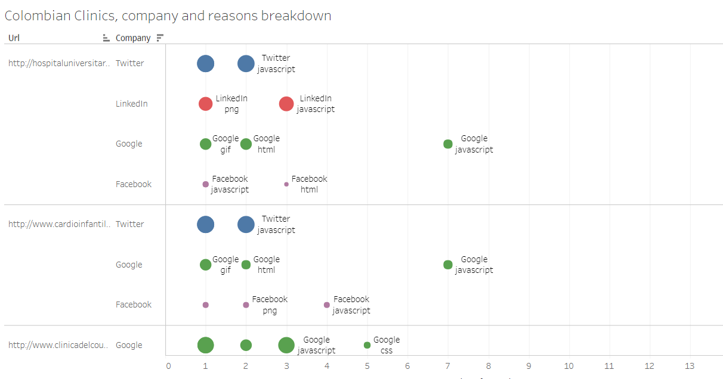

Slide 26
[ preliminary results from Latam ]
Mexico
https://public.tableau.com/profile/claudio.of.tracking.exposed#!/vizhome/MexicanClinicsconnections/SiteRanksandFrequency
Chile
https://public.tableau.com/profile/claudio.of.tracking.exposed#!/vizhome/ChileClinicsconnections_0/ChileanClinicsandreasonsbreakdown
Brazil
https://public.tableau.com/profile/claudio.of.tracking.exposed#!/vizhome/BrasilianClinicsconnections/SiteRanksandFrequency
Colombia
https://public.tableau.com/profile/claudio.of.tracking.exposed#!/vizhome/ColombianClinicsconnections/SiteRanksandFrequency

Slide 27
[ take at home points ]
Web tracking technologies can be used to enforce discrimination policies (social, political, market)
Our analysis is open source and so the website content, we look for persons belonging to the appropriate community in taking interest on this.
We cannot take down the web tracking ecosystem, but we can reduce its impact by assessing individual responsibility (this why all the analysis are open data, to incentive data-reuse and deeper investigations)

Slide 28
[ thanks! and contacts]
Claudio Agosti
@_vecna
@joana_varon
@CodingRights

