Slide 1

Activity-Aware Smart Insole for Early Diabetic Foot Ulcer Risk Prediction using Machine Learning and Explainable AI
Batch Members:
Vedesh N : 727723eucs268
Sri Nikitha Savula S : 727723eucs240
Sri Vaishnavi R : 727723eucs241
Batch No: 5
Supervisor: Ms S.Vidhiya
Date:

Slide 2
ABSTRACT
Diabetic Foot Ulcer (DFU) is a serious complication of diabetes caused by peripheral neuropathy, poor circulation, and repeated foot pressure. Because neuropathy reduces pain sensation, early warning signs often go unnoticed until damage is severe. This project proposes an Activity-Aware Smart Insole that continuously monitors plantar pressure (FSR), foot temperature (DS18B20), and activity (MPU6050 IMU) via an ESP32 microcontroller. Sensor data is analyzed using Machine Learning to predict ulcer risk, and every prediction is explained using Explainable AI (SHAP/LIME) through a patient- and doctor-facing dashboard. Unlike existing systems, which rely on simple threshold alerts or unexplained ML predictions, the proposed system combines multimodal sensing, machine learning, and explainability in one wearable platform to support early, informed intervention.

Slide 3
LITERATURE SURVEY
Paper Title | Author Details | Methodology | Merits
Low-Cost Wireless Footwear System | D. Wang et al., 2021 | Flexible pressure sensors + Random Forest classifier | 94.7% accuracy; low-cost, durable
AI Driven Smart Orthopaedic Insoles | D.S. et al., 2026 | FSR + DS18B20 + IMU + ESP32 + AI | Multimodal sensing; closest match to our project
DiaShoe: Smart Shoe for Diabetic Monitoring | X. Chen et al., 2026 | FSR + IMU + Temp + TabPFN + Knowledge Distillation | 96% activity accuracy; runs on embedded hardware
Explainable AI Framework for DFU | P. Velvizhy et al., 2025 | EfficientNetB0 + SHAP / LIME / Grad-CAM | 96.97% accuracy; uses Explainable AI
Severity Prediction using Hybrid ML | R. Satheesh et al., 2025 | CNN + LSTM + SHAP / Grad-CAM | 95.4% accuracy; multimodal + XAI concept
Demerits
No activity sensing; no Explainable AI
No quantitative validation; no XAI
No Explainable AI
Works on static images, not a continuous wearable
Conceptual only; untested on real hardware

Slide 4
PROBLEM STATEMENT
Diabetic patients with peripheral neuropathy lose sensation in their feet and cannot feel minor injuries, pressure points, or early warning signs.
Continuous pressure on unnoticed injuries worsens tissue damage, turning small wounds into ulcers, which can become infected and lead to amputation.
Current monitoring relies on periodic hospital visits, leaving patients unmonitored for most of their daily activity.
Existing wearable devices typically track only one parameter (pressure OR temperature), using fixed thresholds that generate false alarms.
Most systems ignore physical activity, even though pressure varies significantly between standing, walking, and resting.
Existing AI-based prediction systems, where present, do not explain why a prediction was made, reducing clinical trust.

Slide 5
EXISTING SYSTEM
Threshold-based smart insoles/slippers (FSR + DS18B20 + ESP32/ESP8266) send pressure and temperature alerts over BLE/Wi-Fi when fixed limits are crossed.
These systems cannot adapt to individual patient baselines, resulting in frequent false alarms or missed early-stage changes.
A smaller set of systems use Machine Learning (Random Forest, SVM) on pressure or clinical data, reaching 94–96% classification accuracy.
These ML-based systems ignore activity/gait context and do not explain their predictions.
Only two known systems combine pressure, temperature, and activity sensing in one wearable — but neither includes Machine Learning validation or Explainable AI.
A few Explainable AI (SHAP/LIME/Grad-CAM) systems exist for diabetic foot prediction, but they work on static images or clinical records, not a continuously worn device.

Slide 6
PROPOSED SYSTEM
An Activity-Aware Smart Insole that continuously monitors plantar pressure (FSR), foot temperature (DS18B20), and motion/activity (MPU6050 IMU) using an ESP32 microcontroller.
Sensor data is transmitted via Wi-Fi/MQTT to a cloud backend and stored in a database for historical trend analysis.
A supervised Machine Learning model (Random Forest / SVM / XGBoost) classifies diabetic foot ulcer risk as Low, Medium, or High.
Explainable AI (SHAP/LIME) explains every prediction, showing which factor — pressure, temperature, or activity — contributed most to the risk assessment.
A role-based dashboard delivers simple alerts to patients and detailed explanations to doctors, supporting early, informed intervention.
Novelty: no existing system combines continuous multimodal sensing, Machine Learning, and Explainable AI in a single deployed wearable platform — this project fills that gap.

Slide 7
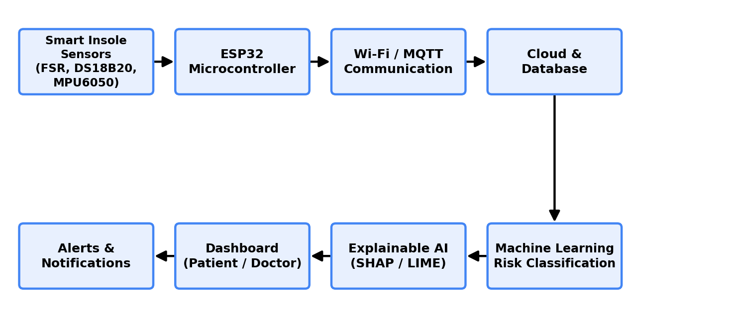
ARCHITECTURE DIAGRAM
Fig. 1: System Architecture of the Proposed Activity-Aware Smart Insole

Slide 8






MODULE
Sensor Module
FSR pressure sensors, DS18B20 temperature sensor, MPU6050 IMU for activity detection
Data Acquisition & Communication Module
ESP32 microcontroller reads sensors and transmits data via Wi-Fi/MQTT
Cloud & Database Module
Stores historical sensor readings, predictions, and patient records for trend analysis
Machine Learning Module
Trained classifier (Random Forest / SVM / XGBoost) predicts ulcer risk level
Explainable AI Module
SHAP/LIME generate feature-level explanations for every prediction
Dashboard & Alert Module
Role-based web dashboard for patients and doctors, with real-time risk alerts

Slide 9
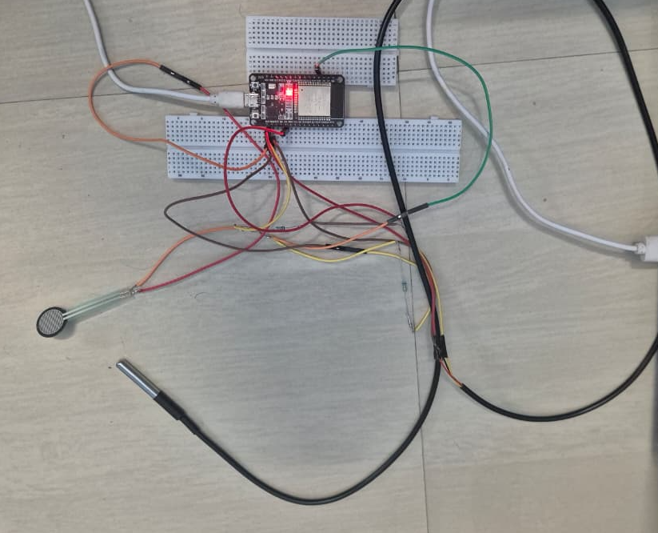
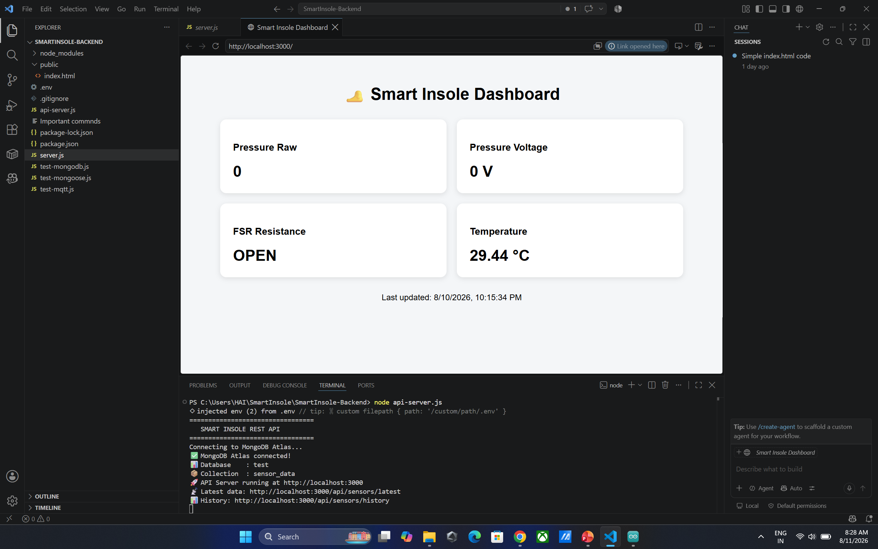
SCREEN SHOTS

Slide 10
REFERENCE
[1] D. Wang, J. Ouyang, P. Zhou, J. Yan, L. Shu, and X. Xu, "A Novel Low-Cost Wireless Footwear System for Monitoring Diabetic Foot Patients," IEEE Trans. Biomedical Circuits and Systems, doi: 10.1109/TBCAS.2020.3043538.
[2] M. M. Manohara Pai, S. V. Kolekar, and R. M. Pai, "Development of Smart Sole based Foot Ulcer Prediction System," ICCT, 2019.
[3] A. M. Shayan et al., "ShrewdShoe, a Smart Pressure Sensitive Wearable Platform," ICRoM, 2018.
[4] D. S. et al., "AI Driven Smart Orthopaedic Insoles For Continuous Diabetic Foot Health Monitoring," AIMLA, 2026, doi: 10.1109/AIMLA67915.2026.11522290.
[5] K. Malarvizhi et al., "Design of a Smart Slipper for Diabetic Foot Pressure and Temperature Monitoring," AIMLA, 2026, doi: 10.1109/AIMLA67915.2026.11522336.
[6] S. Shanmugapriya et al., "IoT-Enabled Smart Insole for Preventive Diabetic Care," ICIMA, 2026, doi: 10.1109/ICIMA68728.2026.11564303.
[7] P. Velvizhy et al., "An Explainable AI Framework for Diabetic Foot Ulcer Detection and Personalized Footwear Recommendation," RMKMATE, 2025, doi: 10.1109/RMKMATE64874.2025.11042366.
[8] X. Chen et al., "DiaShoe: A Smart Shoe for Diabetic Health Monitoring with Gait and Nanoclimate Sensing," IEEE ICCE, 2026, doi: 10.1109/ICCE67443.2026.11449711.
[9] A. Abdigaliyeva et al., "Explainable Machine Learning for Medical Diagnosis: A Comparative Study of SHAP, LIME and Grad-CAM Methods," SIST, 2026, doi: 10.1109/SIST61674.2026.11596151.
[10] S. Ishwarya and S. Anitha Pillai, "Explainable Artificial Intelligence in Healthcare - A Review," ICICT, 2024, doi: 10.1109/ICICT60155.2024.10544745.
[11] P. Gupta et al., "IoT and Cloud Based Healthcare Solution for Diabetic Foot Ulcer," PDGC, 2020, doi: 10.1109/PDGC50313.2020.9315824.
[12] M. Wang and L. Timbol-Cuison, "Machine Learning Classification Techniques for Diabetic Foot Ulcers," AIAM, 2022, doi: 10.1109/AIAM57466.2022.00054.
[13] R. Satheesh et al., "Severity of Diabetic Foot Ulcer Patients Prediction using a Hybrid and Machine Learning Techniques," IConSCEPT, 2025, doi: 10.1109/IConSCEPT66142.2025.11437373.
[14] N. Rashid, T. Mortlock, and M. A. Al Faruque, "Stress Detection Using Context-Aware Sensor Fusion From Wearable Devices," IEEE JBHI, vol. 28, no. 3, pp. 14115-14127, 2024.
[15] P. M. Kumar, L. U. Khan, and C. S. Hong, "Affirmative Fusion Process for Improving Wearable Sensor Data Availability in AIoMT," IEEE Sensors Journal, vol. 22, no. 8, pp. 8130-8138, 2022, doi: 10.1109/JSEN.2022.3153410.

Slide 11
PUBLICATION DETAILS
Target output: Conference paper / journal paper based on this project's literature survey and implementation results.
Suggested target venues (based on similar recent work in this survey): IEEE conferences on AI & Machine Learning Applications (AIMLA), Inventive Material Science and Applications (ICIMA), or Knowledge Management & AI Telecommunication Engineering (RMKMATE).
Paper title (proposed): "Activity-Aware Smart Insole for Early Diabetic Foot Ulcer Risk Prediction using Machine Learning and Explainable AI."
Status: Literature survey complete; hardware procurement complete; sensor-level testing in progress.
[Add final target journal/conference name, submission deadline, and paper status once confirmed with guide]

