Slide 1
Modeling of Attempt-to-Escape Frequency: Tunneling Emission of Trapped Electrons in Tunneling Oxides of 3-D NAND Flash Memory
Font : Arial
Myung Jin and Hyuncheol Shin
10.1109/TED.2025.3589340

Slide 2
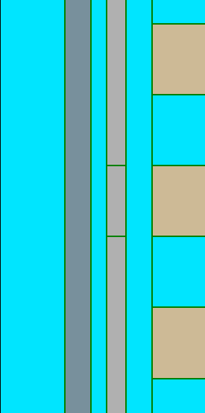
Fig. 1
(a)
(b)
t_{CTN}
Cylindrical
(c)
n_{t}
WL
t_{TOX}
t_{BOX}
$\text{r}$_{Ch}
$$\text{r}\text{0}$$
$$\text{r}\text{1}$$
$$\text{r}\text{2}$$
...
WL
$$\text{r}\text{3}$$
$\text{r}$_{N}
$\text{r}$_{WL}
Wordline (WL)
Si - Channel (Ch)
filler
WL
$$C_{TOX}$$
$$C_{1}$$
$$C_{2}$$
$$C_{3}$$
$$C_{N}$$
$$C_{BOX}$$
Ch
(d)
O/N/O
ΔQ₀
ΔQ₁
ΔQ₂
ΔQ₃
ΔQ_{N-1}
ΔQ_{N}
Q
=
ΔQ₀
ΔQ₂
...
ΔQ_{N}
...
+
+
+
=
...
+
+
+
r₀
r₁
r_{N}
CTN charge
ΔQ_{i} = πr_{i}²(n_{t,i+1}-n_{t,i})
n_{t,0} = 0
n_{t,N+1} = 0
where, i=1-N

Slide 3
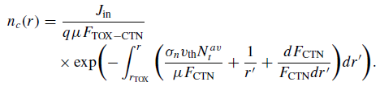
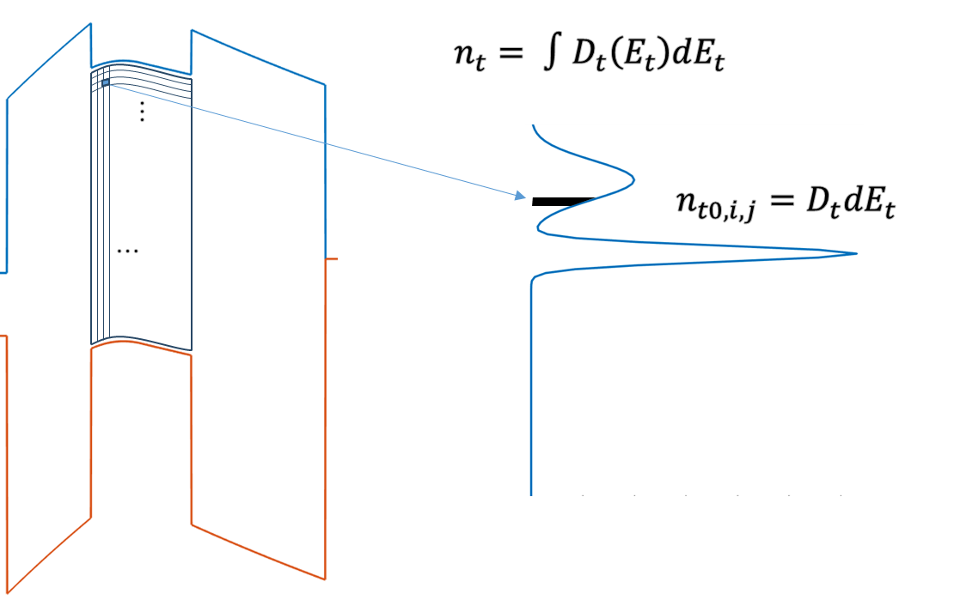


Fig. 2
(a)
$e_{ch}=ν_{ch}×{\left|TC\right|}_{ch}$
$e_{WL}=ν_{WL}×{\left|TC\right|}_{WL}$
(b)
t_{CTN}
n_{t}
(c)
Other Parameters
μ [eV] | σ [eV] | N_{t} [cm⁻³]
0.84 | 0.2 | 1.15 × 10¹⁹
1.8 | 0.05 | 3.5 × 10¹⁹
(e)
(b)
(c)

Slide 4
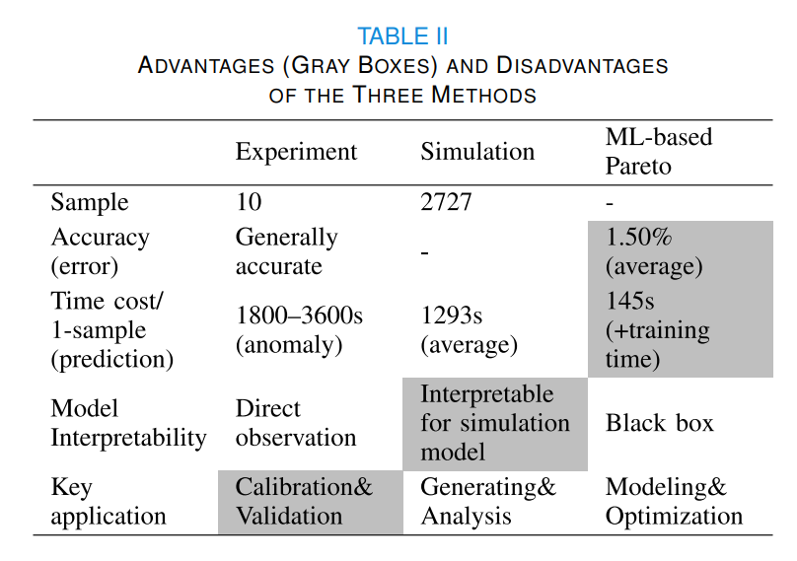
Fig. 3
(a)
(b)
(c)
μ [eV] | σ [eV] | N_{t} [cm⁻³]
0.84 | 0.2 | 1.15 × 10¹⁹
1.8 | 0.05 | 3.5 × 10¹⁹

