Slide 1
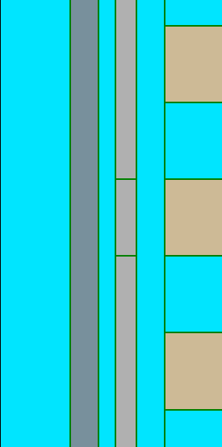
(a)
(b)
t_{CTN}
extracted from TCAD after program
Cylindrical
n_{t}
WL
(c)
t_{TOX}
t_{BOX}
$\text{r}$_{Ch}
$$\text{r}\text{0}$$
$$\text{r}\text{1}$$
$$\text{r}\text{2}$$
...
WL
$$\text{r}\text{3}$$
$\text{r}$_{N}
$\text{r}$_{WL}
Wordline (WL)
Si - Channel (Ch)
filler
WL
$$C_{TOX}$$
$$C_{1}$$
$$C_{2}$$
$$C_{3}$$
$$C_{N}$$
$$C_{BOX}$$
Ch
(d)
O/N/O
ΔQ₀
ΔQ₁
ΔQ₂
ΔQ₃
ΔQ_{N-1}
ΔQ_{N}
Q
=
ΔQ₀
ΔQ₁
...
ΔQ_{N}
...
+
+
+
=
...
+
+
+
r₀
r₁
r_{N}
CTN charge
ΔQ_{i} = πr_{i}²(n_{t,i+1}-n_{t,i})
n_{t,0} = 0
n_{t,N+1} = 0
where, i=1-N

