Slide 1
Modeling of Attempt-to-Escape Frequency: Tunneling Emission of Trapped Electrons in Tunneling Oxides of 3-D NAND Flash Memory
Font : Arial
Myung Jin and Hyuncheol Shin
10.1109/TED.2025.3589340

Slide 2
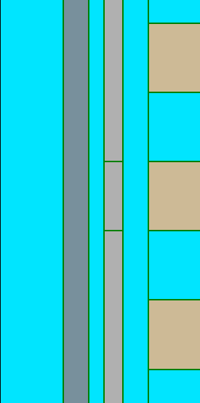
Fig. 1
(a)
(b)
t_{CTN}
extracted from TCAD after program
Cylindrical
n_{t}
WL
(c)
t_{TOX}
t_{BOX}
$\text{r}$_{Ch}
$$\text{r}\text{0}$$
$$\text{r}\text{1}$$
$$\text{r}\text{2}$$
...
WL
$$\text{r}\text{3}$$
$\text{r}$_{N}
$\text{r}$_{WL}
Wordline (WL)
Si - Channel (Ch)
filler
WL
$$C_{TOX}$$
$$C_{1}$$
$$C_{2}$$
$$C_{3}$$
$$C_{N}$$
$$C_{BOX}$$
Ch
(d)
O/N/O
ΔQ₀
ΔQ₁
ΔQ₂
ΔQ₃
ΔQ_{N-1}
ΔQ_{N}
Q
=
ΔQ₀
ΔQ₁
...
ΔQ_{N}
...
+
+
+
=
...
+
+
+
r₀
r₁
r_{N}
CTN charge
ΔQ_{i} = πr_{i}²(n_{t,i+1}-n_{t,i})
n_{t,0} = 0
n_{t,N+1} = 0
where, i=1-N

Slide 3
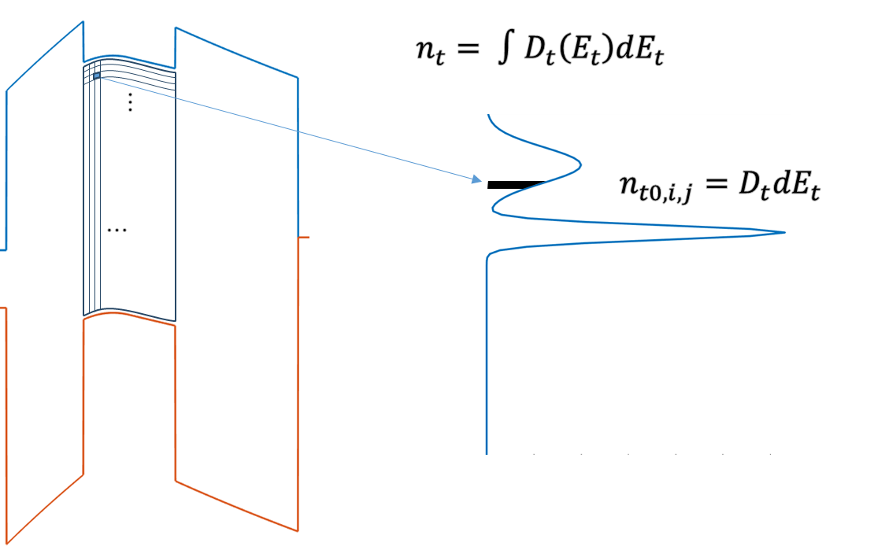


Fig. 2
ΔV_{t} | 1.8 | [V]
(a)
3.1 eV
1.0 eV
$e_{ch}=ν_{ch}×{\left|TC\right|}_{ch}$
$e_{WL}=ν_{WL}×{\left|TC\right|}_{WL}$
3.65 eV
(b)
TCAD-aligned model consistent with [6], [7]
Trap density [6], [9]
n_{t, shallow} | 1.15e19 | [cm⁻³]
n_{t, deep} | 3.5e19 | [cm⁻³]
t_{CTN}
(c)
n_{t}
TCAD parameter deck
μ_{CTN} | 0.1 [8] | [cm²/V·s]
σ_{n} | 1e-16 [8] | [cm²]
ε_{O/N/O} | 3.9/7.5/3.9ε₀ [9] | [F/cm]
t_{O/N/O} | 3/6/8 | [nm]
Trap profile [6], [9]
E_{t, shallow} | 0.84 | [eV]
σ_{t, shallow} | 0.2 | [eV]
E_{t, deep} | 1.8 | [eV]
σ_{t, deep} | - | [eV]
(e)
(b)
(c)

Slide 4
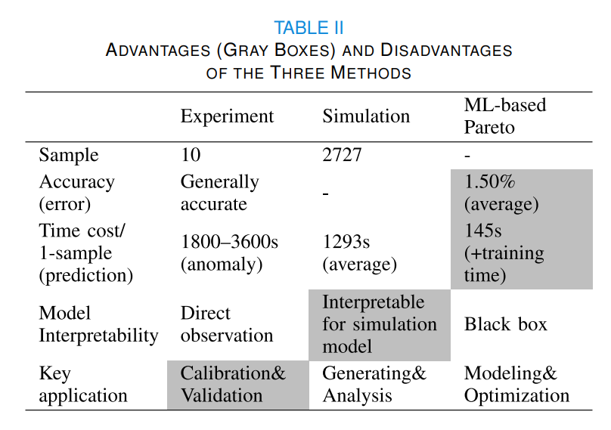
Fig. 3
(a)
 | TCAD Simulation | Autonomous Model
Computation dependency over time domain | Every time step needed | Independent of time domain (only initial condition needed)
Simulation time | > 10000 s | < 10 s
(a)
(b)
μ [eV] | σ [eV] | N_{t} [cm⁻³]
0.84 | 0.2 | 1.15 × 10¹⁹
1.8 | 0.05 | 3.5 × 10¹⁹
t_{TOX}
= 3, 3.5, 4, 4.5, 5 [nm]
(c)

Slide 5

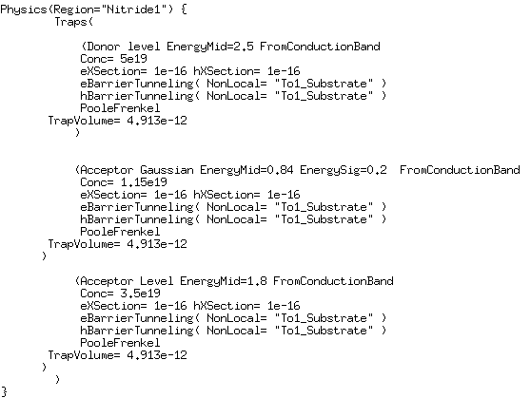


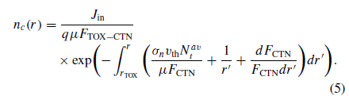
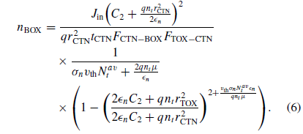
Revision
R1-1
R2
R1-6

