Slide 1
Modeling Attempt-to-Escape Frequency: Tunneling Emission of Trapped Electrons in Tunneling Oxides of 3-D NAND Flash Memory Myung Jin and Hyungcheol Shin

Slide 2
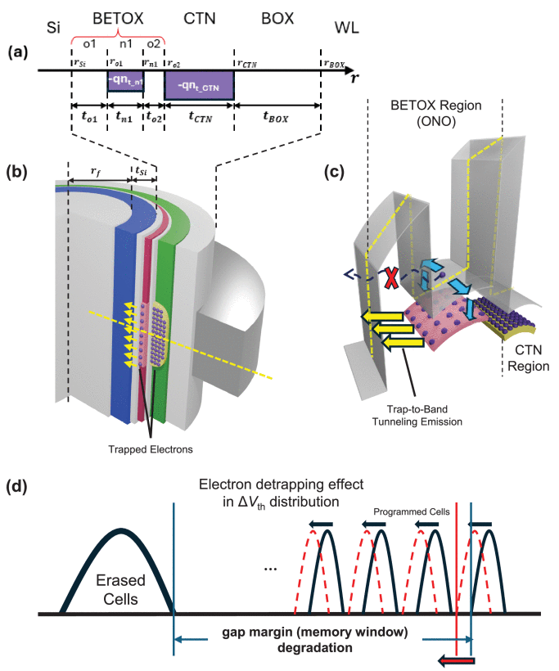
I. Introduction

Slide 3
II. Setup and Device Parameters

Slide 4
III. Model Description

Slide 5
IV. Simulation Result and Validation of the Model

Slide 6
V. Conclusion

Slide 7
Appendix

