Slide 1
What is Real-Time system?
A system in which the correctness of the computation not only depends upon the logical correctness of the computation but also upon the time at which the result is produced.
Computation is performed during the actual time that an external process occurs, in order that the computation results may be used to control, monitor, or respond in a timely manner to the external process
A real-time system responds in a (timely) predictable way to unpredictable external stimuli arrivals

Slide 2
What makes OS a RTOS?
Has to be multi-threaded and preemptive.
Scheduling of multiple threads must be priority based.
Should provide predictable thread synchronization.
Priority Inheritance must exist.
Interrupt Latency , Interrupt Response and Interrupt Recovery must be calculable.
For every system call , the maximum time of completion should be provided by manufacturer for a given platform
System interrupt levels and driver IRQ levels must be known to the developer of the system.

Slide 3
What is Reentrant function?
A function/Sub-routine when invoked simultaneously or nested or interleaved should not interfere with each other.
Shares same copy of code but different copies of data for protection.
Usually use local variables. Global and static variables are discouraged.
Particularly useful in implementation of recursive functions and Interrupt handling.

Slide 4
What is BSP?
A Platform dependent package (in form of source code or binary files) provided by RTOS manufacturers to build the RT-Kernel on a Customized hardware platform .
Sometimes it is a collection of drivers and HALs (Hardware Abstraction Layer).
It also largely depends on OEM’s (Original Equipment Manufacturer) Adaptation Layer.

Slide 5
What is TCB?
A Task’s context need to be saved when context switch occurs in a multi-tasking environment.
The task’s context storing data structure is called as Task Control Block or TCB.
TCB mainly contains the following
  thread of execution, that is, the task's program counter
  the CPU registers and (optionally) floating-point registers
  a stack for dynamic variables and function calls
  I/O assignments for standard input, output, and error
  a delay timer
  a time-slice timer
  kernel control structures
  signal handlers
  debugging and performance monitoring values

Slide 6
What is Critical Section?
A section of code in a program , while executing , no other program should execute.
All interrupts must be disabled while Critical Section code is executing including the Scheduler interrupt.

Slide 7
What is a Deadlock?
A deadlock is a situation wherein two or more competing actions are waiting for the other to finish, and thus neither ever does.
Conditions for deadlock occurrence
  MUTEX
  Hold and Wait
  Non-preemption
  Circular dependency (circular wait)

Slide 8
Priority Inversion
Occurs whenever a higher priority task is blocked ,waiting for a mutex that is held by a lower priority task
In scheduling, priority inversion is the scenario where a low priority task holds a shared resource that is required by a high priority task. This causes the execution of the high priority task to be blocked until the low priority task has released the resource, effectively "inverting" the relative priorities of the two tasks. If some other medium priority task, one that does not depend on the shared resource, attempts to run in the interim, it will take precedence over both the low priority task and the high priority task.

Slide 9
Priority Inversion
Task Blocked
High priority task
Medium priority task
Low priority task
T0 T1 T2 T3 T4 T5 T6

Slide 10
Interrupts
Hardware mechanism to inform the CPU that an asynchronous event has occurred
The ISR processes the event and returns to
  the background in a foreground/ background system
  the interrupted task for a non preemptive kernel
  the highest priority task ready to run for a preemptive kernel
Notes:
We will have a closer look at the interrupts which are the key to real time programming. The processors can process the events as they occur if they are working through interrupts.This avoids the processor wasting its time in polling an event.

Slide 11
Interrupt Latency
Interrupt latency is the sum of the maximum amount of time interrupts are disabled and the time to start executing the first instruction in the ISR
The longer the interrupts are disabled, the higher the interrupt latency
Notes:
Interrupt latency is processor specific. But the real time kernel suppliers will have to provide the details about these timings along with the other specifications.

Slide 12
Interrupt Nesting
TIME
TASK
ISR1
ISR2
ISR3
Interrupt1
Interrupt2
Interrupt3
Notes:
The figure gives us a situation of interrupt nesting.Say when a task is being executed,an interrupt occurs.Before the completion of the interrupt say an other interrupt occurs and so on.This is the way the ISRs and tasks will get executed.

Slide 13
Interrupt Response
Time between the reception of the interrupt and the start of the user code that handles the interrupt
For a foreground background system and non preemptive kernel = interrupt latency + time to save the CPU’s context
For a preemptive kernel = interrupt latency + the time to save the CPU’s context + execution time of the kernel ISR entry function
Notes:
Also known as the response time. Normally,once the processor is interrupted,it saves its program counters and associated segment registers (context) and enters into the ISR.Preemptive kernel,on the other hand calls a special function which notifies to the kernel that an ISR is in progress and lets the kernel to keep track of interrupt nesting.In MicroC/OS-II it is the function OSIntEnter().

Slide 14
Interrupt Recovery
Time required for the processor to return to the interrupted code
For a foreground/background system and non preemptive kernel = time to restore the CPU’s context + time to execute the return from interrupt instruction
For a preemptive kernel = time to determine if a higher priority task is ready + time to restore the CPU’s context of the highest priority task + time to execute the return from interrupt instruction
Notes:
In a preemptive kernel,a function [OSIntExit()] is called.This function allows the kernel to determine whether all interrupts have nested.If they have nested,the kernel determines if a higher priority task has been made ready to run as a result of the ISR.If so,it will run that task.Hence,we see that the interrupted task will only resume when it becomes the highest priority task ready to run.

Slide 15
Interrupt Timings
TIME
Context
saved
Context
restored
TASK
Background
Interrupt
Latency
User ISR code
Interrupt
Request
ISR
Interrupt
Recovery
Interrupt Response
Notes:
The figure explains the various interrupt latency,interrupt recovery and interrupt response timings for a foreground / background method and a non preemptive kernel.

Slide 16
Interrupt Timings
TIME
Context
saved
ISR entry
function
ISR exit
function
Context
restored
TASK A
Task A
Interrupt
Latency
User ISR code
Interrupt
Request
ISR
Interrupt
Recovery
Interrupt Response
Task B
Interrupt
Recovery
Notes:
The figure explains the various interrupt latency,interrupt recovery and interrupt response timings for a preemptive kernel.Here,after the ISR is served,the kernel can return back to the interrupted task or to a higher priority task that was made ready by the ISR.The interrupt recovery time in the latter case is going to be more as the context switch is going to take more time.

Slide 17
What is micro-kernel
A kernel that provides the mechanisms needed to implement an operating system, such as low-level address space management, thread management, and inter-process communication.
If the hardware provides multiple privilege levels, then the microkernel is the only software executing at the most privileged level (generally referred to as supervisor or kernel mode).
Actual operating system services, such as device drivers, protocol stacks, file systems and user interface code are contained in user space.

Slide 18
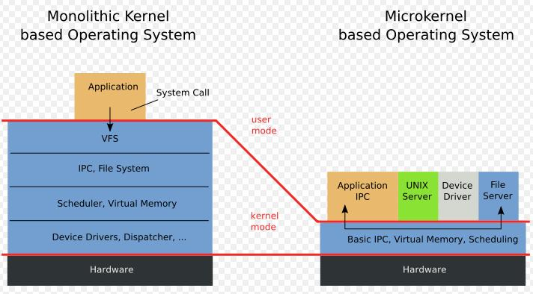

Slide 19
Monolithic Kernels
All OS services operate in kernel space
Good performance
Disadvantages
  Dependencies between system component
  Complex & huge (millions(!) of lines of code)
  Larger size makes it hard to maintain
E.g. Multics, Unix, BSD, Linux

Slide 20
Microkernels
Minimalist approach
  IPC, virtual memory, thread scheduling
Put the rest into user space
  Device drivers, networking, file system, user interface
More stable with less services in kernel space
Disadvantages
  Lots of system calls and context switches
E.g. Mac, wind(vxworks).

Slide 21
What is Hard RealTime
A system where all the critical tasks are highly deterministic.
Late response is considered to be a wrong response. Hence all the real time tasks not only produce logically correct result, but also their delivery time is predictable.
OS used in Mission-critical systems, like automotive, avionics, space missions, medical equipment are supposed to be hard real time.

Slide 22
What is Soft-realtime
A system where miss in task deadline is not a Catastrophe(disaster / Hazard), but possible a reduction in quality.
Home appliance, real video streaming, set-top box (in DTH ) in television.

Slide 23
Few more questions
Explain what is scalable and configurable feature in RTOS(VxWorks).
Why the virtual memory may be absent in RT Kernels?
What is the advantage of Micro-kernel?
How to reduce latency?
What is priority inheritance?
What is watchdog timer?

