Slide 1
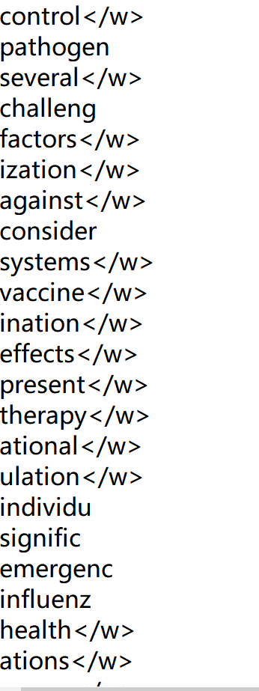
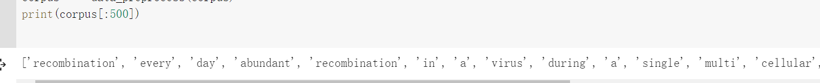
Tokenization
split( )
NLTK
BPE
file.read.split( )
word_tokenize(s)

Slide 2
Pros and Cons for each Tokenization
advantages:
can keep the meaning of words well
split( )
word granularity
disadvantage:
the dictionary needed to be constructed is too large
causes out of the vocabulary problems
NLTK
solve the problem
each token in this list has a certain meaning
saves memory and preserves semantics
BEP
subword granularity

Slide 3
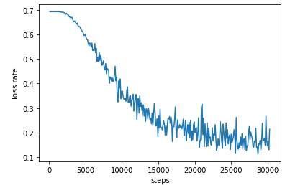
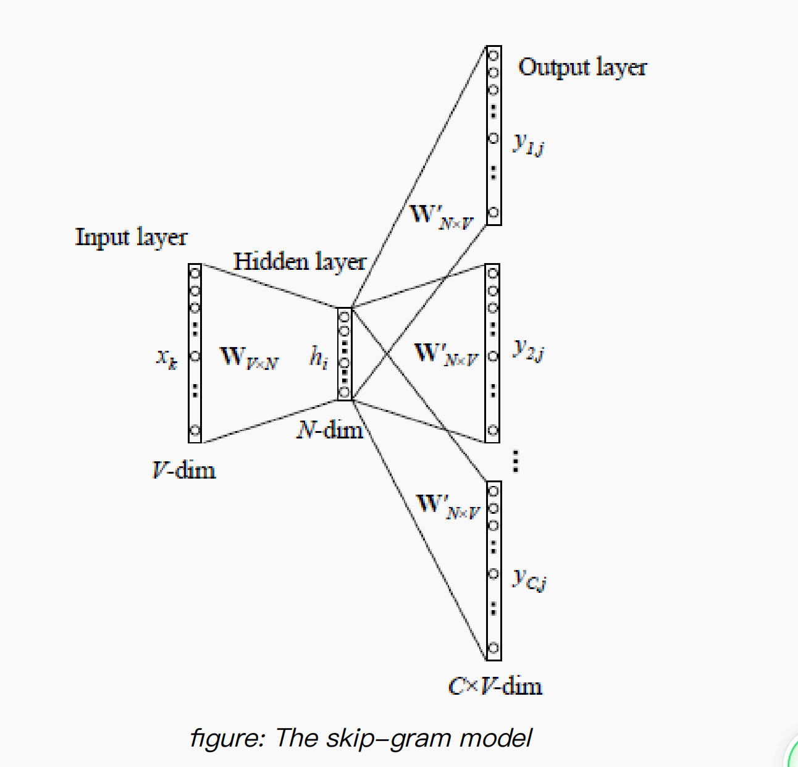
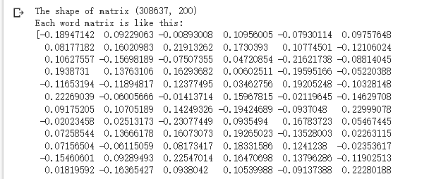
Skip-gram model
loss rate in 30000 steps
embedding size=200
learning rate=0.0002

Slide 4


optimization
negative sampling
subsampling
modified loss function
the possibility of wi to be deleted
the loss can be approximated from the softmax layer by only updating a small subset of all the weights at once rather than using all the weights
some common words are discarded with a certain probability. Like “the”, “a”.....

