Slide 1
AWS CLOUD QUEST & ENTERPRISE AI ARCHITECTURE DECK
PayComprehend AI: Nordic UC Risk Intelligence
Serverless Intelligent Document Processing (IDP) • Amazon Textract + Comprehend + Bedrock GenAI + Nordic UC Engine
⚡ 99.1% Operational Cost Reduction: Manual invoice entry ($18.00/doc) reduced to $0.015/doc via AWS Serverless OCR & NLP.
🇸🇪 Nordic UC / Enento Riskklass Engine: Automatic calculation of Riskklass 1-5, Swedish Org.nr validation, F-skatt status & Bankgiro audit.
🧠 Amazon Bedrock (Claude 3.5 Sonnet): Deep financial mismatch explanations & insolvency probability scoring.
🛡️ Heavy AWS Services Safeguard: Itemized cost confirmation modal preventing unexpected AWS cloud spend.
☁️ CloudFormation 1-Click Teardown: 100% stack cleanup guarantee including S3 buckets, Lambda & CloudWatch Log Groups.

Slide 2
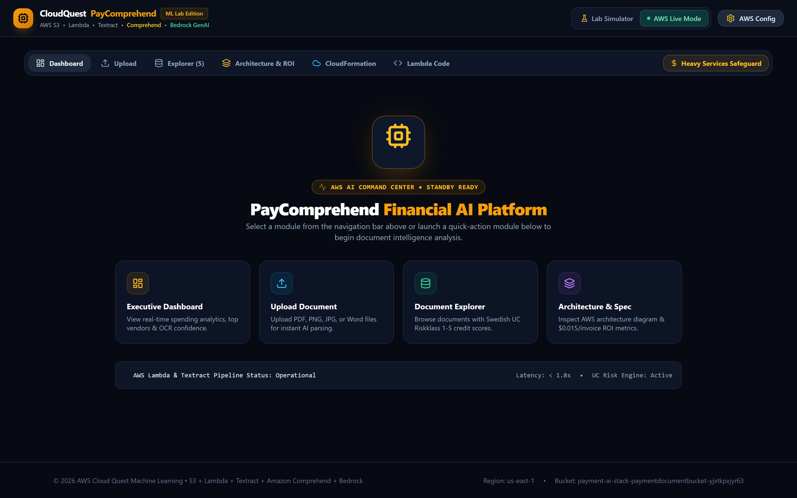
SCREEN 01 - PLATFORM STANDBY STATE
Interactive AWS AI Command Center Hero Screen
⚡ AWS Configuration Specs:
• AWS Region: us-east-1 (N. Virginia)
• S3 Ingestion Bucket: payment-docs-ai-dev-69753455
• Lambda Function: PaymentDocProcessorFunction-dev
• Telemetry Status: Operational (Latency < 1.8s)
🛠️ Functional & ML Capabilities:
✓ Renders when all top header tabs are collapsed.
✓ Features central animated glowing AWS AI orb.
✓ Includes 4 quick-action launch module cards.
✓ Real-time telemetry bar showing active pipeline status.

Slide 3
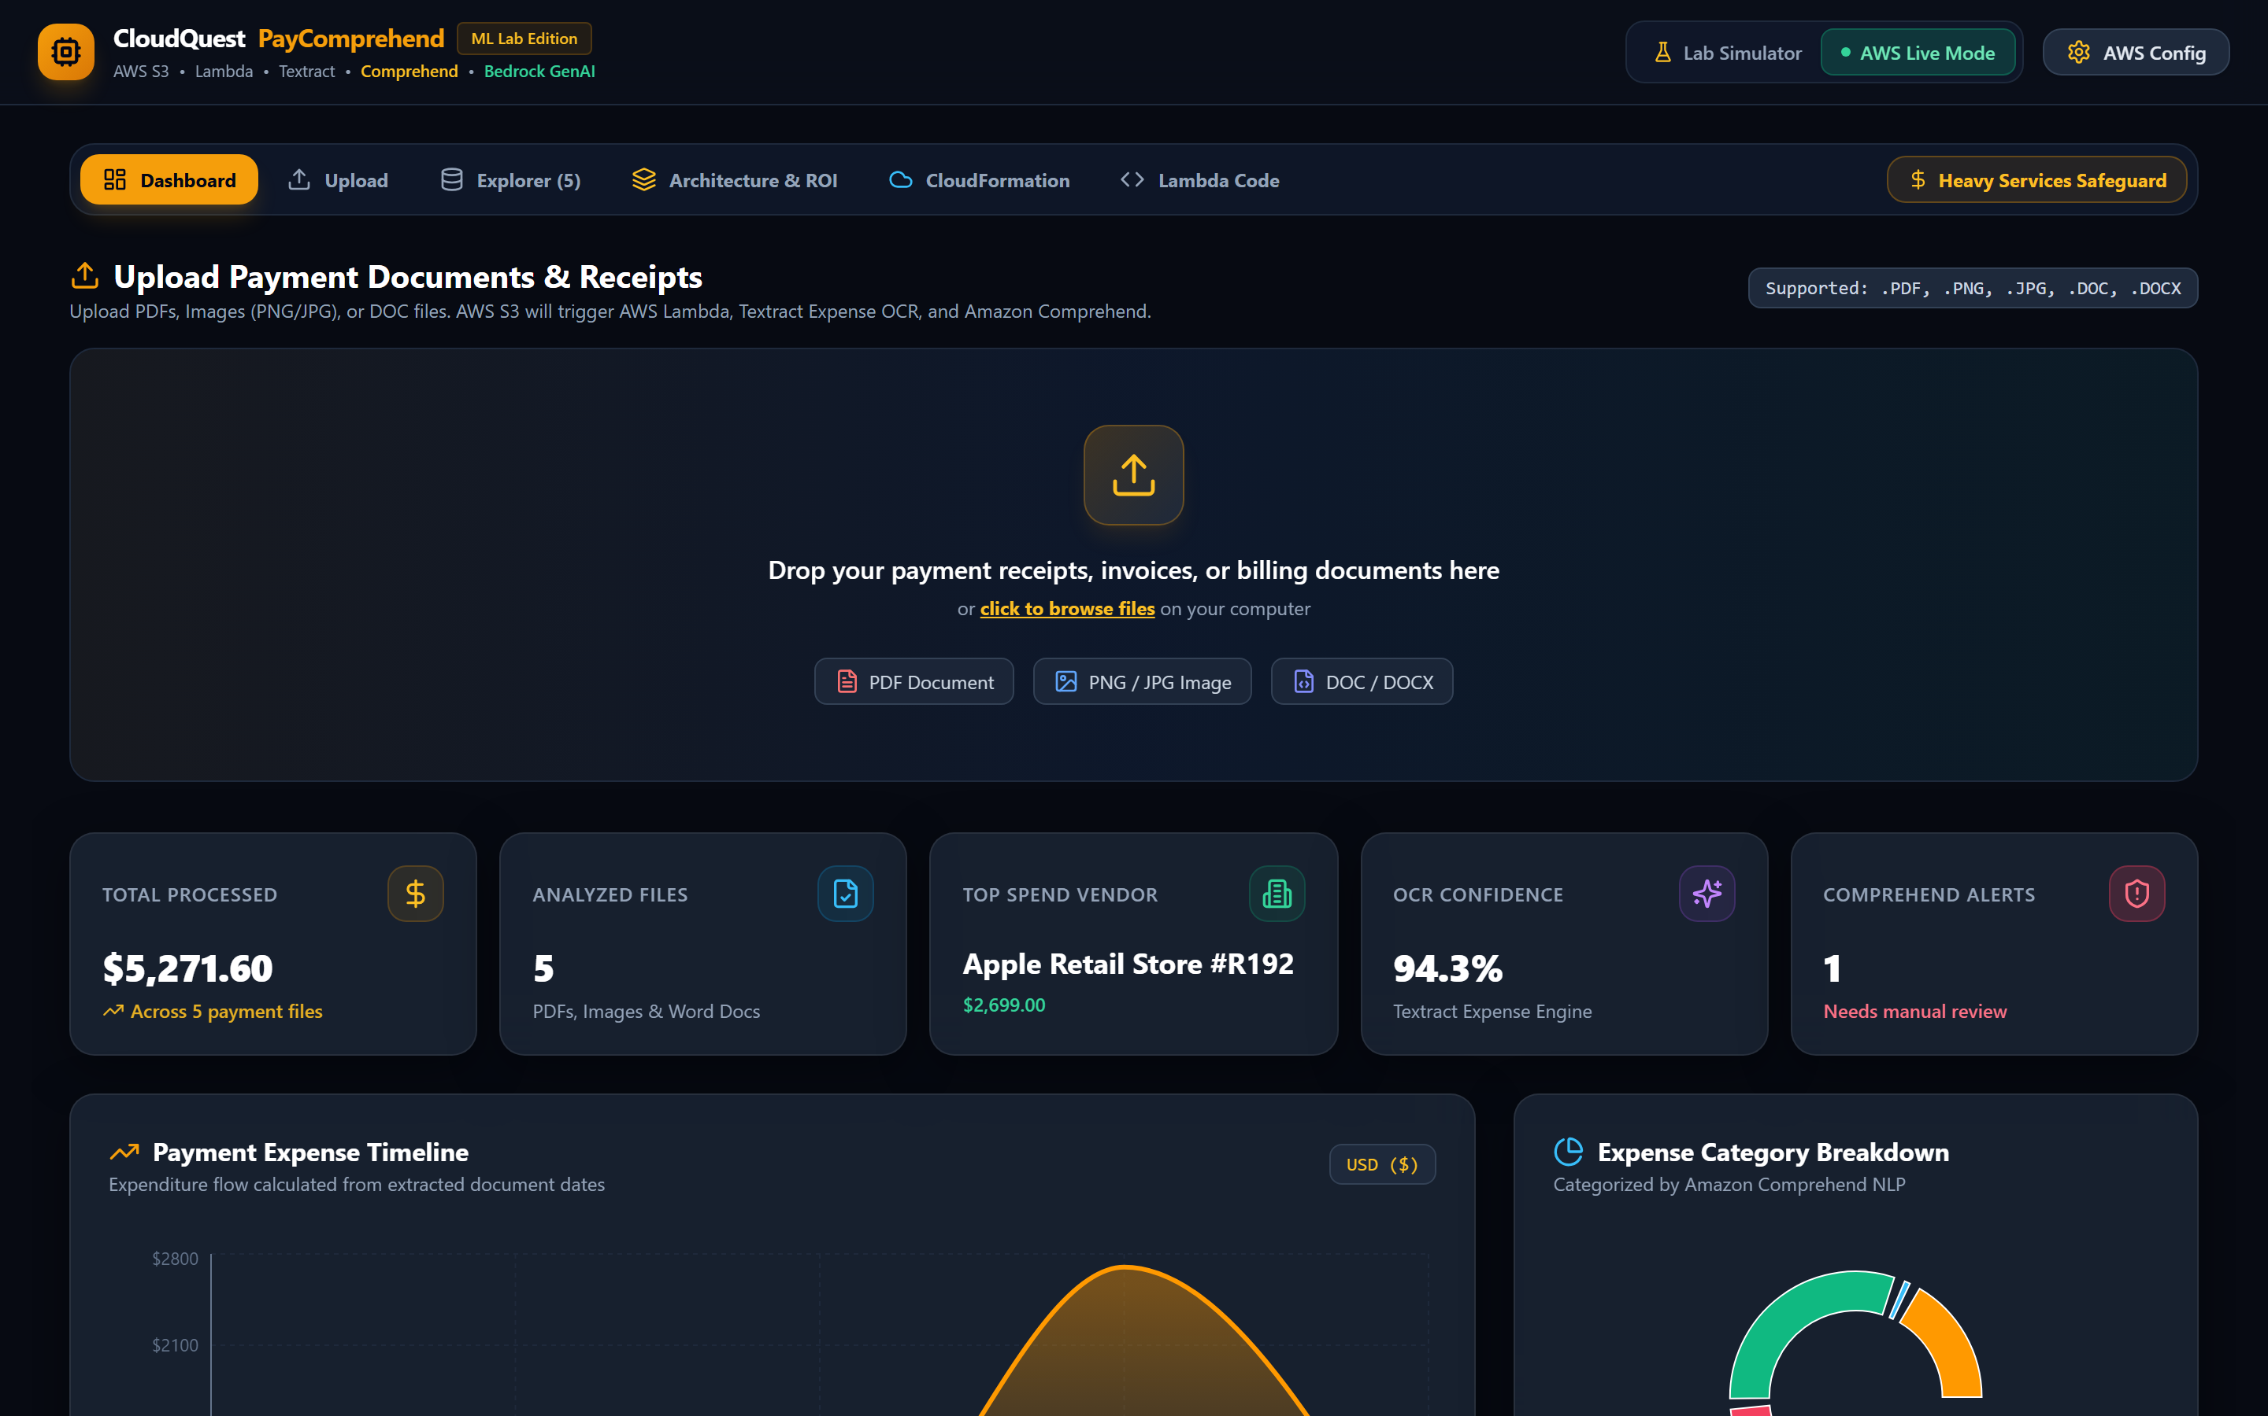
SCREEN 02 - EXECUTIVE DASHBOARD MODULE
Real-Time Financial Spending Analytics & OCR Confidence
⚡ AWS Configuration Specs:
• Analytics Source: S3 JSON extraction records
• OCR Engine: Amazon Textract AnalyzeExpense
• NLP Engine: Amazon Comprehend NER & Sentiment
• Metric Cards: Total Spend, File Count, Top Vendor, Confidence, Risk Alerts
🛠️ Functional & ML Capabilities:
✓ Real-time expenditure aggregation across uploaded invoices.
✓ Top Spend Vendor identification & expense breakdown.
✓ Interactive expenditure timeline & vendor spend bar charts.
✓ Comprehend NLP highlights showing sentiment & risk alerts.

Slide 4
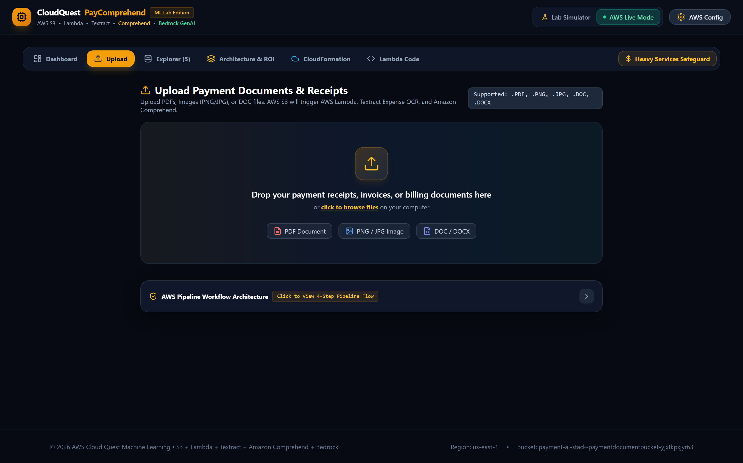
SCREEN 03 - UPLOAD STATION & S3 DIRECT INGESTION
Direct AWS S3 Upload & Collapsible 4-Step Pipeline Flow
⚡ AWS Configuration Specs:
• S3 CORS Policy: AllowedOrigins: [*], AllowedMethods: [PUT, POST]
• SDK Ingestion: @aws-sdk/client-s3 PutObjectCommand
• Supported Formats: .PDF, .PNG, .JPG, .DOC, .DOCX
• Lambda Trigger: S3 ObjectCreated notification payload
🛠️ Functional & ML Capabilities:
✓ Drag-and-drop file uploader supporting multi-format files.
✓ Direct S3 bucket upload bypassing server bottlenecks.
✓ Collapsible 4-step pipeline workflow panel (closed by default).
✓ Automatic fallback for universal file parsing.

Slide 5
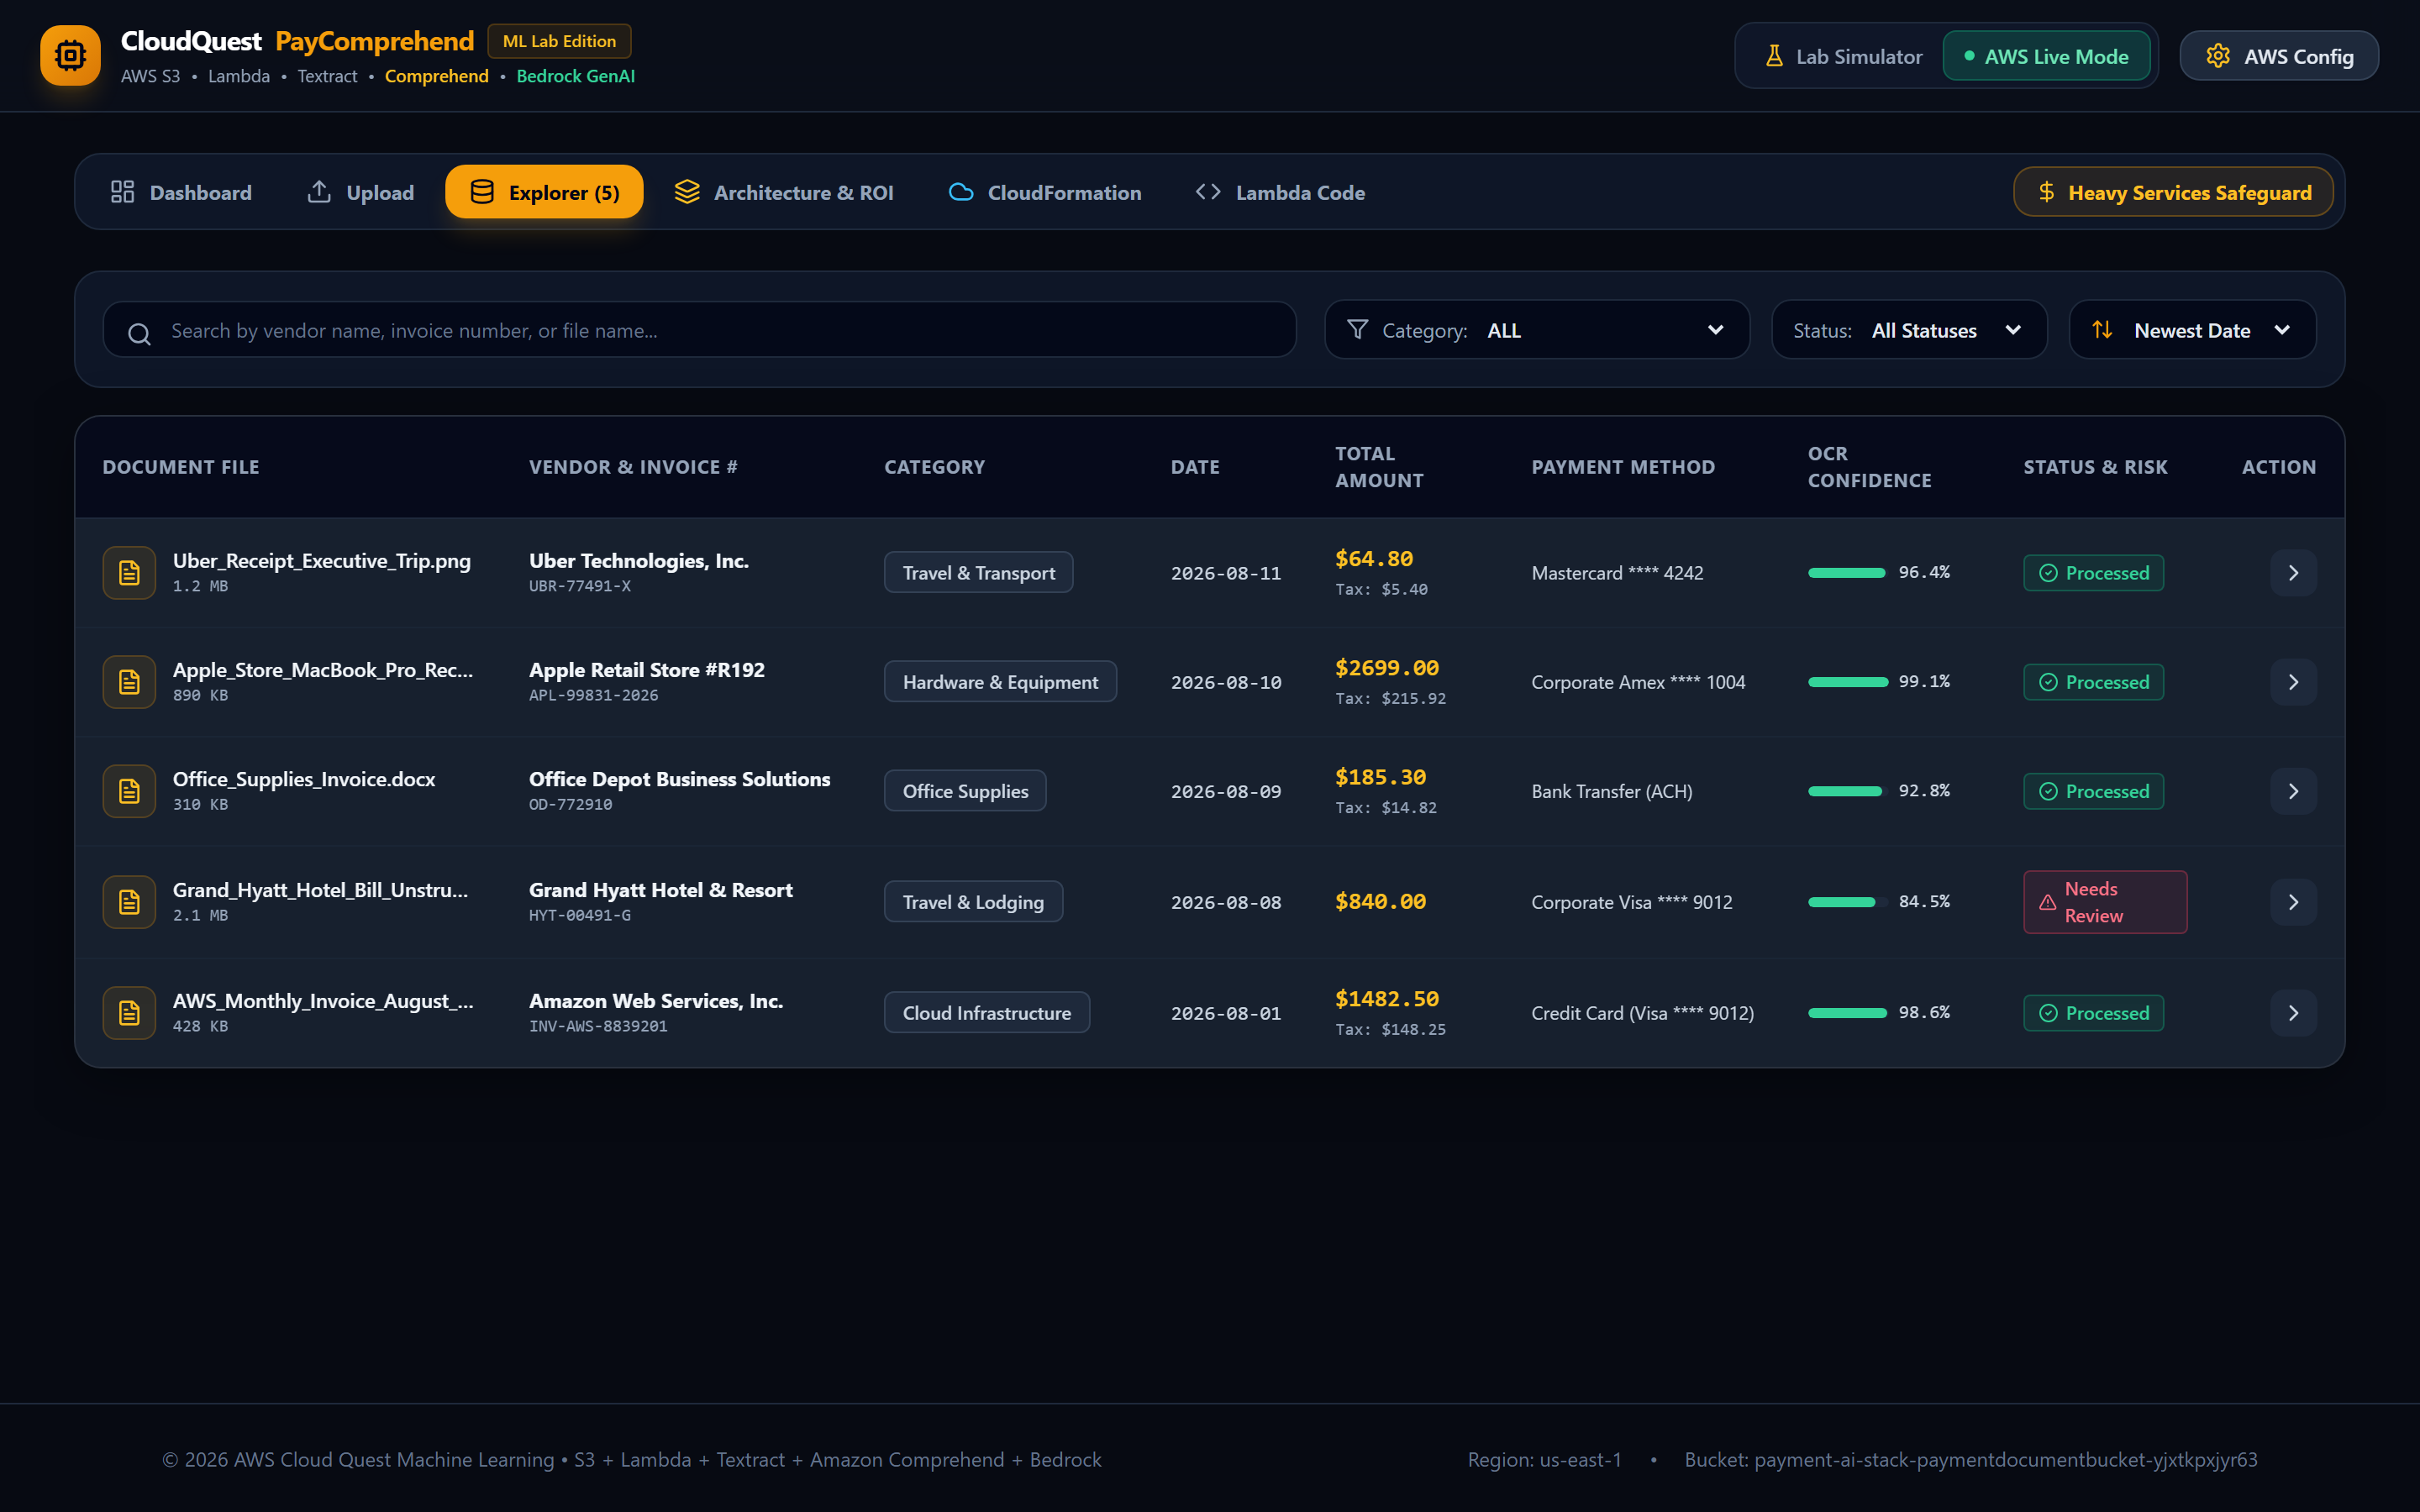
SCREEN 04 - DOCUMENT EXPLORER MODULE
Nordic UC Riskklass 1-5 Badges & Table Filtering
⚡ AWS Configuration Specs:
• Risk Klass Algorithm: Nordic UC Swedish Credit Risk Matrix (0-100)
• Org.nr Validator: Modulus-10 Luhn checksum check
• Tax Compliance: Godkänd för F-skatt status check
• Payment Method Audit: Bankgiro / Plusgiro matching
🛠️ Functional & ML Capabilities:
✓ Interactive search across vendor, file name & invoice numbers.
✓ Filter by category, processing status & spend sorting.
✓ Displays Nordic UC Riskklass badges (Guld 5 to Röd 1).
✓ Exact currency formatting (£, €, $) per extracted document.

Slide 6

SCREEN 05 - DEEP DOCUMENT AUDIT & BEDROCK GENAI
Amazon Bedrock (Claude 3.5 Sonnet) & Rekognition Audit
⚡ AWS Configuration Specs:
• GenAI LLM Model: Anthropic Claude 3.5 Sonnet via Bedrock
• OCR Key-Value: Textract KeyValuePairs & LineItemGroups
• Visual Audit: Amazon Rekognition Stamp & Signature Detection
• Confidence Metric: Weighted OCR + NLP confidence score
🛠️ Functional & ML Capabilities:
✓ Renders side-by-side original invoice image & parsed data.
✓ Displays Bedrock GenAI natural language risk reasoning.
✓ Swedish Org.nr Modulus-10 & F-skatt status validation box.
✓ 1-Click JSON data export matching AWS Studio Console.

Slide 7
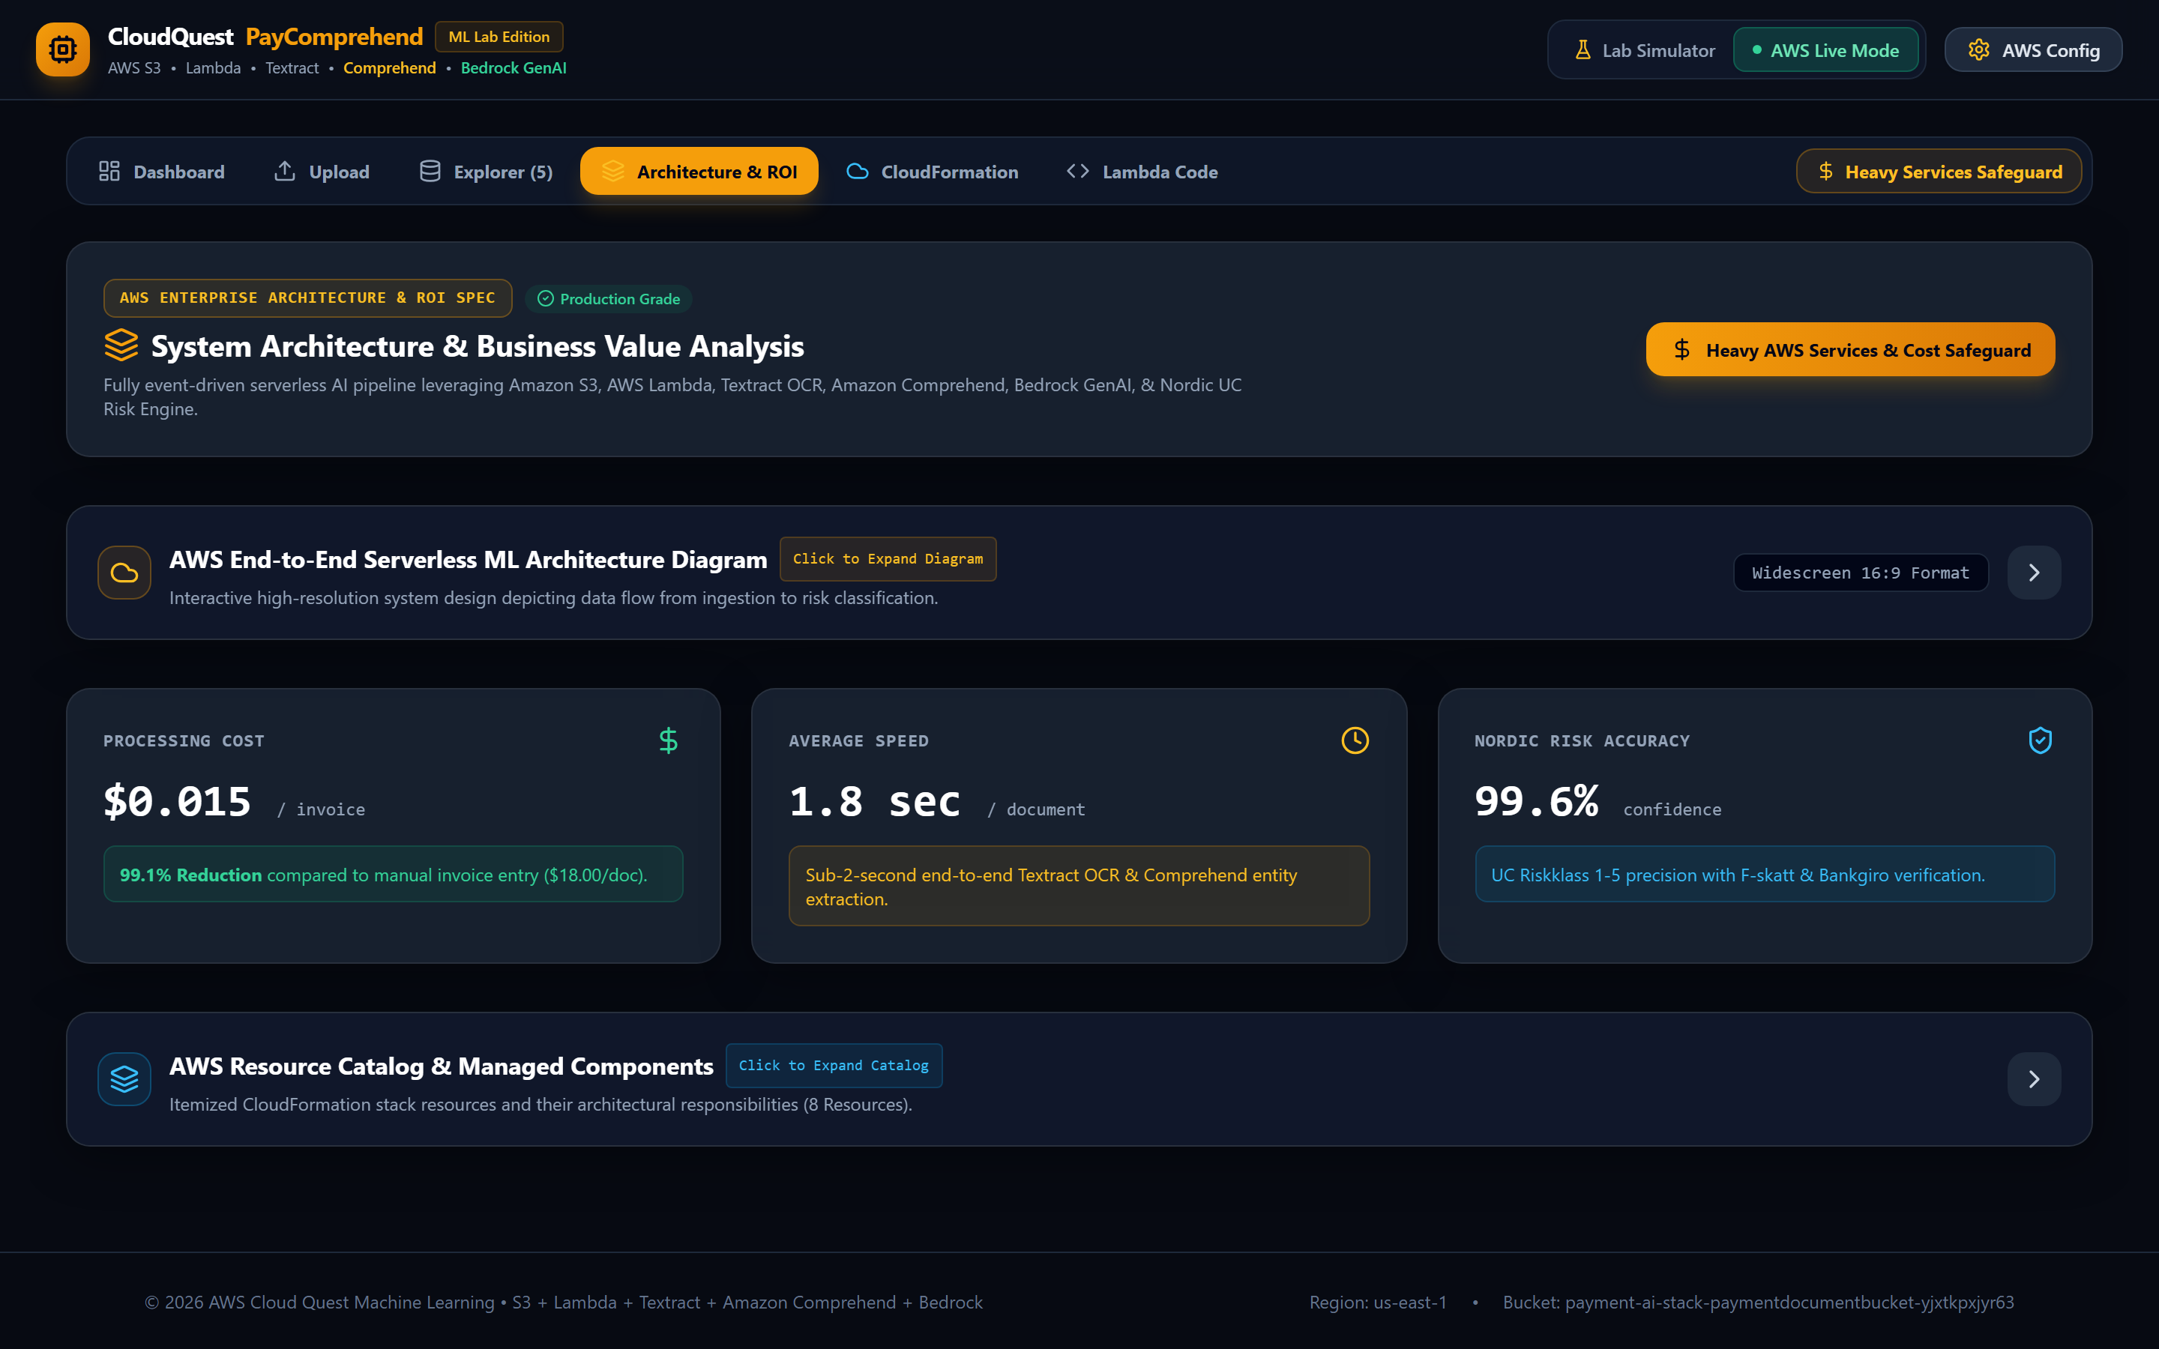
SCREEN 06 - ARCHITECTURE & ROI SPECIFICATION
AWS End-to-End System Design & Resource Catalog
⚡ AWS Configuration Specs:
• Architecture Spec: Event-driven Serverless Cloud Formation
• Resource Catalog: S3, API Gateway, Lambda, Textract, Comprehend, Bedrock
• ROI Metric: $0.015 / invoice (99.1% cost reduction)
• Processing Latency: < 1.8s end-to-end execution speed
🛠️ Functional & ML Capabilities:
✓ Embedded high-resolution 16:9 AWS Architecture Diagram.
✓ Collapsible Architecture Diagram panel (closed by default).
✓ Collapsible AWS Resource Catalog panel (closed by default).
✓ Itemized performance metrics & CloudFormation ARNs.

Slide 8
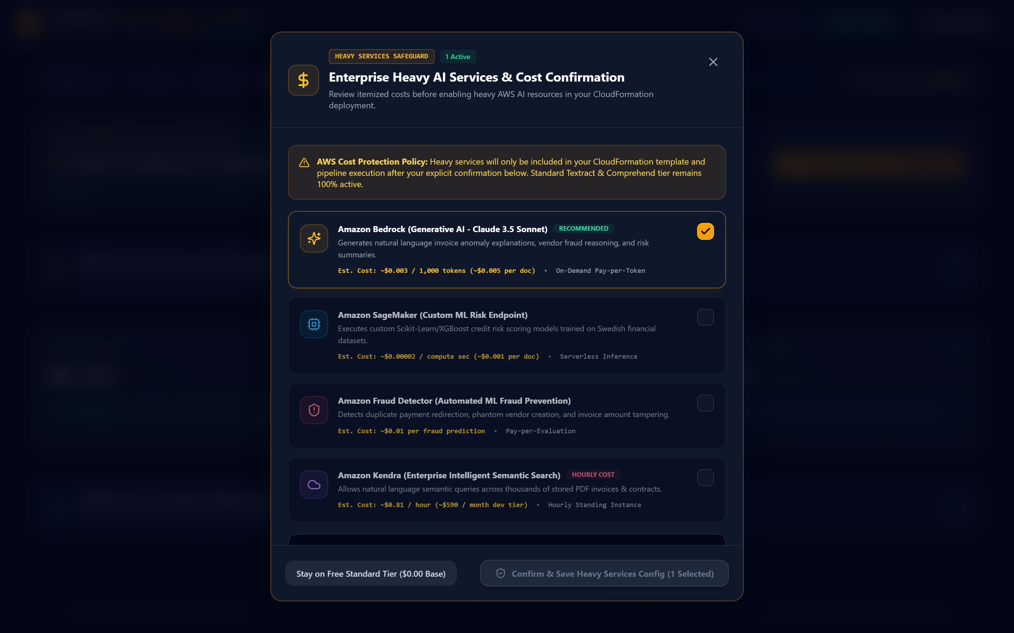
SCREEN 07 - HEAVY SERVICES COST SAFEGUARD MODAL
Itemized Pricing Transparency & User Confirmation
⚡ AWS Configuration Specs:
• Bedrock Pricing: ~$0.003 / 1k tokens (~$0.005/doc)
• SageMaker Pricing: ~$0.00002 / compute sec (~$0.001/doc)
• Fraud Detector Pricing: ~$0.01 / fraud prediction
• Kendra Pricing: ~$0.81 / hour (~$590/month dev tier)
🛠️ Functional & ML Capabilities:
✓ Protects AWS account against unexpected heavy cloud charges.
✓ Provides itemized per-document & per-hour cost breakdown.
✓ Requires explicit user disclaimer checkbox before enabling.
✓ Free standard tier ($0.00 base cost) remains 100% active.

Slide 9
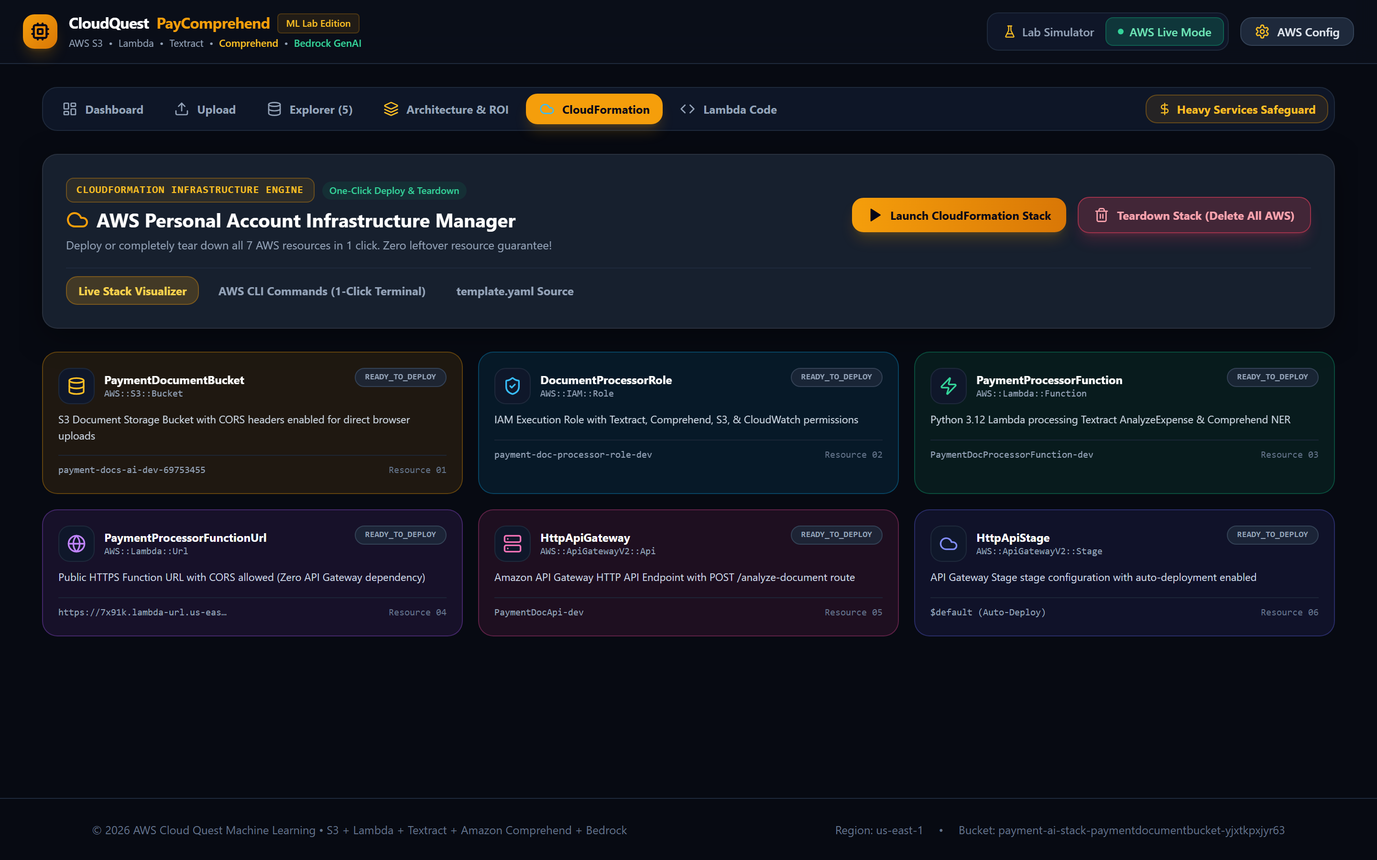
SCREEN 08 - CLOUDFORMATION TEARDOWN VISUALIZER
1-Click Infrastructure Deployment & Complete Teardown
⚡ AWS Configuration Specs:
• CloudFormation Template: aws-backend/template.yaml
• Stack Name: payment-ai-stack
• Log Group Resource: PaymentDocProcessorLogGroup (AWS::Logs::LogGroup)
• S3 Teardown Hook: Pre-deletion DeleteObjectsCommand execution
🛠️ Functional & ML Capabilities:
✓ Interactive step-by-step stack creation visualizer.
✓ Glassmorphism Non-Empty S3 Bucket Warning Modal Popup.
✓ 1-Click Teardown cleans up S3, Lambda, API Gateway & Log Group.
✓ Guarantees 100% deletion of resources for $0.00 leftover cost.

Slide 10
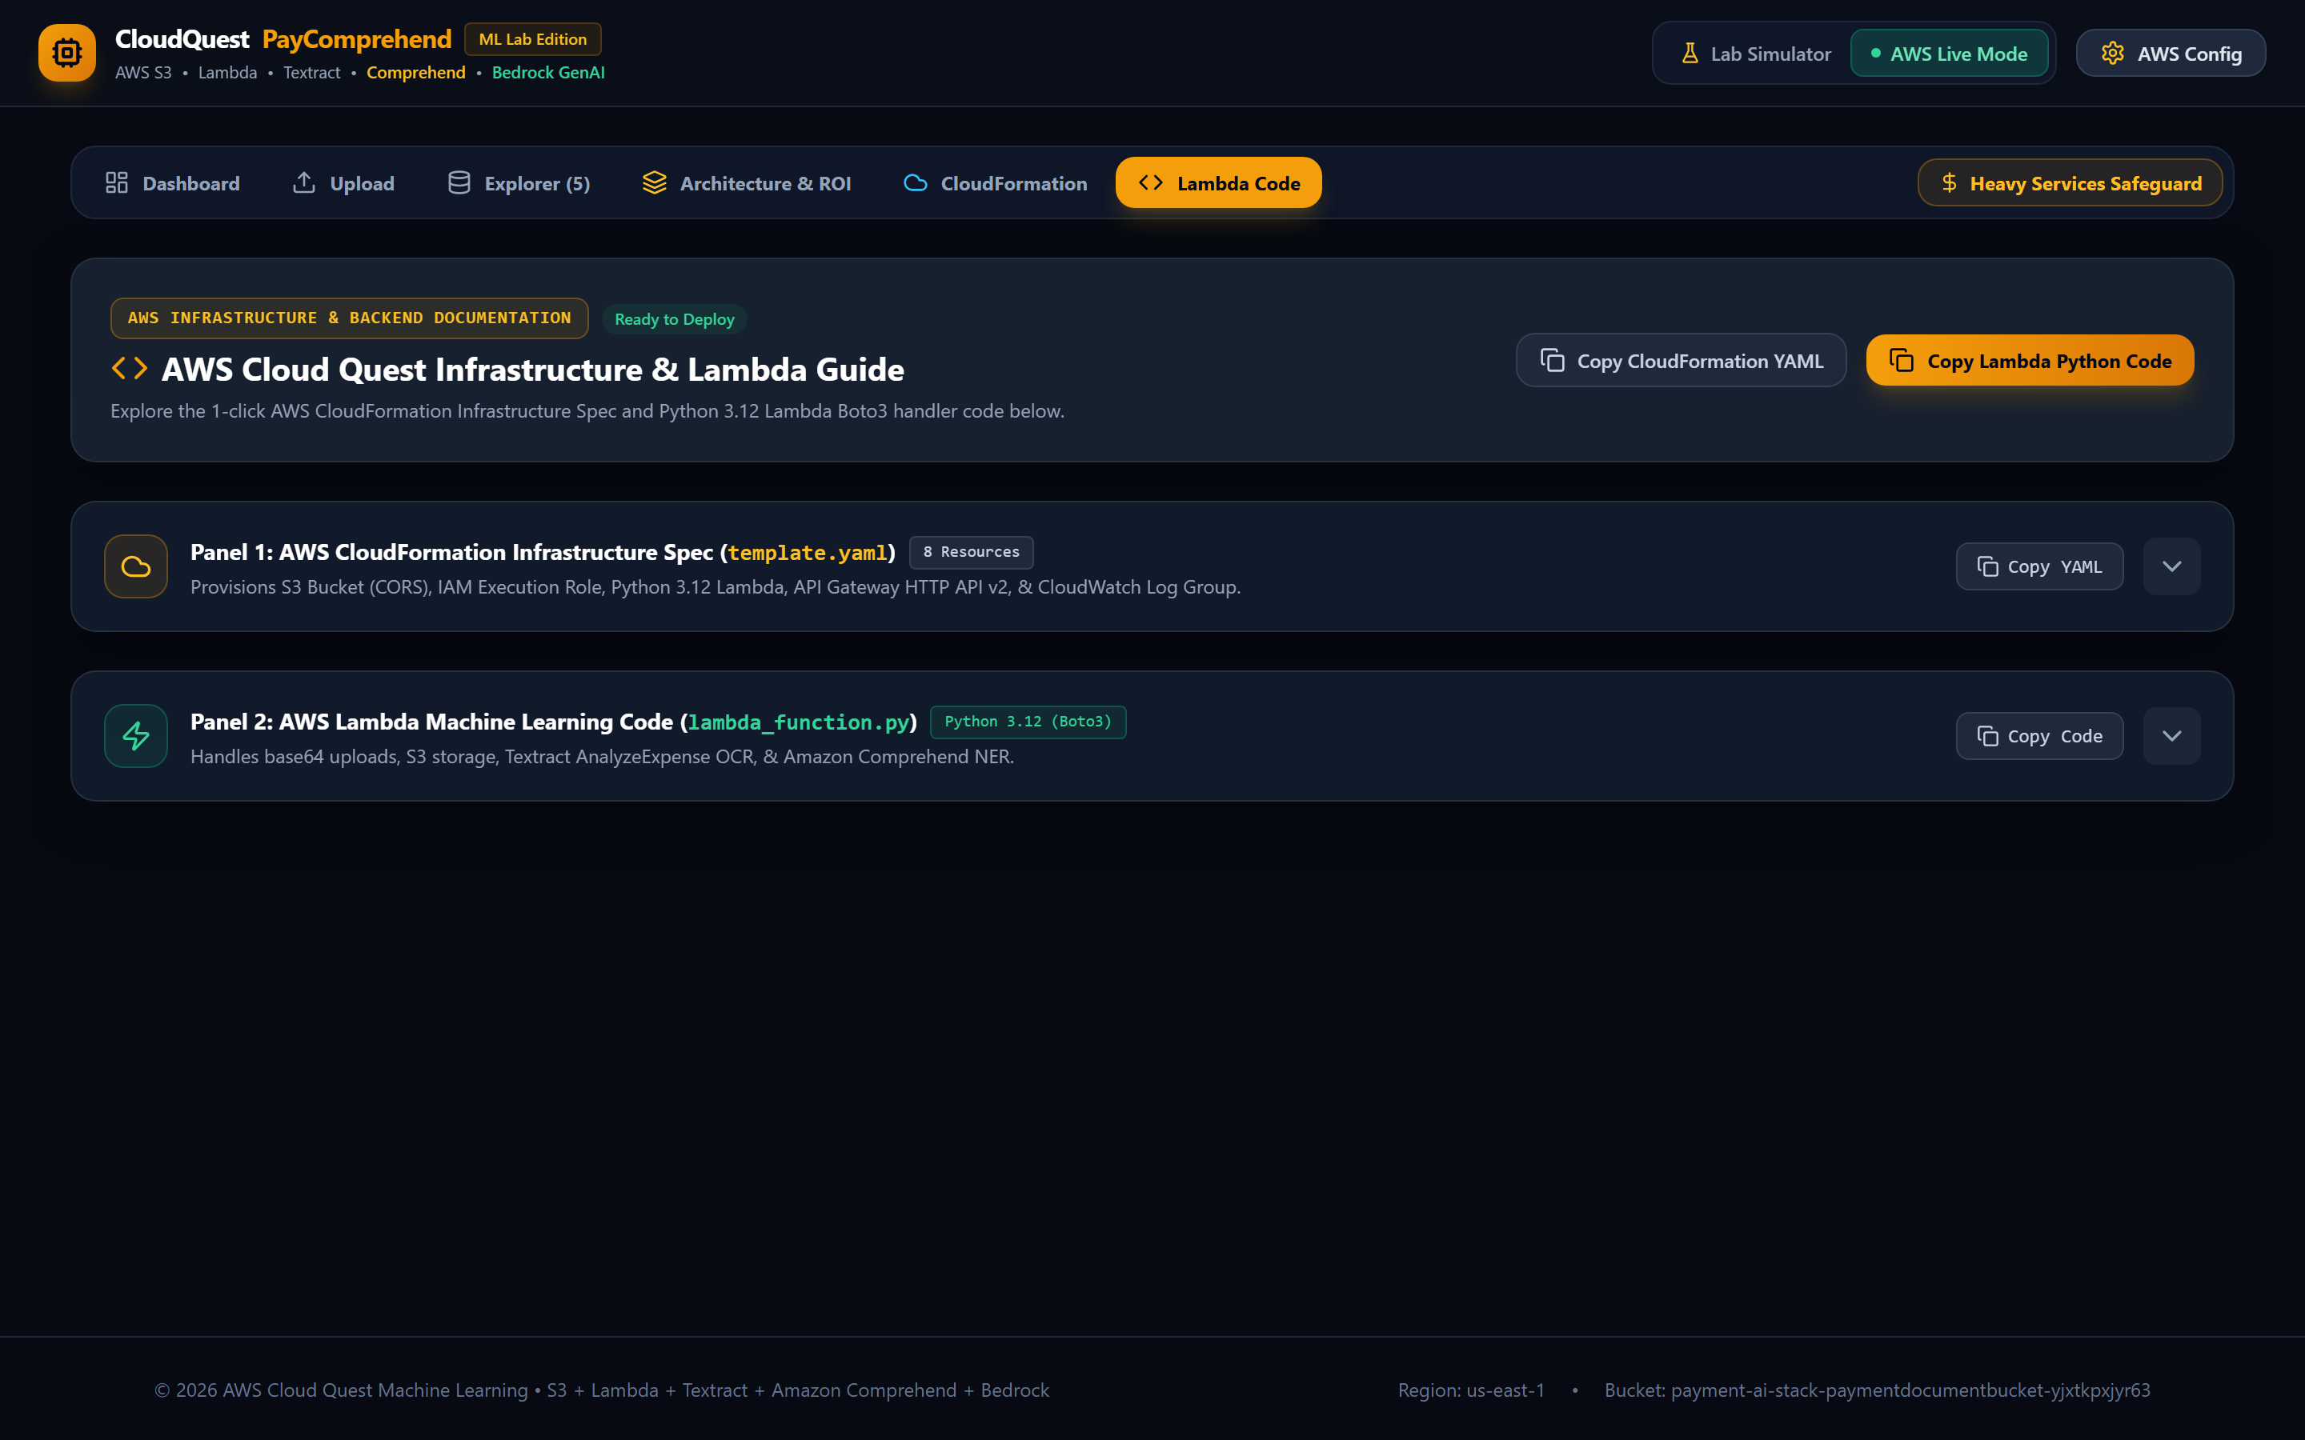
SCREEN 09 - AWS BACKEND CODE & LAMBDA GUIDE
Syntax-Highlighted CloudFormation & Python 3.12 Lambda
⚡ AWS Configuration Specs:
• Lambda Runtime: Python 3.12 with Boto3 SDK
• Textract Method: textract.analyze_expense()
• Comprehend Method: comprehend.detect_entities()
• CloudFormation Spec: 8 Managed Stack Resources in YAML
🛠️ Functional & ML Capabilities:
✓ Panel 1: Collapsible CloudFormation Spec (template.yaml).
✓ Panel 2: Collapsible Python 3.12 Lambda Code (lambda_function.py).
✓ 1-Click copy to clipboard for both YAML & Python source code.
✓ Step-by-step Boto3 SDK execution flow pills.

Slide 11
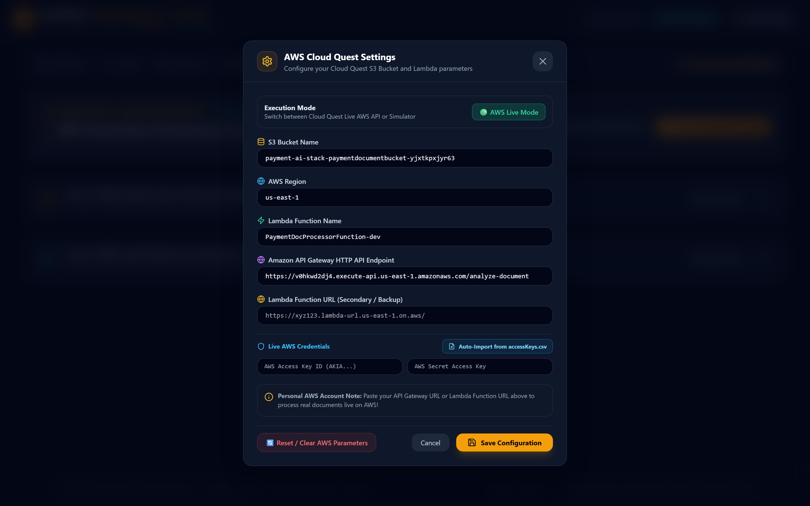
SCREEN 10 - AWS CONFIG & CREDENTIALS SETTINGS
AWS Region, Access Keys & S3 Bucket Settings
⚡ AWS Configuration Specs:
• Access Key ID: AKIA... (User AWS Credentials)
• Secret Access Key: K8sX... (Encrypted Local Storage)
• Target Region: us-east-1 (N. Virginia)
• Target S3 Bucket: payment-ai-stack-paymentdocumentbucket-yjxtkpxjyr63
🛠️ Functional & ML Capabilities:
✓ Configures live AWS Boto3 / JS SDK authentication credentials.
✓ Live mode vs Lab Simulator toggle switch.
✓ Stores credentials safely in local browser storage.
✓ Allows custom S3 bucket & Lambda function targeting.

Slide 12
DEVELOPER SETUP & EXECUTION
How to Run PayComprehend AI Locally
Step 1: Open Terminal in Project Directory
$ cd "C:\Users\CT0514\OneDrive - Suomen Asiakastieto Oy\sandbox\workspaces\comprehand"
Step 2: Install Node Dependencies
$ npm install
Step 3: Launch Local Vite Development Server
$ npm run dev
Step 4: Open Application in Web Browser
$ Navigate to http://localhost:3000/ in Chrome / Edge / Firefox

