Slide 1
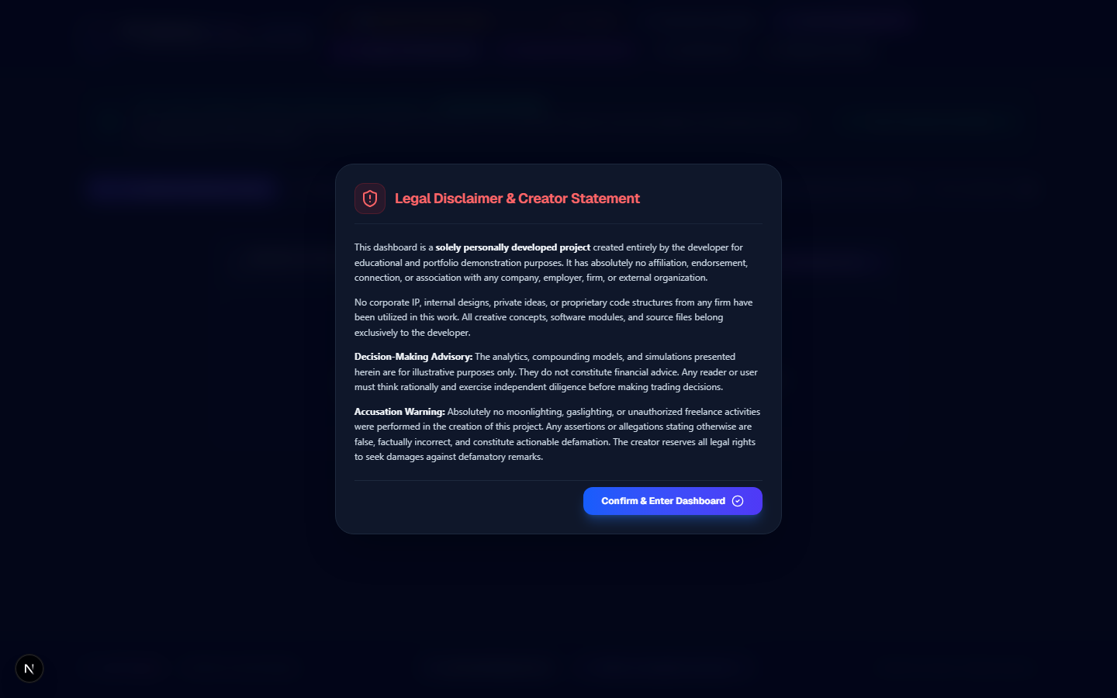
Slide 1: Legal Disclaimer & Creator Statement
Mandatory zero-trust legal statement & portfolio confirmation modal displayed on every page load.
API Collection Runner Walkthrough | Ved Tripathi (vedmtripathi@gmail.com)

Slide 2
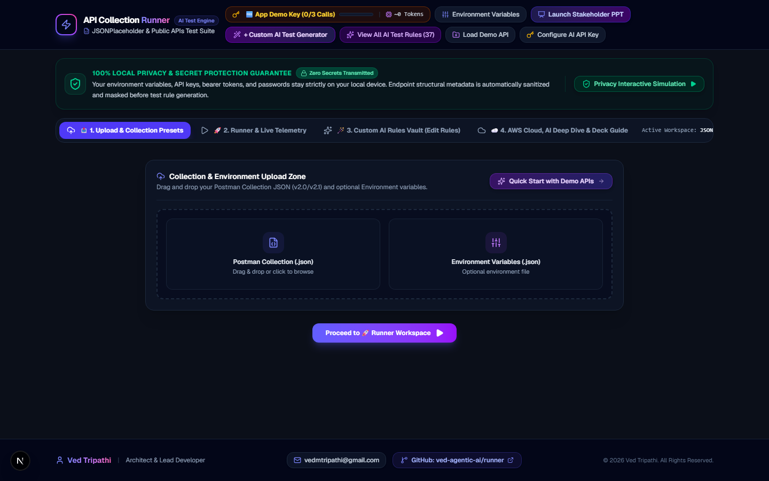
Slide 2: Workspace 1: Upload & Collection Presets
Drag-and-drop Postman collection & environment JSON parser with instant JSONPlaceholder & ReqRes presets.
API Collection Runner Walkthrough | Ved Tripathi (vedmtripathi@gmail.com)

Slide 3
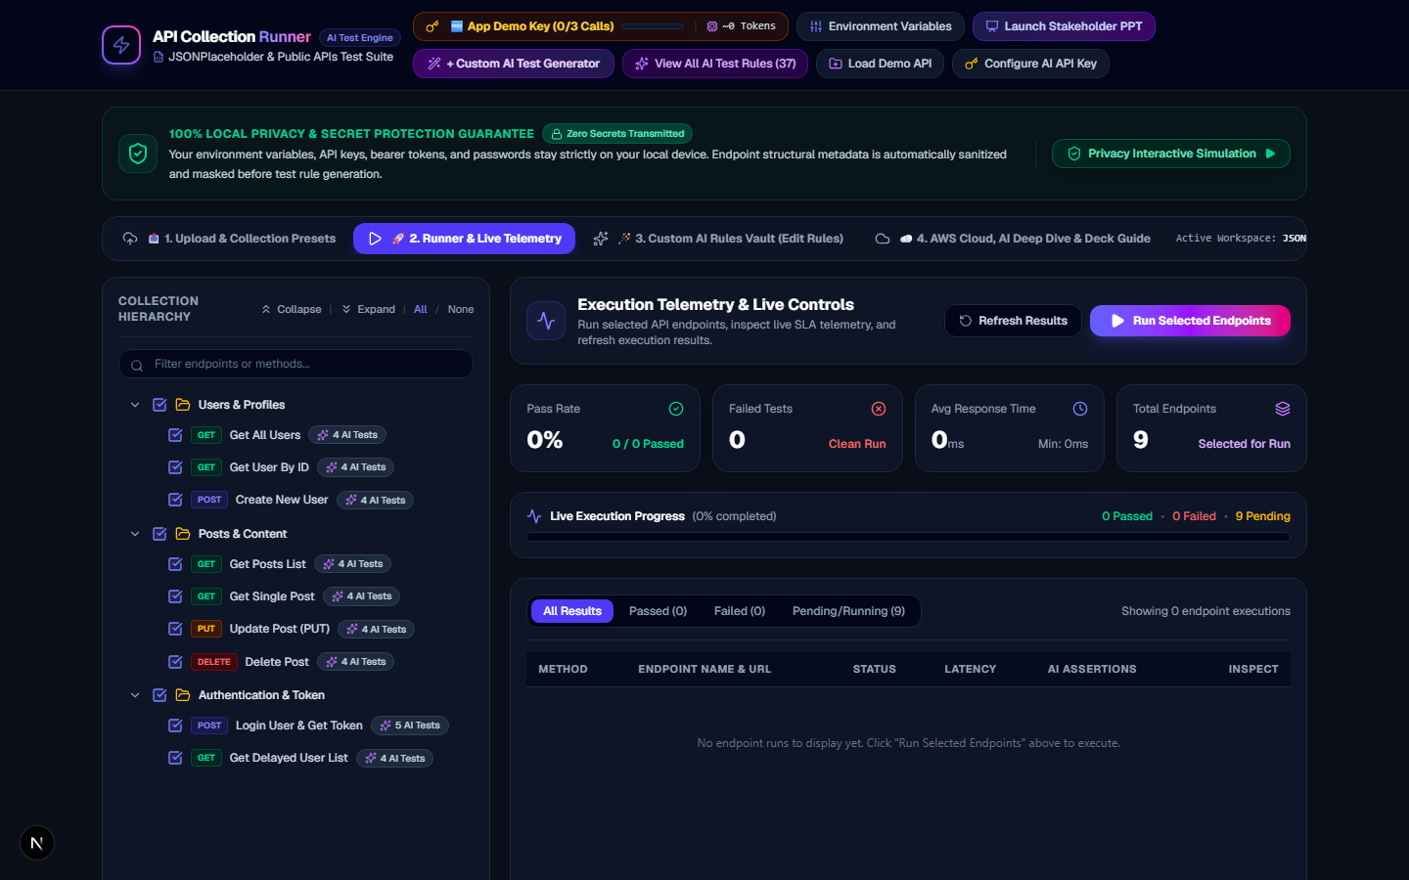
Slide 3: Workspace 2: Execution Telemetry & Runner Dashboard
Hierarchical tree selector with multi-level checkboxes, response SLA latency charts, and live execution progress.
API Collection Runner Walkthrough | Ved Tripathi (vedmtripathi@gmail.com)

Slide 4
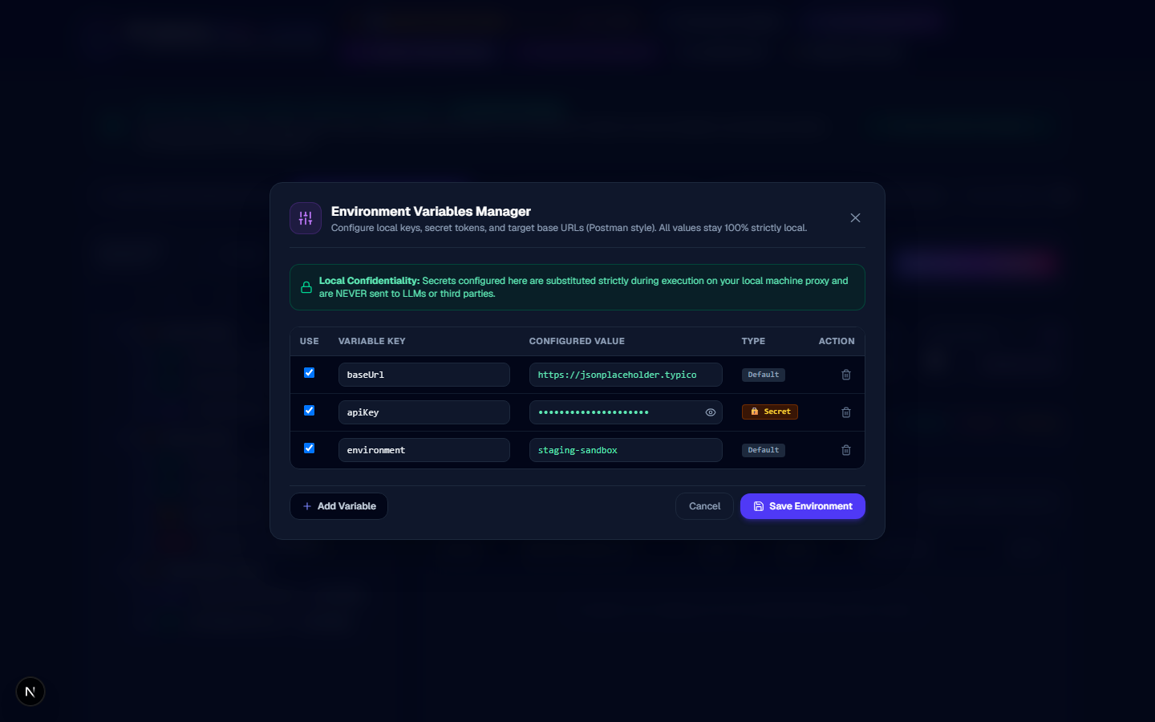
Slide 4: Postman-Style Environment Variables Manager
Scrollable environment key-value manager with local secret masking (password, tokens, auth keys).
API Collection Runner Walkthrough | Ved Tripathi (vedmtripathi@gmail.com)

Slide 5
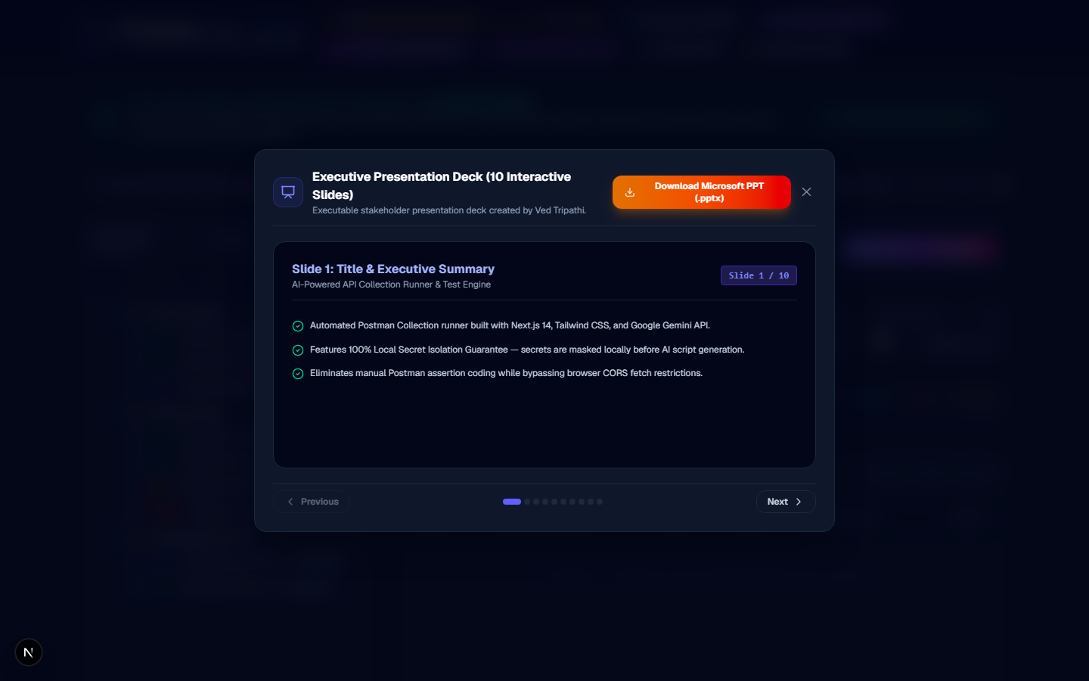
Slide 5: Executable Stakeholder Presentation Deck Modal
Interactive slide viewer and 1-click native Microsoft PowerPoint (.pptx) file generator.
API Collection Runner Walkthrough | Ved Tripathi (vedmtripathi@gmail.com)

Slide 6
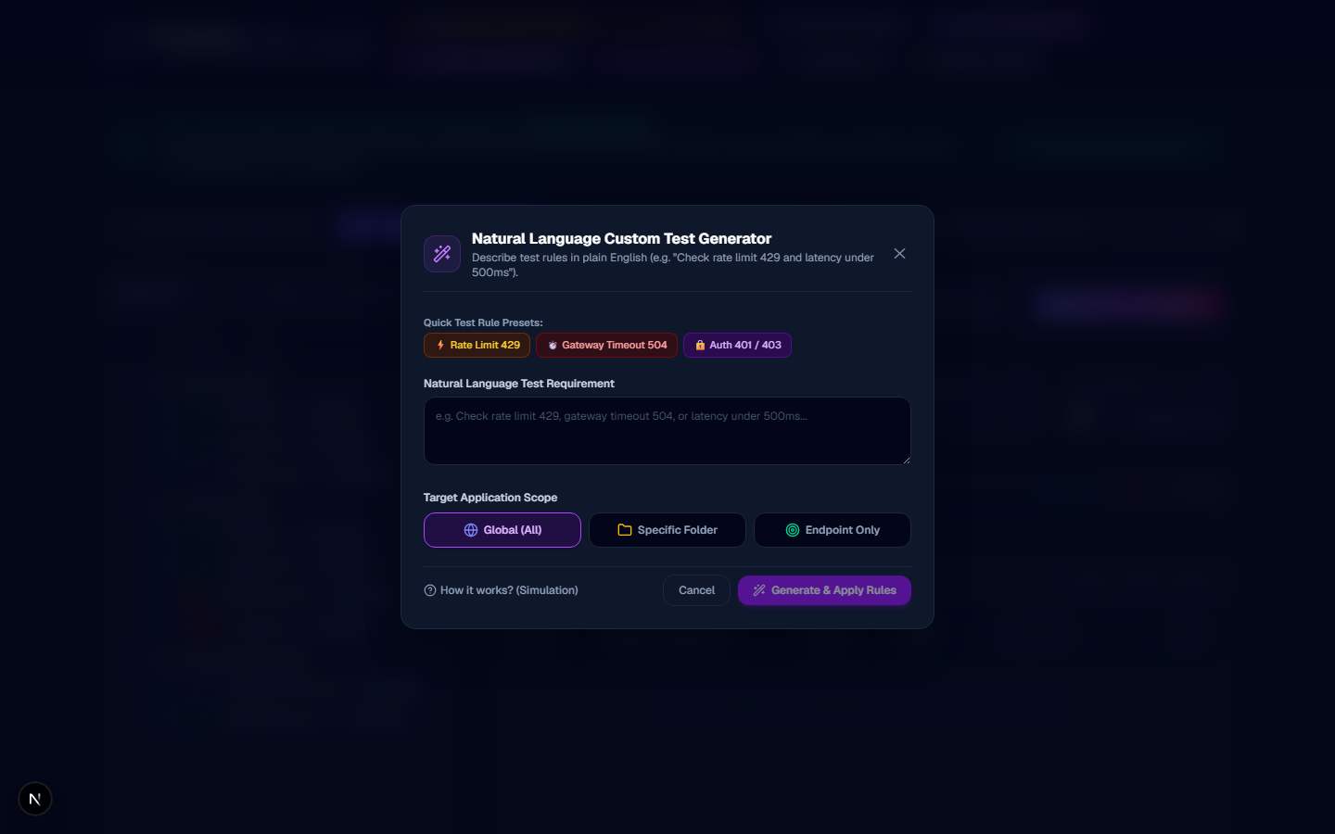
Slide 6: Natural Language Custom AI Test Generator
Type natural language testing criteria (e.g. "Check rate limit 429 and latency < 300ms") to generate JSON test rules.
API Collection Runner Walkthrough | Ved Tripathi (vedmtripathi@gmail.com)

Slide 7
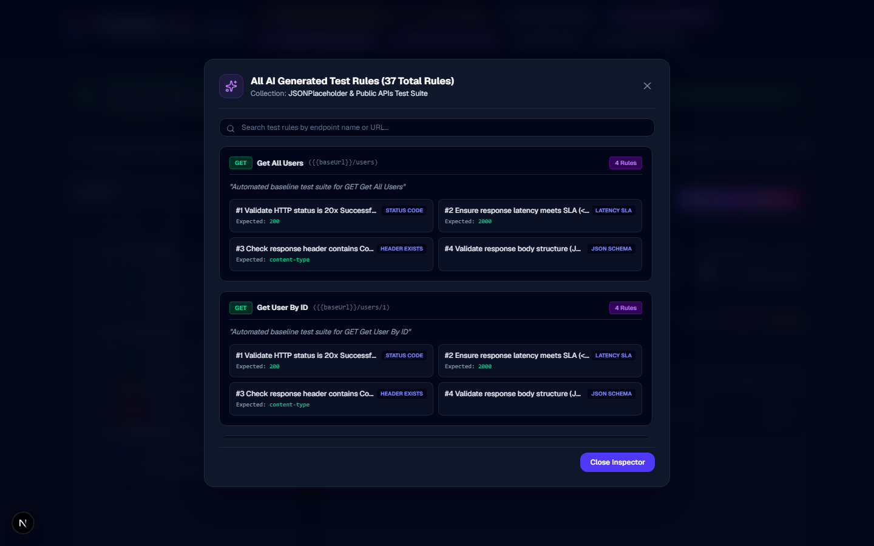
Slide 7: Comprehensive AI Test Rules Suite Viewer
Inspect generated assertions across endpoints (HTTP status codes, latency SLAs, headers, and JSON schemas).
API Collection Runner Walkthrough | Ved Tripathi (vedmtripathi@gmail.com)

Slide 8
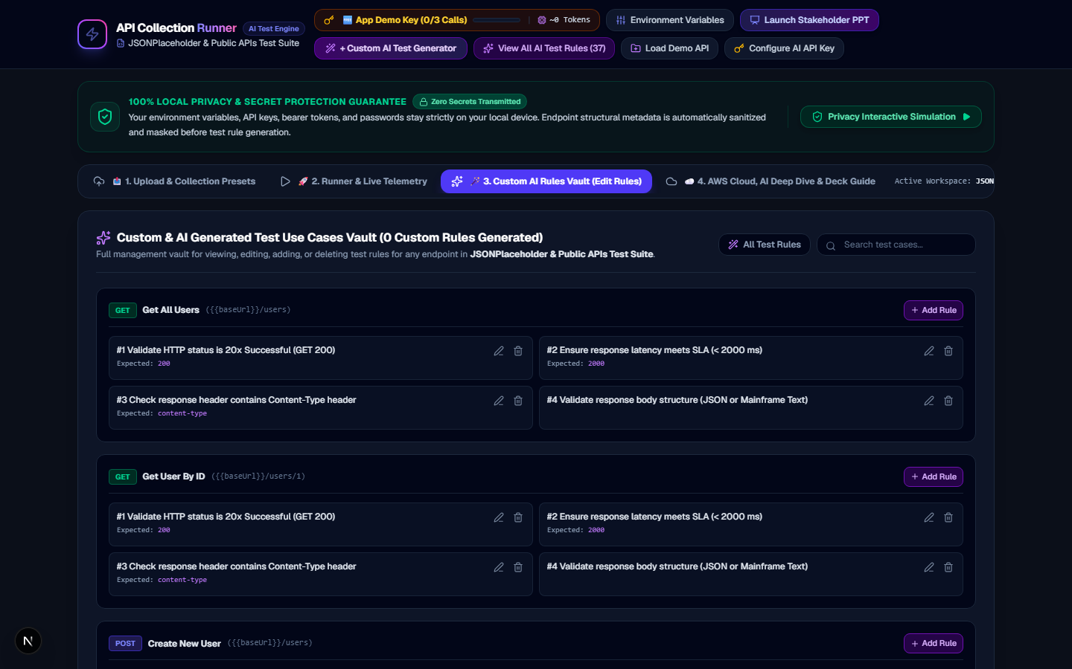
Slide 8: Workspace 3: Interactive Custom AI Rules Vault
Full CRUD management vault with Global, Folder, or Endpoint scope filters and custom rule badges.
API Collection Runner Walkthrough | Ved Tripathi (vedmtripathi@gmail.com)

Slide 9
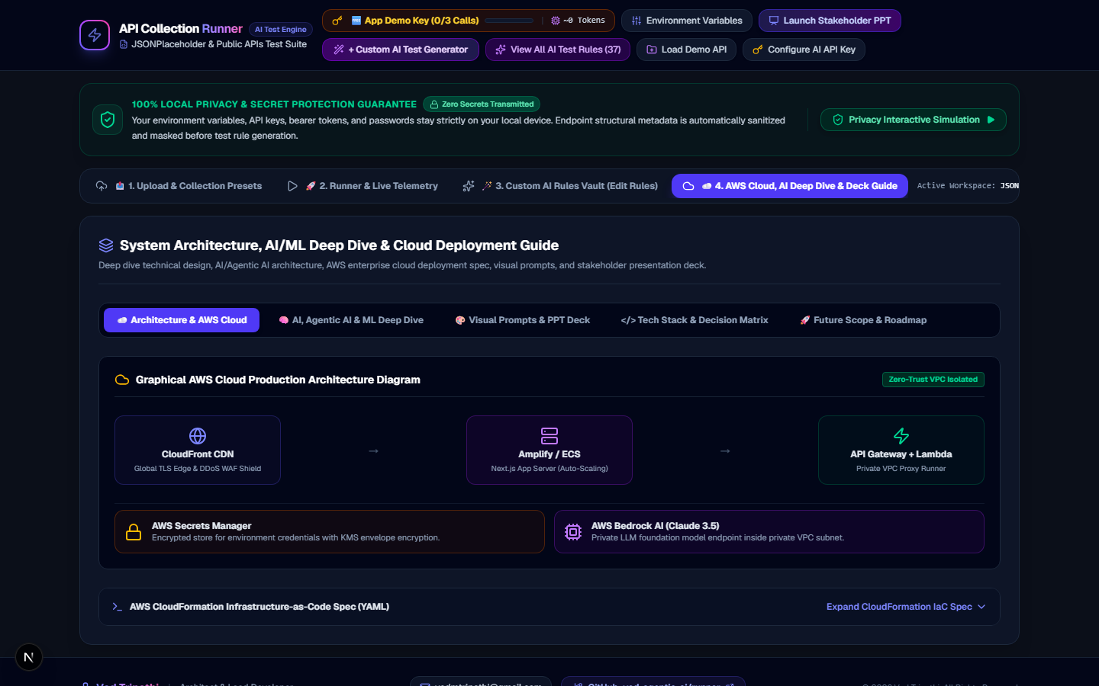
Slide 9: Workspace 4: AWS Cloud Architecture & AI Deep Dive
Enterprise AWS Cloud production architecture, CloudFormation IaC spec, and AI/Agentic AI execution loop deep dive.
API Collection Runner Walkthrough | Ved Tripathi (vedmtripathi@gmail.com)

