Slide 1



MANIPAL UNIVERSITY JAIPUR
Department of Computer and Communications Engineering
TEAM NAME
Plot Armor
TEAM ID
U6USN474
PROBLEM STATEMENT ID
HM-02
PROBLEM STATEMENT TITLE
Prescription Safety Checker for Indian Brand Medicines
36-HOUR HACKATHON • 24–25 OCTOBER 2026
THEME / DOMAIN
Health & MedTech
BUILD / INNOVATE / CREATE
CATEGORY
Software
hypnexismuj.com | @hypnexis.muj | hypnexis2026@muj.manipal.edu
Notes:
1

Slide 2

36-HOUR HACKATHON | 24–25 OCTOBER 2026 | MANIPAL UNIVERSITY JAIPUR
PARCHI: COUNT DOSES, NOT BRANDS
Plot Armor | U6USN474
PROBLEM STATEMENT
OUR SOLUTION
  A brand name doesn't tell you what's inside. Combination pills hide repeats, and one name can even mean two drugs: Medzol is sold as a sedative in one pack and an acid-reducer in another.
  The people with the most pills are hit hardest. 49% of older Indians take many medicines at once, often from doctors who each see only their own prescription.
  Today's tools don't close the gap. They check drugs two at a time, so a dose that adds up across three brands slips through. Hospital warning systems get overridden 46 to 96% of the time, and chatbots grade how serious an interaction is correctly only 37% of the time.
  Parchi reads a prescription the way a careful pharmacist would. It works out what is really inside every brand, even a misspelt one, and adds up each ingredient across all brands and all doctors.
  Then it checks the total against the patient's age, weight and kidneys, and looks for repeats, clashes and banned combinations.
  What's different: it counts doses, not just pairs of drugs, and it is built for Indian brand names and the way Indian doctors write dosing.
ONE DRUG, HIDDEN IN THREE BRANDS
Dolo 650 1-1-1 → 1,950 mg
Paracetamol
4,100 mg/day
vs 4,000 mg limit
Did you know? In September 2026 alone, India's drug regulator flagged 330 medicine samples as not of standard quality.
Crocin Cold&Flu TDS → 1,500 mg
INTERRUPT
Zerodol-P BD → 650 mg
Department of Computer and Communications Engineering • Manipal University Jaipur
2
Notes:
2

Slide 3
36-HOUR HACKATHON | 24–25 OCTOBER 2026 | MANIPAL UNIVERSITY JAIPUR
TECHNICAL APPROACH
Plot Armor | U6USN474
SYSTEM ARCHITECTURE
CORE TECHNOLOGIES
Goes in
The order, and past prescriptions
Age, weight, sex
A kidney test, if any
Safety check
Brand matcher
Dosing reader
Dose ledger
Limits and rules
Ranking
Comes out
Review queue
Prescription X-ray
Audit log
  TypeScript, React and Vite, packaged as an installable web app (PWA). One build runs on any phone, tablet or PC with a browser.
  Python cleans the public drug data once. Two libraries do the heavy lifting: fuse.js for fuzzy matching and Workbox to cache the app.
  A small Vercel API lets an e-pharmacy plug Parchi into its own system. An AI model (Gemini or Claude) only reads messy dosing text and drafts customer leaflets. It never decides an alert.
  Data in. Every line passes a brand matcher that forgives typos and sound-alikes, so 'dollo' and 'Brufan' still land on Dolo and Brufen.
  Dose maths. A reader turns 1-0-1, TDS and SOS into doses a day, and a ledger adds up each ingredient, brand by brand. 'As needed' is counted at its daily maximum.
  Alerts out. Rules compare the totals with limits and look for clashes. What comes out is ranked, with a reason and a source on every alert.
UNIQUE POINTS
  Same slip, same answer. Rules decide, so a pharmacist can always ask why.
  Hard to copy: 31,978 Indian brand names cleaned down to ingredients and strengths, tied to about 70,000 drug-pair interactions.
  It admits what it can't see. Ingredients with no interaction data are listed, so a quiet result is never read as 'safe'.
Department of Computer and Communications Engineering • Manipal University Jaipur
3
Notes:
3

Slide 4
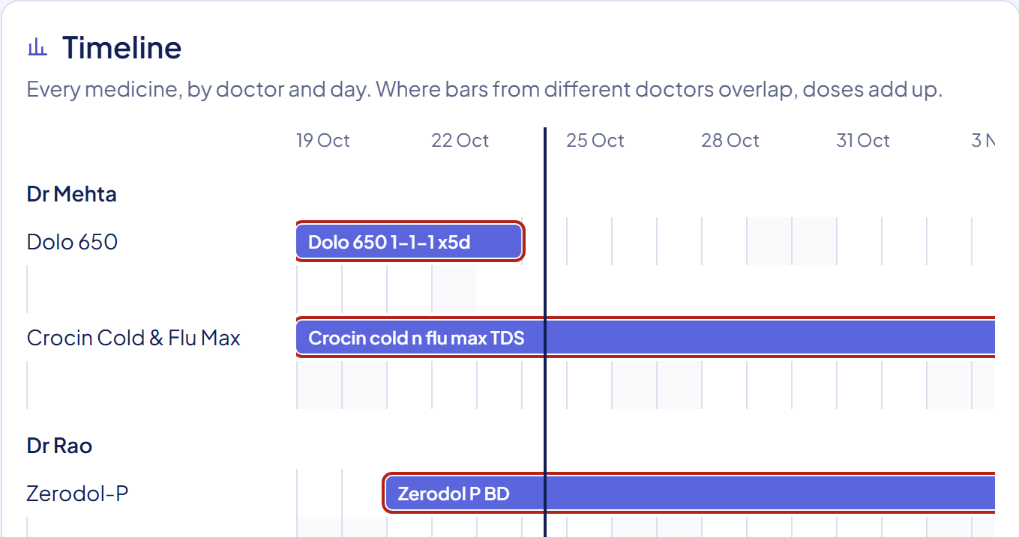
36-HOUR HACKATHON | 24–25 OCTOBER 2026 | MANIPAL UNIVERSITY JAIPUR
USER EXPERIENCE & DESIGN
Plot Armor | U6USN474
USER INTERFACE
USER FLOW
DESIGN GOAL
  Four screens. Check, for one prescription. Review queue, for many orders with the riskiest on top. Order, with each doctor's medicines laid out by date. Data, a look-up of every limit and rule.
  Open an alert to see why it fired. Overriding one needs a reason, and the reason goes into a log. One tap copies a note for the prescriber or the customer.
  Made to be read fast. Every alert has an icon and a word, never colour alone, and the whole app works from a keyboard.
1
An order lands in the queue. The pharmacist opens the top one and sees every doctor's medicines on one timeline.
In a few seconds the pharmacist sees whether to act, why, and where the warning comes from.
Parchi informs. The pharmacist decides.
2
Parchi adds up what overlaps and re-checks when a new kidney result arrives. Brands it doesn't know are marked unverified and left out of the totals.
3
The pharmacist holds or releases the order, and adds a short note if needed.
A real screen from the running app.
Department of Computer and Communications Engineering • Manipal University Jaipur
4
Notes:
4

Slide 5
36-HOUR HACKATHON | 24–25 OCTOBER 2026 | MANIPAL UNIVERSITY JAIPUR
FEASIBILITY AND VIABILITY
Plot Armor | U6USN474
TECHNICAL FEASIBILITY
ECONOMIC FEASIBILITY
OPERATIONAL VIABILITY
  It's built, not a mock-up. 1,137 automated tests pass.
  We tested it against outside lists, not only our own. A US expert panel named 16 drug pairs that must always alert, and we missed most of them. So we fixed it. The doses we could compare also match India's national formulary.
  A check takes under 3 milliseconds on a laptop, and each part can be swapped without touching the rest.
  Almost free to run. It is built on open tools, and a check runs on the pharmacist's own device.
  Cost grows slowly for the same reason. The one real cost is data: our interaction database is free only for non-commercial use, so a paid product needs a licensed one.
  No outside funding is needed to start. Revenue comes from the buyers on slide 7.
  It runs in a browser and works offline after the first load, which suits counters with patchy internet. An API connects it to an e-pharmacy's own review desk.
  Risk: it sounds like dose advice. Every alert ends 'pharmacist to review', and a test blocks any wording that names a dose. India's 2026 software rules put inform-only tools in the lowest-risk group.
  Risk: a wrong number hurts someone. Every limit stays marked 'not approved' until a pharmacist signs it. None has yet.
  Risk: patient privacy. We store nothing. The DPDP Act fines go up to ₹250 crore.
  Risk: more typing for a busy pharmacist. It reads the order data the buyer already has (CSV or FHIR).
3 → 13
of the 16 must-alert drug pairs now stop the pharmacist (3 are notes on purpose)
Department of Computer and Communications Engineering • Manipal University Jaipur
5
Notes:
5

Slide 6
36-HOUR HACKATHON | 24–25 OCTOBER 2026 | MANIPAL UNIVERSITY JAIPUR
IMPACT AND BENEFITS
Plot Armor | U6USN474
1
SOCIAL IMPACT
2
ENVIRONMENTAL IMPACT
  Safer for those most at risk. 28% of older Indians take medicines doctors advise against at their age, and 53.6% of Indians treat themselves. A check at the counter catches what no single doctor sees.
  A second pair of eyes for pharmacists, one that doesn't get tired at the end of a long queue.
  A duplicate caught early is a strip that isn't sold, taken or thrown away.
  The whole app is about 3 MB, downloaded once.
  We haven't measured any of this. It is a likely benefit, not a result.
3
TECHNICAL IMPACT
4
EDUCATIONAL IMPACT
  A fair way to test a safety tool. Every test says who wrote its answer: a published source, or us. Ours are never called proof.
  85 realistic Indian prescriptions (ours), plus a list of our own gaps, such as 480 brands where a second listing shows an ingredient our data lacks.
  Each alert names the brand that hides the ingredient. Pylokit looks like a stomach kit; it contains clarithromycin. Staff learn the hidden ones by seeing them.
  The Data page shows every limit and where it came from, so a pharmacy student can check our work.
Department of Computer and Communications Engineering • Manipal University Jaipur
6
Notes:
6

Slide 7
36-HOUR HACKATHON | 24–25 OCTOBER 2026 | MANIPAL UNIVERSITY JAIPUR
BUSINESS MODEL & SUSTAINABILITY
Plot Armor | U6USN474
TARGET USERS
REVENUE & COST MODEL
SUSTAINABILITY
  Who uses it: the pharmacist who checks each order at an e-pharmacy or a chain's counter. Not doctors, not patients.
  Who buys it: e-pharmacies like Tata 1mg, whose pharmacists already review every prescription, and chains like Apollo and MedPlus. Hospitals come later.
  Who goes first: a chain's central review desk, where one team checks many orders.
  Pilot: free at one partner pharmacy, to measure the minutes saved and the errors caught.
  Pricing: a small fee per check for e-pharmacies, a licence per store for chains, free for independent chemists.
  They would pay because reviews go faster and fewer risky products reach customers.
  Partners: a panel of pharmacists signs off the limits and rules. Buyers share their own product catalogue.
  Next: breastfeeding checks, more rules for older patients, and the customer leaflet in more languages.
  Open to checking: we would share our test set and source list so anyone can test our claims. The licence is still to be decided.
US$30B → 53B
India's pharmacy retail, 2025 to 2031 (Ken Research estimate)
Department of Computer and Communications Engineering • Manipal University Jaipur
7
Notes:
7

Slide 8
36-HOUR HACKATHON | 24–25 OCTOBER 2026 | MANIPAL UNIVERSITY JAIPUR
RESEARCH AND REFERENCES
Plot Armor | U6USN474
KEY TECH & RESEARCH SOURCES
  Poly T. N. et al., "Appropriateness of overridden alerts in computerized physician order entry: systematic review," JMIR Med. Inform., 8(7), e15653, 2020.
  Sicard J. et al., "Can large language models detect drug-drug interactions leading to adverse drug reactions?," Ther. Adv. Drug Saf., 16, 2025.
  Thapa R. B., Karki S., Shrestha S., "Exploring potential drug-drug interactions in discharge prescriptions: ChatGPT's effectiveness," Explor. Res. Clin. Soc. Pharm., 17, 100564, 2025.
  Bhagavathula A. S. et al., "Prevalence of polypharmacy, hyperpolypharmacy and potentially inappropriate medication use in older adults in India," Front. Pharmacol., 12, 685518, 2021.
  Neelakantan M., Sharma P., Kulkarni A., "Look-alike, sound-alike (LASA) drugs in India," Lancet Reg. Health Southeast Asia, 26, 100425, 2024.
  Rashid M. et al., "Prevalence and predictors of self-medication practices in India: a systematic review and meta-analysis," Curr. Clin. Pharmacol., 15(2), 90-101, 2020.
  Phansalkar S. et al., "High-priority drug-drug interactions for use in electronic health records," J. Am. Med. Inform. Assoc., 19(5), 735-743, 2012.
  Lapi F. et al., "Concurrent use of diuretics, ACE inhibitors, and ARBs with NSAIDs and risk of acute kidney injury," BMJ, 346, e8525, 2013.
  AGS Beers Criteria Update Expert Panel, "2023 updated AGS Beers Criteria," J. Am. Geriatr. Soc., 71(7), 2052-2081, 2023.
  Cockcroft D. W., Gault M. H., "Prediction of creatinine clearance from serum creatinine," Nephron, 16(1), 31-41, 1976.
  Standards and formulas: HL7 FHIR (India's ABDM prescription profile), the Cockcroft-Gault kidney formula, WHO AWaRe antibiotic groups.
  Datasets: DDInter 2.0 (302,516 interactions, 2,310 drugs); Kaggle A-Z and 1mg Indian brand data; CDSCO lists (156 combinations banned in 2024, 16 more in June 2026, plus monthly quality alerts); Jan Aushadhi; openFDA labels; Eka Care's brand and National Formulary question sets.
  Existing solution studied: medThinks does brand unpacking, pairwise interactions and banned-combination flags. Its public page (checked 24 Oct) doesn't mention adding up doses across brands.
  Documentation and links: open.fda.gov/apis/drug/label (drug labels), ddinter2.scbdd.com (interactions), huggingface.co/ekacare (Eka Care sets), cdsco.gov.in (banned and quality lists).
Department of Computer and Communications Engineering • Manipal University Jaipur
8
Notes:
8

Slide 9
THANK YOU
Plot Armor | U6USN474 | 7744039295
CREATE / AN / IMPACT
Notes:
9

