Slide 1
Welcome to rage.bait games…..
Play
_Ved❤️

Slide 2
So friends, this game has two parts,
Escape the Kidnappers.
Try to be weird.
Continue
_Ved❤️

Slide 3
The first game is escape the Kidnappers…..!
Continue

Slide 4
Hey dude, there are lot of conditions in our life where actually our brain and reasoning power is used even if we aren’t aware………
Now just Imagine, you have been kidnapped,then what would you do…?
Would you rather…….?
Continue…?
Latent S1 reference🍋🌶️

Slide 5
Escape the Kidnappers
One Wrong Move and You’re Gone
Continue
_Ved❤️

Slide 6

Hello There,
You have been kidnapped by a group, who has kept you in a big bungalow….
Choose each step after thinking properly, one mistake and the game is over
Continue
_Ved❤️

Slide 7
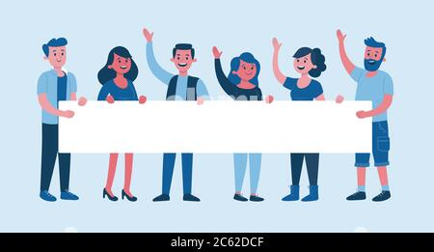
Ok…,
So You are kept in a room which is in the basement,
The bungalow has 3 floors and there are total 6 people who have Kidnapped you, where each and everyone always remain in pair…….!
Kidnappers
Continue
_Ved❤️

Slide 8
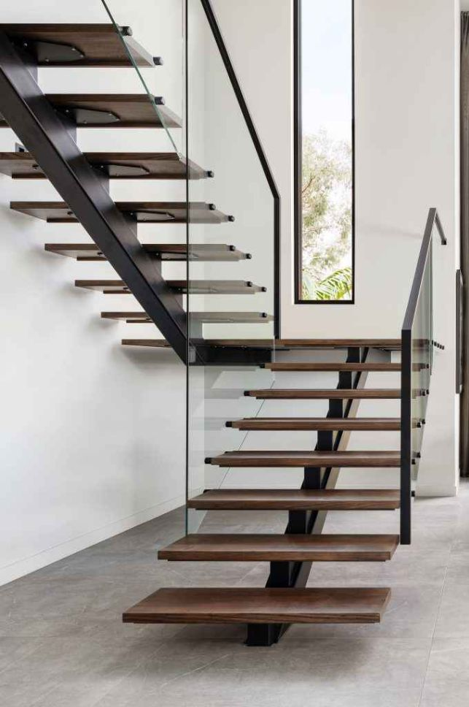
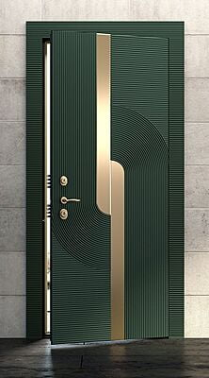
You somehow managed to free yourself and now you have two options…
Go towards the staircase……
Go toward the door……
Choose below
1.)
2.)
_Ved❤️

Slide 9
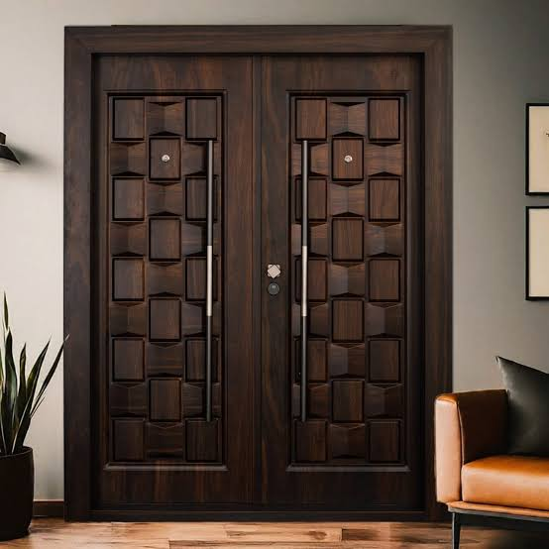
Well, you are safe, no kidnappers are around
Again you have 2 options
Climb up the stairs
Go toward the main hall from the door
1.)
2.)
_Ved❤️

Slide 10

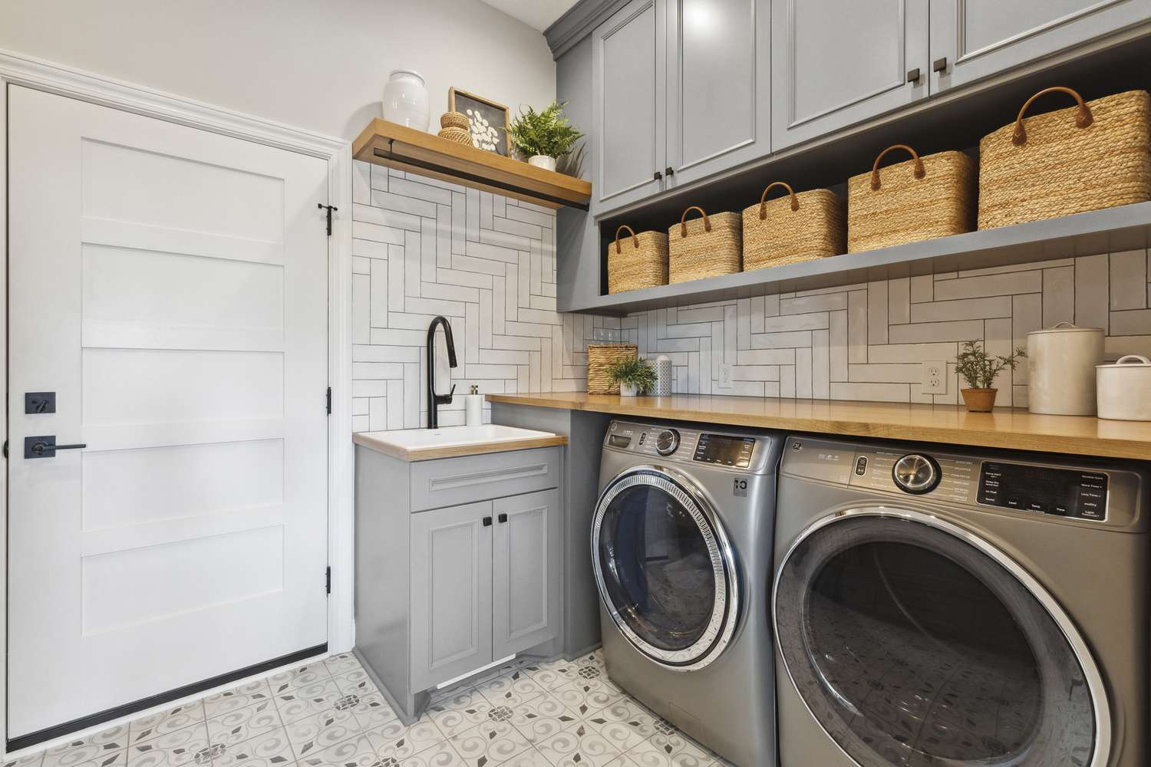
Sounds Safe……
Now there are two doors in front of you again…🤧
It’s the point of alert
Open the door that has written Kitchen
Open the door that has written Laundry
1.)
2.)
_Ved❤️

Slide 11
More to go yet…..
Almost halfway there…..
Would you rather…?
1.) Go towards the kitchen
2.) Go towards the dining area
1.)
2.)
_Ved❤️

Slide 12
Lesssss gooo 🥳
Halfway there
Continue
_Ved❤️

Slide 13
Suddenly you saw Kidnappers in front of you….
Would you rather…?
Walk Ahead slowly……
Run back immediately….
1.)
2.)
_Ved❤️

Slide 14
They were sleeping dude…..
You could choose any of it 😂
So, Would you rather…?
1.) Take a break and find something to eat……
2.) Go towards the gym area….
1.)
2.)
_Ved❤️

Slide 15
Ahhhhh…. I see, slowly being expert Huhhh….¿
Let the true game begin…😈
Just one more mistake, and the game is over…..
Continue
_Ved❤️

Slide 16
Difficulty increases here…..
Would you rather…?
Take the pepper spray, spray it in front of Kidnappers
Take a stick and hit the Kidnapper in front of you
1.)
2.)
_Ved❤️

Slide 17
You eliminated 1 Kidnapper, Yayyyy…
Would you rather…
1.) Take up the torch
2.) Take the mobile phone
1.)
2.)
_Ved❤️

Slide 18
Good choice…
Not yet, So would you rather
Try to eliminate the other Kidnapper
Go towards the second floor
1.)
2.)
_Ved❤️

Slide 19
Now it’s feeling boring, isn’t it ?
Let’s make it more crazier 🫠🤡
The elimination round starts now…😓
One Wrong Choice..,
The game is over..!!
Continue
_Ved❤️

Slide 20
The game creator himself got ragebitted while creating this game, so he wishes to just keep 2 more elimination qualifiers…
Would you rather..
Plan to unconscious other Kidnappers
Try to find out the way to get out of the house
1.)
2.)
_Ved❤️

Slide 21
Last but not the least…,
Would you rather….?
Jump out of the window
Run with maximum speed and get out
1.)
2.)
_Ved❤️

Slide 22

Told you to be careful…….🤕
You have been spotted by the Kidnappers..
Game over sticker
Continue
_Ved❤️

Slide 23
Congratulations, you successfully escaped from the Kidnappers…..🫡
But yeah…. You seemed lucky enough…..
Because this game is created in such a way that a person could easily be ragebitted
Thats other thing that creator got ragebitted
Continue
_Ved❤️

Slide 24
Congrats dude
Let’s go to the part 2 of this game wohooo🤓
It’s called how weird you could think…..
Continue
_Ved❤️

Slide 25
Let’s start game of rage.bait,
Very unfortunate unusual situational game it’s
Play
_Ved❤️

Slide 26
So, Where would you go to Travel
Disney Land
Universal Studios
1
2
_Ved❤️

Slide 27
Ewwww, bad choicee
Zero friendly vibes 🥺
Continue
_Ved❤️

Slide 28
Which travel method would you recommend
Airways from India to Australia
Train from USA to Alaska
1
2
_Ved❤️

Slide 29
Ewwww, bad choicee
Zero friendly vibes 🥺
Continue
_Ved❤️

Slide 30
What would you eat everyday for lunch for a week
French Fries
Pizza
1
2
_Ved❤️

Slide 31
Good Choice dude…,
Friendly vibes 🙃
Continue
_Ved❤️

Slide 32
Would you rather…
Watch your parents eating pizza everyday
Join them twice and eat bitter gourd and stop their pizza forever
1
2
_Ved❤️

Slide 33
Good Choice dude…,
Friendly vibes 🙃
Continue
_Ved❤️

Slide 34
Which cake is best
Chocolate Truffle
Brownies made by mom
1
2
_Ved❤️

Slide 35
Where would you go if you had a helicopter
Private Island
Cousins home
1
2
_Ved❤️

Slide 36
What would you do if you got 10 $
buy yourself some food
Do party with cousins
1
2
_Ved❤️

Slide 37
Good Choice dude…,
Friendly vibes 🙃
Continue
_Ved❤️

Slide 38
What if you found a genie
You would ask for a cool house
You would ask for a cool car
1
2
_Ved❤️

Slide 39
Good Choice dude…,
Friendly vibes 🙃
Continue
_Ved❤️

Slide 40
If you were a writer then,
you would write a motivational book
You would write a murder mystery
1
2
_Ved❤️

Slide 41
Ewwww, bad choicee
Zero friendly vibes 🥺
Continue
_Ved❤️

Slide 42
What will you watch in TV
Netflix show
Mr beast
1
2
_Ved❤️

Slide 43
Good Choice dude…,
Friendly vibes 🙃
Continue
_Ved❤️

Slide 44
If you’re looking to get a good food,then
you would go to nearest restaurant
You would order online
1
2
_Ved❤️

Slide 45
Ewwww, bad choicee
Zero friendly vibes 🥺
Continue
_Ved❤️

Slide 46
If you saw a ghost in front of you,Then
You would take a selfie
You would argue with him
1
2
_Ved❤️

Slide 47
Ewwww, bad choicee
Zero friendly vibes 🥺
Continue
_Ved❤️

Slide 48
So, the last question of this game…
What would you do if your opponent is you, yourself,
You would just ignore it
You would fight urself..
1
2
_Ved❤️

Slide 49
Good Choice dude…,
Friendly vibes 🙃
Continue
_Ved❤️

Slide 50
I don’t know about you but I definitely got ragebitted…..
So Thank you guys for playing this game
Email me for the game reviews 😋
_Ved❤️
My friend @pahal desai saved the day.. 😛

