Slide 1
INVESTMENT ASSIGNMENT SUBMISSION
Name: Vedavyas Burli

Slide 2
Introduction
Abstract: Spark Funds wants to make investments in a few companies. The CEO of Spark Funds wants to understand the global trends in investments so that she can take the investment decisions effectively.
Objective: The objective is to identify the best sector, countries and suitable investment type for making investments.
Business Understanding:
Spark Funds has two minor constraints for investments:
It wants to invest between 5 to 15 million USD per round of investment
Invest only in English-speaking countries because of the ease of communication with the companies it would invest in
Data Understanding
Company details – Basic details of 66368 companies with unique company ID, Company name main sector, category name, country.
Funding round details – Total observations are 114949
Sector classification mapping of category names in company table to 8 broad sector names

Slide 3
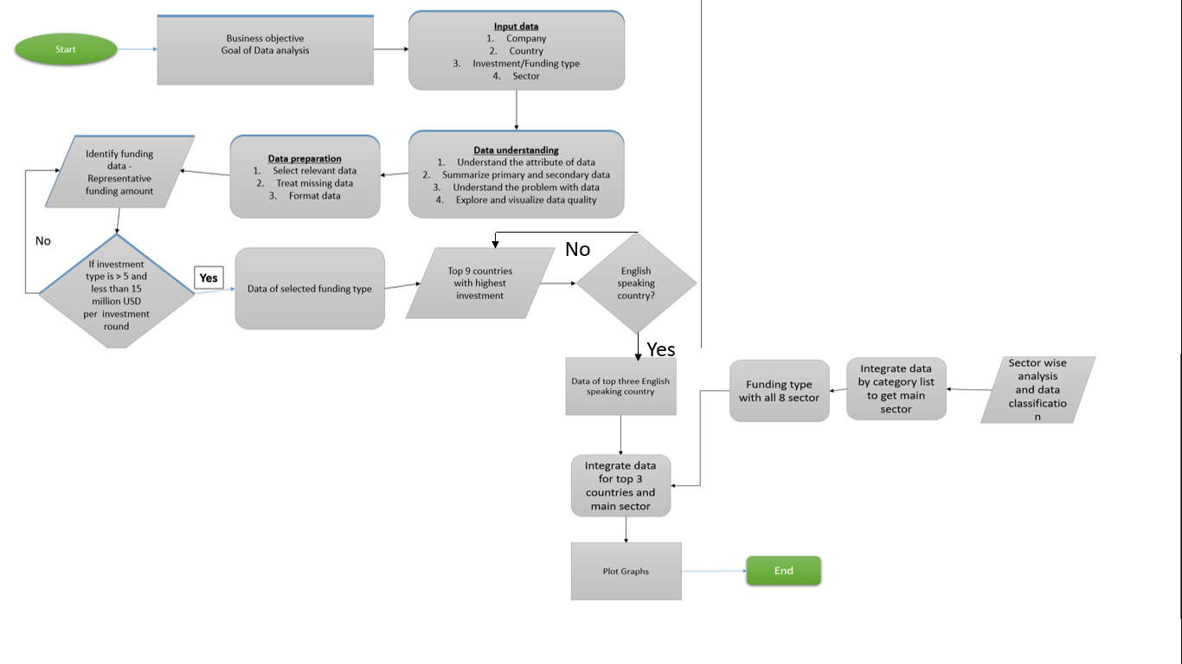
Problem solving methodology

Slide 4
Goals of data analysis
Goals are divided into three sub-goals:
Investment type analysis: Comparing the typical investment amounts in the venture, seed, angel, private equity etc. so that Spark Funds can choose the type that is best suited for their strategy.
Country analysis: Identifying the countries which have been the most heavily invested in the past. These will be Spark Funds’ favorite's as well.
Sector analysis: Understanding the distribution of investments across the eight main sectors

Slide 5
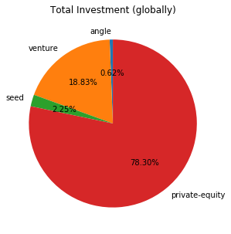
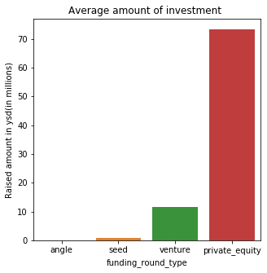
Funding type analysis
Plot 1
A plot showing the representative amount of investment in each funding type. Pie chart should make it clear that a certain funding type (FT) is best suited for Spark Funds.
Below graph shows average funding amount of 4 funding types – venture, angel, seed and private_equity
Venture funding type looks promising and most suitable as its average funding amount is between $5Million and $15 million

Slide 6
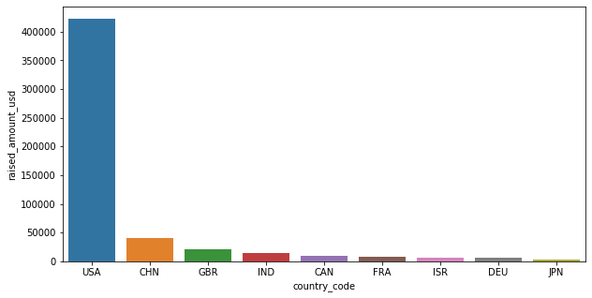
Country analysis
Plot 2
Spark fund wants to invest in countries which have been heavily invested in past but they should be only English speaking countries
Based on analysis , heavily invested top 9 countries are Usa,GBR,IND,China,Canada,France,Isreal,Germany And Japan
Top 3 English speaking country are with highest investment

Slide 7
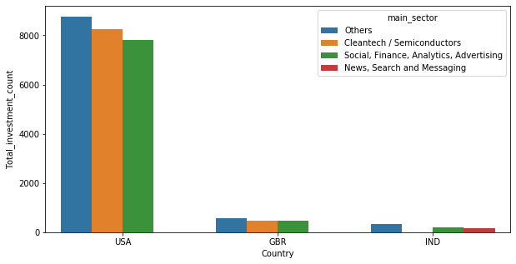
Sector analysis
Plot 3
Based on sector analysis , below graph shows top 3 sectors where most investors are investing for top 3 countries.
This plot should clearly display the top 3 sectors each in USA,GBR and IND

Slide 8
Conclusions
Considering all the Objectives, constraints, strategy Spark funds should consider investing in the following:
Spark fund should consider investing in “Venture” funding type in Others main sector in USA as that is where most investments are present
USA, Great Britain and India are other different countries spark fund should consider to invest to reduce the risk due to country specific economy fluctuations
If Spark funds wants to further reduce risk by investing in different sectors also with different countries then please consider mentioned sectors in previous slides for top 3 country wise top 3 sectors.

