Slide 1


Shri Ramdeobaba College of Engineering & Management, Nagpur
Department of Computer Science & Engineering(AIML)
Session 2023-2024
SEMINAR
ON
Movie Recommendation Web App using Machine Learning
Presented By:
Group No : 6
Group Members :
Chaitanya Muley
Harshal Bardikar
Om Aote
Ved Pandhare
Guided By: Dr. Amit Pimpalkar

Slide 2
Contents
Introduction
Motivation
Literature Survey
Objectives
Proposed Plan of Work
Architecture
Dataset
Output
Technology
Expected Outcome
Summary
Timeline
References

Slide 3
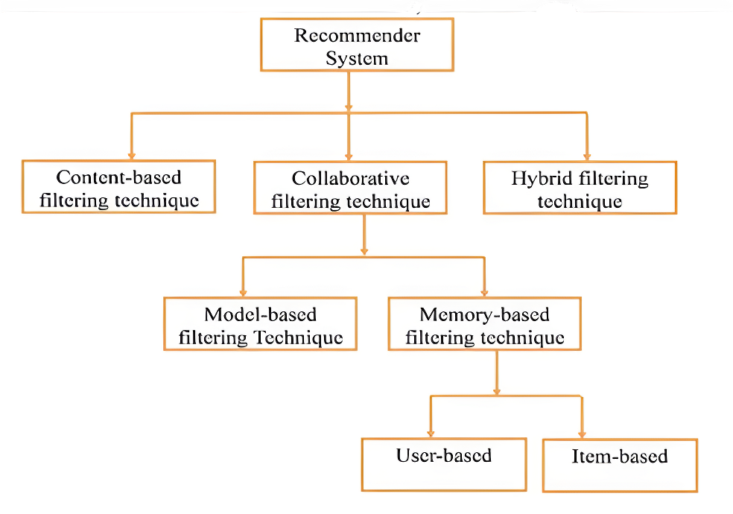
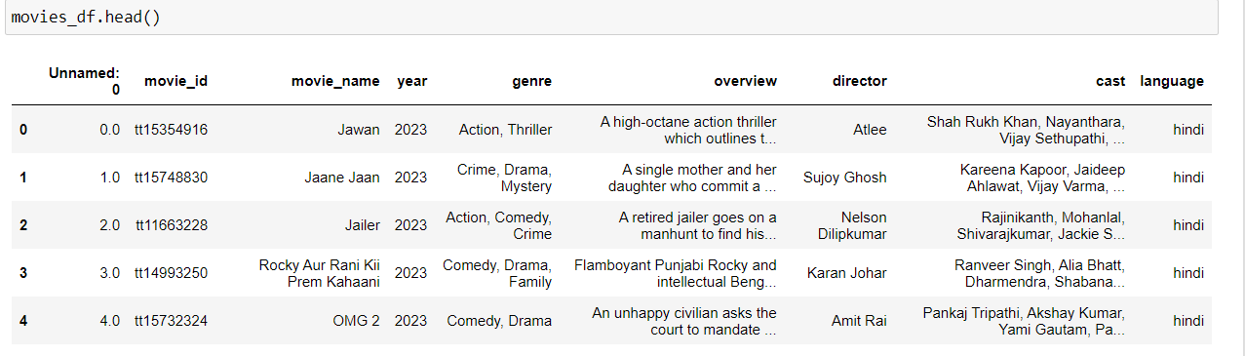
Introduction
The project aims to develop a recommendation system using machine learning.
We extract features like genre, plot, cast, and language to recommend movies similar to those the user desire for.
The system will focus on Hindi and Marathi movies.

Slide 4
Motivation
Many people feel unsure about what to watch after finishing a movie.
Recommendation systems solve this by understanding user preferences and suggesting movies.
They enhance user satisfaction by offering tailored suggestions.
This improves user experience and boosts engagement.
Machine learning identifies patterns in movie data for more accurate, personalized recommendations.

Slide 5
Literature Survey
Ref | Year | Approach/ Algorithm | Work Done | Source/ Dataset | Findings & Accuracy
[1] | 2023 | Content-Based Filtering & Neural Networks | Developed a system using content-based filtering enhanced with neural networks to improve movie recommendations. | IJFMR Paper Dataset: MovieLens 100k | Achieved high accuracy (85%) but faced challenges in handling sparse datasets.
[2] | 2024 | Collaborative Filtering & SVD | Implemented collaborative filtering using matrix factorization (SVD) to personalize recommendations. | NAAC Paper Dataset: MovieLens 1M | Improved recommendation accuracy (78%) but faced scalability issues.
[3] | 2023 | Hybrid Approach (Collaborative & Content-Based) | Proposed a hybrid model combining collaborative filtering and content-based approaches. | Studocu Paper Dataset: MovieLens 2M | Effectively reduced sparsity issues, leading to 80% accuracy in predictions.
[4] | 2023 | Improved KNN | Proposed an optimized KNN method combined with collaborative filtering. | IJNRD paper Dataset: Custom dataset | Improved accuracy (82%) but low quality of data and not optimal.
[5] | 2023 | Deep Learning & Collaborative Filtering | Applied deep learning techniques combined with content-based filtering to predict user preferences. | ScienceDirect Paper Dataset: Netflix Prize dataset. | Achieved accuracy of 84%, though faced challenges with cold-start users.

Slide 6
Objectives
Objectives
Develop a user-friendly web app
Implement a movie recommendation system
Enable advanced filtering options
Deploy the app on Vercel

Slide 7
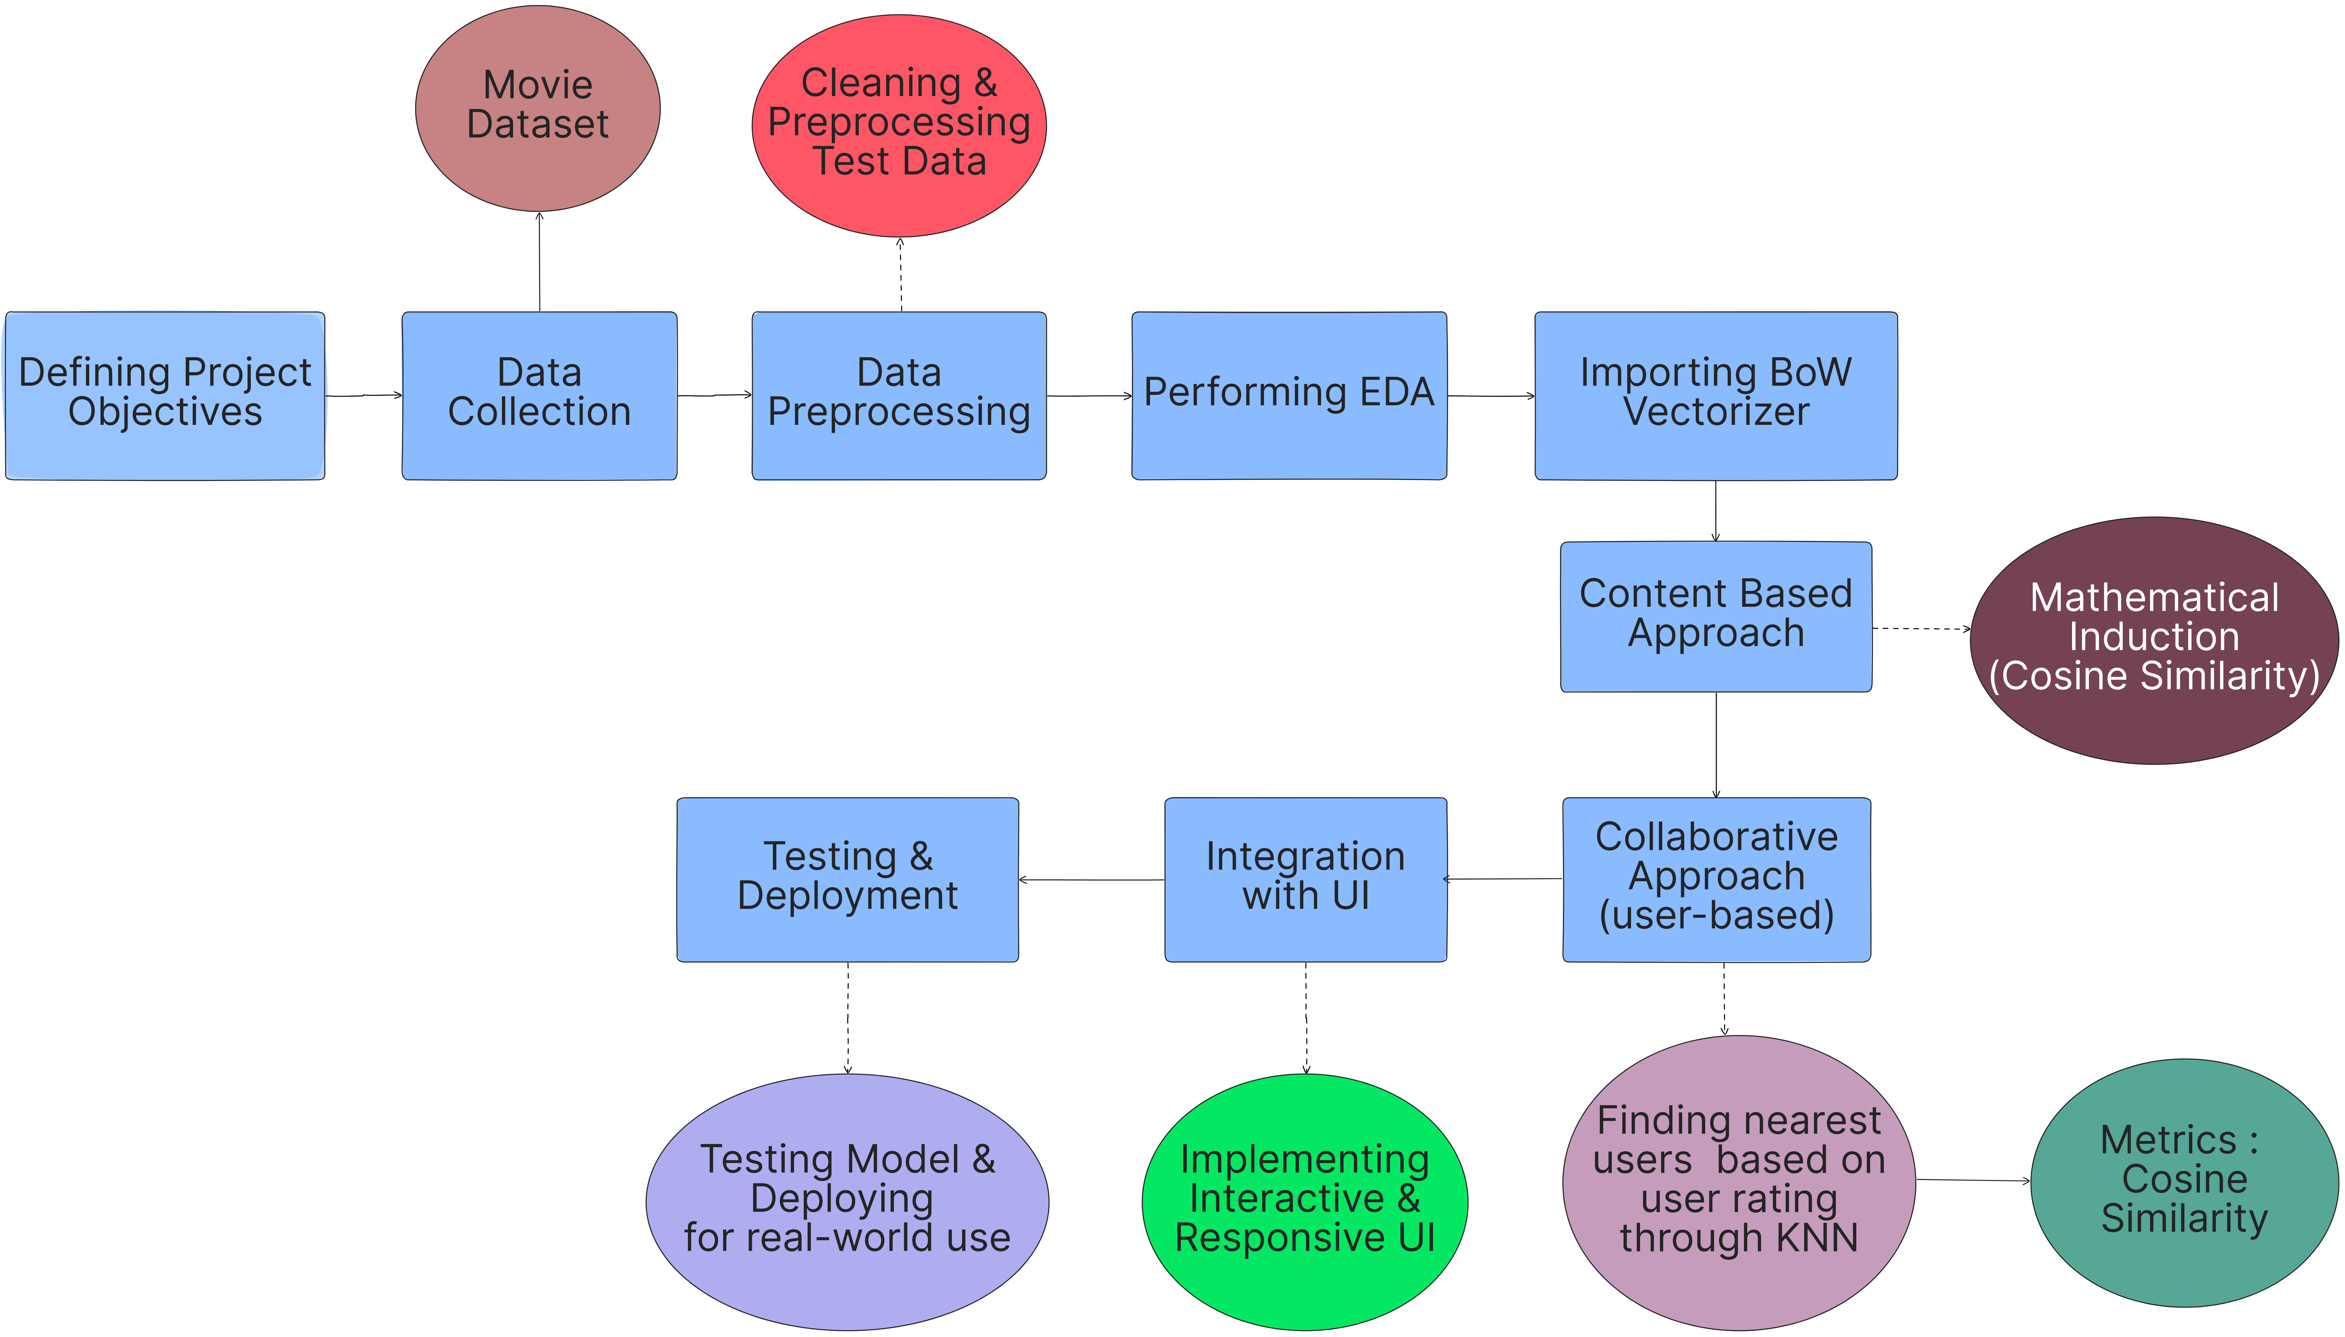
Proposed Plan of Work

Slide 8
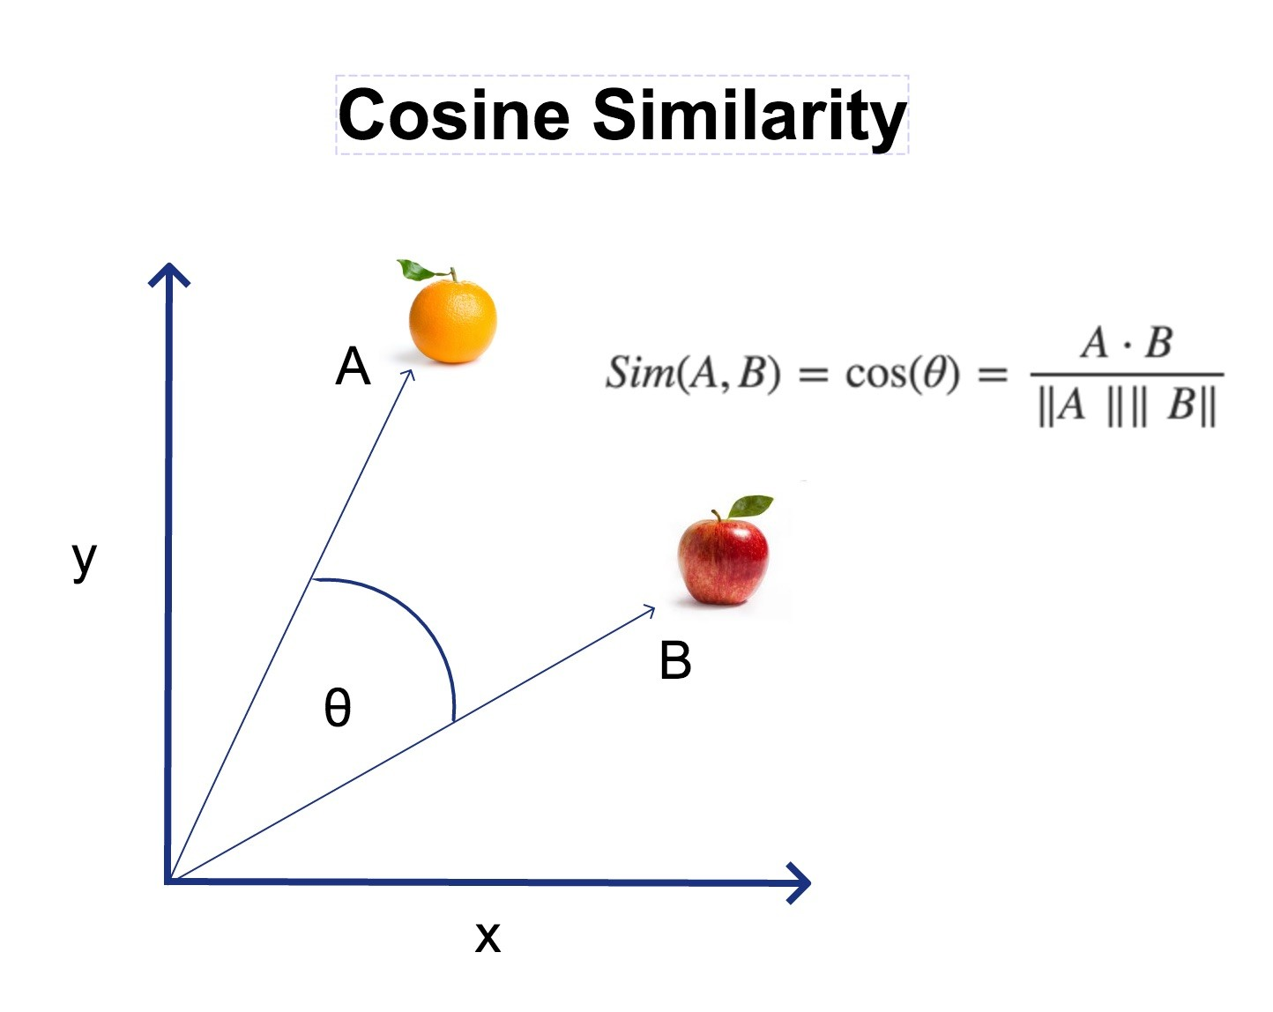
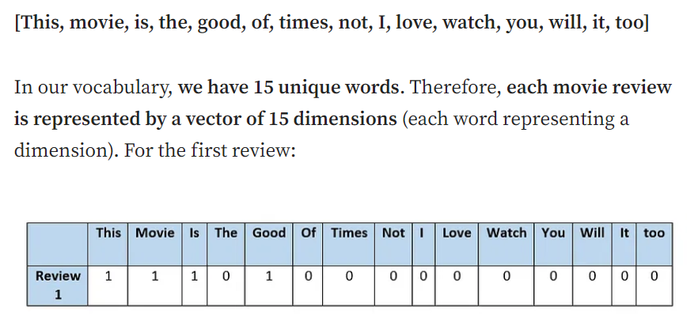
Cosine Similarity:
Measures the angle between two vectors.
Ranges from -1 (completely opposite) to 1 (exactly similar).
Often used in text and recommendation systems to find similarity between items.
Focuses on the direction of vectors, not their magnitude.
BoW Vectorization:
Converts text into a vector of word counts.
Ignores grammar and word order, focusing on word frequency.
Simple but effective method for text representation in machine learning.
Used in tasks like text classification and information retrieval.

Slide 9
Collaborative User-Based Approach:
Recommends movies based on preferences of users with similar taste.
Identifies users who rate movies similarly and suggests movies they liked.
Assumes that similar users will enjoy similar movies.
Continuously improves as more users rate movies.
K-Nearest Neighbors (KNN):
Finds the k most similar users based on their movie ratings.
Recommends movies that the nearest neighbors liked but the target user hasn't watched.
Uses cosine similarity or other distance metrics to identify close users.
Simple, effective method for real-time movie recommendations.

Slide 10
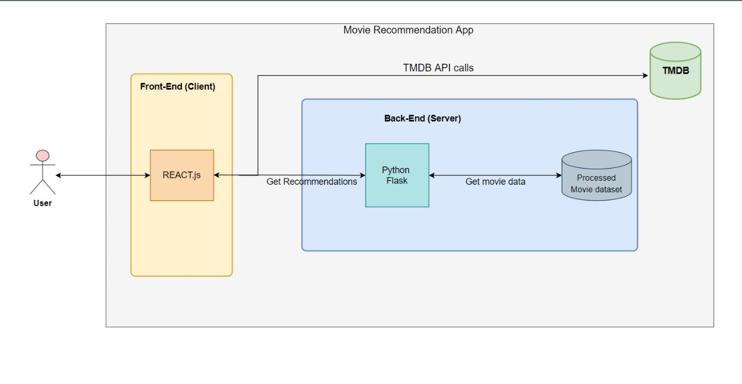
Architecture

Slide 11
Dataset
Attributes : ID, Name, Year, Genre, Overview, Director, Cast, Language
Language : Hindi & Marathi
Genre : Action, Drama, History, Comedy, etc.
Timeline : 1950-2023
Total Movies : 2500

Slide 12
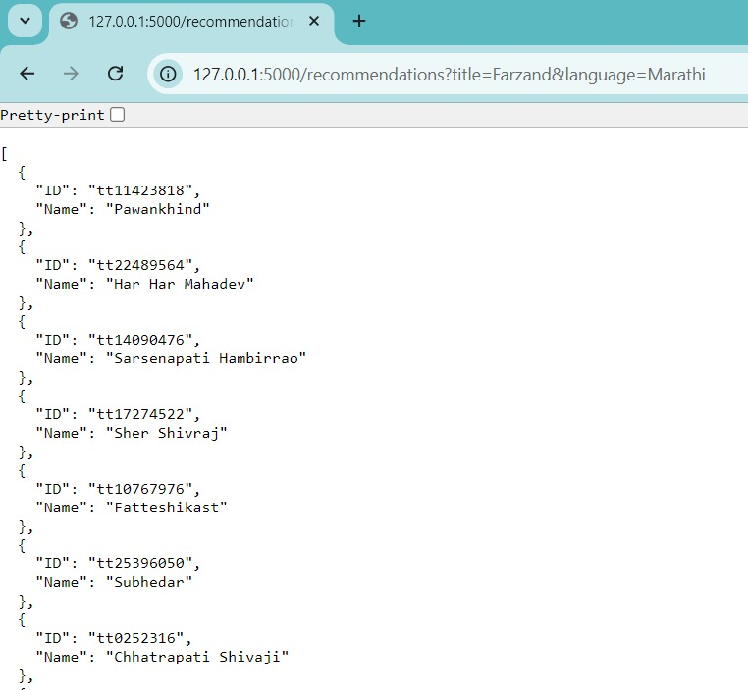
Output
GitHub Link

Slide 13






Technology
Backend: Flask (Python)
Frontend: React JS
Machine Learning: KNN, Scikit-Learn
Data Preprocessing: Bag of Words vectorization, Pandas
Deployment: Vercel, GitHub for version control

Slide 14
Expected Outcome
A functional movie recommendation web app.
Accurate movie suggestions.
Efficient search and filtering system.
Integration of collaborative filtering.

Slide 15
Summary
Combines feature extraction and similarity measures for movie recommendations.
Utilizes Bag of Words and cosine similarity for efficient initial deployment.
Introduces collaborative filtering with K-Nearest Neighbors (KNN) to enhance recommendations based on user behavior.
Built with a Flask backend and React frontend.
Deployed on Vercel for accessibility and scalability.

Slide 16
Timeline
Week 1
Planning & Analysis
Defining project scope, gathering requirements, and analyzing data needs.
Weeks 2-4
Data Collection
Gathering data from various sources and preparing it for analysis.
Week 5
ML Implementation
Vectorizing data and implementing Machine Learning Algorithm.
Week 6
Backend Development
Developing the server-side logic using the Flask framework.
Week 7
Frontend Development
Building the user interface using the React framework.

Slide 17
Result

Slide 18
References
[1]. C.M.Surushe, S.R.Tathe, Ms. K. R. Ghule , “Movie Recommendation System,” International Journal For Multidisciplinary Research (IJFMR), vol. 9, no. 1, Jan. 2023, pp. 210-215.
[2]. S. Basak, S. Pandey, S.D.Chowdhury, T. Gayen “MOVIE RECOMMENDATION SYSTEM USING HYBRID-BASED MODEL,” IEM Group, 2024, pp. 150-155..
[3]. Shaurya Gupta, Satyam Mishra, Pranav Pandey, “Recommendation Systems: Methods and
Evaluation,” Studocu, 2022, pp. 90-95.
[4]. Nirbhay Singh Sanket Bhokare Mayur Shah, “Enhanced KNN Algorithm for Movie Recommendation System,” International Journal of Novel Research and Development (IJNRD), vol. 8, no. 4, April 2023, pp. 680-685.
[5]. Gopal Behera and Neeta Nain, “Collaborative Filtering with Temporal Features for Movie Recommendation System,” Procedia Computer Science, vol. 215, Jan. 2023, pp. 307-315.

Slide 19
Thank You

Slide 20
Working
Content Based Filtering
'overview': ["A superhero saves the world", "A superhero faces challenges"]
Vocabulary: ['challenges', 'faces', 'saves', 'superhero', 'world’]
Movie 1: [0, 0, 1, 1, 1] # "saves", "superhero", "world“
Movie 2: [1, 1, 0, 1, 0] # "challenges", "faces", "superhero“
Cosine Similarity= Dot Product / ( ∥Movie1∥×∥Movie2∥ )
Cosine Score Matrix
 | A | B | C
A | 1.0 | 0.666 | 0.447
B | 0.666 | 1.0 | 0.0
C | 0.447 | 0.0 | 1.0
Then we will return top 10 movies on the basis of decreasing order of cosine score except the target movie.

Slide 21
Working
Collaborative Based Filtering
User-Movie Matrix
User/Movie | Movie A | Movie B | Movie C | Movie D | Movie E
User 1 | 5 | 3 | 0 | 0 | 4
User 2 | 4 | 0 | 0 | 5 | 1
User 3 | 1 | 0 | 4 | 4 | 0
User 4 | 0 | 3 | 5 | 4 | 0
User 5 | 3 | 4 | 0 | 0 | 5
Get similar users using cosine similarity.
Calculate the avg rating for each movie across similar users.
Filter out movies already rated by the target user.
Sort and Recommend movies.

Slide 22
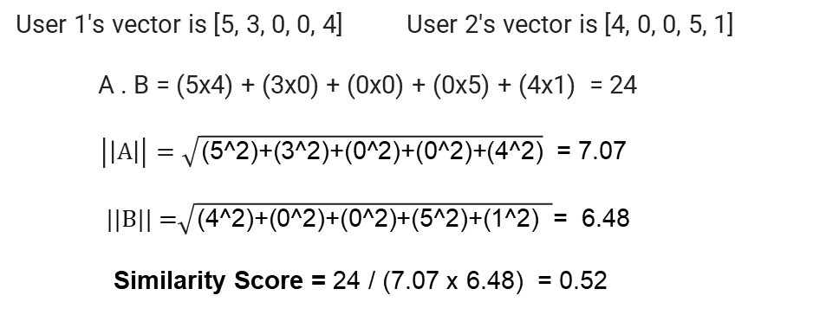
Finding Cosine Score
Get similar users using cosine similarity.
User 1's vector is [5, 3, 0, 0, 4] User 2's vector is [4, 0, 0, 5, 1]
A . B = (5x4) + (3x0) + (0x0) + (0x5) + (4x1) = 24
$\left|\left|A\right|\right|=\sqrt{\text{(5}\text{^}\text{2)+(3^2)+(0^2)+(0^2)+(4^2)}}$ = 7.07
||B|| =$\sqrt{\text{(}\text{4}\text{^2)+(}\text{0}\text{^2)+(0^2)+(}\text{5}\text{^2)+(}\text{1}\text{^2)} }\text{= 6.48}$
Similarity Score = 24 / (7.07 x 6.48) = 0.52
Calculate the avg rating for each movie across similar users
Example of averaged ratings:
Movie A: (3 + 0 + 4 + 1) / 4 = 2.0
Movie B: (4 + 3 + 0 + 0) / 4 = 1.75
Movie C: (0 + 5 + 0 + 4) / 4 = 2.25
Movie D: (0 + 4 + 5 + 4) / 4 = 3.25
Movie E: (5 + 0 + 1 + 0) / 4 = 1.5

