Slide 1
Image Compression using the 2D Discrete Cosine Transform
A JPEG-baseline style codec with rate-distortion analysis
IC2306 — Signal and Image Processing
Course project • Presented by Ved

Slide 2
Agenda
What we will cover
• Why compress images at all — the information-theoretic motivation
• From the DFT to the DCT — and why the DCT is the right tool
• The 2D DCT in matrix form, and what its 64 basis images look like
• Quantisation — where the loss actually happens
• System design: encoder, decoder, quality factor
• Results on the 512×512 ‘ascent’ image at Q = 10, 20, 50, 90
• Rate–distortion analysis and where the reconstruction error lives
• Discussion, limitations, and future extensions

Slide 3
Motivation
Why compress images?
• A 512×512 8-bit grayscale image is 256 KB of raw pixel data.
• Neighbouring pixels are strongly correlated — most of that data is redundant.
• The human eye is far more sensitive to low-frequency detail than to high.
• A good codec should exploit both: decorrelate, then throw away what cannot be seen.
• JPEG does this with three stages — we will reproduce the first two from scratch.
Goal: not to produce a JPEG file, but to make the mathematics visible.

Slide 4
Course outcomes
Mapping to the IC2306 syllabus
• CO1 – sampling & LTI operations → used implicitly in block-wise DCT
• CO2 – DFT and FFT → DCT is derived from an even-symmetric DFT
• CO3 – filter design → quantisation acts like a spatial low-pass filter with varying cutoff
• CO4 – pixel operations → level shift, padding, clipping, block traversal
• CO5 – image transforms → 2D DCT basis, separability, energy compaction
• CO6 – image enhancement & restoration → blocking & ringing as predictable artefacts

Slide 5
Mathematics 1 of 4
From the DFT to the DCT
• The DFT of a real block is complex — every coefficient needs two numbers.
• The implied periodic extension is discontinuous — creates spurious high-frequency energy.
• Extending the signal even-symmetrically before transforming fixes both issues.
DCT-II of length N:
X[k] = α(k) · Σₙ x[n] · cos( (2n+1) k π / (2N) ), k = 0 … N−1
with α(0) = √(1/N), α(k) = √(2/N) for k > 0
Result: real coefficients, smoother periodic extension, better energy compaction.

Slide 6
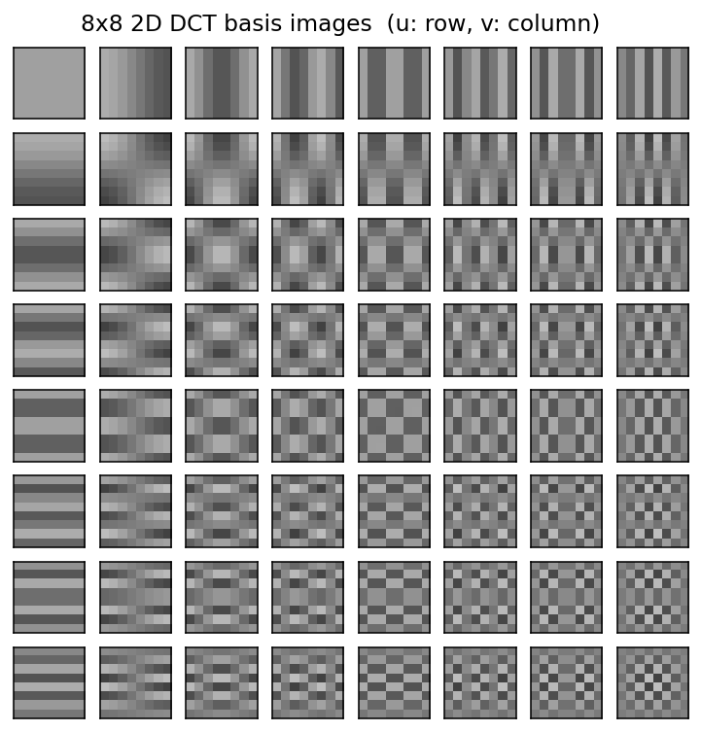
Mathematics 2 of 4
The 2D DCT is separable
• Build T once: T[k,n] = α(k) cos((2n+1)kπ/2N)
• T is orthonormal, so T⁻¹ = Tᵀ.
• 2D DCT of an 8×8 block: F = T · f · Tᵀ
• 2D IDCT: f = Tᵀ · F · T
• Separability cuts cost from O(N⁴) to O(N³).
• Basis images are outer products — see right.

Slide 7
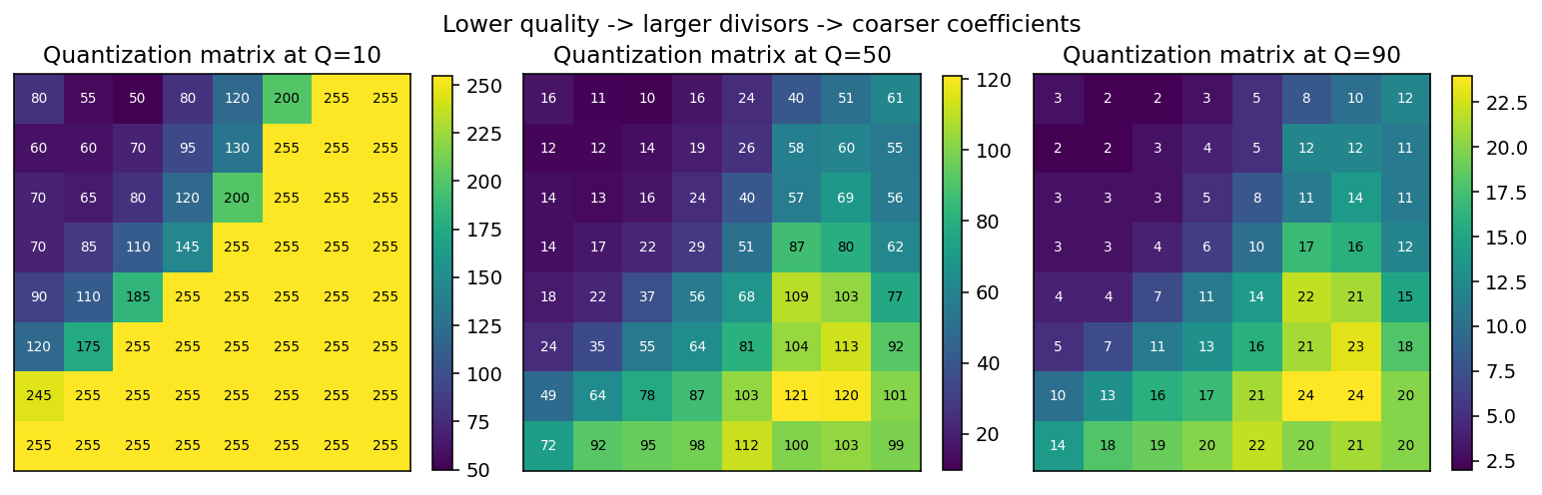
Mathematics 3 of 4
Quantisation is where loss happens
• F_q(u,v) = round( F(u,v) / Q'(u,v) ) — only lossy step in the pipeline.
• Q' is the IJG luminance table scaled by the quality factor.
• High-frequency coefficients get larger divisors → more zeros after rounding.

Slide 8
Mathematics 4 of 4
One integer controls everything
• Scale factor: scale = 5000 / Q if Q < 50, scale = 200 − 2Q otherwise
• Q'(u,v) = max(1, round( Q₅₀(u,v) · scale / 100 ))
• Lower Q ⇒ bigger divisors ⇒ more zeros ⇒ lower entropy AND more detail lost.
• Measure distortion with PSNR = 20 · log₁₀(255 / √MSE).
• Measure rate with Shannon entropy of the quantised coefficient stream.

Slide 9
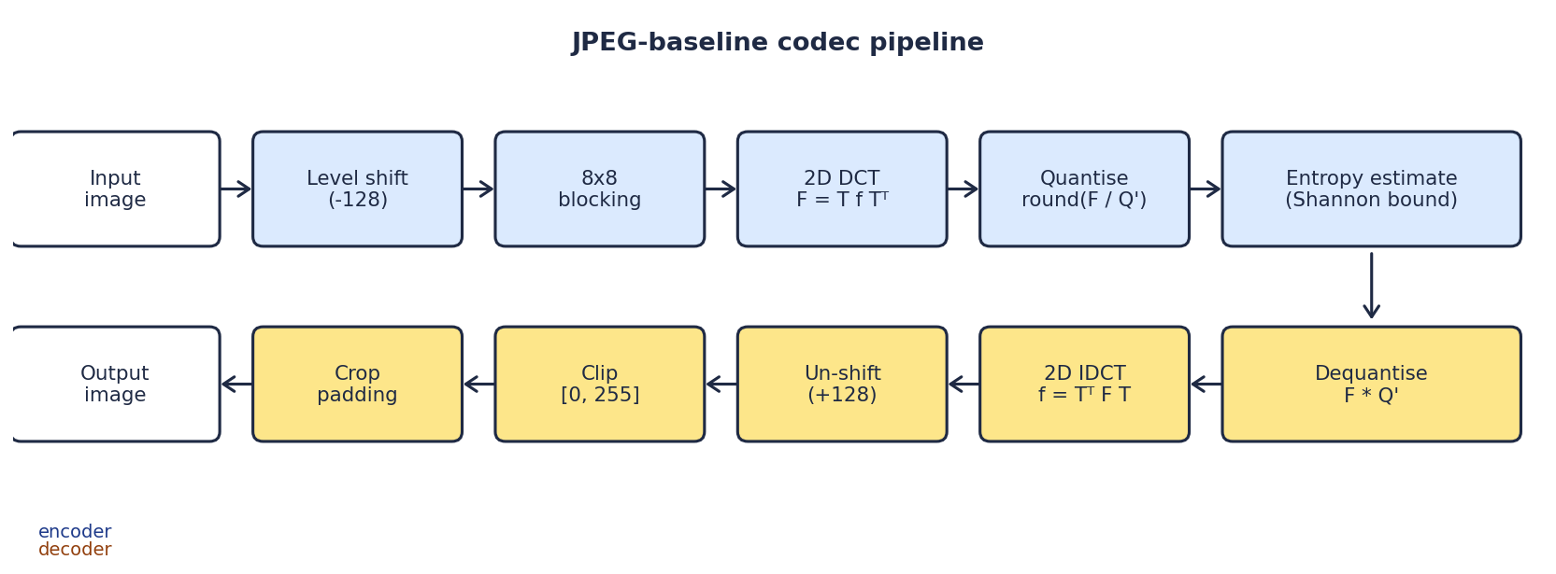
Design
System block diagram

Slide 10
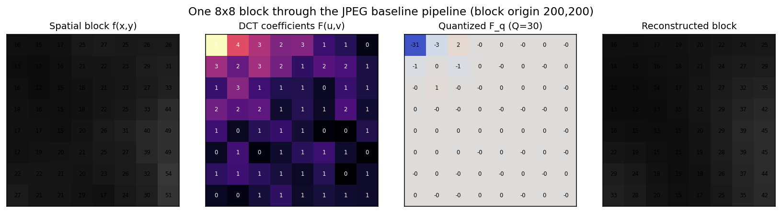
Walk-through
One 8×8 block end to end
At Q=30: 57 non-zero DCT coefficients collapse to 6 after quantisation — block PSNR is still 36.4 dB.

Slide 11
Python / NumPy
Implementation highlights
• dct_compression.py – pure DSP; no plotting, no file I/O.
• run_project.py – driver that generates every figure you see.
• DCT matrix built once at import time; reused for every block.
• Verified: T·Tᵀ = I to 1e−14; dct2(idct2(·)) is an identity to float precision.
def build_dct_matrix(n=8):
k = np.arange(n).reshape(-1, 1)
i = np.arange(n).reshape(1, -1)
T = np.cos((2*i + 1) * k * np.pi / (2*n))
T *= np.sqrt(2.0 / n)
T[0, :] *= 1.0 / np.sqrt(2.0)
return T

Slide 12
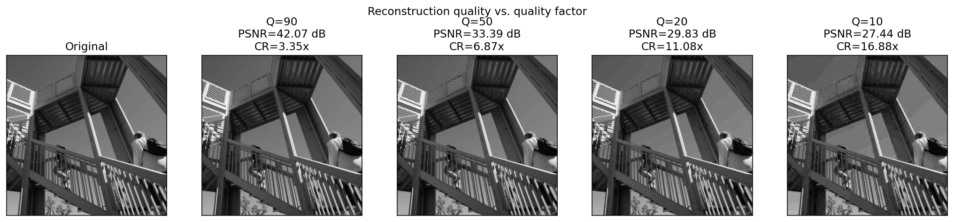
Results 1 of 3
Reconstruction across quality factors

Slide 13
Results 2 of 3
Numerical summary
Q
PSNR (dB)
MSE
Sparsity
bpp
CR
90
42.07
4.04
69.8 %
2.39
3.35×
50
33.39
29.82
86.0 %
1.16
6.87×
20
29.83
67.56
91.6 %
0.72
11.08×
10
27.44
117.36
94.6 %
0.47
16.88×
17× compression for ~27 dB PSNR; 3.4× compression for visually lossless 42 dB.

Slide 14
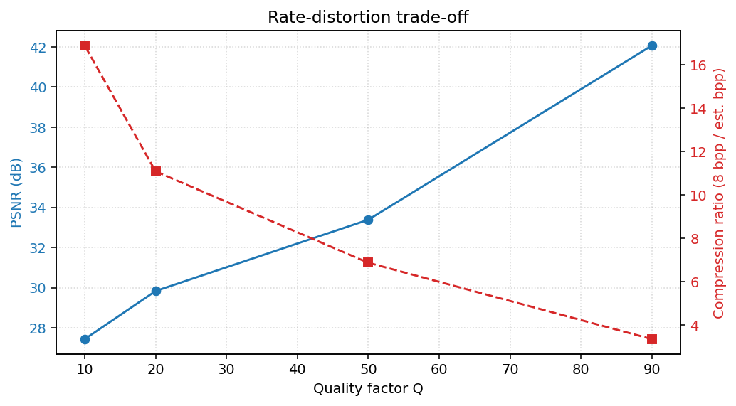
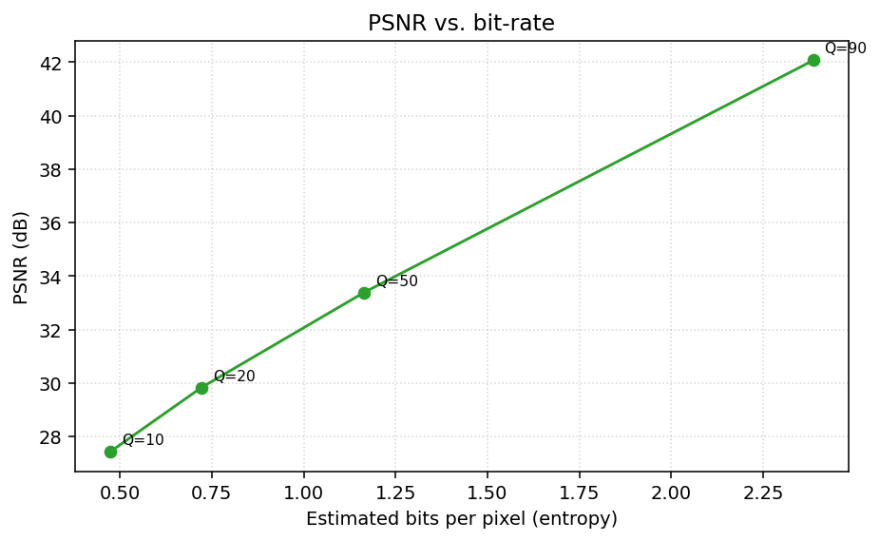
Results 3 of 3
Rate–distortion trade-off
Concave PSNR vs. bpp curve — diminishing returns past ~1.2 bpp.

Slide 15
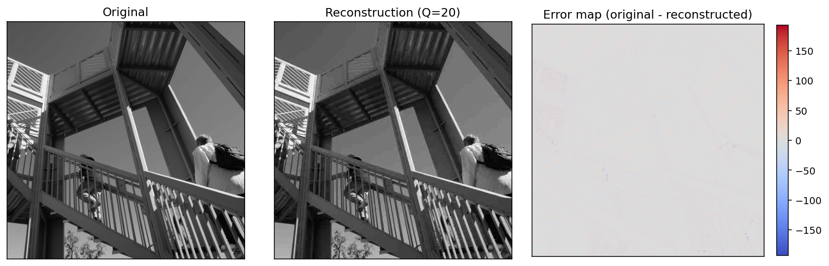
Diagnosis
Where does the error live?
Reconstruction error is concentrated on edges — exactly where high-frequency DCT coefficients live, and exactly where the quantiser is coarsest.

Slide 16
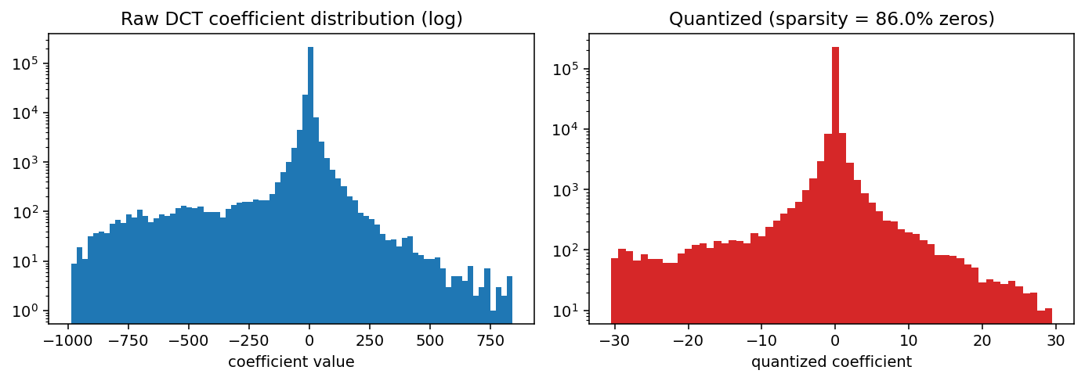
Theory meets data
Why compression works — the statistics
86 % of quantised coefficients at Q=50 are exactly zero — a single Huffman symbol covers the bulk of the payload.

Slide 17
Discussion
Limitations & honest caveats
• Compression ratios are based on the Shannon bound, not real Huffman coding.
• DC differentials and run-length markers are not modelled — small but real overhead.
• PSNR is only a loose proxy for perceived quality; SSIM would be more faithful.
• Blocking artefacts are a direct consequence of fixed 8×8 tiling — modern codecs use variable-size transforms plus in-loop deblocking.
• Only grayscale; extending to RGB would mean YCbCr conversion and a separate chroma table.

Slide 18
Conclusion
What this project proves
• Built a JPEG-baseline codec from scratch in ~250 lines of Python.
• Reproduced the textbook rate–distortion curve on a standard test image.
• Visualised every intermediate stage — DCT basis, quantised coefficients, error maps.
• Directly exercised Units 4 and 5 of IC2306, and Unit 2 via the DFT–DCT relationship.
• Natural next steps: add colour, add real entropy coding, measure SSIM.

Slide 19
Thank you
Questions?
References: Gonzalez & Woods (Ch. 7–8) • Proakis & Manolakis (Ch. 7) • Wallace, CACM 34(4), 1991 • Ahmed, Natarajan & Rao, IEEE TC, 1974

