Slide 1
Decomposers and Their Role

Slide 2
Contents of this topic
Definition | Organisms that break down dead matter (bacteria, fungi, earthworms
Nutrient Recycling | Release elements like nitrogen, carbon, and phosphorus to soil and water for reuse by plants
Soil Formation | Enhance fertility and maintain soil structure
Waste Removal | Break down dead matter and organic waste, cleaning the environment
Supporting Food Web | Make nutrients available to producers, supporting all trophic levels
Disease Control | Decompose dead/diseased organisms, reduce pathogense

Slide 3
This is a table
Decomposer Type | Nutrient Recycling | Soil Enrichment | Disease Control
Bacteria | High | Moderate | High
Fungi | High | High | Moderate
earthworms | Moderate | High | Moderate

Slide 4
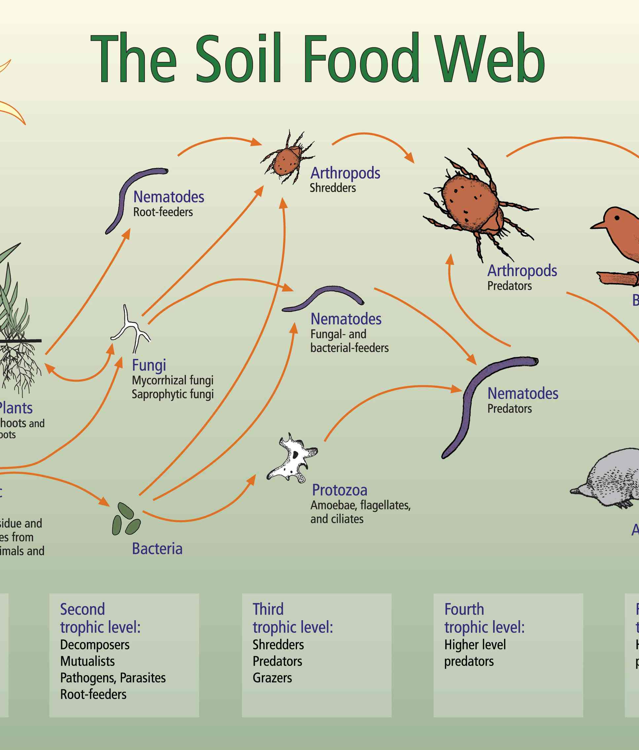
“The Essential Role of Decomposers in Ecosystem Sustainability”
”Decomposers break down organic matter,recycling nutrients back into the soil.This process supports plant growth and sustains the ecosystem’s nutrient cycle.”

Slide 5
Before
decomposers
30%
70%
"Decomposers are vital for ecosystem health. They enrich soil, maintain nutrient balance, remove waste, control diseases, and support biodiversity."
nutrient availability
Waste accumulation

Slide 6
after
decomposers
85%
15%
"Decomposers are vital for ecosystem health. They enrich soil, maintain nutrient balance, remove waste, control diseases, and support biodiversity."
nutrient availability
Waste accumulation

Slide 7
Thank you

