Slide 1
EVONIK CREATION LAB
TEAM RED
A N A S T A S I I A • F A R H A N • V E D A N G • S U N N Y • D A K S H

Slide 2
INTRODUCTION OF THE TOPIC
Right people
Right place
Right time
PRODUCT
PROMOTION
PEOPLE
PRICE
PLACE

Slide 3

Chatbots for Recruitment
C O N T E N T S
Introduction History of chatbots
How can chatbots help the companies History of recruitments
Present scenario Way forward Future scope
T E A M R E D | E V O N I K C R E A T I O N L A B

Slide 4
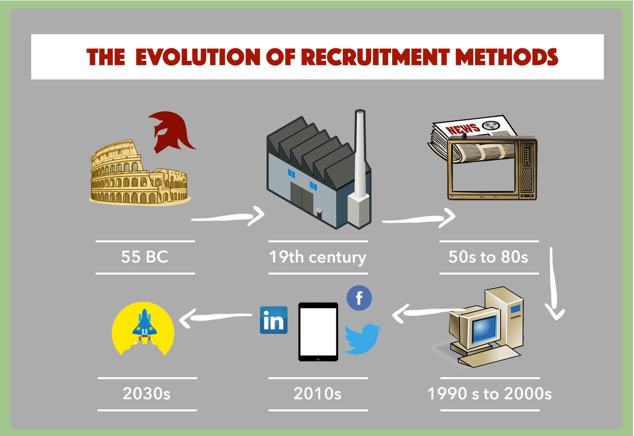
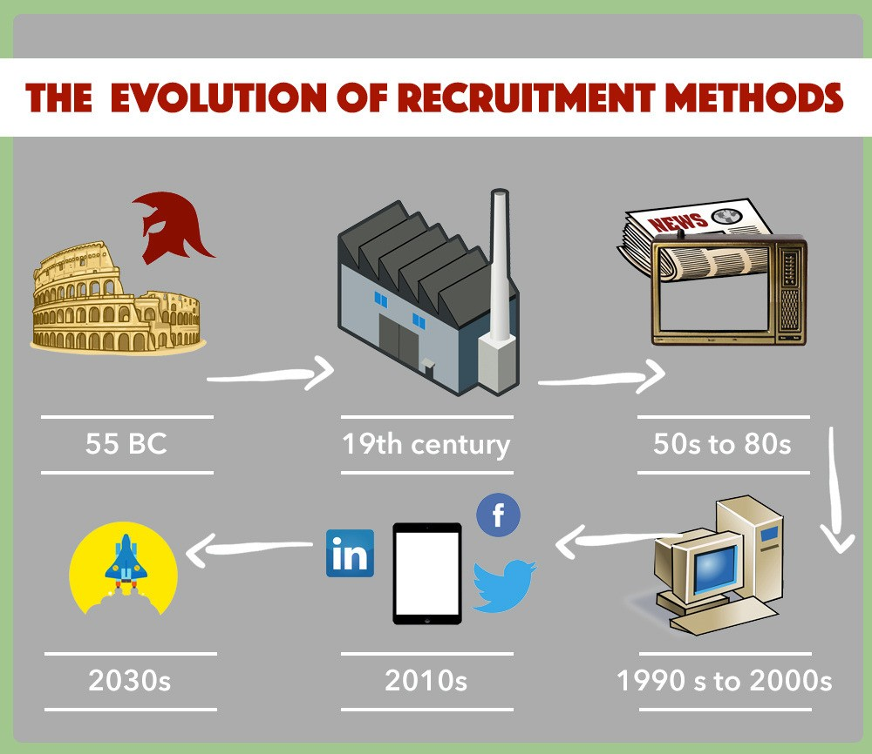

Slide 5
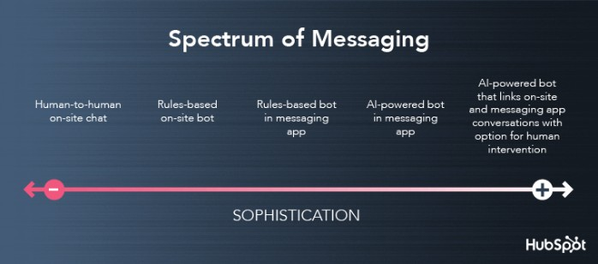
H I S T O R Y
O F C H A T B O T S
1 9 6 6
P A S T
P R E S E N T
F U T U R E

Slide 6

Why Chatbots?
W H Y S H O U L D C O M P A N I E S U S E C H A T B O T S ?
Speed (interaction time) : Live communication
Better communication through effective clarity
24x7 service
Reduce cost by 30% [1]
Know the user (identity)
Easy to use: On the customer's end
T E A M R E D | E V O N I K C R E A T I O N L A B
[1] https://bit.ly/2GmQXGg

Slide 7
PRODUCT STRATEGY

Slide 8
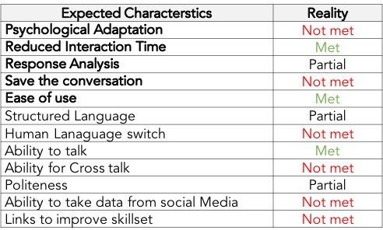
TESTING – EVONIK CHATBOT

Slide 9
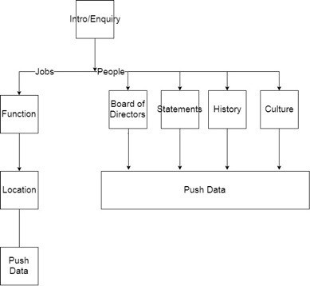
DECISION
TREE

Slide 10



What do we want
F E A T U R E S W E ' D L I K E T O A D D
S O C I A L M E D I A I N T E G R A T I O N | T R A N S L A T I O N A P I I N T E G R A T I O N | S P E E C H R E C O G N I T I O N
ABILITY TO FETCH DATA | LIVE TRANSLATION WEB API | - SPEECH TO TEXT
FROM SOCIAL MEDIA VIA SOCIAL MEDIA LOGIN | INTEGRATION | API INTEGRATION - NLP + MACHINE LEARNING + AI

Slide 11



What do we want
F E A T U R E S W E ' D L I K E T O A D D
3 R D P A R T Y
C O M P A T I B I L I T Y
S U G G E S T I O N S
I N T E G R A T I O N
ALEXA, GOOGLE HOME, SMARTWATCHES,
SMART TVS CHROMEBOOK XBOX, PLAYSTATION
- PAST INTERVIEW QUESTIONS
- GLASSDOR INTEGRATION
- NEWSLETTER/ RSS FOR FUTURE OPENINGS
- LINKEDIN PROFILE ANAYSER
- ABLE TO INTEGRATE WITH 3RD PARTY DEVELOPER APPS
- ABILITY FOR IN-BOT COMMUNICATION

Slide 12
HR ANALYTICS
SENTIMENT ANALYSIS
RESUME ANALYSER
PSYCHOLOGICAL ANALYSIS

Slide 13



TOUCH POINTS
WHAT WE WANT TO TAKE CARE OF
PRIVACY POLICIES
RACISM AND DISCRIMINATION
LAWS AND PUBLIC REGULATIONS
2020 | HEIMAN TRAVEL TOURS

Slide 14
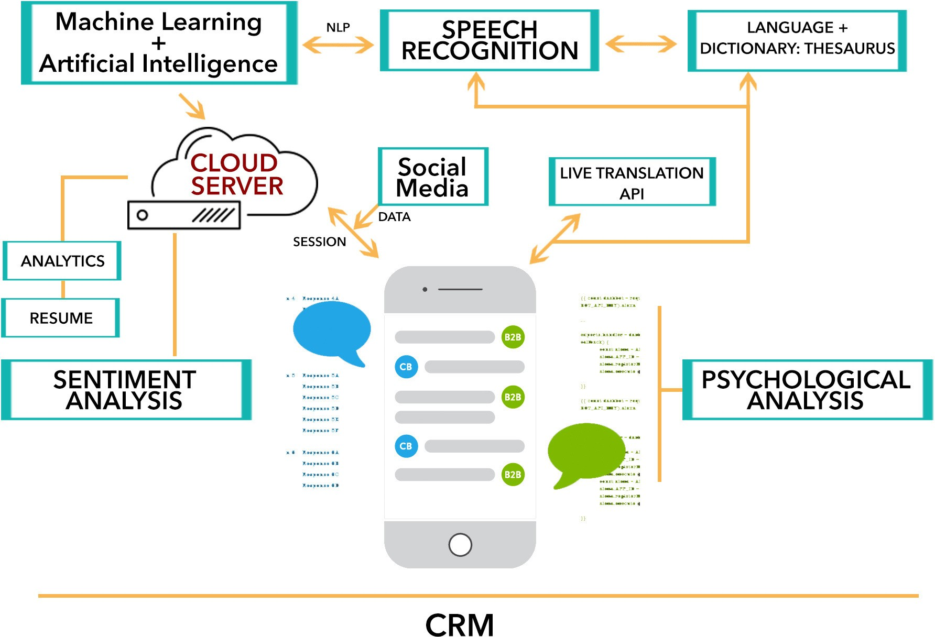

Slide 15
C H A T B O T S A R E N E C E S S A R Y
T O D A Y - M A C H I N E
T O M O R R O W - H U M A N
Conclusion
T E A M R E D
E V O N I K C R E A T I O N L A B
F U T U R E R E Q U I R E S
E M O T I O N A L C O N N E C T I O N W I T H C U S T O M E R S

Slide 16


