Slide 1
CODERSINPUNE HACKATHON • ROUND 1
↗
Handover
IQ
PROJECT
HANDOVER
Turning scattered project work into a clear
handover when a teammate leaves
Team Code Vengers | Round 1 Submission
Team Members:
1.Diptesh Patil
2.Ved Wandile
3.Prachi Patil
4.Ritisha Songire
✓
Because every handover matters.

Slide 2
Understanding the Problem
The challenge is not a lack of activity—it is knowledge scattered across many places.
What was asked
The exact problem
Our focus
Build a system that turns scattered project activity—code, chats, tickets and notes—into a usable handover when someone leaves.
The successor does not know what the leaver owned, what is unfinished, why decisions were made, or who to ask.
Software teams. Start with GitHub activity plus chat or notes, then produce a clear one-page handover.
CODE
CHATS
TICKETS
NOTES
Scattered inputs → Missing context → Slow and risky transition
HandoverIQ • CodersInPune Hackathon • Round 1
02

Slide 3
Who Faces This Problem
Three people experience the handover gap in different ways.
01 Successor
02 Team lead
03 Leaving member
The person taking over the work.
Needs to know where to start on day one and what is still unfinished.
Needs visibility into risks: what may break, stall or get blocked if a teammate leaves.
Wants to hand over in about 30 minutes—not spend days writing documents.
MOST AFFECTED
Student teams • Startups • Agencies • Open-source teams
HandoverIQ • CodersInPune Hackathon • Round 1
03

Slide 4
Our Solution: HandoverIQ
Choose the leaving person and dates. HandoverIQ collects work, ranks what matters and drafts a handover.
Proof for every point
Gap Check
Ask the Handover
Each line links to a commit, pull request or message. No guessing.
The leaver answers only five smart questions about what the data cannot show.
The successor asks questions in chat and gets evidence-based answers.
HOW THE SYSTEM TURNS ACTIVITY INTO A HANDOVER
GitHub
activity
Rank &
filter
AI report
with sources
Leaver
review
Shareable
handover
Evidence first • Human review • Clear ownership
HandoverIQ • CodersInPune Hackathon • Round 1
04

Slide 5
Product Workflow
A simple five-step journey from scattered activity to a usable handover.
1 CONNECT
2 SELECT
3 ANALYSE
4 GAP CHECK
5 HANDOVER
Link a GitHub repo.
Upload chat export
or notes.
Pick the leaving
person and date
range.
Collect work and
rank it by
importance.
Leaver answers
five quick questions
(~10 minutes).
Get the report,
share the link and
ask follow-ups.
INPUT
PROCESS
OUTPUT
GitHub + chat/notes
Collect • Rank • Verify
One-page report + Q&A
HandoverIQ • CodersInPune Hackathon • Round 1
05

Slide 6
Main Features We Will Build
Each feature supports a practical, traceable handover.
Activity collector
Smart ranking
Handover report
Fetches commits, pull requests, issues and review comments from GitHub.
Finds what the person owned and what is still open.
Owned areas, open work, key decisions, risks, contacts and first-week checklist.
Source links
Gap Check + Ask chat
PDF export
Every statement points to its proof.
Fills missing knowledge and answers follow-up questions.
One-click shareable handover.
CORE OUTPUT
OWNERSHIP • OPEN WORK • DECISIONS • RISKS • CONTACTS • CHECKLIST
HandoverIQ • CodersInPune Hackathon • Round 1
06

Slide 7
Technology Stack and Why
A lightweight stack that is quick to build and suitable for a demo.
FRONTEND
Next.js + Tailwind
Fast to build, easy to deploy
BACKEND
Python FastAPI
Great for data work and AI libraries
DATABASE
PostgreSQL (Supabase)
Stores activity and reports; free tier
DATA SOURCES
GitHub API + chat export file
Real activity without heavy approvals
AI
LLM API ([Final LLM Provider])
Plain-language summaries and structured output
HOSTING
Vercel + Render
Free and quick to demo
SYSTEM FLOW
Next.js
FastAPI
PostgreSQL
LLM API
Vercel / Render
HandoverIQ • CodersInPune Hackathon • Round 1
07

Slide 8
Biggest Technical Challenge
Large activity histories contain noise—and AI summaries can sound confident even when wrong.
OUR SAFEGUARDS
THE PROBLEM
1
Rule-based ranking
A person can have hundreds of commits and messages.
Most are noise, and AI can write confident summaries that are incorrect.
Ownership • Recency • Still open
2
Send only top items to AI
Reduce noise before summarising
3
Evidence links + source traceability
Drop any point without a source
4
Human verification + gap flags
Flag missing/uncertain info; permission-aware access before sharing
NO SOURCE → NO CLAIM
HandoverIQ • CodersInPune Hackathon • Round 1
08

Slide 9
Team Roles and Responsibilities
Clear ownership helps the team build and test in parallel.
Diptesh Patil
Team lead + backend
GitHub collector, ranking engine and API
Prachi Patil
AI engineer
Prompts, report generator, source check and Q&A
Ved Wandile
Frontend
Dashboard, report page, Gap Check form and chat UI
Ritisha Songire
Design + testing
UX, sample data, testing, PDF export and demo
IMPORTANT
Each member submits their own form with their own contribution.
HandoverIQ • CodersInPune Hackathon • Round 1
09

Slide 10
Development Plan: 3 Rounds
A focused scope keeps the project achievable and demo-ready.
ROUND 1 • PLAN
ROUND 2 • CORE PRODUCT
ROUND 3 • POLISH
DELIVERABLES
DELIVERABLES
DELIVERABLES
Problem understanding + user identification
Workflow and architecture
Planning and proposal
GitHub integration + activity extraction
Activity ranking
Evidence-linked handover
Basic dashboard / report
Gap Check + Ask Handover
Human review + PDF export
Controlled sharing
Testing + final demo
SCOPE DECISION
Start with one data source (GitHub) so the team can finish, validate and demonstrate it well.
HandoverIQ • CodersInPune Hackathon • Round 1
10

Slide 11
IMPACT AND FUTURE SCOPE
A smoother handover.
A stronger team.
~30 MINUTES
LESS KNOWLEDGE LOSS
NO LONG DOCUMENTS
Target / expected handover time: about 30 minutes, versus days of manual documentation.
Fewer lost decisions. Successors can start faster.
Leavers contribute through a short guided review.
FUTURE SCOPE
1. Multi-platform integration (Jira, Slack, Notion, Google Docs)
2. AI-powered knowledge assistant
3. Automatic handover reports
4. Real-time updates and notifications
5. Smart risk detection and knowledge gap identification
6. Team contribution and workload analysis

Slide 12
The 5-Pillar Handover Intelligence Engine
How HandoverIQ structures scattered GitHub activity into verifiable, zero-hallucination engineering intelligence.
01 • Ownership & Bus-Factor
02 • Unfinished Work & PRs
03 • Architectural Decisions
Maps primary module owners and single-maintainer silos from commit & PR authorship.
Flags unmerged pull requests, draft branches, and open issues that risk stalling.
Reconstructs the 'why' behind refactors and stack changes from commits and PR threads.
04 • Setup & Dependencies
05 • Risks & Gap Checklist
06 • Archon Mascot & Accounts
Extracts languages, runtime versions, and day-one environment setup requirements.
Identifies bug clusters and generates an interactive checklist for leaver sign-off.
20-second interactive Judge Tour (with 1-click Skip) + SaaS workspace accounts.
VERIFICATION RULE
EVERY INSIGHT LINKS DIRECTLY TO CLICKABLE GITHUB COMMIT SHAs, PRs & ISSUES
HandoverIQ • CodersInPune Hackathon • Round 1
12

Slide 13
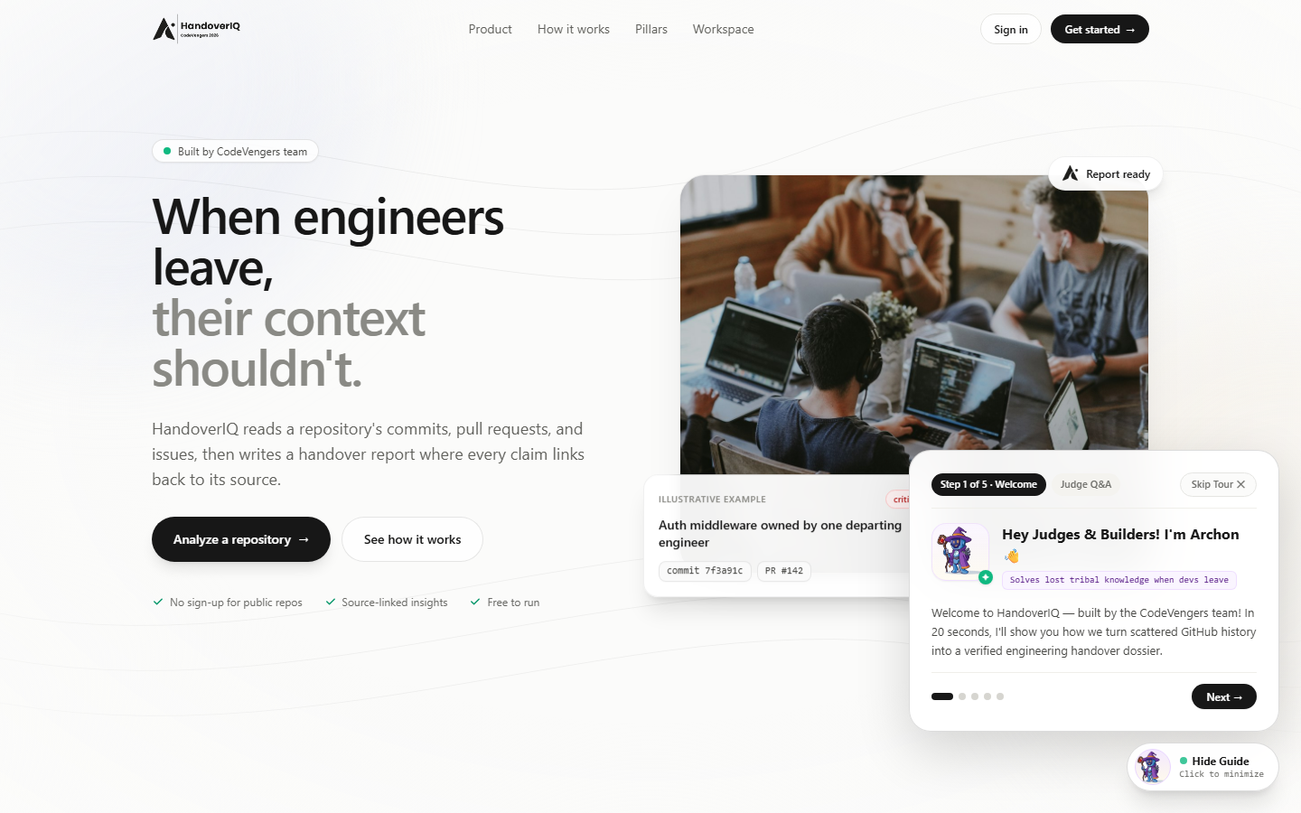
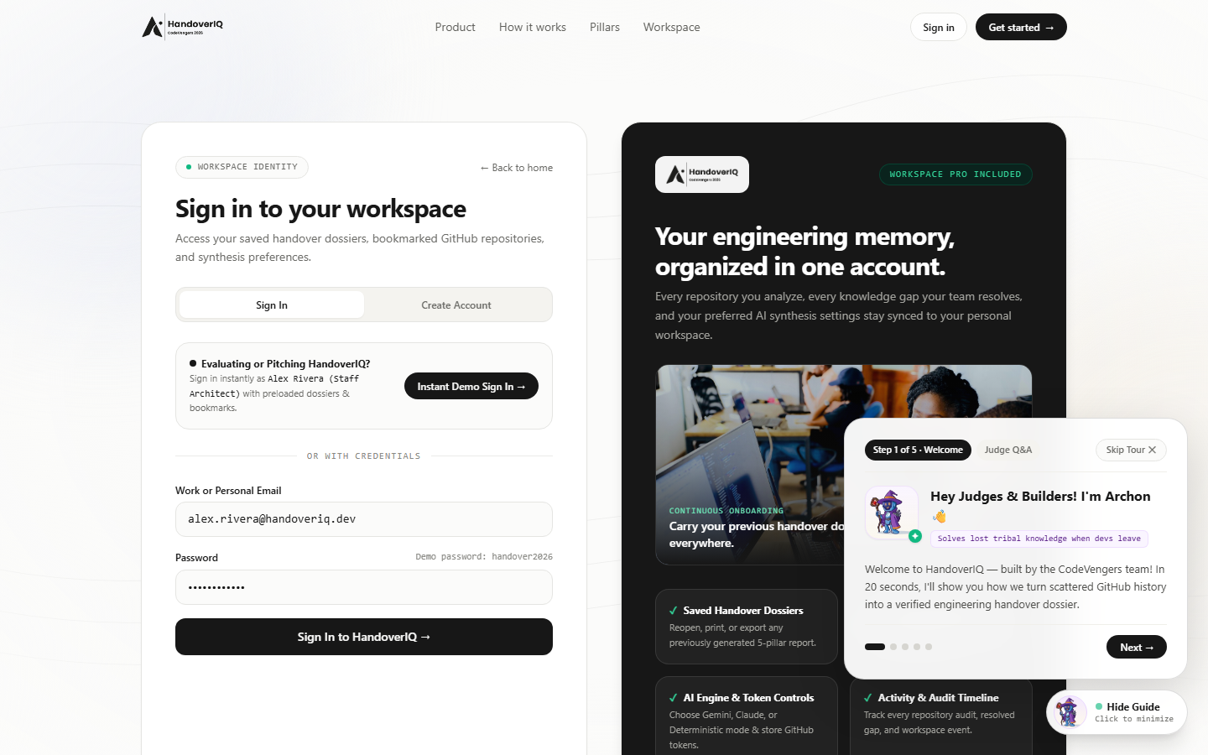
Live Product Showcase: Landing Page & Mascot Tour
Minimalist curves aesthetic paired with our Archon Wizard-Bot Judge Guide (with Skip option) and SaaS Account Portal.
01 • MINIMALIST LANDING PAGE & ARCHON AI MASCOT TOUR
02 • SAAS WORKSPACE IDENTITY & 1-CLICK DEMO ARCHITECT LOGIN
Custom HandoverIQ branding, real photography, and 5-step interactive Judge Tour with 1-click Skip.
Sign in or create an account to persist handover dossiers, pinned repos, and AI preferences.
UX HIGHLIGHTS
CUSTOM LOGO • LIGHT CURVES THEME • ARCHON MASCOT GUIDE • 1-CLICK DEMO LOGIN
HandoverIQ • CodersInPune Hackathon • Round 1
13

Slide 14
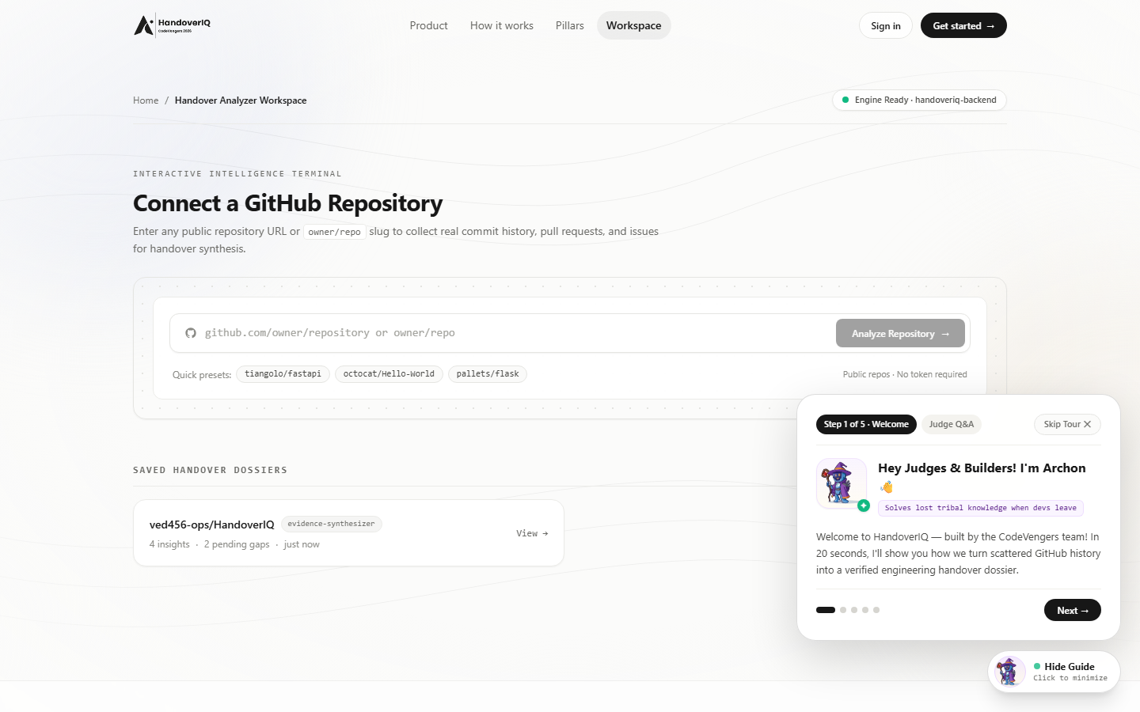
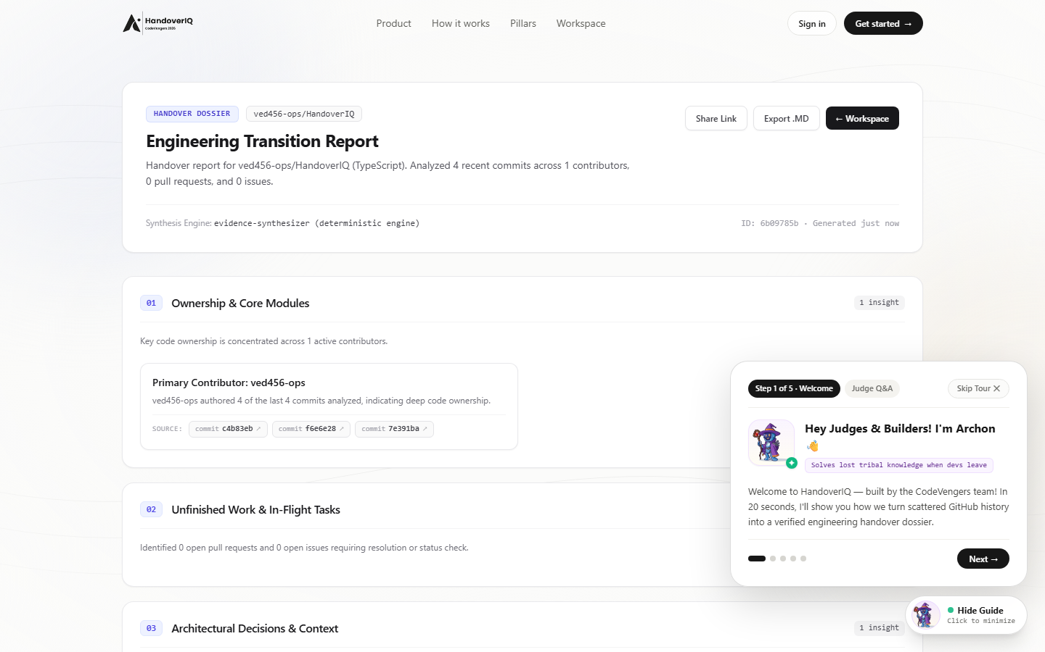
Live Product Showcase: Analyzer & 5-Pillar Dossier
Real-time GitHub REST API v3 ingestion, evidence-linked handover report, interactive Gap Check, and Markdown/PDF export.
03 • INTERACTIVE GITHUB REPOSITORY ANALYZER WORKSPACE
04 • GENERATED 5-PILLAR DOSSIER (ANALYZING HANDOVERIQ ITSELF)
Connect any public repo (owner/repo) or use 1-click presets; displays live engine status & saved dossiers.
Every claim cites clickable commit SHAs (c4b83eb, f6e6e28, 7e391ba) with Share Link & Export .MD.
LIVE ENGINE
100% REAL GITHUB REST API v3 DATA • CLICKABLE PROOF CHIPS • MARKDOWN & PDF EXPORT
HandoverIQ • CodersInPune Hackathon • Round 1
14

Slide 15
Live Cloud Deployment & Production Readiness
Fully deployed, end-to-end verified architecture ready for live judge evaluation and team onboarding.
Live Web App (Railway/Vercel)
Live FastAPI Backend Engine
Multi-Engine AI + Fallback
Next.js 15 App Router + TypeScript + Tailwind CSS live on production HTTPS domain.
Async Python 3.13 + FastAPI + Pydantic v2 serving REST endpoints with OpenAPI docs.
Supports Gemini 1.5, Claude 3.5, and a Deterministic Evidence Engine (zero API key needed).
Interactive Gap Check Sync
Personal Workspace Accounts
Open GitHub Repository
Reviewers resolve knowledge gaps, add custom handover tasks, and share permanent links.
PBKDF2-SHA256 auth storing user dossiers, pinned GitHub repos, and audit timeline.
Publicly accessible at github.com/ved456-ops/HandoverIQ with Docker & cloud configs.
LIVE DEMO URL
HTTPS://HANDOVERIQ-WEB-PRODUCTION.UP.RAILWAY.APP • GITHUB.COM/VED456-OPS/HANDOVERIQ
HandoverIQ • CodersInPune Hackathon • Round 1
15

Slide 16
CODERSINPUNE HACKATHON • ROUND 1
THANK YOU
HandoverIQ
Because every handover matters.
Turning scattered project work into a clear handover when a teammate leaves
HandoverIQ • CodersInPune Hackathon • Round 1

