Slide 1
Chapter 1 Introduction to Computers, Programs, and Java
刘艳霞
cslyx@scut.edu.cn

Slide 2
Content
Chapter 1 Introduction to Computers, programs and Java
Chapter 2 Elementary Programming
Chapter 3 Selections
Chapter 4 Mathematical Functions, Characters, and Strings
Chapter 5 Loops
Chapter 6 Methods
Chapter 7 Single-Dimensional Arrays
Chapter 9 Objects and Classes
Chapter 10 Thinking in Objects
Chapter 11 Inheritance and Polymorphism
Chapter 12 Exception Handling and Text IO
Chapter 13 Abstract Classes and Interfaces
Chapter 14 JavaFX Basics
Chapter 15 Event-Driven Programming and Animations
Chatper 17 Binary I/O

Slide 3
Lab
Lab1：Java command line environment
Lab2：Bank Project - OO programming
Lab 3：Bank Project – Interface implementation and Exception Handling
Lab 4: Bank Project – GUI and I/O access
Week 9,10,11,12 , Tuesday
Week 13 Review

Slide 4
Objectives
Describing key features of Java and history of Java
  Describing the Java technology and development environment
To distinguish the terms JDK, JVM , JRE
To explain the basic syntax of a Java program
To create, compile, and run Java programs
To write a simple Java program and display output on the console or dialog boxes

Slide 5


1. Why Java?
The answer is that Java enables users to develop and deploy applications on the Internet for servers, desktop computers, and small hand-held devices.
Java is a general purpose programming language.
Java is the Internet programming language.
Evans data study: 9 million / 14million developers

Slide 6
Java, Web, and Beyond
Java can be used to develop Web applications.
Java Applets
Java Web Applications
Java can also be used to develop applications for hand-held devices such as Palm and cell phones

Slide 7
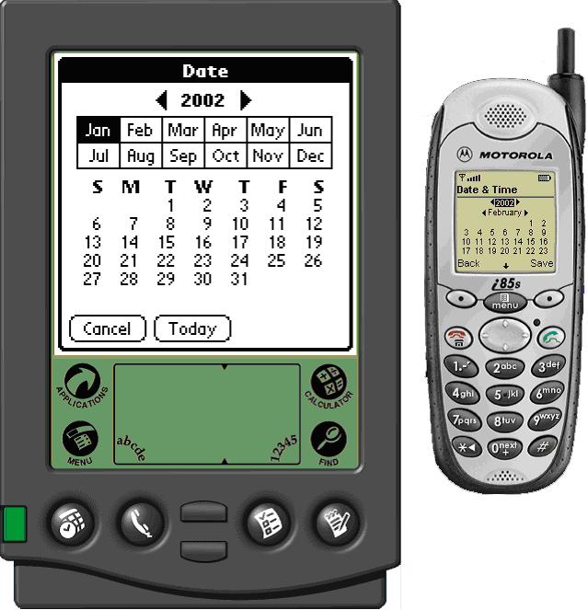
PDA and Cell Phone

Slide 8
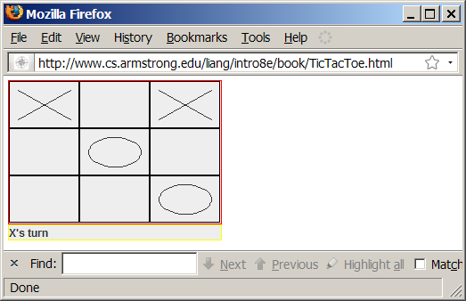
Examples of Java’s Versatility (Applets)

Slide 9

Web Application

Slide 10
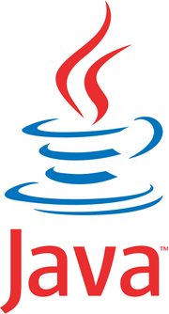
Java’s History
James Gosling and Sun Microsystems, ‘Green Project’ , Star 7, 1992
Oak
Java, May 20, 1995, Sun World
HotJava
  The first Java-enabled Web browser
Early History Website:
http://www.oracle.com/technetwork/java/index.html

Slide 11
Key Concepts of the Java Programming Language
  Object-oriented
  Distributed
  Simple
  Multi-threaded
  Secure
  Platform-independent
Notes:
The terms listed in the slide represent object-oriented concepts. You will discuss these terms in depth, and this discussion will help you build a foundation for understanding the Java technology.
Java SE 7 Fundamentals 2 - <number>

Slide 12
Procedural Programming
Procedural programming focuses on sequence.
1
Step 1
2
Step 2
3
Step 3
4
Step 4
5
Step 5
Notes:
The Java programming language is an object-oriented programming (OOP) language because one of the main goals of the Java technology programmer is to create objects—pieces of autonomous code—that can interact with other objects to solve a problem. OOP started with the SIMULA-67 programming language in 1967, and has led to popular programming languages such as C++, upon which the Java programming language is loosely based.
The diagram demonstrates a procedural program’s focus on sequence.
Java SE 7 Fundamentals 2 - <number>

Slide 13
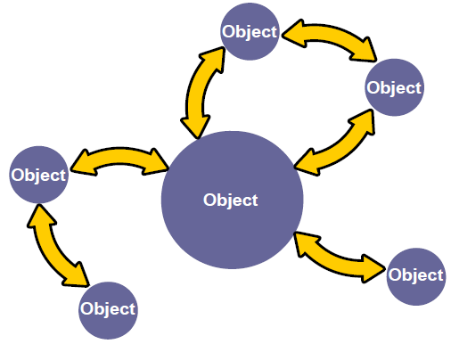
Object-Oriented
Notes:
OOP differs from procedural programming, because procedural programming stresses the sequence of coding steps required to solve a problem, whereas OOP stresses the creation and interaction of objects.
Modularity: The source code for an object can be written and maintained independently of the source code for other objects. After it is created, an object can be easily passed around inside the system.
Information-hiding: By interacting only with an object’s methods, the details of its internal implementation remain hidden from the outside world.
Code re-use: If an object already exists (perhaps written by another software developer), you can use that object in your program. This allows specialists to implement, test, and debug complex, task-specific objects, which you can then trust to run in your own code.
Pluggability and debugging ease: If a particular object is found to be problematic, you can simply remove it from your application and plug in a different object as its replacement. This is analogous to fixing mechanical problems in the real world. If a bolt breaks, you replace the bolt, not the entire machine.
The diagram illustrates an object-oriented program’s focus on objects and object interactions.
Java SE 7 Fundamentals 2 - <number>

Slide 14
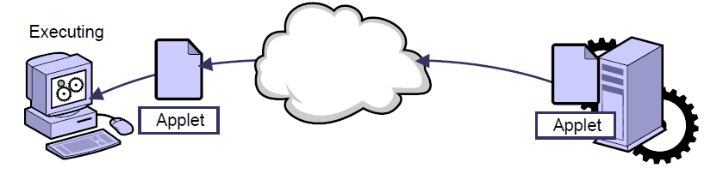
Distributed
Notes:
The Java programming language is a distributed language because the language provides support for distributed network technologies, such as Remote Method Invocation (RMI), Common Object Request Broker Architecture (CORBA), and Universal Resource Locator (URL). Additionally, the dynamic class–loading capabilities of Java technology allow pieces of code to be downloaded over the Internet and executed on a personal computer.
Note: The terms Java technology and Java programming language do not refer to the same thing. Java technology refers to a family of Java technology products, of which the programming language is only one part.
Java SE 7 Fundamentals 2 - <number>

Slide 15
Simple
  References are used instead of memory pointers.
  A boolean data type can have a value of either true or false.
  Memory management is automatic.
Notes:
Java SE 7 Fundamentals 2 - <number>
The Java programming language is simple because the designers removed some of the complex or obscure programming constructs found in other popular programming languages. As an example, the Java programming language does not allow programmers to directly manipulate pointers to memory locations (a complex feature of the C and C++ programming languages). Instead, the Java programming language allows programmers to only manipulate objects using object references. The programming language also uses a feature called a garbage collector to monitor and remove objects that are no longer referred to. Another feature that makes the Java programming language simple is that a Java boolean can have only a true or false value, unlike some other languages in which boolean is represented by 0 and 1.f

Slide 16
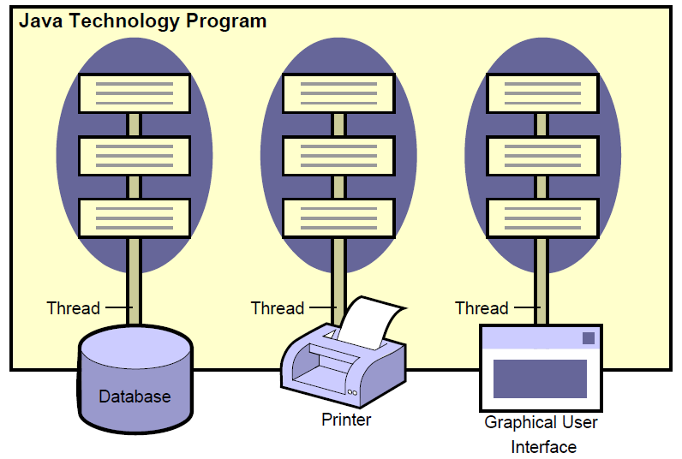
Multi-Threaded
Notes:
Java SE 7 Fundamentals 2 - <number>
The Java programming language supports multithreading. This allows several tasks to run concurrently (at the same time), such as querying a database, performing long-running and complex calculations, and displaying a user interface. Multithreading allows a Java technology program to be very efficient in its use of system resources. The image illustrates how the Java programming language is multi-threaded.

Slide 17
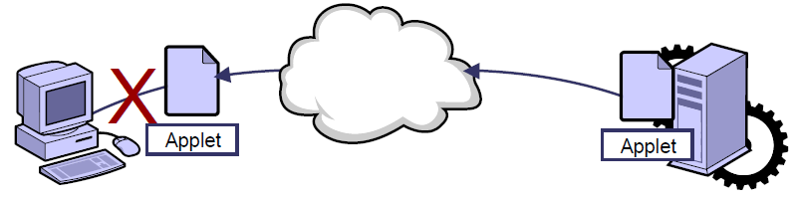
Secure
Notes:
Java technology programs are secure because the Java programming language, with the environment in which Java technology programs run, uses security measures to protect programs from attacks. These measures include:
Prohibiting distributed programs, such as applets, from reading and writing to a hard disk of a computer
Verifying that all Java technology programs contain valid code
Supporting digital signatures. Java technology code can be “signed” by a company or person in a way that another person receiving the code can verify the legitimacy of the code.
Prohibiting the manipulation of memory by using pointers
The image illustrates how Java technology programs are secured by not allowing invalid code to execute on a computer.
Java SE 7 Fundamentals 2 - <number>

Slide 18
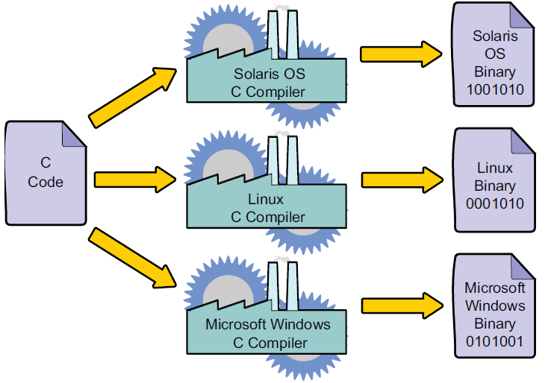
Platform-Dependent Programs
Notes:
Programs written in most languages usually require numerous modifications to run on more than one type of computing platform (a combination of a CPU and operating system). This platform dependence is because most languages require you to write code specific to the underlying platform. Popular programming languages like C and C++ require programmers to compile and link their programs, resulting in an executable program unique to a platform. A compiler is an application that converts a program that you write into a CPU-specific code called machine code. These platform-specific files (binary files) are often combined with other files, such as libraries of prewritten code, using a linker to create a platform-dependent program, called an executable, that can be executed by an end user. Unlike C and C++, the Java programming language is platform-independent.
The image illustrates how a compiler creates a binary file.
Java SE 7 Fundamentals 2 - <number>

Slide 19
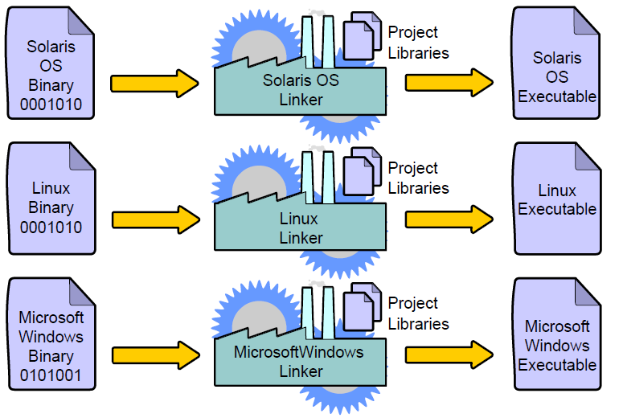
Platform-Dependent Programs
Notes:
The image illustrates how a binary file is linked with libraries to create a platform-dependent executable.
Java SE 7 Fundamentals 2 - <number>

Slide 20
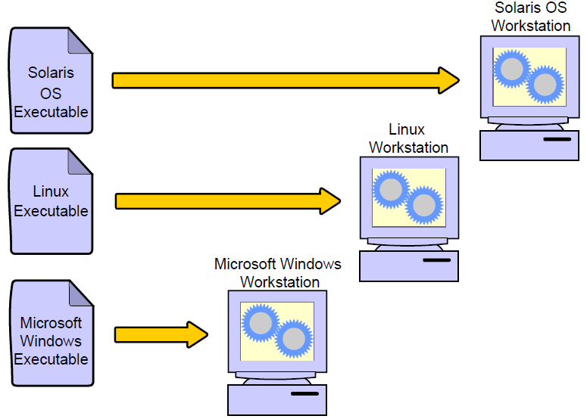
Platform-Dependent Programs
Notes:
The image illustrates how platform-dependent executables can execute on only one platform.
Java SE 7 Fundamentals 2 - <number>

Slide 21
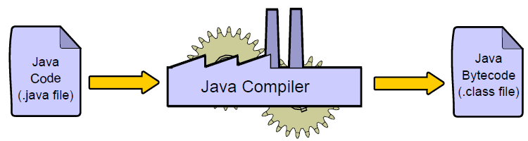
Platform-Independent Programs
Notes:
The image illustrates the Java technology compiler (Java compiler) creating Java bytecode.
A Java technology program can run on several different CPUs and operating system combinations, such as the Solaris OS on a SPARC chip, MacOS X on an Intel chip, and Microsoft Windows on an Intel chip, usually with few or no modifications.
Java technology programs are compiled using a Java technology compiler. The resulting format of a compiled Java technology program is platform-independent Java technology bytecode instead of CPU-specific machine code. After the bytecode is created, it is interpreted (executed) by a bytecode interpreter called the virtual machine or VM. A virtual machine is a platform-specific program that understands platform-independent bytecode and can execute it on a particular platform. For this reason, the Java programming language is often referred to as an interpreted language, and Java technology programs are said to be portable or executable on any platform. Other interpreted languages include Perl.
Java SE 7 Fundamentals 2 - <number>

Slide 22
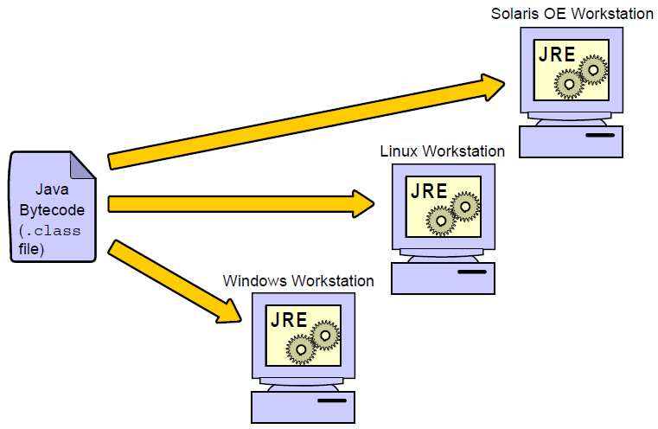
Platform-Independent Programs
Notes:
The image illustrates a Java technology bytecode (Java bytecode) file executing on several platforms where a Java runtime environment exists.
A virtual machine gets its name because it is a piece of software that runs code, a task usually accomplished by the CPU or hardware machine. For Java technology programs to be platform-independent, a virtual machine called the Java Virtual Machine (JVM) is required on every platform where your programming will run. The Java Virtual Machine is responsible for interpreting Java technology code, loading Java classes, and executing Java technology programs.
However, a Java technology program needs more than just a Java Virtual Machine to execute.
A Java technology program also needs a set of standard Java class libraries for the platform. Java class libraries are libraries of prewritten code that can be combined with the code that you write to create robust applications.
Combined, the JVM software and Java class libraries are referred to as the Java runtime environment (JRE). Java runtime environments are available from Oracle for many common platforms.
Note: Some modifications might be required to make a Java technology program platform-independent. For example, directory names might need to be altered so that they use the appropriate delimiters (forward and backward slashes) for the underlying operating system.
Java SE 7 Fundamentals 2 - <number>

Slide 23
Terms
JVM
  Java Virtual Machine (JVM) is required on every platform where your programming will run. The Java Virtual Machine is responsible for interpreting Java technology code, loading Java classes, and executing Java technology programs.
JRE
  A Java technology program also needs a set of standard Java class libraries for the platform. Java class libraries are libraries of prewritten code that can be combined with the code that you write to create robust applications.
  Combined, the JVM software and Java class libraries are referred to as the Java runtime environment (JRE).
JDK
  Java Development Kit, including JRE/ Java tool(javac/java/jdb) and Java API .

Slide 24
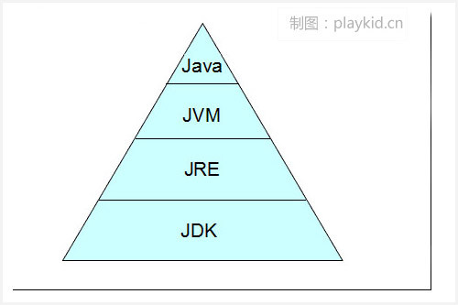
Terms

Slide 25
Quiz 1
The Java programming language is said be platform-independent because:
  Compiled code runs on multiple platforms with few or no modifications
  It does not allow pointers to be used to manipulate memory
  The format of a compiled Java program is CPU-specific code
  It is multi-threaded
Notes:
Answer: a
b is a correct statement but an incorrect answer because it does not relate to platform independence.
c is incorrect because a compiled Java program is not CPU-specific. It is interpreted by the virtual machine that resides on the system.
d is a correct statement because Java is multi-threaded, but that is not why it is called platform-independent.
Java SE 7 Fundamentals 2 - <number>

Slide 26
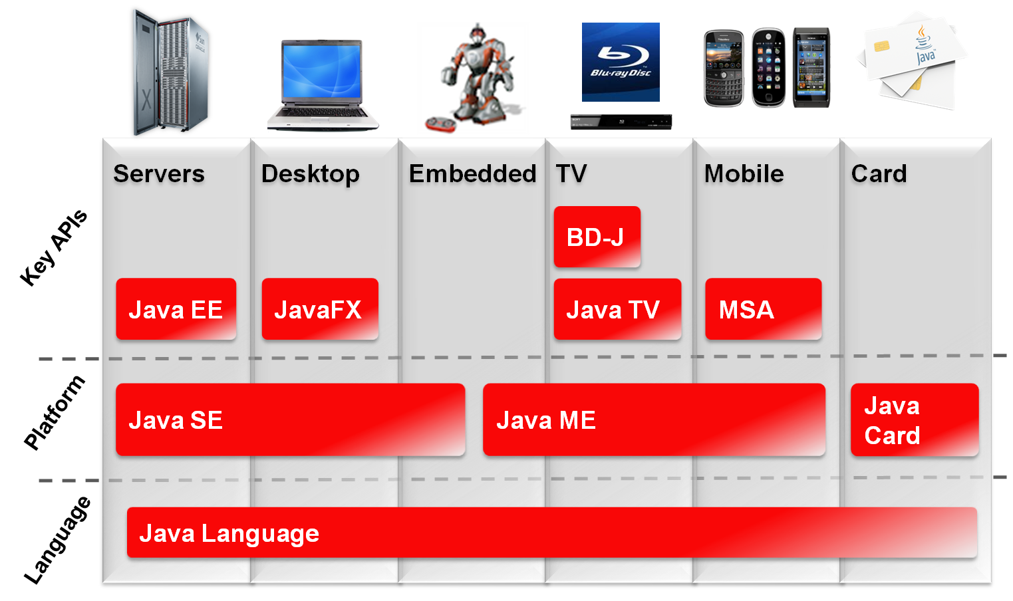






2. Identifying Java Technology Product Groups
Notes:
Java SE 7 Fundamentals 2 - <number>
Oracle provides a complete line of Java technology products, ranging from kits that create Java technology programs to emulation (testing) environments for consumer devices such as cellular phones. As indicated in the graphic, all Java technology products share the foundation of the Java language. Java technologies, such as the Java Virtual Machine, are included (in different forms) in three different groups of products, each designed to fulfill the needs of a particular target market. The figure illustrates the three Java technology product groups and their target device types. Each edition includes a Java Development Kit (JDK) [also known as a Software Development Kit (SDK)] that allows programmers to create, compile, and execute Java technology programs on a particular platform.
Note: The JavaFX API is a rich client for creating user interfaces for your Java program. The MSA API is the mobile software application used to create user interfaces on portable devices.

Slide 27


Java SE
Is used to develop applets that run within web browsers and applications that run on desktop computers
This book uses J2SE to introduce Java programming.
Notes:
Java SE 7 Fundamentals 2 - <number>
Java Platform, Standard Edition (Java SE) is used to develop applets and applications that run within web browsers and on desktop computers. For example, you can use the Java SE JDK to create a word processing program for a personal computer.
We are using two Java desktop applications in this course: NetBeans and UMLet.
Note: Applets and applications differ in several ways. Primarily, applets are launched inside a web browser, while applications are launched within an operating system. Although this course focuses mainly on application development, most of the information in this course can be applied to applet development.

Slide 28
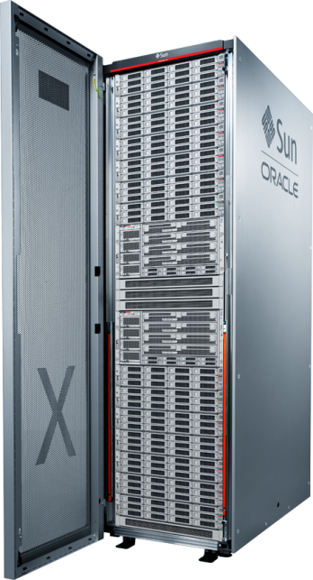
Java EE
Is used to create large enterprise, server-side, and client-side distributed applications
Notes:
Java SE 7 Fundamentals 2 - <number>
Java Platform, Enterprise Edition (Java EE) is used to create large enterprise, server-side, and client-side distributed applications. For example, you can use the Java EE JDK to create a web shopping (eCommerce) application for a retail company’s website.
Java EE is built on top of the Java SE Platform, extending it with additional APIs supporting the needs of large-scale, high-performance enterprise software. The APIs are packaged and grouped to support different kinds of containers, such as a web container for web-based applications, a client container for thick clients, and the EJB container to run workhorse Java components. Some of the kinds of functionality supported by the different APIs include objects, UI, integration, persistence, transactions, and security.

Slide 29



Java ME
Is used to create applications for resource-constrained consumer devices
Notes:
Java SE 7 Fundamentals 2 - <number>
Java Platform, Micro Edition (Java ME) is used to create applications for resource-constrained consumer devices. For example, you can use the Java ME JDK to create a game that runs on a cellular phone. Blu-ray Disc Java applications and Java TV use the same SDK as Java ME.

Slide 30
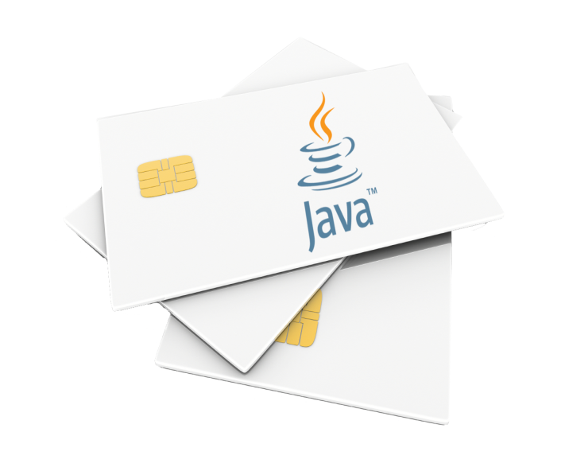
Java Card
Java Card is typically used in the following areas (and many more):
  Identity
  Security
  Transactions
  Mobile phone SIMs
Notes:
Java SE 7 Fundamentals 2 - <number>

Slide 31
Setting Up the Java Development Environment
It is easy to set up your Java development environment.
  Download and install the Java Development Kit (JDK) from oracle.com/java.
  Set your PATH to the installed JDK.
  Compile and run a Java application by using the command line.
Notes:
Java SE 7 Fundamentals 2 - <number>
Setting up your Java development environment is a simple task. The JDK is available for free from the Oracle Java website.

Slide 32
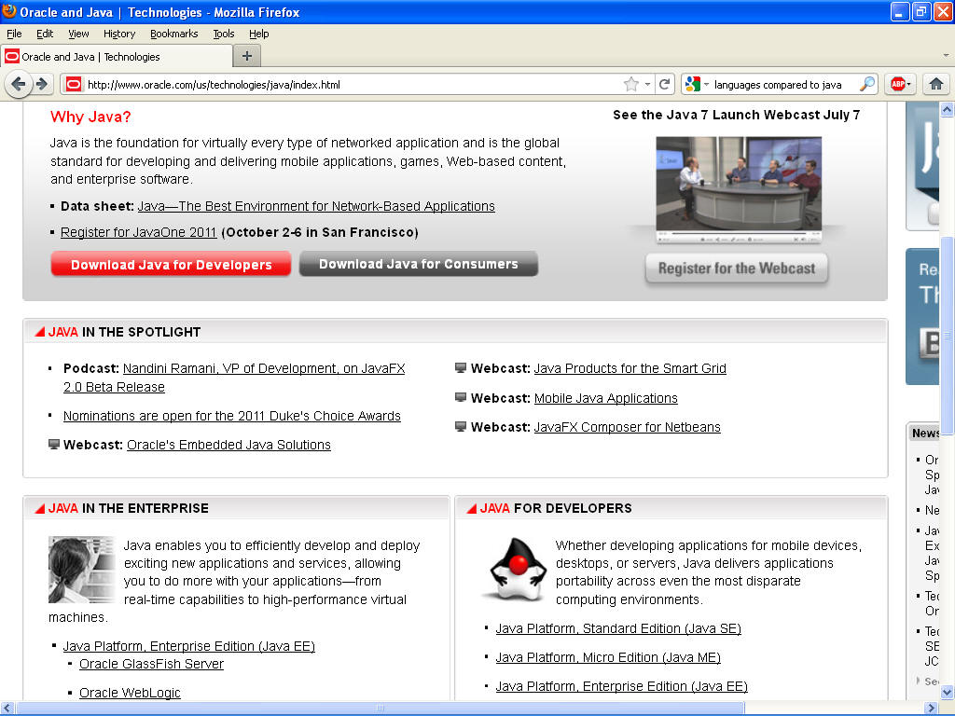
Downloading and Installing the JDK
Java SE Development Kit
Notes:
1. Go to oracle.com/java.
2. Select the Java Platform, Standard Edition (Java SE) link.
3. Download the version for your platform.
4. Follow the installation instructions.
5. Set your Java PATH.
6. Compile and run a sample Java application.
Note: The practice activities for this lesson show you how to complete steps 5 and 6.
Java SE 7 Fundamentals 2 - <number>

Slide 33
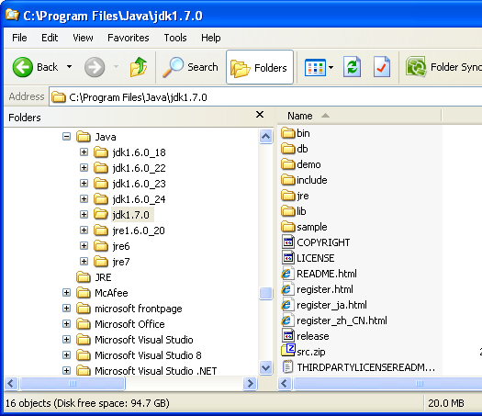
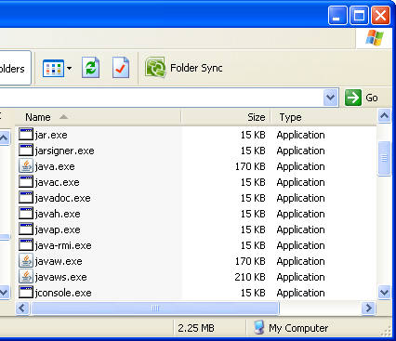
Examining the Installed Java Development Kit
Compiler
Notes:
Java SE Development Kit
When you download and install the Java SE Development Kit, the following items are installed:
Java runtime environment (JRE)
A Java Virtual Machine (JVM) for the platform you choose
Java class libraries for the platform you choose
A Java technology compiler
Additional utilities, such as utilities for creating Java archive files (JAR files) and for debugging Java technology programs
Examples of Java technology programs
In addition to the Java SDK download, other items are available as a separate download, such as the Java class library (API) documentation and the Java Language Specification.
Note: The compiler (javac) is located in the ../jdk<version>/bin directory.
Java SE 7 Fundamentals 2 - <number>

Slide 34
JDK Versions
JDK 1.02 (1995)
JDK 1.1 (1996)
JDK 1.2 (1998)
JDK 1.3 (2000)
JDK 1.4 (2002)
JDK 1.5 (2004) a. k. a. JDK 5 or Java 5
JDK 1.6 (2006) a. k. a. JDK 6 or Java 6
JDK 1.7 (2011) a. k. a. JDK 7 or Java 7
JDK 1.8 (2014) a. k. a. JDK 8 or Java 8

Slide 35
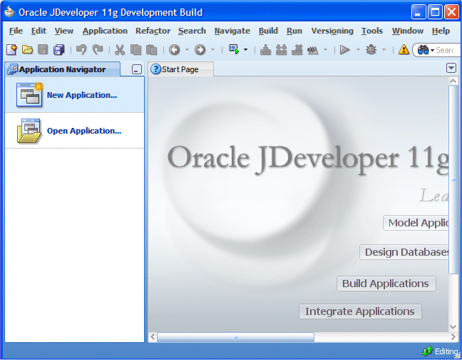
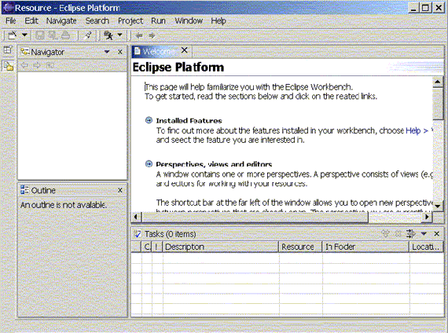
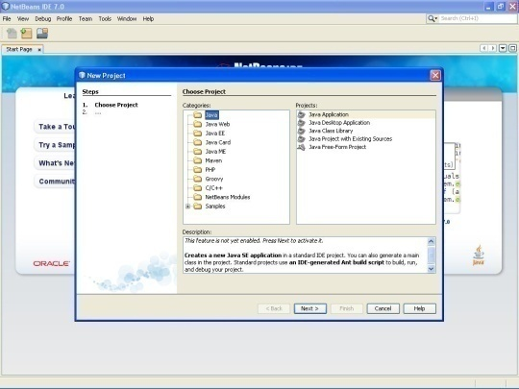
Using an Integrated Development Environment
An integrated development environment (IDE) is a tool that can assist you with your Java application development.
  There are several available IDEs:
    NetBeans IDE from Oracle
    JDeveloper from Oracle
    Eclipse from IBM
  Features include:
    Full integration
    Easy deployment
    Smart editor
    Easy project development
    Built-in source code control
Notes:
Integrated development environments help reduce development time by:
Automating simple tasks
Using code auto-completion
Integrating debugging
Facilitating the compilation and deployment of applications
Java SE 7 Fundamentals 2 - <number>

Slide 36
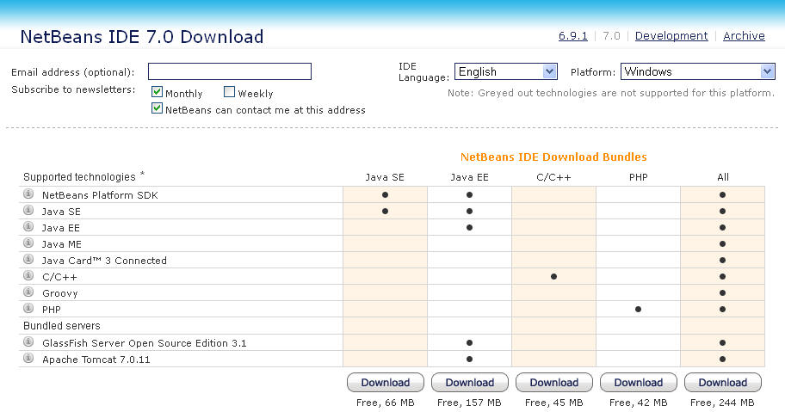
NetBeans IDE Download
  Available free from NetBeans.org
  Sets the application’s Java properties automatically
  Several available bundles
Notes:
We will use the NetBeans IDE for the course activities. When you are familiar with an IDE, you can easily transfer your skills to any similar IDE of your choice.
The NetBeans IDE 7.0 (and later versions) is compatible with and supports Java SE 7. The IDE’s installer requires a JDK to install the IDE on your system, because NetBeans is a Java application. However, you can add additional JDK versions after NetBeans is in place, and you can choose which JDK version to use when you create a NetBeans project. The IDE is available with specific downloads that support various Java technologies, as shown in the graphic. For example, you might choose to download and install the Java SE download only, or you can choose the NetBeans All bundle.
Java SE 7 Fundamentals 2 - <number>

Slide 37
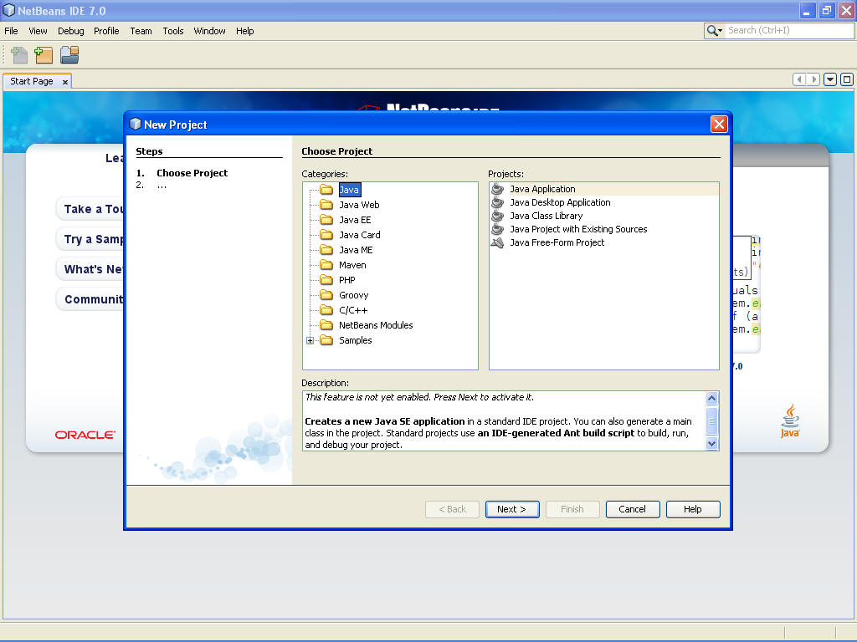
NetBeans IDE and New Project Wizard
Notes:
In NetBeans, you work within the context of a project, which consists of an organized group of source files and associated metadata; project-specific properties files; an Ant build script and run settings; and all the tools you’ll need to write, compile, test, and debug your application. You can create a main project with subprojects, and you can link projects through dependencies. So getting started is as easy as giving your project a name. After you tell NetBeans the name of a new project, it then:
Creates a source tree with an optional skeleton class inside
Creates a folder for unit tests
Sets classpaths for compiling, running, and testing
Sets the Java platform on which the project runs
Creates an Ant build script (build.xml), which contains instructions that the IDE uses when you perform commands on your project, such as compile or run
You explore these features during the practice activities for this lesson.
Java SE 7 Fundamentals 2 - <number>

Slide 38
Quiz -2
The Java technology product group that is designed for developing applications for consumer devices is _______.
  Java SE JDK
  Java ES SDK
  Java EE SDK
  Java ME SDK
Notes:
Answer: d
Java SE 7 Fundamentals 2 - <number>

Slide 39

3. A Simple Java Program
Listing 1.1
// This program prints Welcome to Java!
public class Welcome {
public static void main(String[] args) {
System.out.println("Welcome to Java!");
}
}
Animation
Welcome
IMPORTANT NOTE: If you cannot run the buttons, see www.cs.armstrong.edu/liang/javaslidenote.doc.
Run

Slide 40

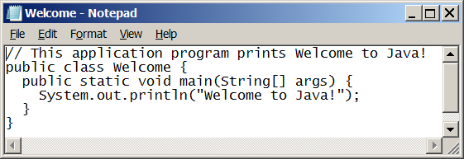
Creating and Editing Using NotePad
To use NotePad, type
  notepad Welcome.java
from the DOS prompt.

Slide 41
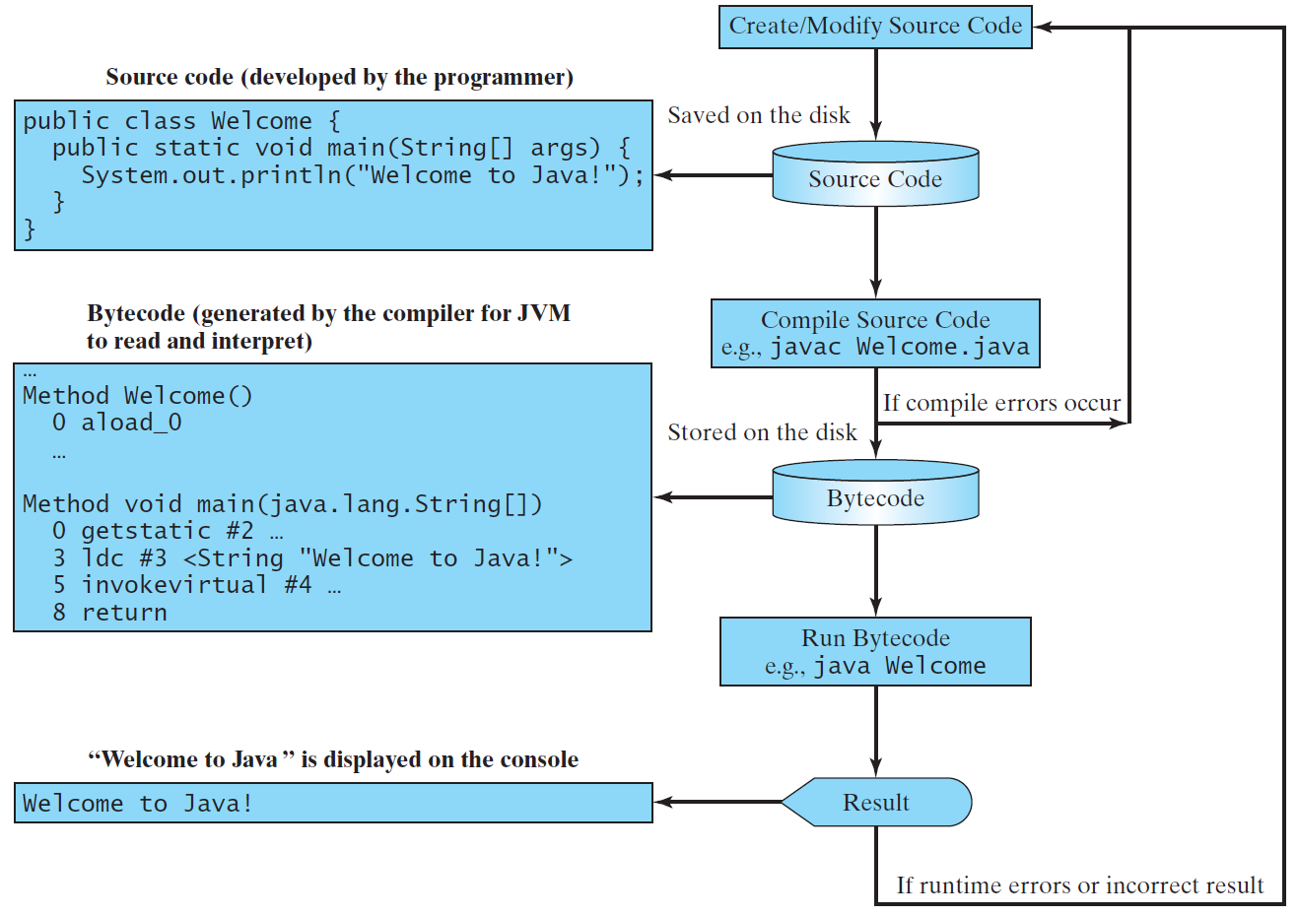
Creating, Compiling, and Running Programs

Slide 42
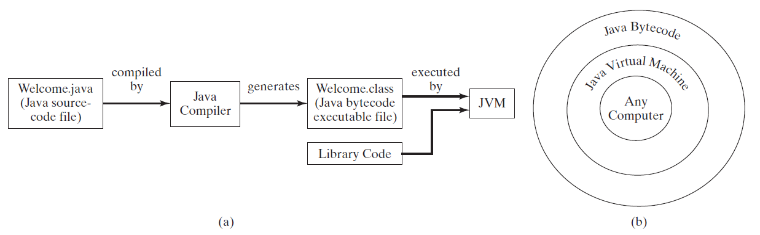
Compiling Java Source Code
You can port a source program to any machine with appropriate compilers. The source program must be recompiled, however, because the object program can only run on a specific machine. Nowadays computers are networked to work together. Java was designed to run object programs on any platform. With Java, you write the program once, and compile the source program into a special type of object code, known as bytecode. The bytecode can then run on any computer with a Java Virtual Machine, as shown below. Java Virtual Machine is a software that interprets Java bytecode.

Slide 43
Trace a Program Execution
animation
Enter main method
// This program prints Welcome to Java!
public class Welcome {
public static void main(String[] args) {
System.out.println("Welcome to Java!");
}
}

Slide 44
Trace a Program Execution
animation
Execute statement
// This program prints Welcome to Java!
public class Welcome {
public static void main(String[] args) {
System.out.println("Welcome to Java!");
}
}

Slide 45

Trace a Program Execution
animation
// This program prints Welcome to Java!
public class Welcome {
public static void main(String[] args) {
System.out.println("Welcome to Java!");
}
}
print a message to the console

Slide 46

Compiling and Running Java from the Command Window
Companion Website
Set path to JDK bin directory
  set path=c:\Program Files\java\jdk1.8.0\bin
Set classpath to include the current directory
  set classpath=.
Compile
  javac Welcome.java
Run
  java Welcome

Slide 47
Anatomy of a Java Program
Class name
Main method
Statements
Statement terminator
Reserved words
Comments
Blocks

Slide 48
Class Name
Every Java program must have at least one class. Each class has a name. By convention, class names start with an uppercase letter. In this example, the class name is Welcome.
// This program prints Welcome to Java!
public class Welcome {
public static void main(String[] args) {
System.out.println("Welcome to Java!");
}
}

Slide 49
Main Method
Line 2 defines the main method. In order to run a class, the class must contain a method named main. The program is executed from the main method.
// This program prints Welcome to Java!
public class Welcome {
public static void main(String[] args) {
System.out.println("Welcome to Java!");
}
}

Slide 50
Statement
A statement represents an action or a sequence of actions. The statement System.out.println("Welcome to Java!") in the program in Listing 1.1 is a statement to display the greeting "Welcome to Java!“.
// This program prints Welcome to Java!
public class Welcome {
public static void main(String[] args) {
System.out.println("Welcome to Java!");
}
}

Slide 51
Statement Terminator
Every statement in Java ends with a semicolon (;).
// This program prints Welcome to Java!
public class Welcome {
public static void main(String[] args) {
System.out.println("Welcome to Java!");
}
}

Slide 52
Reserved words
Reserved words or keywords are words that have a specific meaning to the compiler and cannot be used for other purposes in the program. For example, when the compiler sees the word class, it understands that the word after class is the name for the class.
// This program prints Welcome to Java!
public class Welcome {
public static void main(String[] args) {
System.out.println("Welcome to Java!");
}
}

Slide 53

Blocks
A pair of braces in a program forms a block that groups components of a program.

Slide 54

Special Symbols

Slide 55
{ … }
// This program prints Welcome to Java!
public class Welcome {
public static void main(String[] args) {
System.out.println("Welcome to Java!");
}
}

Slide 56
( … )
// This program prints Welcome to Java!
public class Welcome {
public static void main(String[] args) {
System.out.println("Welcome to Java!");
}
}

Slide 57
;
// This program prints Welcome to Java!
public class Welcome {
public static void main(String[] args) {
System.out.println("Welcome to Java!");
}
}

Slide 58
// …
// This program prints Welcome to Java!
public class Welcome {
public static void main(String[] args) {
System.out.println("Welcome to Java!");
}
}

Slide 59
" … "
// This program prints Welcome to Java!
public class Welcome {
public static void main(String[] args) {
System.out.println("Welcome to Java!");
}
}

Slide 60
Programming Style and Documentation
Appropriate Comments
Naming Conventions
Proper Indentation and Spacing Lines
Block Styles

Slide 61
Appropriate Comments
Include a summary at the beginning of the program to explain what the program does, its key features, its supporting data structures, and any unique techniques it uses.
Include your name, class section, instructor, date, and a brief description at the beginning of the program.

Slide 62
Naming Conventions
Choose meaningful and descriptive names.
Class names:
  Capitalize the first letter of each word in the name. For example, the class name ComputeExpression.

Slide 63
Proper Indentation and Spacing
Indentation
  Indent two spaces.
Spacing
  Use blank line to separate segments of the code.

Slide 64

Block Styles
Use end-of-line style for braces.

Slide 65
Programming Errors
Syntax Errors
  Detected by the compiler
Runtime Errors
  Causes the program to abort
Logic Errors
  Produces incorrect result

Slide 66
Syntax Errors
public class ShowSyntaxErrors {
public static main(String[] args) {
System.out.println("Welcome to Java);
}
}
ShowSyntaxErrors
Run

Slide 67
Runtime Errors
public class ShowRuntimeErrors {
public static void main(String[] args) {
System.out.println(1 / 0);
}
}
ShowRuntimeErrors
Run

Slide 68
Logic Errors
public class ShowLogicErrors {
public static void main(String[] args) {
System.out.println("Celsius 35 is Fahrenheit degree ");
System.out.println((9 / 5) * 35 + 32);
}
}
ShowLogicErrors
Run

Slide 69
Summary
What is Java?
Why study java?
How to run java programs?

Slide 70
Quiz 3
Write a program to display "Good Morning".
What command is used to compile a Java program?
What command is used to run a Java program?

