Slide 1
Chapter 2 Elementary Programming

Slide 2
Motivations
In the preceding chapter, you learned how to create, compile, and run a Java program. Starting from this chapter, you will learn how to solve practical problems programmatically. Through these problems, you will learn
Java primitive data types and related subjects, such as variables, constants, data types, operators, expressions, and input and output.

Slide 3
Objectives
To write Java programs to perform simple computations (§2.2).
To obtain input from the console using the Scanner class (§2.3).
To use identifiers to name variables, constants, methods, and classes (§2.4).
To use variables to store data (§§2.5–2.6).
To program with assignment statements and assignment expressions (§2.6).
To use constants to store permanent data (§2.7).
To name classes, methods, variables, and constants by following their naming conventions (§2.8).
To explore Java numeric primitive data types: byte, short, int, long, float, and double (§2.9.1).
To read a byte, short, int, long, float, or double value from the keyboard (§2.9.2).
To perform operations using operators +, -, *, /, and % (§2.9.3).
To perform exponent operations using Math.pow(a, b) (§2.9.4).
To write integer literals, floating-point literals, and literals in scientific notation (§2.10).
To write and evaluate numeric expressions (§2.11).
To obtain the current system time using System.currentTimeMillis() (§2.12).
To use augmented assignment operators (§2.13).
To distinguish between postincrement and preincrement and between postdecrement and predecrement (§2.14).
To cast the value of one type to another type (§2.15).
To describe the software development process and apply it to develop the loan payment program (§2.16).
To write a program that converts a large amount of money into smaller units (§2.17).
To avoid common errors and pitfalls in elementary programming (§2.18).

Slide 4

Introducing Programming with an Example
Listing 2.1 Computing the Area of a Circle
This program computes the area of the circle.
ComputeArea
Animation
Run
IMPORTANT NOTE: If you cannot run the buttons, see www.cs.armstrong.edu/liang/javaslidenote.doc.

Slide 5
Trace a Program Execution
animation
allocate memory for radius
public class ComputeArea {
/** Main method */
public static void main(String[] args) {
double radius;
double area;
// Assign a radius
radius = 20;
// Compute area
area = radius * radius * 3.14159;
// Display results
System.out.println("The area for the circle of radius " +
radius + " is " + area);
}
}
radius
no value

Slide 6
Trace a Program Execution
animation
public class ComputeArea {
/** Main method */
public static void main(String[] args) {
double radius;
double area;
// Assign a radius
radius = 20;
// Compute area
area = radius * radius * 3.14159;
// Display results
System.out.println("The area for the circle of radius " +
radius + " is " + area);
}
}
memory
radius
no value
area
no value
allocate memory for area

Slide 7
Trace a Program Execution
animation
public class ComputeArea {
/** Main method */
public static void main(String[] args) {
double radius;
double area;
// Assign a radius
radius = 20;
// Compute area
area = radius * radius * 3.14159;
// Display results
System.out.println("The area for the circle of radius " +
radius + " is " + area);
}
}
assign 20 to radius
radius
20
area
no value

Slide 8
Trace a Program Execution
animation
public class ComputeArea {
/** Main method */
public static void main(String[] args) {
double radius;
double area;
// Assign a radius
radius = 20;
// Compute area
area = radius * radius * 3.14159;
// Display results
System.out.println("The area for the circle of radius " +
radius + " is " + area);
}
}
memory
radius
20
area
1256.636
compute area and assign it to variable area

Slide 9

Trace a Program Execution
animation
public class ComputeArea {
/** Main method */
public static void main(String[] args) {
double radius;
double area;
// Assign a radius
radius = 20;
// Compute area
area = radius * radius * 3.14159;
// Display results
System.out.println("The area for the circle of radius " +
radius + " is " + area);
}
}
memory
radius
20
area
1256.636
print a message to the console

Slide 10

Reading Input from the Console
1. Create a Scanner object
  Scanner input = new Scanner(System.in);
  note: http://docs.oracle.com/javase/8/docs/api/
2. Use the method nextDouble() to obtain to a double value. For example,
  System.out.print("Enter a double value: ");
  Scanner input = new Scanner(System.in);
  double d = input.nextDouble();
Animation
ComputeAreaWithConsoleInput
ComputeAverage
Run
Run

Slide 11
Identifiers
An identifier is a sequence of characters that consist of letters, digits, underscores (_), and dollar signs ($).
An identifier must start with a letter, an underscore (_), or a dollar sign ($). It cannot start with a digit.
An identifier cannot be a reserved word. (See Appendix A, “Java Keywords,” for a list of reserved words).
An identifier cannot be true, false, or
null.
An identifier can be of any length.

Slide 12
Variables
// Compute the first area
radius = 1.0;
area = radius * radius * 3.14159;
System.out.println("The area is “ + area + " for radius "+radius);
// Compute the second area
radius = 2.0;
area = radius * radius * 3.14159;
System.out.println("The area is “ + area + " for radius "+radius);

Slide 13
Declaring Variables
int x; // Declare x to be an
// integer variable;
double radius; // Declare radius to
// be a double variable;
char a; // Declare a to be a
// character variable;

Slide 14
Assignment Statements
x = 1; // Assign 1 to x;
radius = 1.0; // Assign 1.0 to radius;
a = 'A'; // Assign 'A' to a;

Slide 15
Declaring and Initializing in One Step
int x = 1;
double d = 1.4;

Slide 16
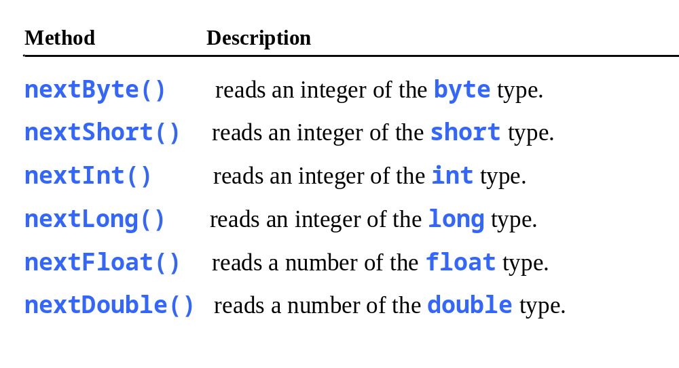
Reading Numbers from the Keyboard
Scanner input = new Scanner(System.in);
int value = input.nextInt();

Slide 17
Named Constants
final datatype CONSTANTNAME = VALUE;
final double PI = 3.14159;
final int SIZE = 3;

Slide 18
Naming Conventions
Choose meaningful and descriptive names.
Variables and method names:
  Use lowercase. If the name consists of several words, concatenate all in one, use lowercase for the first word, and capitalize the first letter of each subsequent word in the name. For example, the variables radius and area, and the method computeArea.

Slide 19
Naming Conventions, cont.
Class names:
  Capitalize the first letter of each word in the name. For example, the class name ComputeArea.
Constants:
  Capitalize all letters in constants, and use underscores to connect words. For example, the constant PI and MAX_VALUE

Slide 20

Numerical Data Types

Slide 21

Numeric Operators

Slide 22
Integer Division
+, -, *, /, and %
5 / 2 yields an integer 2.
5.0 / 2 yields a double value 2.5
5 % 2 yields 1 (the remainder of the division)

Slide 23

Remainder Operator
Remainder is very useful in programming. For example, an even number % 2 is always 0 and an odd number % 2 is always 1. So you can use this property to determine whether a number is even or odd. Suppose today is Saturday and you and your friends are going to meet in 10 days. What day is in 10 days? You can find that day is Tuesday using the following expression:

Slide 24
Problem: Displaying Time
Write a program that obtains minutes and remaining seconds from seconds.
DisplayTime
Run

Slide 25
NOTE
Calculations involving floating-point numbers are approximated because these numbers are not stored with complete accuracy. For example,
System.out.println(1.0 - 0.1 - 0.1 - 0.1 - 0.1 - 0.1);
displays 0.5000000000000001, not 0.5, and
System.out.println(1.0 - 0.9);
displays 0.09999999999999998, not 0.1. Integers are stored precisely. Therefore, calculations with integers yield a precise integer result.

Slide 26
Scientific Notation
Floating-point literals can also be specified in scientific notation, for example, 1.23456e+2, same as 1.23456e2, is equivalent to 123.456, and 1.23456e-2 is equivalent to 0.0123456. E (or e) represents an exponent and it can be either in lowercase or uppercase.

Slide 27
Exponent Operations
System.out.println(Math.pow(2, 3));
// Displays 8.0
System.out.println(Math.pow(4, 0.5));
// Displays 2.0
System.out.println(Math.pow(2.5, 2));
// Displays 6.25
System.out.println(Math.pow(2.5, -2));
// Displays 0.16

Slide 28
Number Literals
A literal is a constant value that appears directly in the program. For example, 34, 1,000,000, and 5.0 are literals in the following statements:
int i = 34;
long x = 1000000;
double d = 5.0;

Slide 29
Integer Literals
An integer literal can be assigned to an integer variable as long as it can fit into the variable. A compilation error would occur if the literal were too large for the variable to hold. For example, the statement byte b = 1000 would cause a compilation error, because 1000 cannot be stored in a variable of the byte type.
An integer literal is assumed to be of the int type, whose value is between -2³¹ (-2147483648) to 2³¹–1 (2147483647). To denote an integer literal of the long type, append it with the letter L or l. L is preferred because l (lowercase L) can easily be confused with 1 (the digit one).

Slide 30
Floating-Point Literals
Floating-point literals are written with a decimal point. By default, a floating-point literal is treated as a double type value. For example, 5.0 is considered a double value, not a float value. You can make a number a float by appending the letter f or F, and make a number a double by appending the letter d or D. For example, you can use 100.2f or 100.2F for a float number, and 100.2d or 100.2D for a double number.

Slide 31
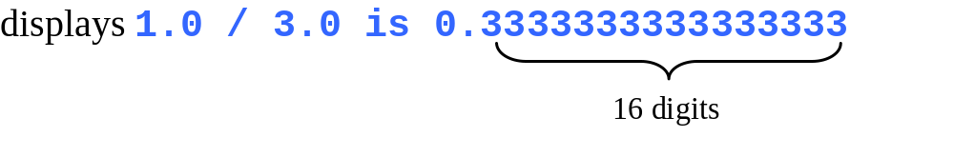
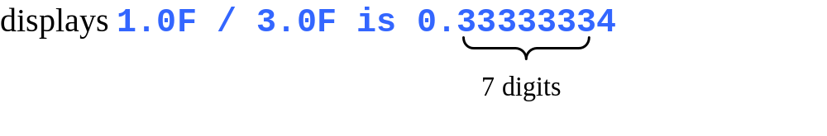
double vs. float
The double type values are more accurate than the float type values. For example,
System.out.println("1.0 / 3.0 is " + 1.0 / 3.0);
System.out.println("1.0F / 3.0F is " + 1.0F / 3.0F);

Slide 32

Arithmetic Expressions
is translated to
(3+4*x)/5 – 10*(y-5)*(a+b+c)/x + 9*(4/x + (9+x)/y)

Slide 33

How to Evaluate an Expression
Though Java has its own way to evaluate an expression behind the scene, the result of a Java expression and its corresponding arithmetic expression are the same. Therefore, you can safely apply the arithmetic rule for evaluating a Java expression.

Slide 34

Problem: Converting Temperatures
Write a program that converts a Fahrenheit degree to Celsius using the formula:
Note: you have to write
celsius = (5.0 / 9) * (fahrenheit – 32)
FahrenheitToCelsius
Run

Slide 35

Problem: Displaying Current Time
Write a program that displays current time in GMT in the format hour:minute:second such as 1:45:19.
The currentTimeMillis method in the System class returns the current time in milliseconds since the midnight, January 1, 1970 GMT. (1970 was the year when the Unix operating system was formally introduced.) You can use this method to obtain the current time, and then compute the current second, minute, and hour as follows.
ShowCurrentTime
Run

Slide 36
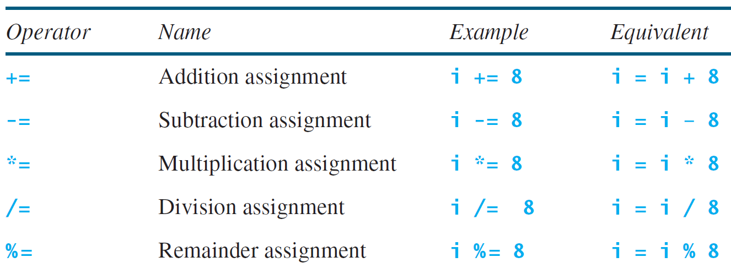
Augmented Assignment Operators

Slide 37
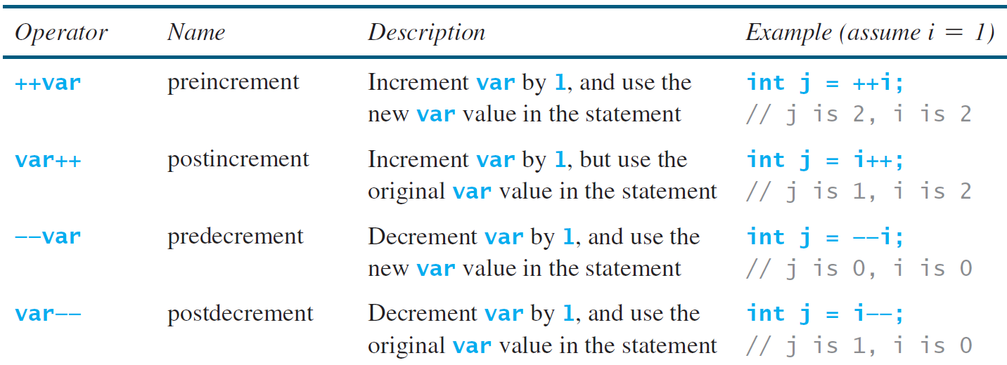
Increment and
Decrement Operators

Slide 38
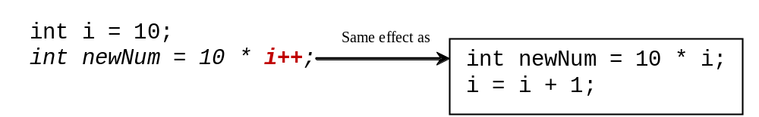
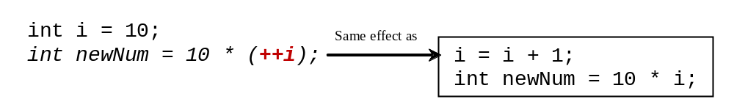
Increment and
Decrement Operators, cont.

Slide 39
Increment and
Decrement Operators, cont.
Using increment and decrement operators makes expressions short, but it also makes them complex and difficult to read. Avoid using these operators in expressions that modify multiple variables, or the same variable for multiple times such as this: int k = ++i + i.

Slide 40
Assignment Expressions and Assignment Statements
Prior to Java 2, all the expressions can be used as statements. Since Java 2, only the following types of expressions can be statements:
variable op= expression; // Where op is +, -, *, /, or %
++variable;
variable++;
--variable;
variable--;

Slide 41
Numeric Type Conversion
Consider the following statements:
byte i = 100;
long k = i * 3 + 4;
double d = i * 3.1 + k / 2;

Slide 42
Conversion Rules
When performing a binary operation involving two operands of different types, Java automatically converts the operand based on the following rules:
1. If one of the operands is double, the other is converted into double.
2. Otherwise, if one of the operands is float, the other is converted into float.
3. Otherwise, if one of the operands is long, the other is converted into long.
4. Otherwise, both operands are converted into int.

Slide 43
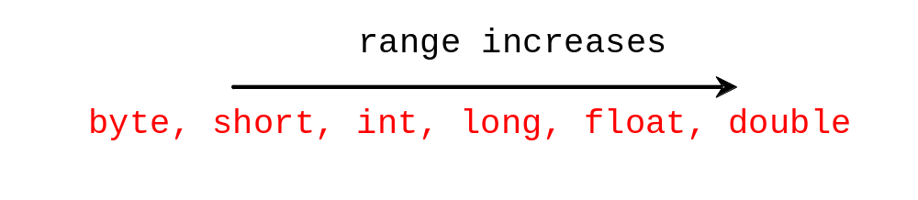
Type Casting
Implicit casting
double d = 3; (type widening)
Explicit casting
int i = (int)3.0; (type narrowing)
int i = (int)3.9; (Fraction part is truncated)
What is wrong? int x = 5 / 2.0;

Slide 44
Problem: Keeping Two Digits After Decimal Points
Write a program that displays the sales tax with two digits after the decimal point.
SalesTax
Run

Slide 45
Casting in an Augmented Expression
In Java, an augmented expression of the form x1 op= x2 is implemented as x1 = (T)(x1 op x2), where T is the type for x1. Therefore, the following code is correct.
int sum = 0;
sum += 4.5; // sum becomes 4 after this statement
sum += 4.5 is equivalent to sum = (int)(sum + 4.5).

Slide 46
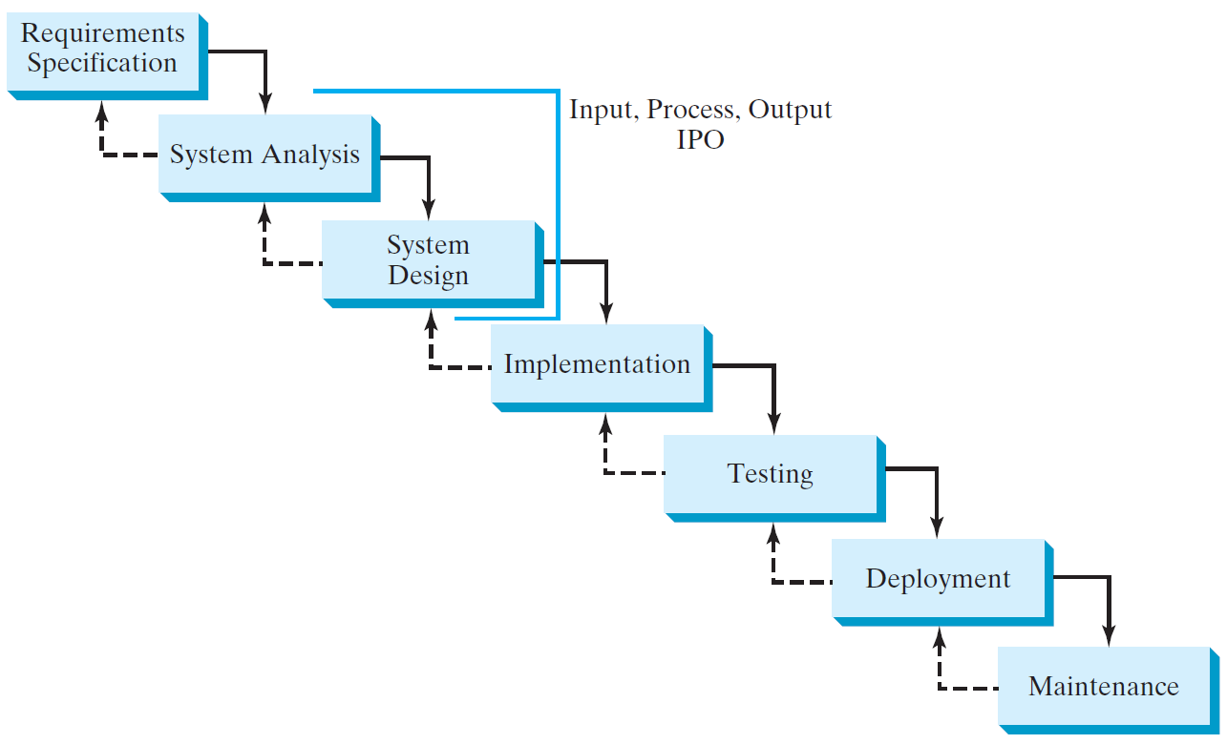
Software Development Process

Slide 47
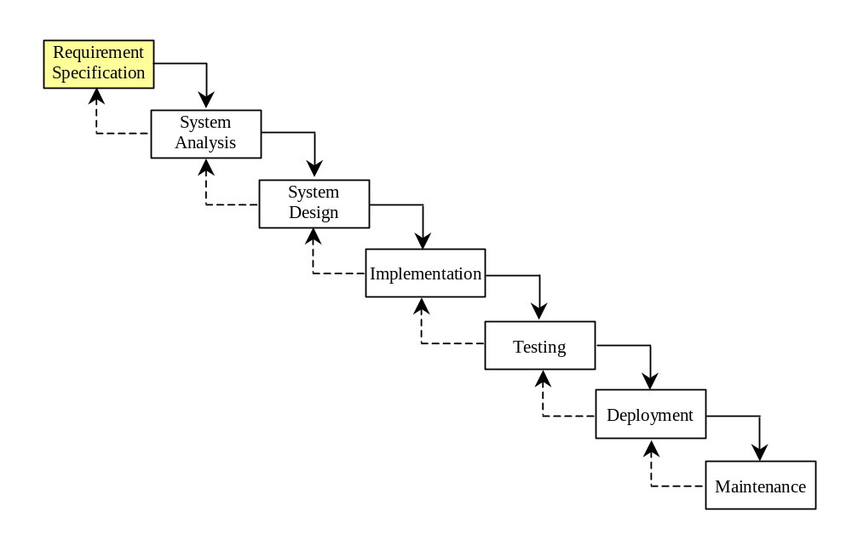
Requirement Specification
A formal process that seeks to understand the problem and document in detail what the software system needs to do. This phase involves close interaction between users and designers.
Most of the examples in this book are simple, and their requirements are clearly stated. In the real world, however, problems are not well defined. You need to study a problem carefully to identify its requirements.

Slide 48
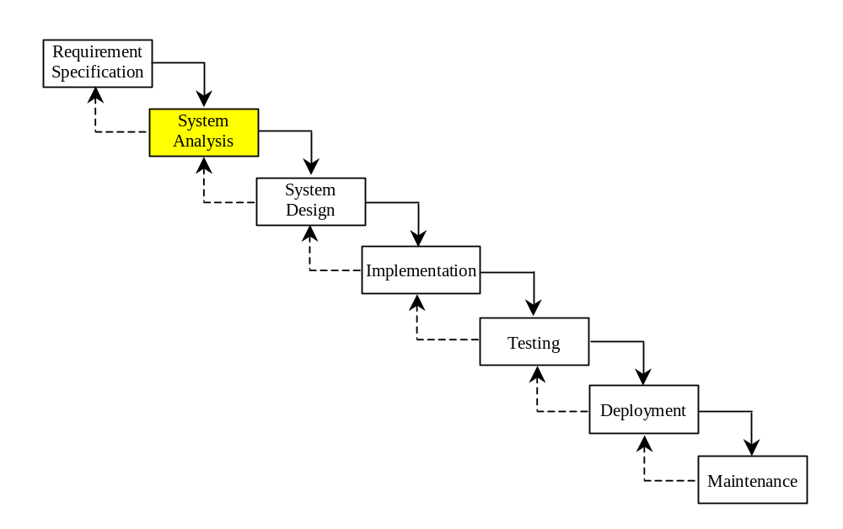
System Analysis
Seeks to analyze the business process in terms of data flow, and to identify the system’s input and output.
Part of the analysis entails modeling the system’s behavior. The model is intended to capture the essential elements of the system and to define services to the system.

Slide 49
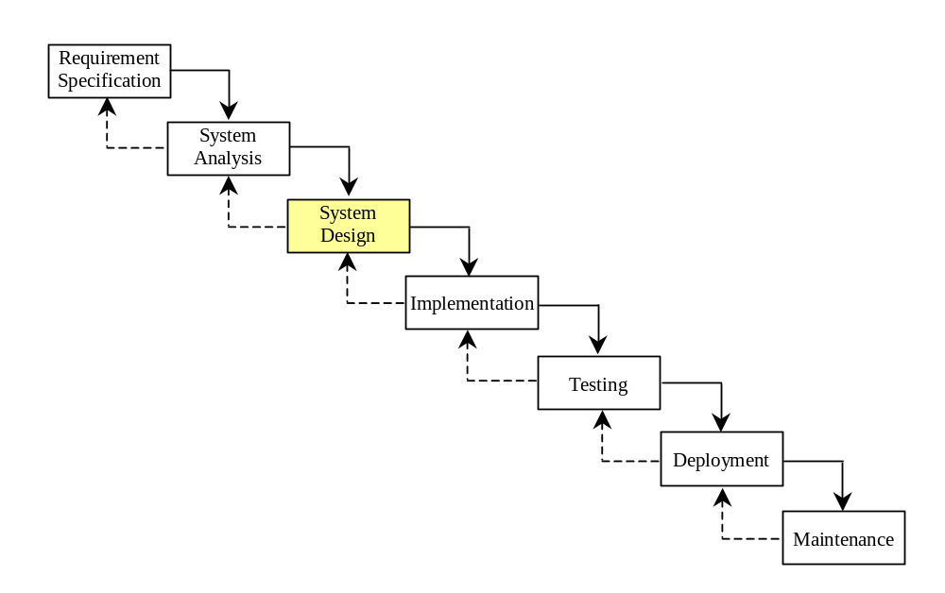
System Design
The process of designing the system’s components.
This phase involves the use of many levels of abstraction to decompose the problem into manageable components, identify classes and interfaces, and establish relationships among the classes and interfaces.

Slide 50
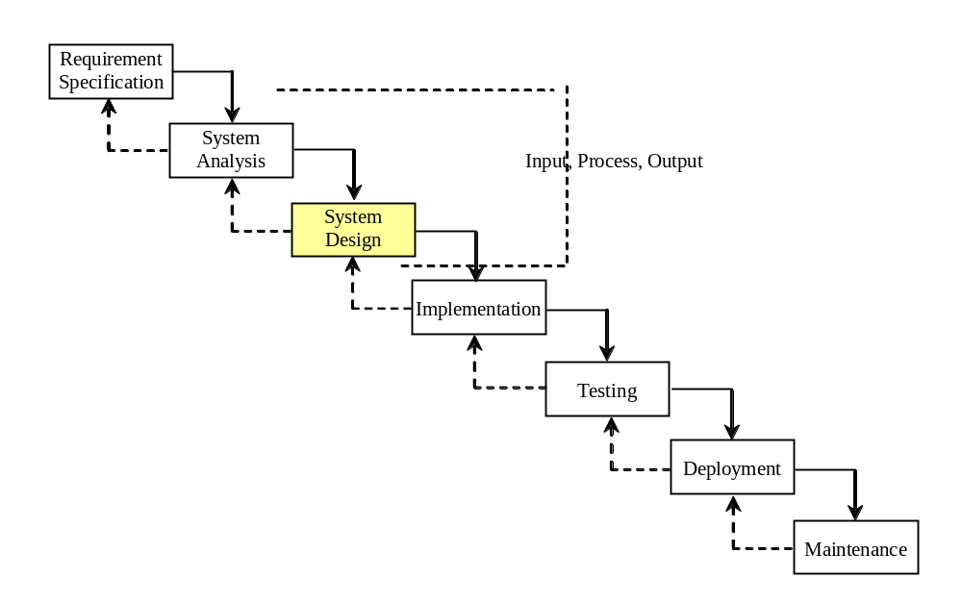
IPO
The essence of system analysis and design is input, process, and output. This is called IPO.

Slide 51
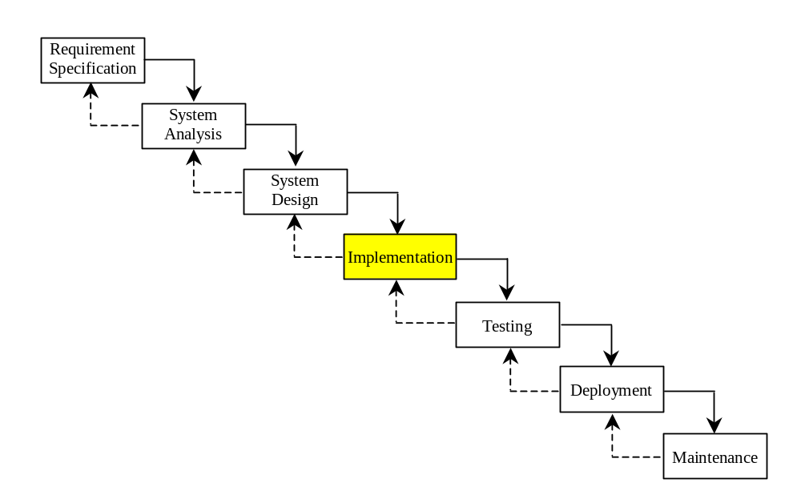
Implementation
The process of translating the system design into programs. Separate programs are written for each component and put to work together.
This phase requires the use of a programming language like Java. The implementation involves coding, testing, and debugging.

Slide 52
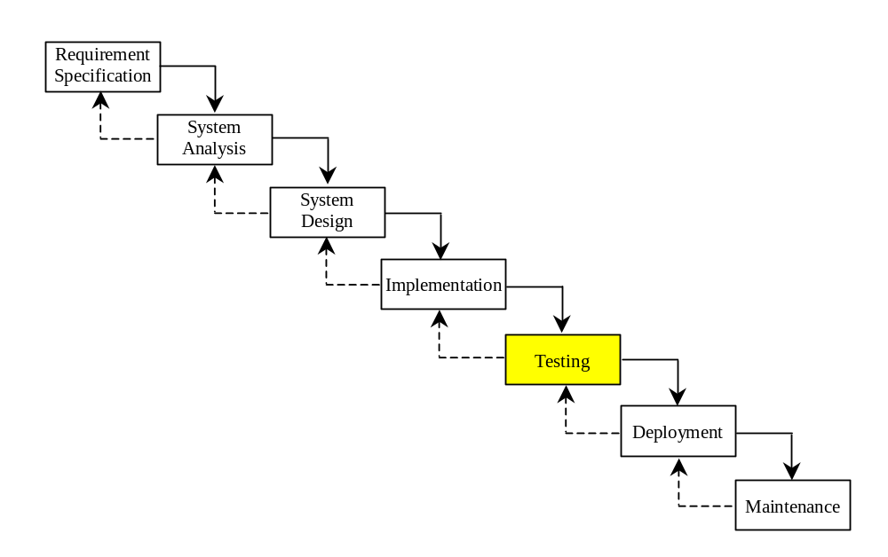
Testing
Ensures that the code meets the requirements specification and weeds out bugs.
An independent team of software engineers not involved in the design and implementation of the project usually conducts such testing.

Slide 53
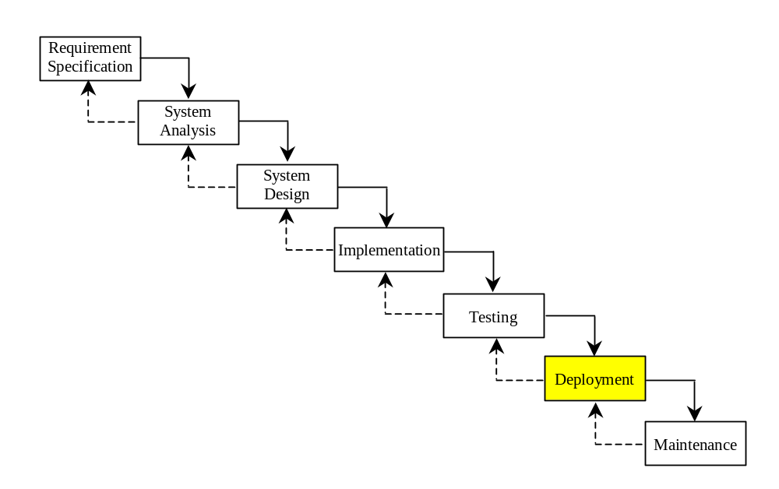
Deployment
Deployment makes the project available for use.
For a Java program, this means installing it on a desktop or on the Web.

Slide 54
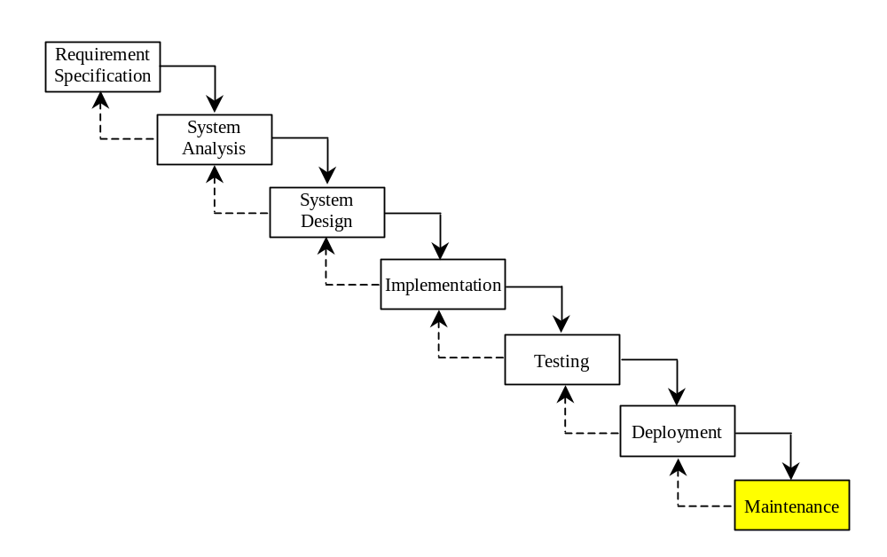
Maintenance
Maintenance is concerned with changing and improving the product.
A software product must continue to perform and improve in a changing environment. This requires periodic upgrades of the product to fix newly discovered bugs and incorporate changes.

Slide 55

Problem:
Computing Loan Payments
This program lets the user enter the interest rate, number of years, and loan amount, and computes monthly payment and total payment.
ComputeLoan
Run

Slide 56
Problem: Monetary Units
This program lets the user enter the amount in decimal representing dollars and cents and output a report listing the monetary equivalent in single dollars, quarters, dimes, nickels, and pennies. Your program should report maximum number of dollars, then the maximum number of quarters, and so on, in this order.
ComputeChange
Run

Slide 57
Common Errors and Pitfalls
Common Error 1: Undeclared/Uninitialized Variables and Unused Variables
Common Error 2: Integer Overflow
Common Error 3: Round-off Errors
Common Error 4: Unintended Integer Division
Common Error 5: Redundant Input Objects
Common Pitfall 1: Redundant Input Objects

Slide 58
Common Error 1: Undeclared/Uninitialized Variables and Unused Variables
double interestRate = 0.05;
double interest = interestrate * 45;

Slide 59
Common Error 2: Integer Overflow
int value = 2147483647 + 1;
// value will actually be -2147483648

Slide 60
Common Error 3: Round-off Errors
System.out.println(1.0 - 0.1 - 0.1 - 0.1 - 0.1 - 0.1);
System.out.println(1.0 - 0.9);

Slide 61
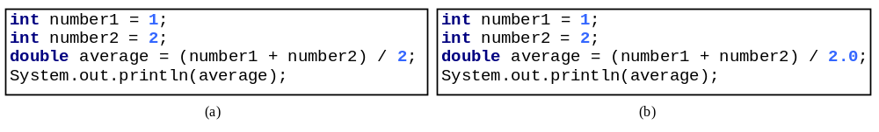
Common Error 4: Unintended Integer Division

Slide 62
Common Pitfall 1: Redundant Input Objects
Scanner input = new Scanner(System.in);
System.out.print("Enter an integer: ");
int v1 = input.nextInt();
Scanner input1 = new Scanner(System.in);
System.out.print("Enter a double value: ");
double v2 = input1.nextDouble();

Slide 63
Quiz
Problem Description:
Write a program that reads in investment amount, annual interest rate, and number of years, and displays the future investment value using the following formula:
futureInvestmentValue = investmentAmount * (1 + monthlyInterestRate)^{numberOfYears*12}
For example, if you enter amount 1000, annual interest rate 3.25%, and number of years 1, the future investment value is 1032.98.
Hint: Use the Math.pow(a, b) method to compute a raised to the power of b.
Here is a sample run:
Sample 1:
Enter investment amount: 1000
Enter annual interest rate: 4.25
Enter number of years: 1
Accumulated value is 1043.34

Slide 64
import java.util.*;
public class test {
public static void main(String[] args) {
java.util.Scanner input = new java.util.Scanner(System.in);
// Enter the investment amount
System.out.print( "Enter the investment amount, for example 120000.95: ");
double investmentAmount = input.nextDouble();
// Enter yearly interest rate
System.out.print("Enter annual interest rate, for example 8.25: ");
double annualInterestRate = input.nextDouble();
// Obtain monthly interest rate
double monthlyInterestRate = annualInterestRate / 1200;
// Enter number of years
System.out.print( "Enter number of years as an integer, \nfor example 5: ");
int numOfYears = input.nextInt();
double futureValue = investmentAmount * Math.pow(1 + monthlyInterestRate, numOfYears * 12);
System.out.print("Future value is " + (int)(futureValue * 100) / 100.0); // System.out.printf("%0.2f", futureValue )
}
}

