Slide 1
Chapter 6 Methods

Slide 2
Opening Problem
Find the sum of integers from 1 to 10, from 20 to 30, and from 35 to 45, respectively.

Slide 3
Problem
int sum = 0;
for (int i = 1; i <= 10; i++)
sum += i;
System.out.println("Sum from 1 to 10 is " + sum);
sum = 0;
for (int i = 20; i <= 30; i++)
sum += i;
System.out.println("Sum from 20 to 30 is " + sum);
sum = 0;
for (int i = 35; i <= 45; i++)
sum += i;
System.out.println("Sum from 35 to 45 is " + sum);

Slide 4
Problem
int sum = 0;
for (int i = 1; i <= 10; i++)
sum += i;
System.out.println("Sum from 1 to 10 is " + sum);
sum = 0;
for (int i = 20; i <= 30; i++)
sum += i;
System.out.println("Sum from 20 to 30 is " + sum);
sum = 0;
for (int i = 35; i <= 45; i++)
sum += i;
System.out.println("Sum from 35 to 45 is " + sum);

Slide 5
Solution
public static int sum(int i1, int i2) {
int sum = 0;
for (int i = i1; i <= i2; i++)
sum += i;
return sum;
}
public static void main(String[] args) {
System.out.println("Sum from 1 to 10 is " + sum(1, 10));
System.out.println("Sum from 20 to 30 is " + sum(20, 30));
System.out.println("Sum from 35 to 45 is " + sum(35, 45));
}

Slide 6
Objectives
To define methods with formal parameters (§6.2).
To invoke methods with actual parameters (i.e., arguments) (§6.2).
To define methods with a return value (§6.3).
To define methods without a return value (§6.4).
To pass arguments by value (§6.5).
To develop reusable code that is modular, easy to read, easy to debug, and easy to maintain (§6.6).
To write a method that converts hexadecimals to decimals (§6.7).
To use method overloading and understand ambiguous overloading (§6.8).
To determine the scope of variables (§6.9).
To apply the concept of method abstraction in software development (§6.10).
To design and implement methods using stepwise refinement (§6.10).

Slide 7
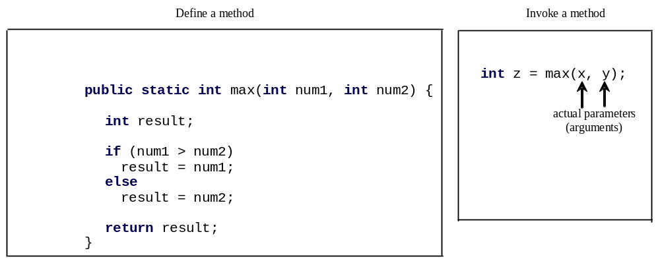
1. Defining Methods
A method is a collection of statements that are grouped together to perform an operation.

Slide 8

Defining Methods
A method is a collection of statements that are grouped together to perform an operation.

Slide 9
Method Signature
Method signature is the combination of the method name and the parameter list.

Slide 10
Formal Parameters
The variables defined in the method header are known as formal parameters.

Slide 11
Actual Parameters
When a method is invoked, you pass a value to the parameter. This value is referred to as actual parameter or argument.

Slide 12
Return Value Type
A method may return a value. The returnValueType is the data type of the value the method returns. If the method does not return a value, the returnValueType is the keyword void. For example, the returnValueType in the main method is void.

Slide 13


Calling Methods
Testing the max method
This program demonstrates calling a method max to return the largest of the int values
Animation
TestMax

Slide 14
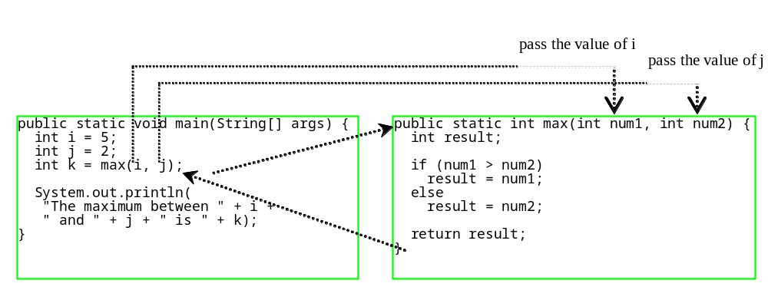
Calling Methods, cont.
animation

Slide 15

Trace Method Invocation
animation
i is now 5

Slide 16
Trace Method Invocation
animation
j is now 2

Slide 17
Trace Method Invocation
animation
invoke max(i, j)

Slide 18
Trace Method Invocation
animation
invoke max(i, j)
Pass the value of i to num1
Pass the value of j to num2

Slide 19
Trace Method Invocation
animation
declare variable result

Slide 20
Trace Method Invocation
animation
(num1 > num2) is true since num1 is 5 and num2 is 2

Slide 21
Trace Method Invocation
animation
result is now 5

Slide 22
Trace Method Invocation
animation
return result, which is 5

Slide 23
Trace Method Invocation
animation
return max(i, j) and assign the return value to k

Slide 24
Trace Method Invocation
animation
Execute the print statement

Slide 25

CAUTION
A return statement is required for a value-returning method. The method shown below in (a) is logically correct, but it has a compilation error because the Java compiler thinks it possible that this method does not return any value.
To fix this problem, delete if (n < 0) in (a), so that the compiler will see a return statement to be reached regardless of how the if statement is evaluated.

Slide 26
Reuse Methods from Other Classes
NOTE: One of the benefits of methods is for reuse. The max method can be invoked from any class besides TestMax. If you create a new class Test, you can invoke the max method using ClassName.methodName (e.g., TestMax.max).

Slide 27
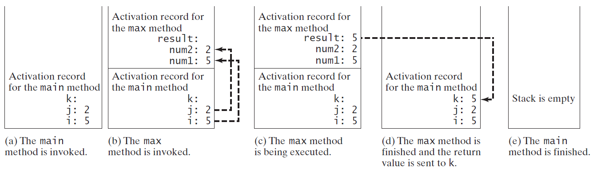
Call Stacks

Slide 28


Trace Call Stack
animation
i is declared and initialized

Slide 29
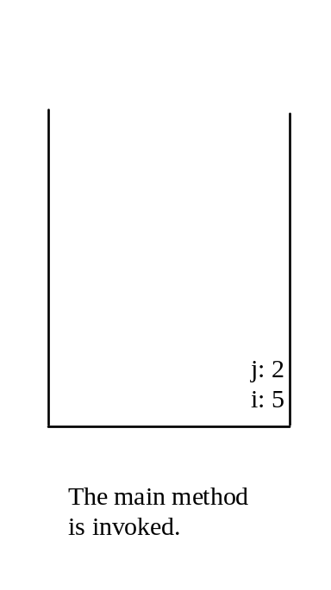
Trace Call Stack
animation
j is declared and initialized

Slide 30

Trace Call Stack
animation
Declare k

Slide 31
Trace Call Stack
animation
Invoke max(i, j)

Slide 32

Trace Call Stack
animation
pass the values of i and j to num1 and num2

Slide 33

Trace Call Stack
animation
Declare result

Slide 34
Trace Call Stack
animation
(num1 > num2) is true

Slide 35

Trace Call Stack
animation
Assign num1 to result

Slide 36

Trace Call Stack
animation
Return result and assign it to k

Slide 37

Trace Call Stack
animation
Execute print statement

Slide 38
void Method Example
This type of method does not return a value. The method performs some actions.
TestVoidMethod
TestReturnGradeMethod

Slide 39
2. Passing Parameters
public static void nPrintln(String message, int n) {
for (int i = 0; i < n; i++)
System.out.println(message);
}
Suppose you invoke the method using
  nPrintln(“Welcome to Java”, 5);
What is the output?
Suppose you invoke the method using
  nPrintln(“Computer Science”, 15);
What is the output?
Can you invoke the method using
  nPrintln(15, “Computer Science”);

Slide 40
Pass by Value
This program demonstrates passing values to the methods.
Increment

Slide 41
Pass by Value
Testing Pass by value
This program demonstrates passing values to the methods.
TestPassByValue

Slide 42
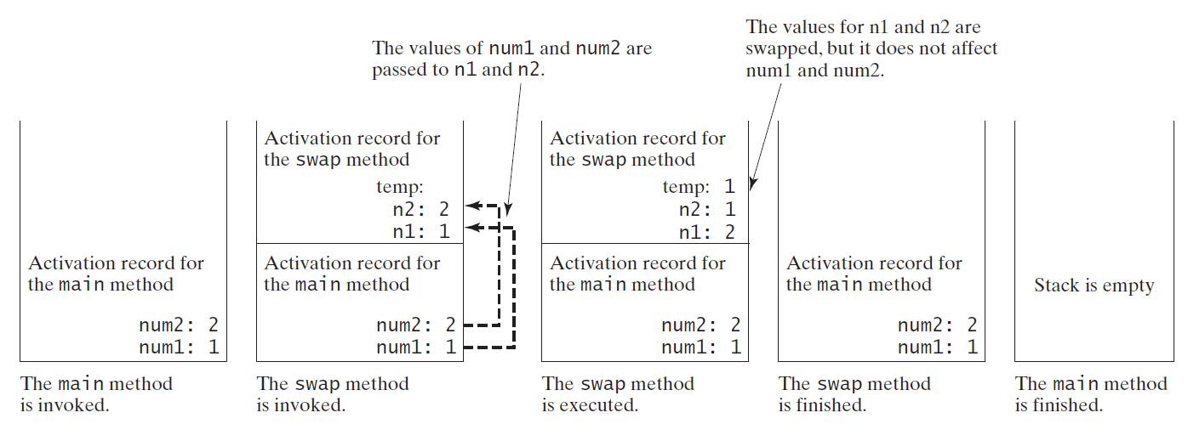
Pass by Value, cont.

Slide 43
Modularizing Code
1） Methods can be used to reduce redundant coding and enable code reuse.
2）Methods can also be used to modularize code and improve the quality of the program.
GreatestCommonDivisorMethod
PrimeNumberMethod

Slide 44
Case Study: Converting Hexadecimals to Decimals
Write a method that converts a hexadecimal number into a decimal number.
ABCD =>
A*16^3 + B*16^2 + C*16^1+ D*16^0
= ((A*16 + B)*16 + C)*16+D
= ((10*16 + 11)*16 + 12)*16+13 = ?
Hex2Dec

Slide 45
3. Overloading Methods
Overloading the max Method
public static double max(double num1, double num2) {
if (num1 > num2)
return num1;
else
return num2;
}
TestMethodOverloading

Slide 46
Ambiguous Invocation
Sometimes there may be two or more possible matches for an invocation of a method, but the compiler cannot determine the most specific match. This is referred to as ambiguous invocation. Ambiguous invocation is a compile error.

Slide 47
Ambiguous Invocation
public class AmbiguousOverloading {
public static void main(String[] args) {
System.out.println(max(1, 2));
}
public static double max(int num1, double num2) {
if (num1 > num2)
return num1;
else
return num2;
}
public static double max(double num1, int num2) {
if (num1 > num2)
return num1;
else
return num2;
}
}

Slide 48
4. Scope of Local Variables
A local variable: a variable defined inside a method.
Scope: the part of the program where the variable can be referenced.
The scope of a local variable starts from its declaration and continues to the end of the block that contains the variable. A local variable must be declared before it can be used.

Slide 49
Scope of Local Variables, cont.
You can declare a local variable with the same name multiple times in different non-nesting blocks in a method, but you cannot declare a local variable twice in nested blocks.

Slide 50

Scope of Local Variables, cont.
A variable declared in the initial action part of a for loop header has its scope in the entire loop. But a variable declared inside a for loop body has its scope limited in the loop body from its declaration and to the end of the block that contains the variable.

Slide 51

Scope of Local Variables, cont.

Slide 52
Scope of Local Variables, cont.
// Fine with no errors
public static void correctMethod() {
int x = 1;
int y = 1;
// i is declared
for (int i = 1; i < 10; i++) {
x += i;
}
// i is declared again
for (int i = 1; i < 10; i++) {
y += i;
}
}

Slide 53
Scope of Local Variables, cont.
// With errors
public static void incorrectMethod() {
int x = 1;
int y = 1;
for (int i = 1; i < 10; i++) {
int x = 0;
x += i;
}
}

Slide 54

Method Abstraction
You can think of the method body as a black box that contains the detailed implementation for the method.

Slide 55
Benefits of Methods
Write a method once and reuse it anywhere.
Information hiding. Hide the implementation from the user.
Reduce complexity.

Slide 56
Case Study: Generating Random Characters
Computer programs process numerical data and characters. You have seen many examples that involve numerical data. It is also important to understand characters and how to process them.
As introduced in Section 2.9, each character has a unique Unicode between 0 and FFFF in hexadecimal (65535 in decimal). To generate a random character is to generate a random integer between 0 and 65535 using the following expression: (note that since 0 <= Math.random() < 1.0, you have to add 1 to 65535.)
  (int)(Math.random() * (65535 + 1))

Slide 57
Case Study: Generating Random Characters, cont.
Now let us consider how to generate a random lowercase letter. The Unicode for lowercase letters are consecutive integers starting from the Unicode for 'a', then for 'b', 'c', ..., and 'z'. The Unicode for 'a' is
  (int)'a'
So, a random integer between (int)'a' and (int)'z' is
  (int)((int)'a' + Math.random() * ((int)'z' - (int)'a' + 1)

Slide 58
Case Study: Generating Random Characters, cont.
Now let us consider how to generate a random lowercase letter. The Unicode for lowercase letters are consecutive integers starting from the Unicode for 'a', then for 'b', 'c', ..., and 'z'. The Unicode for 'a' is
  (int)'a'
So, a random integer between (int)'a' and (int)'z' is
  (int)((int)'a' + Math.random() * ((int)'z' - (int)'a' + 1)

Slide 59
Case Study: Generating Random Characters, cont.
As discussed in Chapter 2., all numeric operators can be applied to the char operands. The char operand is cast into a number if the other operand is a number or a character. So, the preceding expression can be simplified as follows:
  'a' + Math.random() * ('z' - 'a' + 1)
So a random lowercase letter is
  (char)('a' + Math.random() * ('z' - 'a' + 1))

Slide 60
Case Study: Generating Random Characters, cont.
To generalize the foregoing discussion, a random character between any two characters ch1 and ch2 with ch1 < ch2 can be generated as follows:
  (char)(ch1 + Math.random() * (ch2 – ch1 + 1))

Slide 61
The RandomCharacter Class
// RandomCharacter.java: Generate random characters
public class RandomCharacter {
/** Generate a random character between ch1 and ch2 */
public static char getRandomCharacter(char ch1, char ch2) {
return (char)(ch1 + Math.random() * (ch2 - ch1 + 1));
}
/** Generate a random lowercase letter */
public static char getRandomLowerCaseLetter() {
return getRandomCharacter('a', 'z');
}
/** Generate a random uppercase letter */
public static char getRandomUpperCaseLetter() {
return getRandomCharacter('A', 'Z');
}
/** Generate a random digit character */
public static char getRandomDigitCharacter() {
return getRandomCharacter('0', '9');
}
/** Generate a random character */
public static char getRandomCharacter() {
return getRandomCharacter('\u0000', '\uFFFF');
}
}
RandomCharacter
TestRandomCharacter

Slide 62
Stepwise Refinement (Optional)
The concept of method abstraction can be applied to the process of developing programs. When writing a large program, you can use the “divide and conquer” strategy, also known as stepwise refinement, to decompose it into subproblems. The subproblems can be further decomposed into smaller, more manageable problems.

Slide 63
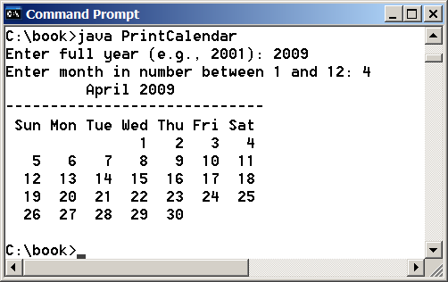
PrintCalender Case Study
Let us use the PrintCalendar example to demonstrate the stepwise refinement approach.
PrintCalendar

Slide 64

Design Diagram

Slide 65
Design Diagram

Slide 66
Design Diagram

Slide 67
Design Diagram

Slide 68
Design Diagram

Slide 69
Design Diagram

Slide 70
Design Diagram

Slide 71
Implementation: Top-Down
Top-down approach is to implement one method in the structure chart at a time from the top to the bottom. Stubs can be used for the methods waiting to be implemented. A stub is a simple but incomplete version of a method. The use of stubs enables you to test invoking the method from a caller. Implement the main method first and then use a stub for the printMonth method. For example, let printMonth display the year and the month in the stub. Thus, your program may begin like this:
A Skeleton for printCalendar

Slide 72
Implementation: Bottom-Up
Bottom-up approach is to implement one method in the structure chart at a time from the bottom to the top. For each method implemented, write a test program to test it. Both top-down and bottom-up methods are fine. Both approaches implement the methods incrementally and help to isolate programming errors and makes debugging easy. Sometimes, they can be used together.

Slide 73
Benefits of Stepwise Refinement
Simpler Program
Reusing Methods
Easier Developing, Debugging, and Testing
Better Facilitating Teamwork

Slide 74
Ex. Write a method that computes the sum of the digits in an integer.
Use the following method header:
public static int sumDigits(long n)
For example, sumDigits(234) returns 9 (2 + 3 + 4). Hint: Use the % operator to extract digits, and the / operator to remove the extracted digit. For instance, to extract 4 from 234, use 234 % 10 (= 4). To remove 4 from 234, use 234 / 10 (= 23). Use a loop to repeatedly extract and remove the digit until all the digits are extracted.
Write a test program that prompts the user to enter an integer and displays the sum of all its digits. The outline of the program is as follows:
public class Test {
public static void main(String[] args) {
// Fill in the code here
}
public static int sumDigits(long n) {
// Fill in the code here
｝

Slide 75
public class Test {
public static void main(String[] args) {
  // Fill in the code here
  java.util.Scanner input = new java.util.Scanner(System.in);
  System.out.print("Enter a number: ");
  int value = input.nextInt();
  System.out.println("The sum of digits for " + value +
  " is " + sumDigits(value));
public static int sumDigits(long n) {
  // Fill in the code here
  int temp = (int)Math.abs(n);
  int sum = 0;
  while (temp != 0) {
  int remainder = temp % 10;
  sum += remainder;
  temp = temp / 10;
｝
}

