Slide 1
Chapter 10 Thinking in Objects

Slide 2
Motivations
You see the advantages of object-oriented programming from the preceding chapter. This chapter will demonstrate how to solve problems using the object-oriented paradigm.

Slide 3
Objectives
To apply class abstraction to develop software (§10.2).
To explore the differences between the procedural paradigm and object-oriented paradigm (§10.3).
To discover the relationships between classes (§10.4).
To design programs using the object-oriented paradigm (§§10.5–10.6).
To create objects for primitive values using the wrapper classes (Byte, Short, Integer, Long, Float, Double, Character, and Boolean) (§10.7).
To simplify programming using automatic conversion between primitive types and wrapper class types (§10.8).
To use the BigInteger and BigDecimal classes for computing very large numbers with arbitrary precisions (§10.9).
To use the String class to process immutable strings (§10.10).
To use the StringBuilder and StringBuffer classes to process mutable strings (§10.11).

Slide 4

1. Class Abstraction and Encapsulation
Class abstraction means to separate class implementation from the use of the class. The creator of the class provides a description of the class and let the user know how the class can be used. The user of the class does not need to know how the class is implemented. The detail of implementation is encapsulated and hidden from the user.

Slide 5
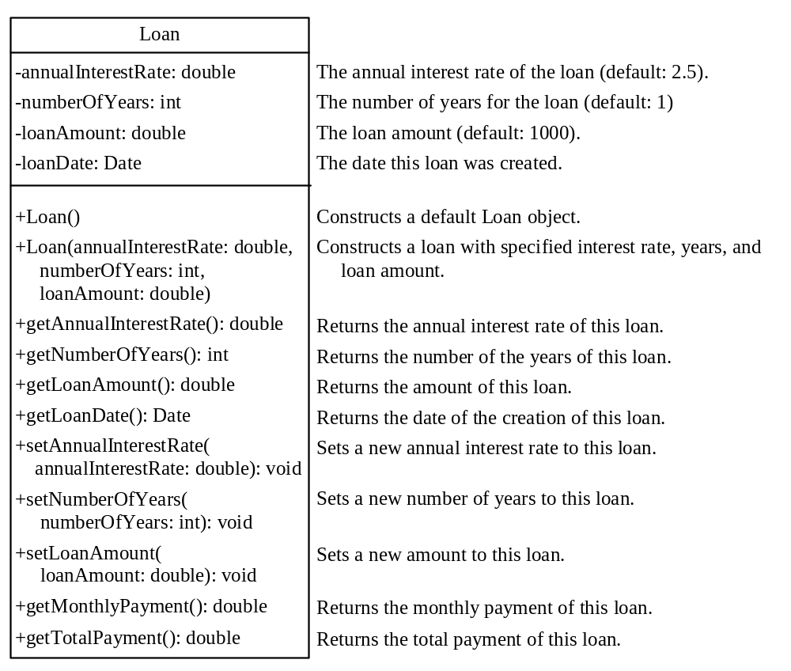
Designing the Loan Class
ComputeLoan
Run
Loan
TestLoanClass
Run

Slide 6
Object-Oriented Thinking
Chapters 1-8 introduced fundamental programming techniques for problem solving using loops, methods, and arrays. The studies of these techniques lay a solid foundation for object-oriented programming. Classes provide more flexibility and modularity for building reusable software. This section improves the solution for a problem introduced in Chapter 3 using the object-oriented approach. From the improvements, you will gain the insight on the differences between the procedural programming and object-oriented programming and see the benefits of developing reusable code using objects and classes.

Slide 7
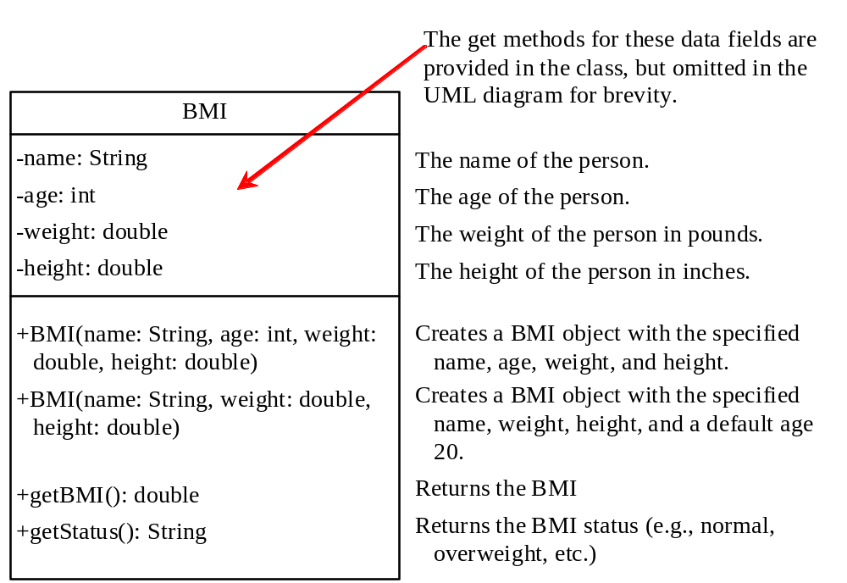
The BMI Class
BMI
UseBMIClass
Run

Slide 8
类与类之间的关系
继承关系
实现关系
依赖关系
关联关系
聚合关系
组合关系

Slide 9
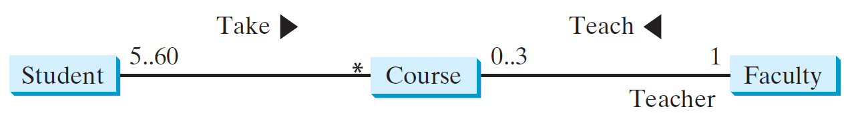
2. Object Composition
Composition is actually a special case of the aggregation relationship. Aggregation models has-a relationships and represents an ownership relationship between two objects. The owner object is called an aggregating object and its class an aggregating class. The subject object is called an aggregated object and its class an aggregated class.
Private Student[] classList;
Private Faculty faculty;

Slide 10
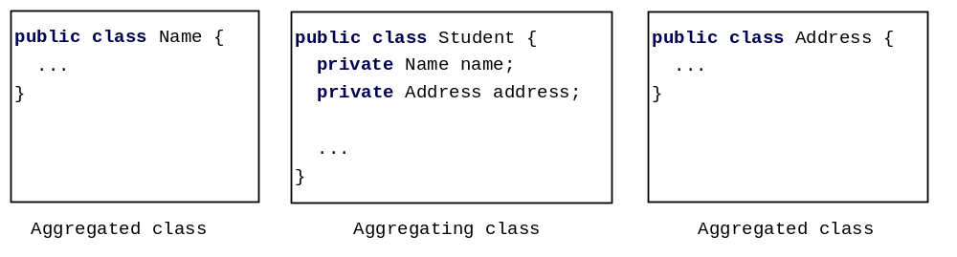
Class Representation
An aggregation relationship is usually represented as a data field in the aggregating class. For example, the relationship in Figure 10.6 can be represented as follows:

Slide 11
Aggregation or Composition
Since aggregation and composition relationships are represented using classes in similar ways, many texts don’t differentiate them and call both compositions.

Slide 12
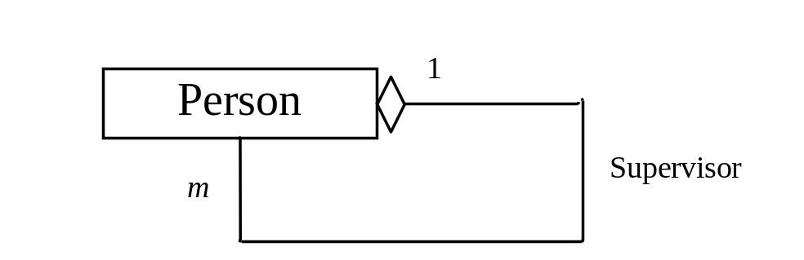
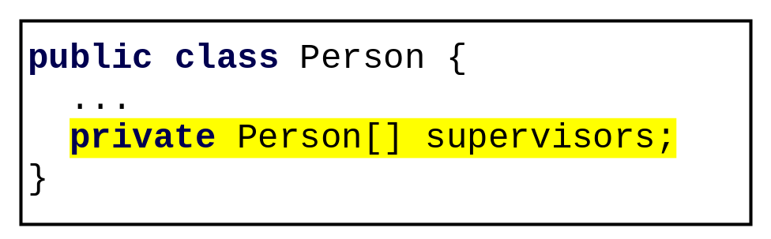
Aggregation Between Same Class
What happens if a person has several supervisors?

Slide 13

Aggregation Between Same Class
Aggregation may exist between objects of the same class. For example, a person may have a supervisor.
public class Person {
// The type for the data is the class itself
private Person supervisor;
...
}

Slide 14
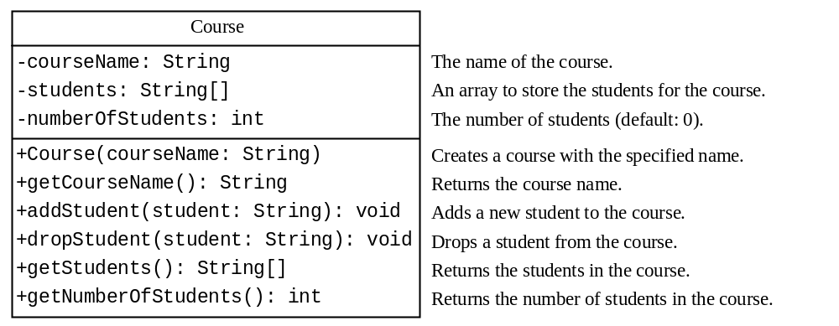
Example: The Course Class
0.9417
Course
TestCourse
Run

Slide 15
设计要求
高内聚（High Cohesion）
  内聚性是指单个模块或类内部元素彼此关联的程度。高内聚意味着类或模块中的元素紧密相关，并且共同协作以完成一个单一、明确定义的任务。
  高内聚的类或模块通常具有以下特点：
  功能单一：每个类或模块只负责一项任务或功能。
  易于理解：由于功能集中，理解和维护变得更加容易。
  易于测试：可以独立地测试单个模块的功能。
低耦合（Low Coupling）
  耦合度是指不同模块之间相互依赖的程度。低耦合意味着各个模块之间的依赖关系尽可能少，每个模块可以独立地更改和更新，而不影响其他模块。
  低耦合的系统通常具有以下特点：
  易于修改：模块间的依赖性小，修改一个模块不太可能影响到其他模块。
  易于扩展：可以添加新功能而不影响现有代码。
  重用性高：独立模块可以被重用在不同的项目中。

Slide 16
设计原则
开闭原则（Open Close Principle，OCP）
里氏替换原则（Liskov Substitution Principle，LSP）
依赖倒转原则（Dependence Inversion Principle，DIP）
单一职能原则（Single Responsibility Principle, SRP）
接口隔离原则（Interface Segregation Principle, ISP）
迪米特法则（Law of Demeter, LoD）

Slide 17
设计原则
单一职责原则（Single Responsibility Principle）：每个类应该只负责一项功能或职责，避免类的功能过于复杂和臃肿。
开闭原则（Open/Closed Principle）：类应该对扩展开放，对修改关闭，通过抽象类、接口等方式来实现类的扩展。
里氏替换原则（Liskov Substitution Principle）：子类应该能够替换其父类而不影响程序的正确性，即子类可以扩展父类的功能但不应该改变其原有的行为。
接口隔离原则（Interface Segregation Principle）：不应该强迫一个类依赖它不需要的接口，因此应该根据业务需求定义合适的接口。
依赖倒置原则（Dependency Inversion Principle）：高层模块不应该依赖于低层模块，而应该依赖于抽象，抽象不应该依赖于具体实现。
最少知识原则（Law of Demeter）：一个对象应该对其他对象有尽可能少的了解，避免直接调用其他对象的方法或属性。

Slide 18

Example: The StackOfIntegers Class
TestStackOfIntegers
Run

Slide 19
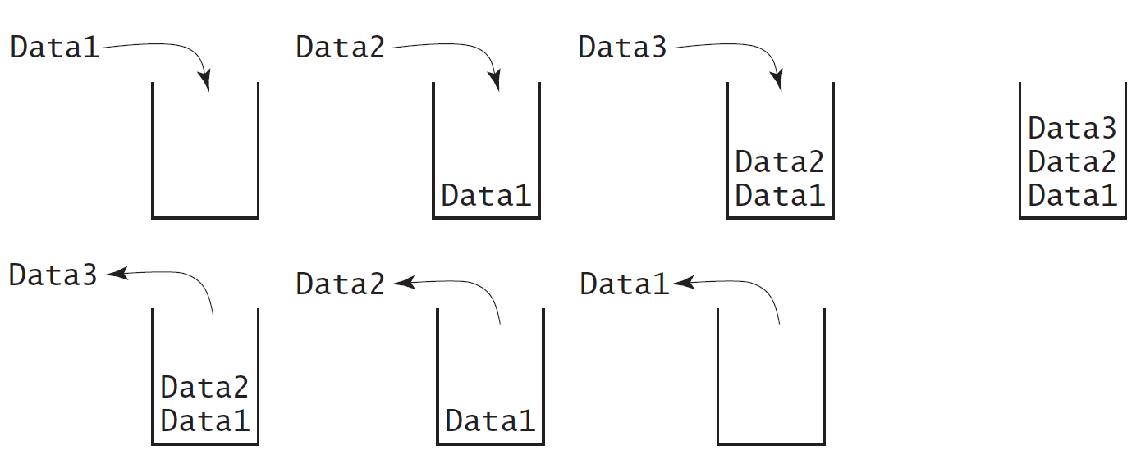
Designing the StackOfIntegers Class

Slide 20
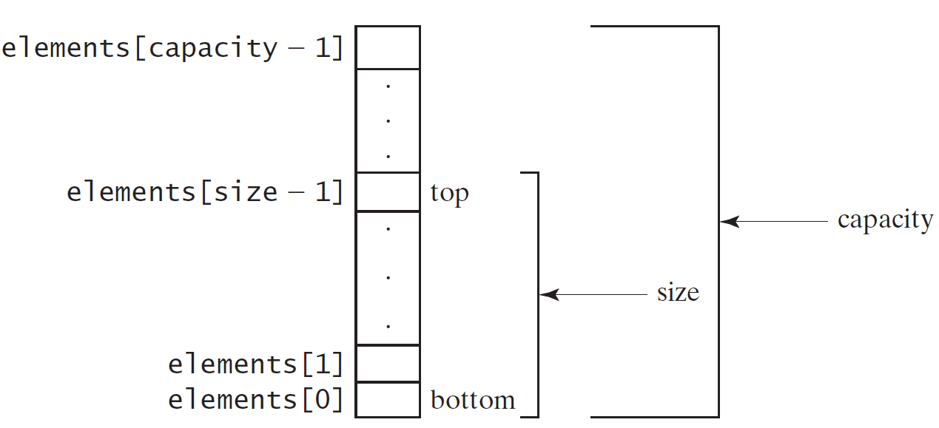
Implementing StackOfIntegers Class
StackOfIntegers

Slide 21
3. Wrapper Classes
Boolean
Character
Short
Byte
Integer
Long
Float
Double
NOTE: (1) The wrapper classes do not have no-arg constructors. (2) The instances of all wrapper classes are immutable, i.e., their internal values cannot be changed once the objects are created.

Slide 22
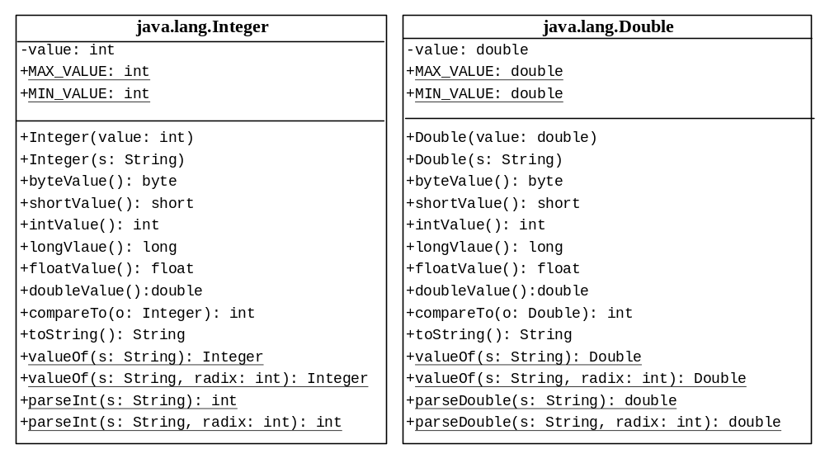
The Integer and Double Classes

Slide 23
The Integer Class and the Double Class
Constructors
Class Constants MAX_VALUE, MIN_VALUE
Conversion Methods

Slide 24
Numeric Wrapper Class Constructors
You can construct a wrapper object either from a primitive data type value or from a string representing the numeric value. The constructors for Integer and Double are:
  public Integer(int value)
  public Integer(String s)
  public Double(double value)
  public Double(String s)

Slide 25
Numeric Wrapper Class Constants
Each numerical wrapper class has the constants MAX_VALUE and MIN_VALUE. MAX_VALUE represents the maximum value of the corresponding primitive data type. For Byte, Short, Integer, and Long, MIN_VALUE represents the minimum byte, short, int, and long values. For Float and Double, MIN_VALUE represents the minimum positive float and double values. The following statements display the maximum integer (2,147,483,647), the minimum positive float (1.4E-45), and the maximum double floating-point number (1.79769313486231570e+308d).

Slide 26
Conversion Methods
Each numeric wrapper class implements the abstract methods doubleValue, floatValue, intValue, longValue, and shortValue, which are defined in the Number class. These methods “convert” objects into primitive type values.

Slide 27
The Static valueOf Methods
The numeric wrapper classes have a useful class method, valueOf(String s). This method creates a new object initialized to the value represented by the specified string. For example:
  Double doubleObject = Double.valueOf("12.4");
  Integer integerObject = Integer.valueOf("12");

Slide 28
The Methods for Parsing Strings into Numbers
You have used the parseInt method in the Integer class to parse a numeric string into an int value and the parseDouble method in the Double class to parse a numeric string into a double value. Each numeric wrapper class has two overloaded parsing methods to parse a numeric string into an appropriate numeric value.
  int i = Integer.parseInt("12");

Slide 29
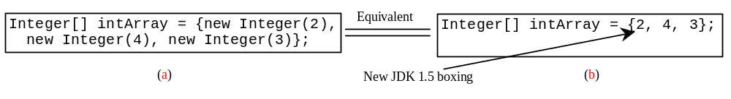
Automatic Conversion Between Primitive Types and Wrapper Class Types
JDK 1.5 allows primitive type and wrapper classes to be converted automatically. For example, the following statement in (a) can be simplified as in (b):
Integer[] intArray = {1, 2, 3};
System.out.println(intArray[0] + intArray[1] + intArray[2]);
Unboxing

Slide 30
4. BigInteger and BigDecimal
If you need to compute with very large integers or high precision floating-point values, you can use the BigInteger and BigDecimal classes in the java.math package. Both are immutable. Both extend the Number class and implement the Comparable interface.

Slide 31
BigInteger and BigDecimal
BigInteger a = new BigInteger("9223372036854775807");
BigInteger b = new BigInteger("2");
BigInteger c = a.multiply(b); // 9223372036854775807 * 2
System.out.println(c);
LargeFactorial
Run
BigDecimal a = new BigDecimal(1.0);
BigDecimal b = new BigDecimal(3);
BigDecimal c = a.divide(b, 20, BigDecimal.ROUND_UP);
System.out.println(c);

Slide 32
5.The String Class
Constructing a String:
  String message = "Welcome to Java“;
  String message = new String("Welcome to Java“);
  String s = new String();
Obtaining String length and Retrieving Individual Characters in a string（charAt）
String Concatenation (concat)
Substrings (substring(index), substring(start, end))
Comparisons (equals, compareTo)
Finding a Character or a Substring in a String (indexOf)
Conversions between Strings and Arrays (toCharArray)

Slide 33
Constructing Strings
String newString = new String(stringLiteral);
String message = new String("Welcome to Java");
Since strings are used frequently, Java provides a shorthand initializer for creating a string:
String message = "Welcome to Java";

Slide 34
Strings Are Immutable
A String object is immutable; its contents cannot be changed. Does the following code change the contents of the string?
String s = "Java";
s = "HTML";

Slide 35

Trace Code
animation
String s = "Java";
s = "HTML";

Slide 36
Trace Code
animation
String s = "Java";
s = "HTML";

Slide 37
Interned Strings
Since strings are immutable and are frequently used, to improve efficiency and save memory, the JVM uses a unique instance for string literals with the same character sequence. Such an instance is called interned. For example, the following statements:

Slide 38
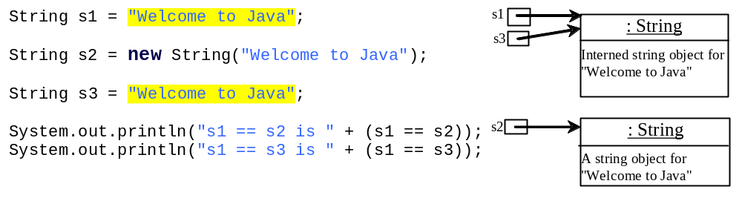
Examples
display
s1 == s is false
s1 == s3 is true
A new object is created if you use the new operator.
If you use the string initializer, no new object is created if the interned object is already created.

Slide 39
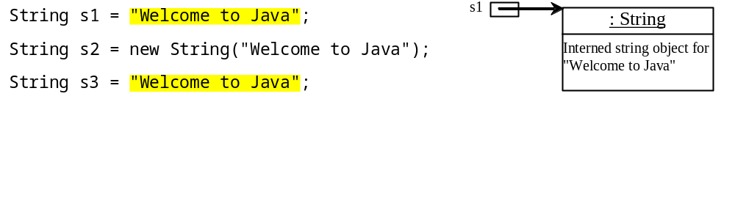
Trace Code
animation

Slide 40
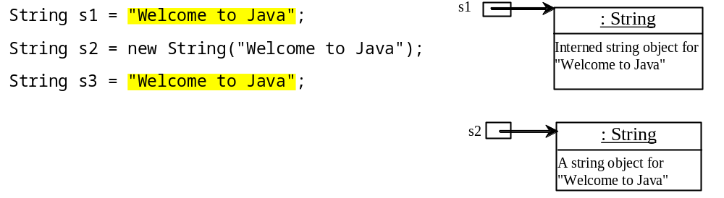
Trace Code

Slide 41
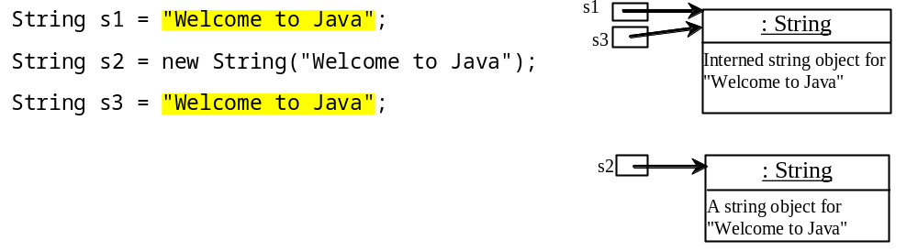
Trace Code

Slide 42
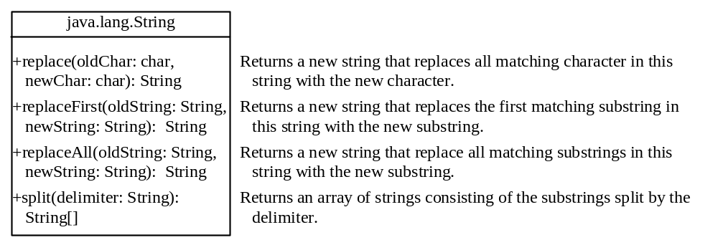
Replacing and Splitting Strings

Slide 43
Examples
"Welcome".replace('e', 'A') returns a new string, WAlcomA.
"Welcome".replaceFirst("e", "AB") returns a new string, WABlcome.
"Welcome".replace("e", "AB") returns a new string, WABlcomAB.
"Welcome".replace("el", "AB") returns a new string, WABcome.

Slide 44
Splitting a String
String[] tokens = "Java#HTML#Perl".split("#");
for (int i = 0; i < tokens.length; i++)
System.out.print(tokens[i] + " ");
displays
Java HTML Perl

Slide 45
Matching, Replacing and Splitting by Patterns
You can match, replace, or split a string by specifying a pattern. This is an extremely useful and powerful feature, commonly known as regular expression. Regular expression is complex to beginning students. For this reason, two simple patterns are used in this section. Please refer to Supplement III.F, “Regular Expressions,” for further studies.
"Java".matches("Java");
"Java".equals("Java");
"Java is fun".matches("Java.*");
"Java is cool".matches("Java.*");

Slide 46
Matching, Replacing and Splitting by Patterns
The replaceAll, replaceFirst, and split methods can be used with a regular expression. For example, the following statement returns a new string that replaces $, +, or # in "a+b$#c" by the string NNN.
String s = "a+b$#c".replaceAll("[$+#]", "NNN");
System.out.println(s);
Here the regular expression [$+#] specifies a pattern that matches $, +, or #. So, the output is aNNNbNNNNNNc.

Slide 47
Matching, Replacing and Splitting by Patterns
The following statement splits the string into an array of strings delimited by some punctuation marks.
String[] tokens = "Java,C?C#,C++".split("[.,:;?]");
for (int i = 0; i < tokens.length; i++)
System.out.println(tokens[i]);

Slide 48
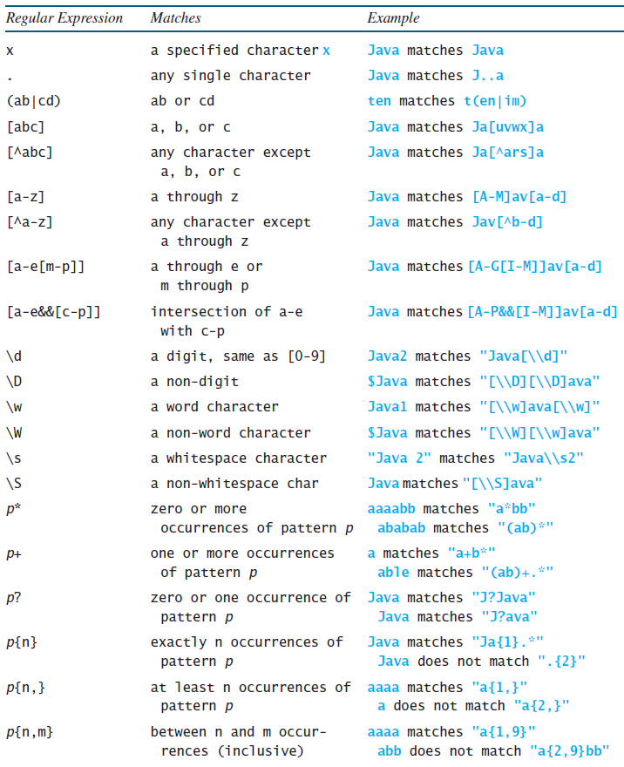
Regular Expression Syntax
Appendix H

Slide 49
Convert Character and Numbers to Strings
The String class provides several static valueOf methods for converting a character, an array of characters, and numeric values to strings. These methods have the same name valueOf with different argument types char, char[], double, long, int, and float. For example, to convert a double value to a string, use String.valueOf(5.44). The return value is string consists of characters ‘5’, ‘.’, ‘4’, and ‘4’.

Slide 50
6.StringBuilder and StringBuffer
The StringBuilder/StringBuffer class is an alternative to the String class. In general, a StringBuilder/StringBuffer can be used wherever a string is used. StringBuilder/StringBuffer is more flexible than String. You can add, insert, or append new contents into a string buffer, whereas the value of a String object is fixed once the string is created.

Slide 51
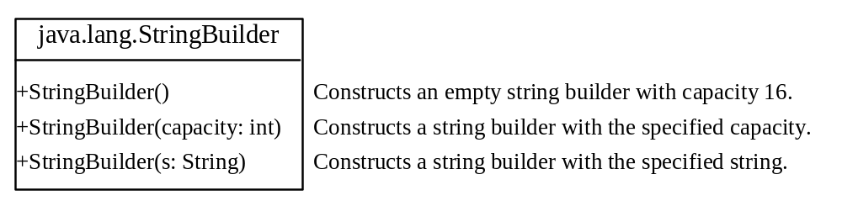
StringBuilder Constructors

Slide 52

Modifying Strings in the Builder

Slide 53
Examples
StringBulider = new StringBuilder(“Welcome to Java”)
stringBuilder.append("Java");
stringBuilder.insert(11, "HTML and ");
stringBuilder.delete(8, 11) changes the builder to Welcome Java.
stringBuilder.deleteCharAt(8) changes the builder to Welcome o Java.
stringBuilder.reverse() changes the builder to avaJ ot emocleW.
stringBuilder.replace(11, 15, "HTML")
changes the builder to Welcome to HTML.
stringBuilder.setCharAt(0, 'w') sets the builder to welcome to Java.

Slide 54
String、StringBuffer以及StringBuilder的性能比较
1）public class StringMore {
  private static int time = 50000;
  public static void main(String[] args) {
  testString();
  testStringBuffer();
  testStringBuilder();
  }
  public static void testString () {
    String s="";
    long begin = System.currentTimeMillis();
    for(int i=0; i<time; i++){
    s += "java";
  }
  long over = System.currentTimeMillis();
  System.out.println("操作"+s.getClass().getName()+"类型使用的时间为："+(over-begin)+"毫秒");
  }

Slide 55

public static void testStringBuffer () {
StringBuffer sb = new StringBuffer();
long begin = System.currentTimeMillis();
for(int i=0; i<time; i++){
sb.append("java");
}
long over = System.currentTimeMillis();
System.out.println("操作"+sb.getClass().getName()+"类型使用的时间为："+(over-begin)+"毫秒");
}
public static void testStringBuilder () {
StringBuilder sb = new StringBuilder();
long begin = System.currentTimeMillis();
for(int i=0; i<time; i++){
sb.append("java");
}
long over = System.currentTimeMillis();
System.out.println("操作"+sb.getClass().getName()+"类型使用的时间为："+(over-begin)+"毫秒");
}
｝

Slide 56
Why （2）
public StringBuilder insert(int index, char str[], int offset, int len)
{
super.insert(index, str, offset, len);
return this;
}
public synchronized StringBuffer insert(int index, char str[], int offset,int len)
{
super.insert(index, str, offset, len);
return this;
}
1）StringBuilder和StringBuffer类拥有的成员属性以及成员方法基本相同
2）synchronized 关键字代表线程安全键字

Slide 57
Conclusion
1） 一般情况下：
String、StringBuilder、StringBuffer三者的执行效率：
StringBuilder > StringBuffer > String
2）直接相加字符串，编译器进行优化，效率高
如String str = “my”+“hello”+ “world” 优化为 “myhelloworld”
效率高于
StringBuilder st = new StringBuilder(“my”).append("hello").append("world")
3）当字符串相加操作或者改动较少的情况下，建议使用 String ；当字符串相加操作较多的情况下，建议使用StringBuilder，如果采用了多线程，则使用StringBuffer。

Slide 58

The toString, capacity, length, setLength, and charAt Methods

Slide 59
Problem: Checking Palindromes Ignoring Non-alphanumeric Characters
This example gives a program that counts the number of occurrence of each letter in a string. Assume the letters are not case-sensitive.
PalindromeIgnoreNonAlphanumeric
Run

Slide 60
Regular Expressions
Appendix H
A regular expression (abbreviated regex) is a string that describes a pattern for matching a set of strings. Regular expression is a powerful tool for string manipulations. You can use regular expressions for matching, replacing, and splitting strings.

Slide 61
Matching Strings
Appendix H
"Java".matches("Java");
"Java".equals("Java");
"Java is fun".matches("Java.*")
"Java is cool".matches("Java.*")
"Java is powerful".matches("Java.*")

Slide 62
Regular Expression Syntax
Appendix H

Slide 63
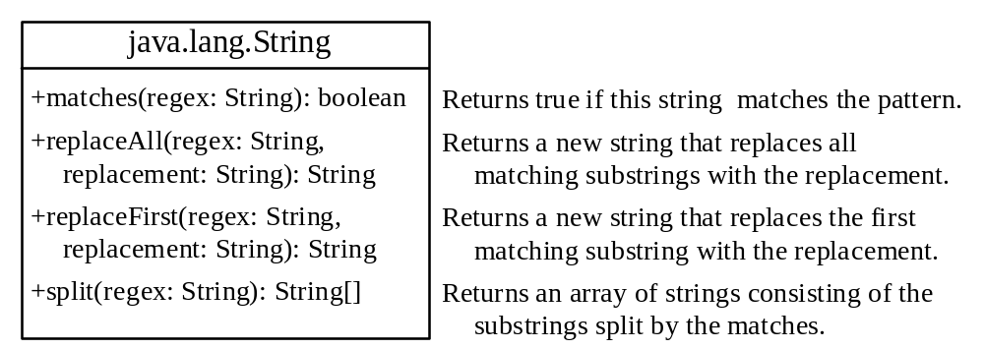
Replacing and Splitting Strings
Appendix H

Slide 64
Examples
Appendix H
String s = "Java Java Java".replaceAll("v\\w", "wi") ;
String s = "Java Java Java".replaceFirst("v\\w", "wi") ;
String[] s = "Java1HTML2Perl".split("\\d");

Slide 65
Summary
Class Abstraction and Encapsulation
Object Composition
Wrapper Classes
BigInteger and BigDecimal
The String Class
StringBuilder and StringBuffer

