Slide 1
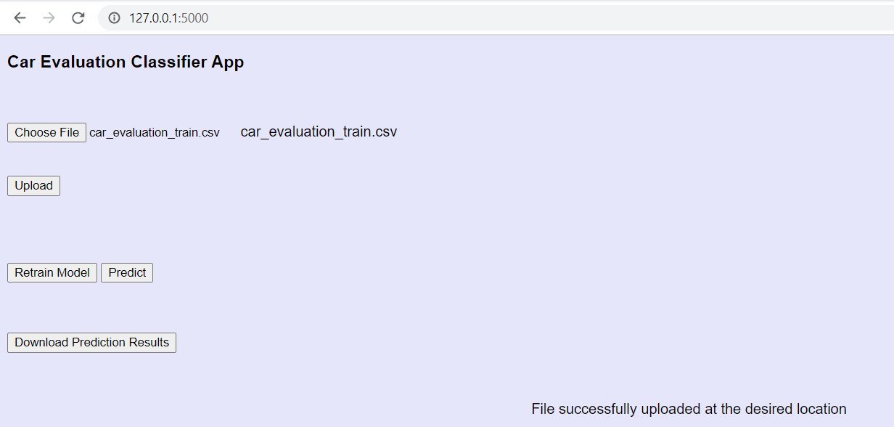
Used Cars Condition Evaluation Classification
GCP deployment URL:
http://104.198.219.252/
Veda
August 30th,2020

Slide 2
Contents
Problem Statement
Dataset Information
Data ingestion
Data Insight
Exploratory Data Analysis
Stats based EDA
Graph based EDA
Feature Engineering
Label Encoding
Handling imbalance data(Oversampling)
Scaling the features
Model Building
Hyperparameter tuning and Cross Validation
Evaluation of Models
Selecting the best model
Exception handling
Logging
UI Development
Dashboard
Dockerization
Deployment to cloud
Challenges
Learning

Slide 3
Problem Statement
The goal here is to build an end to end automated Machine Learning solution to evaluate the condition of the car with the given features and factors of the car.
To build and deploy a web application where the car details are entered into a web-based form which then outputs a predicted car evaluation decision in terms of unaccounted, accounted, good or very good.
A good used car can be evaluated based on the following factors
Price, maintenance cost, No.of doors, Capacity, size of luggage boot and safety

Slide 4
Data Information
Car evaluation data set from UCI machine learning Library: https://archive.ics.uci.edu/ml/datasets/Car+Evaluation
car Evaluation Database was derived from a simple hierarchical decision model originally developed for the demonstration of DEX, M. Bohanec, V. Rajkovic: Expert system for decision making. Sistemica 1(1), pp. 145-157, 1990.). The model evaluates cars according to the following concept structure: CAR car acceptability . PRICE overall price . . buying buying price . . maint price of the maintenance . TECH technical characteristics . . COMFORT comfort . . . doors number of doors . . . persons capacity in terms of persons to carry . . . lug_boot the size of luggage boot . . safety estimated safety of the car The Car Evaluation Database contains examples with the structural information removed, i.e., directly relates CAR to the six input attributes: buying, maint, doors, persons, lug_boot, safety. Because of known underlying concept structure, this database may be particularly useful for testing constructive induction and structure discovery methods.

Slide 5
Attributes Information
Class Values: unacc, acc, good, vgood Attributes: buying: vhigh, high, med, low. maint: vhigh, high, med, low. doors: 2, 3, 4, 5more. persons: 2, 4, more. lug_boot: small, med, big. safety: low, med, high.

Slide 6
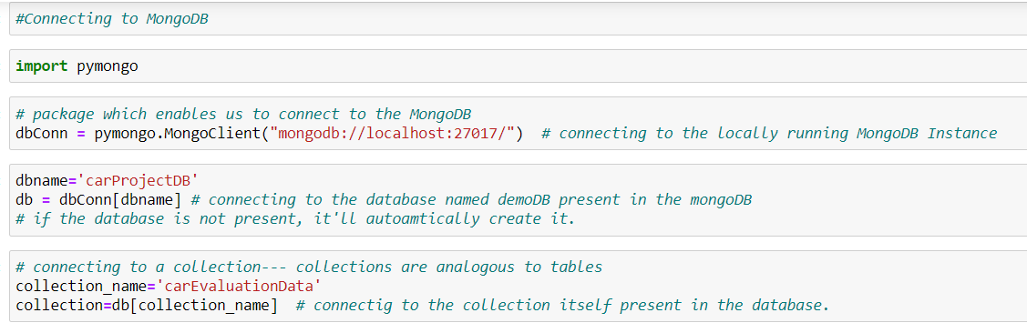
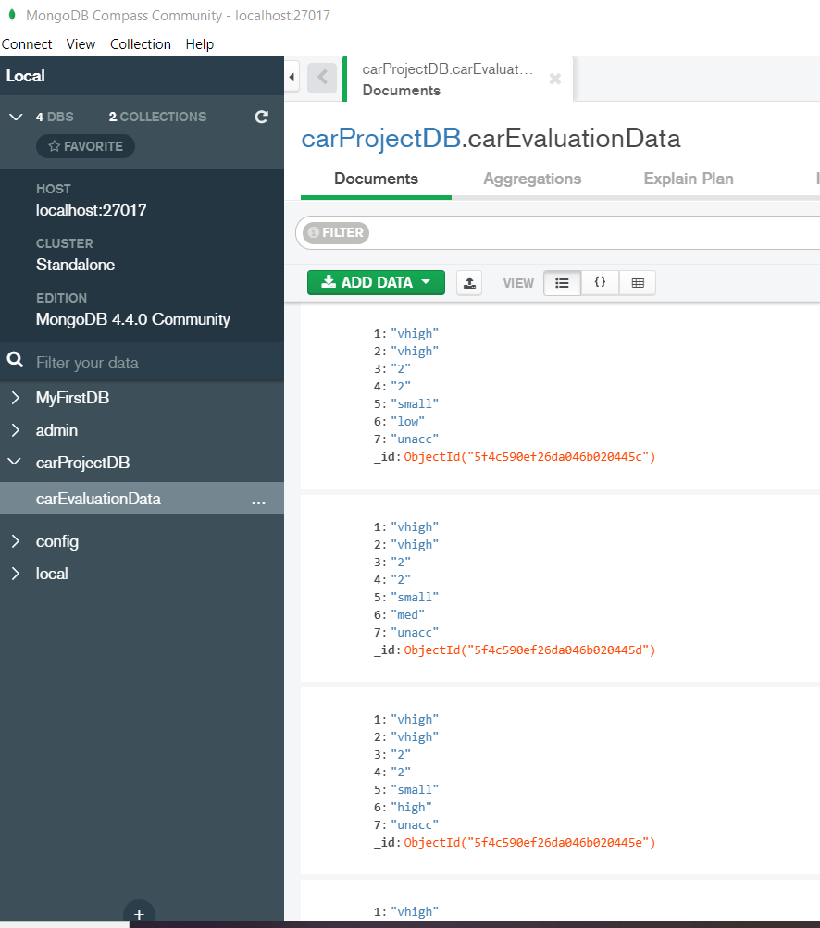


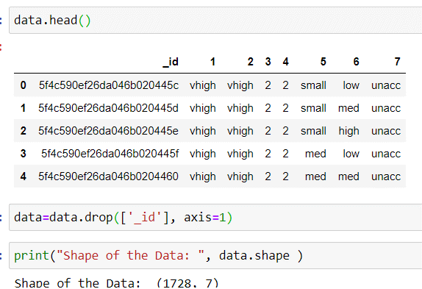
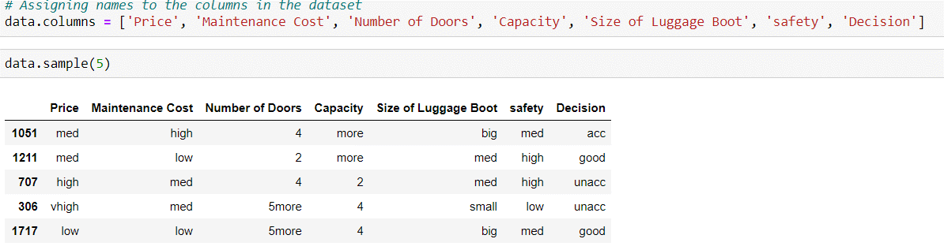
Data Ingestion
Used pymongo to connect MongoDB to fetch the data
Exported the records from MongoDB to python as CSV

Slide 7
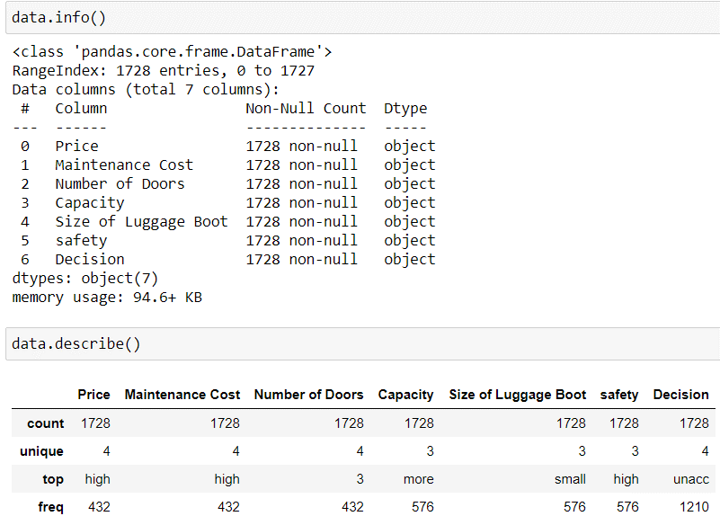
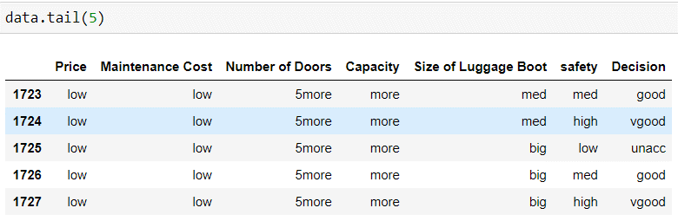
Data Insight
Observation:
1.There are 1728 records and 7 columns in the dataset
2.many of the columns are categorical
3.Decision is a Target variable and it is categorical with four unique values for it.So the machine learning model will be a multi-variate classification problem

Slide 8
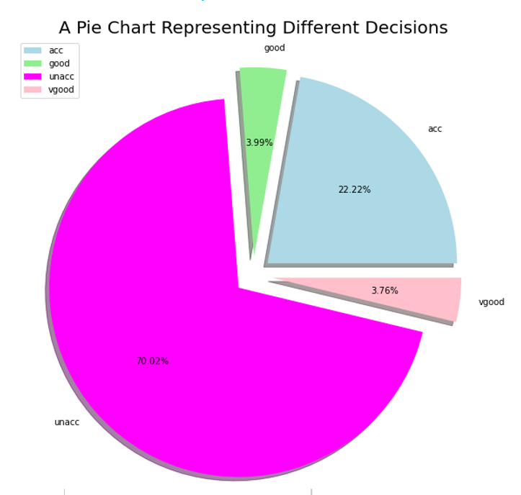
Exploratory Data Analysis
Most cars in the garage are unaccounted and very less number of them are in very good condition.
This shows the data here looks heavily imbalanced.

Slide 9
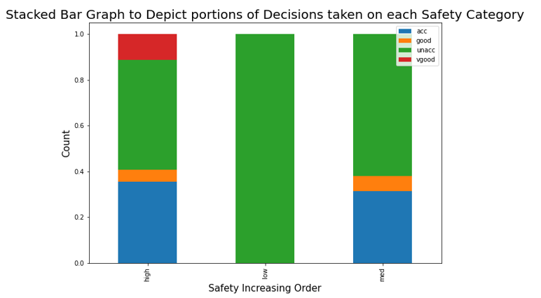
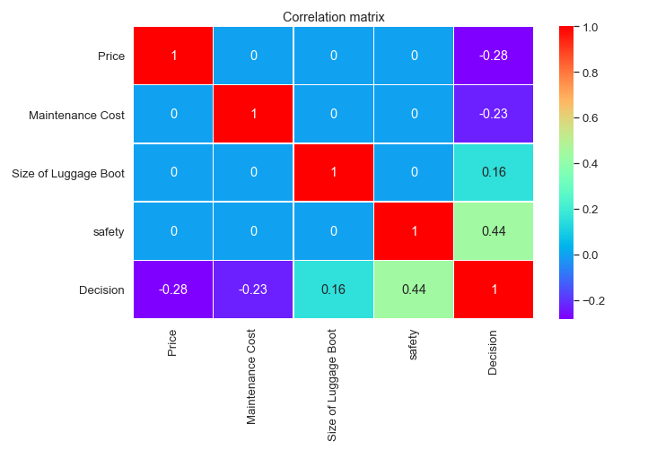
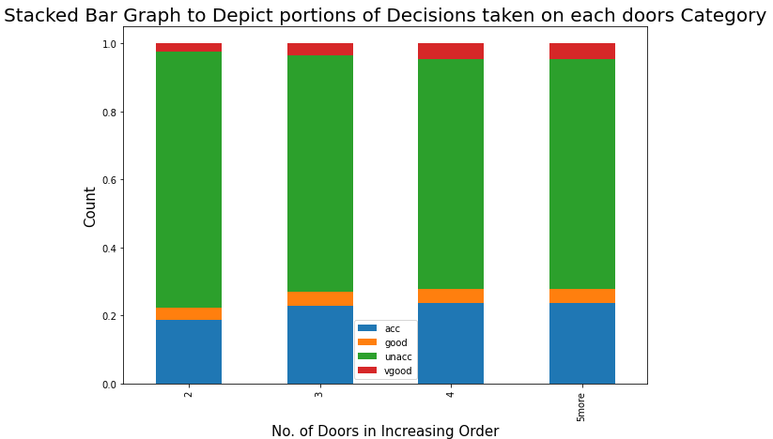
Exploratory Data Analysis
“Safety “ has the highest co-relation with the target variable”Decision”,this shows that Safety is an important predictor for the Target variables.
The co-relation between other predictors are very small ,this indicates there is no “multi-co-linearity
No.of doors are not effecting much on the quality of the cars

Slide 10
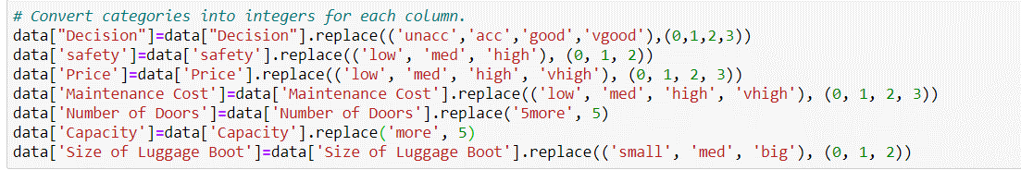

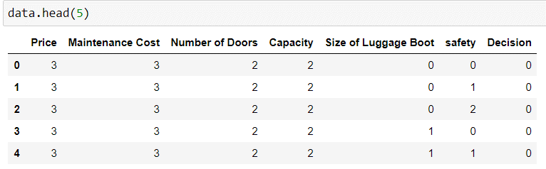

Feature Engineering
Label Encoding
2.Handling imbalance data(Oversampling)
In this the categorical columns are ordinal, so Label encoding has been used to convert the categorical values to numerical values.
Used the SMOTE over sampling method , to balance the minority and majority classes.
Before balancing the classes counts are:
After balancing the classes counts are;
3.Scaling the features
Scaled the input features with the standard scaler

Slide 11
Model Building
Split the entire data set into train and validation sets.
Build the 6 models, each model is trained and make a prediction for the test set. Since our data contains imbalanced classes, for evaluation of our model we are considering 4 matrics i.e. Accuracy, Precision, Recall and F1 score. These are calculated for each model. Then the GridSearchCV to tune the models and search for the best hyperparameters in order to increase the accuracy of each model.
Logistic Regression
KNN
SVC
Naive bayees
Decision tree
Random Forest

Slide 12
}
}
Hyper Parameter Tuning and Cross Validation
Implemented the Cross Validation with k-folds of 5
Best Parameters for Logistic Regression : {'C': 0.1, 'penalty': 'l2', 'solver': 'lbfgs’}
Best NB Parameters: {'var_smoothing': 1e-07}
Best KNN Parameters: {'n_neighbors': 1, 'p': 2, 'weights': 'uniform’}
Best SVC Parameters: {'C’: 1}
Best Decision tree Parameters: {'criterion': 'entropy', 'max_depth': 11}
Best Random Forest Parameters: {'max_depth': 10, 'max_features': 'auto', 'n_estimators': 50

Slide 13
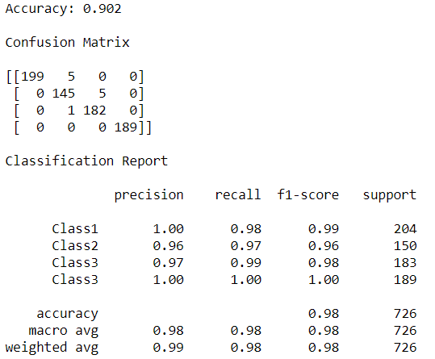
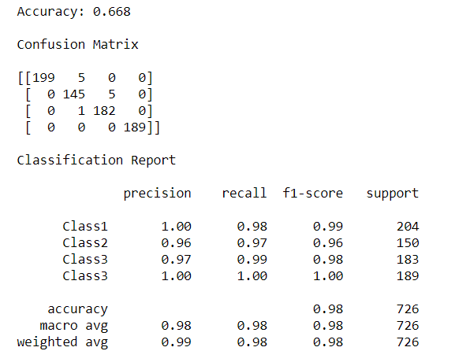
Evaluation of Models
Logistic Regression model-Evaluation Results
Naïve Bayees model-Evaluation Results

Slide 14
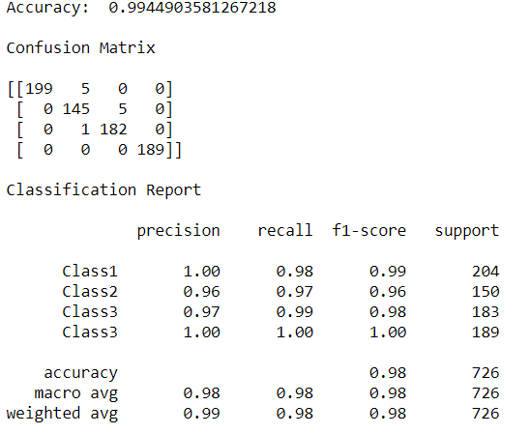
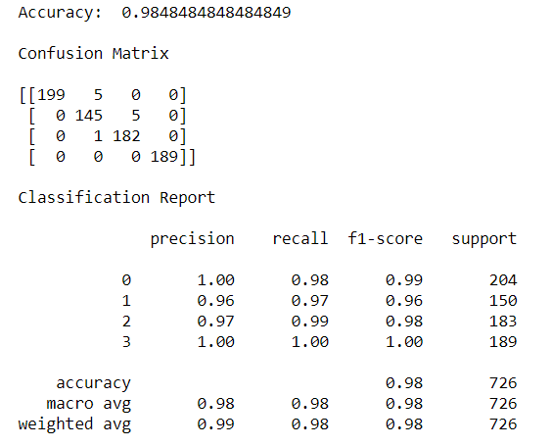
Evaluation of Models
KNN model-Evaluation Results
SVC model-Evaluation Results

Slide 15
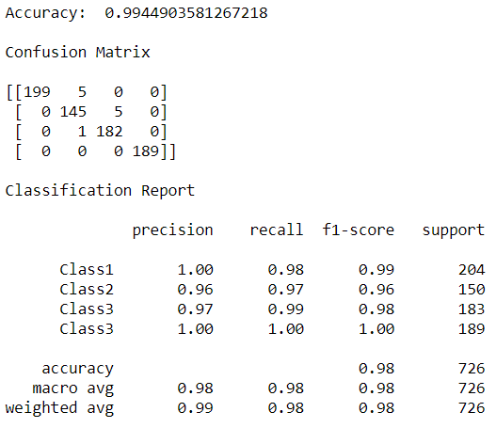
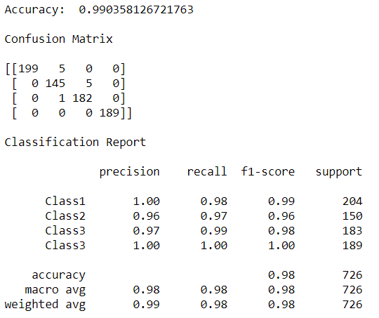
Evaluation of Models
Decision Tree model-Evaluation Results
Random Forest model-Evaluation Results

Slide 16
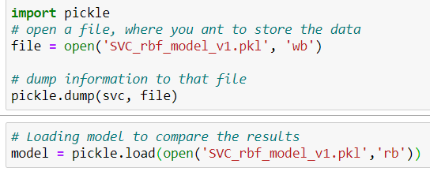
Model Selection
Out of all the six models, SVC is performing very well. So selected SVC for final prediction

Slide 17
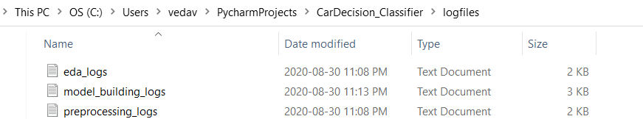
Exception Handling, Logging
All the error messages are displayed for the below cases:
User can only upload file with the given extension
User input is converted to floats if digits are entered as string
Logging is Handled with python’s in-built logging module.
All the log files are stored in logs folder.
Log file included for Preprocessing, EDA, model building

Slide 18
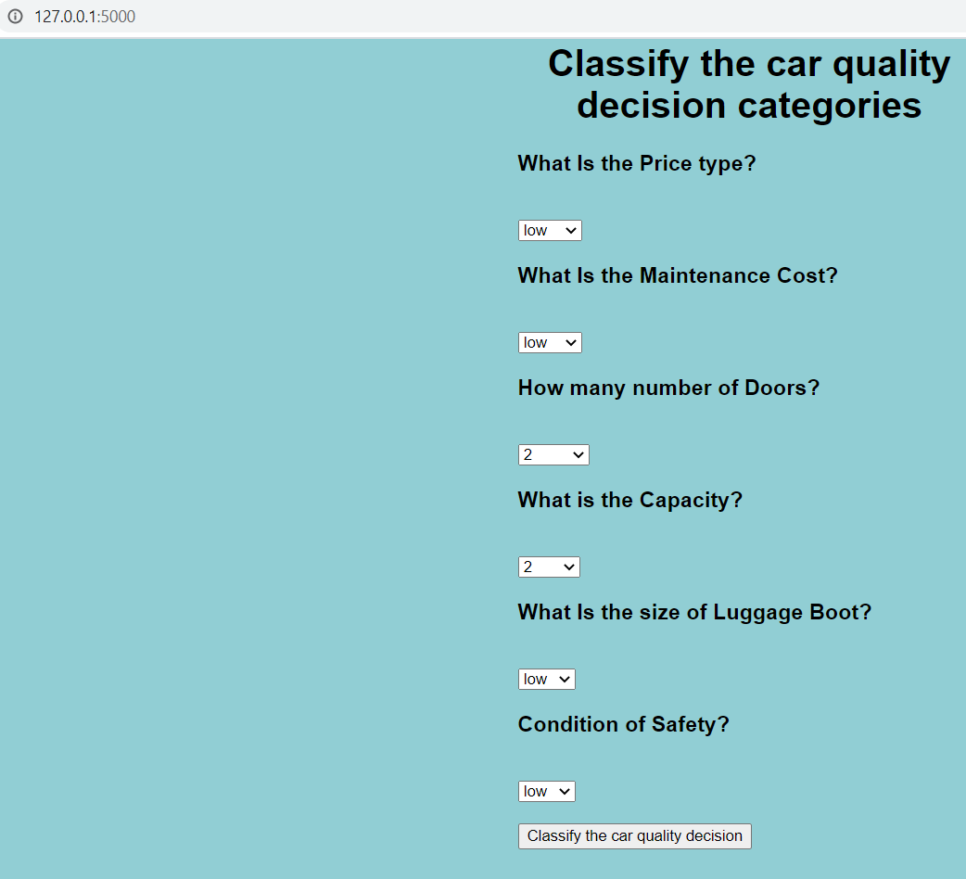
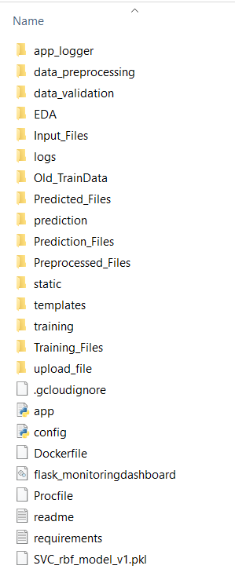
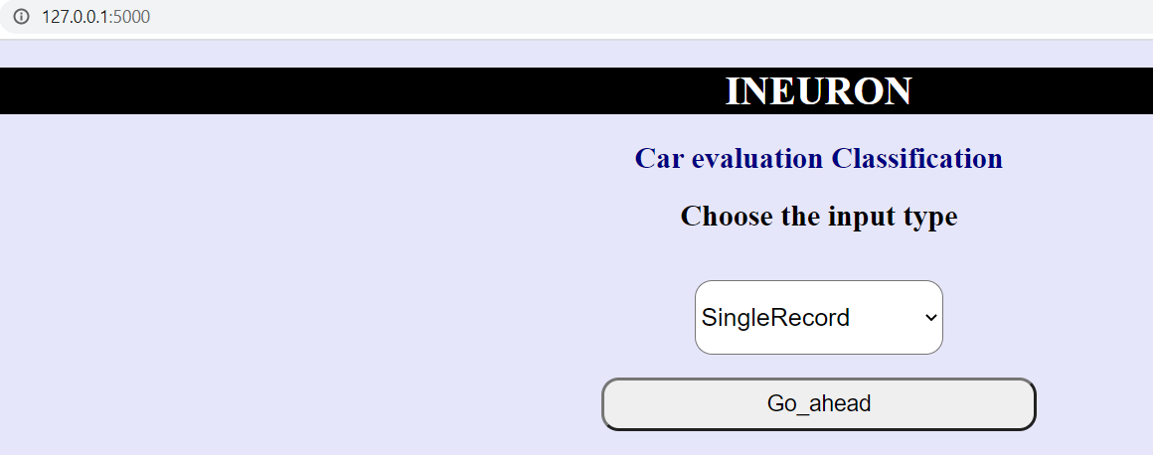
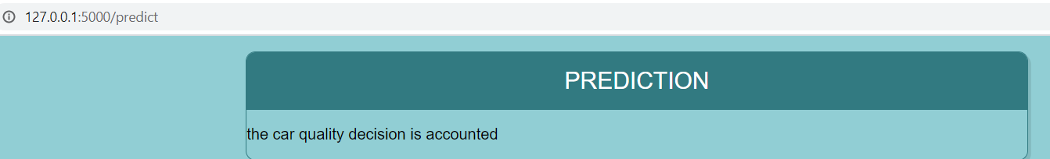
UI Development
Created the web application using Flask framework in Python.
Flask Monitoring Dashboard is used for creating Dashboard which monitors activities on the application
final files required for UI development
For single record entries

Slide 19
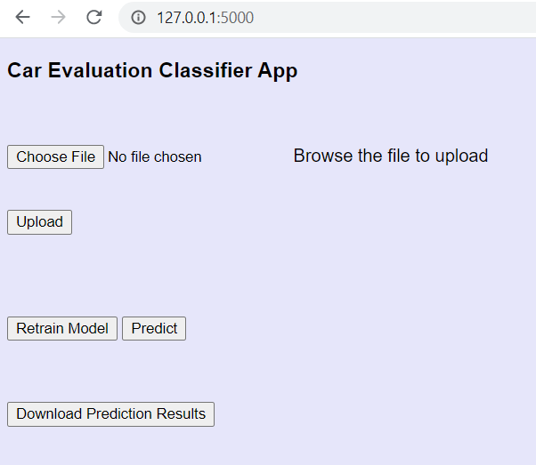
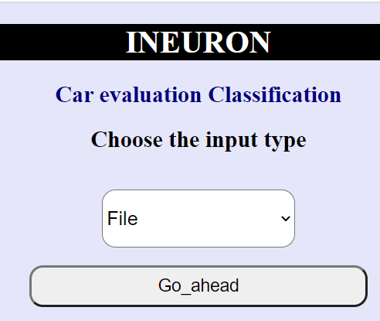
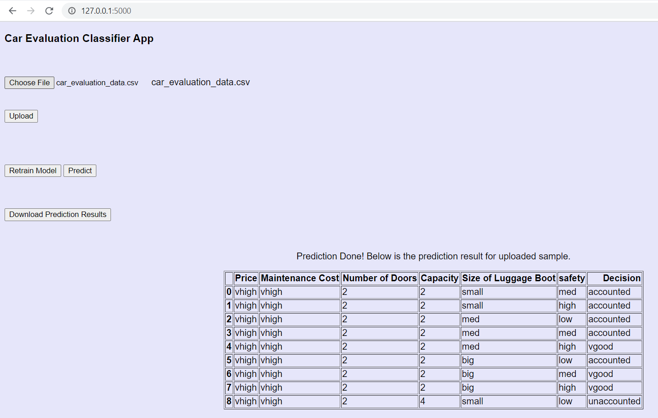
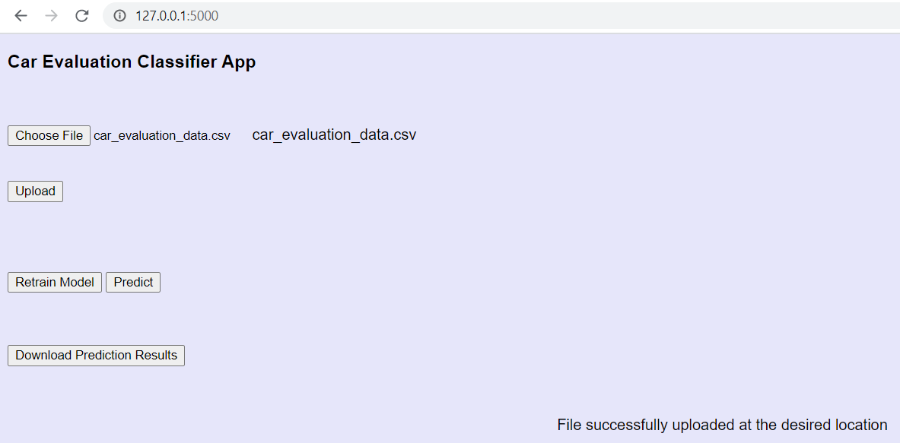
UI Development
For bulk uploads
Choose the file to upload
It has the option of both re-training and prediction
Option to download the predicted results
For Prediction

Slide 20
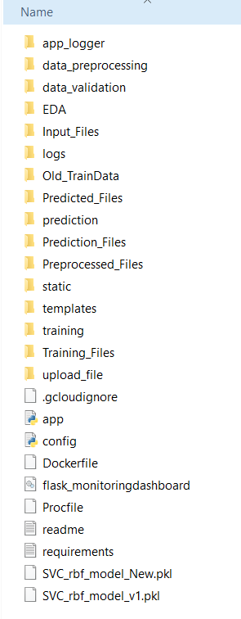
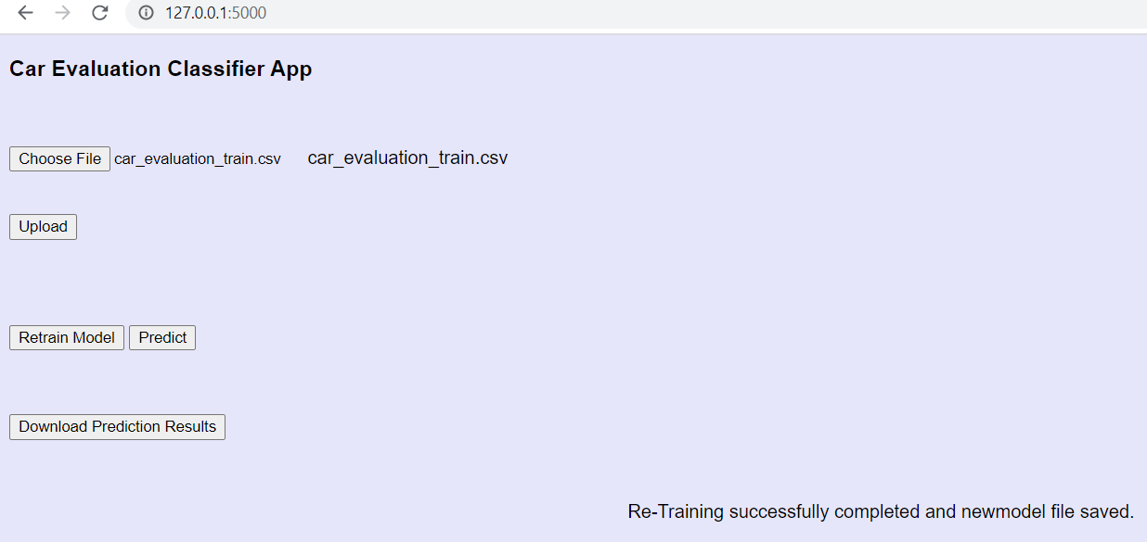
For Retraining:
After Retraining, New pickle file has been saved

Slide 21
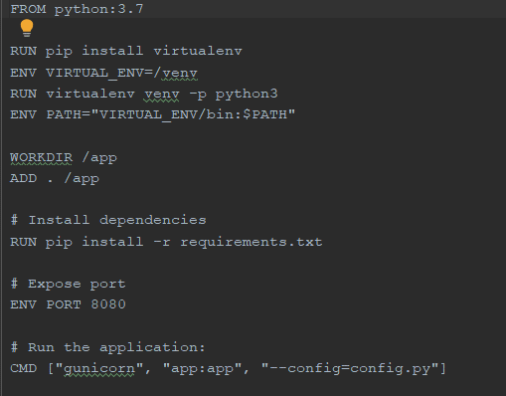
Dockerization
Here Docker is used to build ,run and manage containers.
Created a docker file and build to create a container
Along with Docker , I used the Kubernetes to create the cluster.

Slide 22
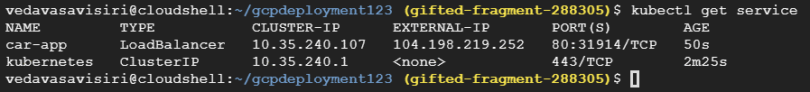
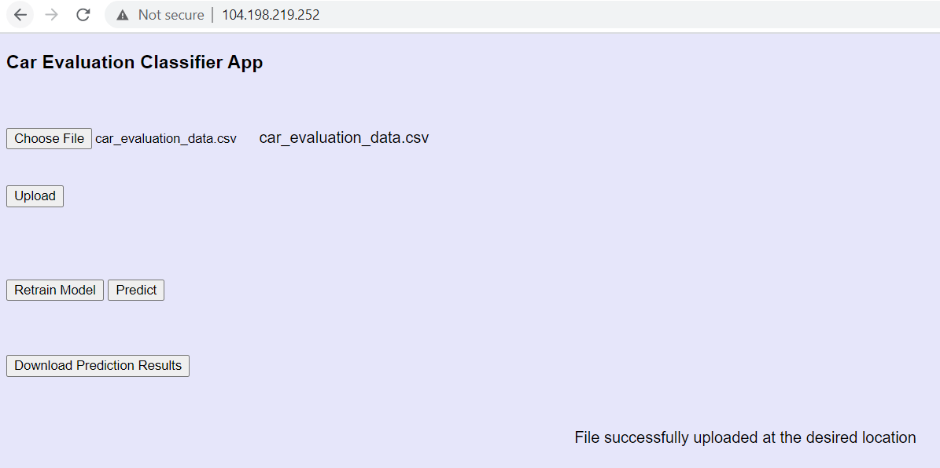
Deployment to Cloud
The Application is Deployed on Google Cloud Platform.
Service used : Kubernetes Engine.
● Created Flask Application and tested on local machine
● Registered on GCP and cloned the files from my github folder
● To deploy the app at GCP requires 3 files (Flask App, config file, requirement.txt, gcloudignore)
● Runtime used is Python 3.7
Deployed successfully as shown below external-IP
GCP deployment URL:
http://104.198.219.252/

Slide 23
Challenges
How to implement exception handling, logger files was bit challenging for me
Deployment in GCP was also challenging for me initially, but I had referred the deployment in GCP documentation from iNeuron, then it was very useful to deploy.

Slide 24
Learnings
I learnt many things while doing this project,few of them are below:
Machine Learning Fundamentals and Libraries
Using MongoDB ,pymongo
Understanding of Flask Framework
HTML
CSS
Docker
Deployment, Google Cloud Platform

Slide 25
THANK YOU
From: Veda
Group:1I
Github link: https://github.com/veda1612/deploymentgcp.git

