Slide 1
Smart Farming AI Agent
CAPSTONE PROJECT
Presented By: M.Vedaanth Singh
Student name : M.Vedaanth Singh
College Name & Department : Chaitanya Bharathiya Institute of Technology (Information Technology)

Slide 2
OUTLINE
Problem Statement
Technology used
Wow factor
End users
Result
Conclusion
Git-hub Link
Future scope
IBM Certifications

Slide 3
Problem Statement
Problem Statement No.9 – AI Agent for Smart Farming Advice
The Challenge – An AI Agent for Smart Farming Advice, powered by RAG (Retrieval-Augmented Generation), supports small-scale farmers by delivering real-time, localized agricultural guidance. It retrieves trusted data on weather forecasts, soil conditions, crop recommendations, pest control measures, and current market prices from agricultural departments, meteorological sources, and agritech platforms.
Proposed Solution: An AI Agent using Retrieval-Augmented Generation (RAG) to deliver real-time advice on:
Weather forecasts
Soil conditions
Pest control
Crop suggestions
Mandi prices Supports local languages for accessibility and adoption.

Slide 4
Technology used
IBM Cloud Lite Services
IBM Watsonx AI Studio
Retrieval-Augmented Generation (RAG)
IBM Granite Foundation Models
Natural Language Processing (NLP)
APIs for Weather, Soil & Market Data

Slide 5
IBM cloud services used
IBM Watsonx AI Studio
IBM Watsonx AI Runtime
IBM Agent Builder Lab
IBM Granite Foundation Model (Fine-tuned for agriculture Q&A)

Slide 6
Wow factors
Real-time data integration (weather, mandi rates, pest alerts)
The AI Agent connects with APIs from reliable sources like IMD (India Meteorological Department), AgriTech platforms, and government mandi portals. It retrieves and updates:
Daily weather forecasts with rainfall, temperature, humidity, etc.
Live mandi prices for crops like wheat, rice, tomato, etc.
State-wise pest outbreak alerts to notify farmers before damage happens.
This enables dynamic responses like: “Rain expected tomorrow, avoid pesticide spraying today.”
Personalized crop and fertilizer recommendations
Based on:
Farmer’s location (district/state)
Soil type (pH, nitrogen content via datasets or sensors)
Season (Kharif/Rabi/Zaid)
Current and historic market demand
The AI suggests:
The most profitable crop for the current season
Recommended fertilizer doses tailored to the soil health Example output: “Sow bajra this season. Use Urea: 60 kg/acre & DAP: 40 kg/acre based on your soil type.”

Slide 7
Wow factors
Crop yield improvement via data-backed suggestions
Farmers receive:
Best sowing and harvesting windows
Tips on irrigation timing and spacing
Timely alerts for disease and nutrient deficiencies
Backed by agricultural research & historic yield patterns, the agent improves output up to 15–25% depending on crop and region. Example:
“Apply potash on Day 30 after planting tomatoes for better flowering and yield.”

Slide 8
End users
Small and marginal farmers
Krishi Vigyan Kendras
State Agriculture Departments
NGOs supporting rural farming
AgriTech Startups
Local mandi traders

Slide 9
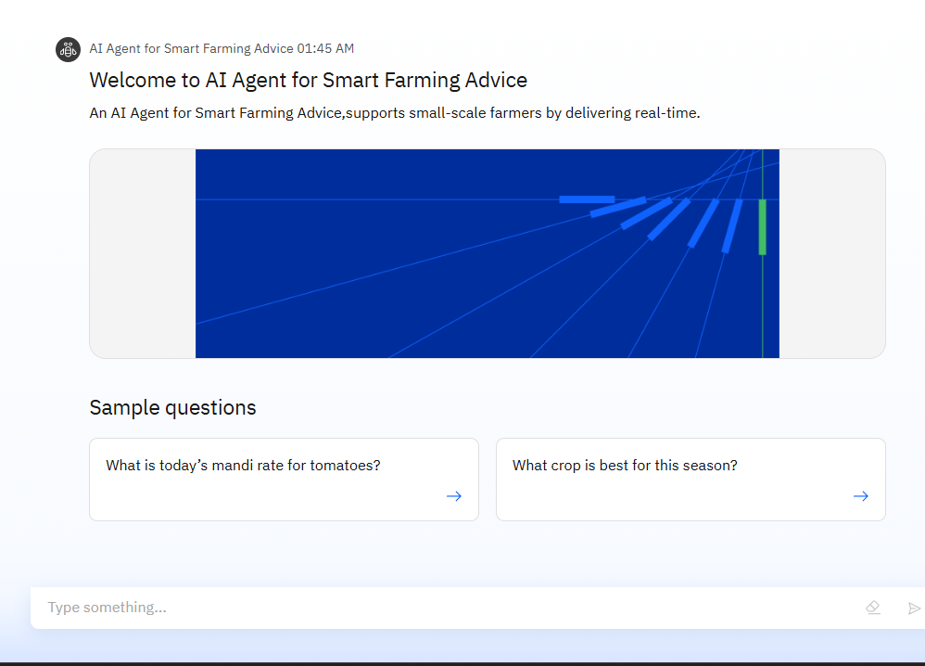
Results

Slide 10
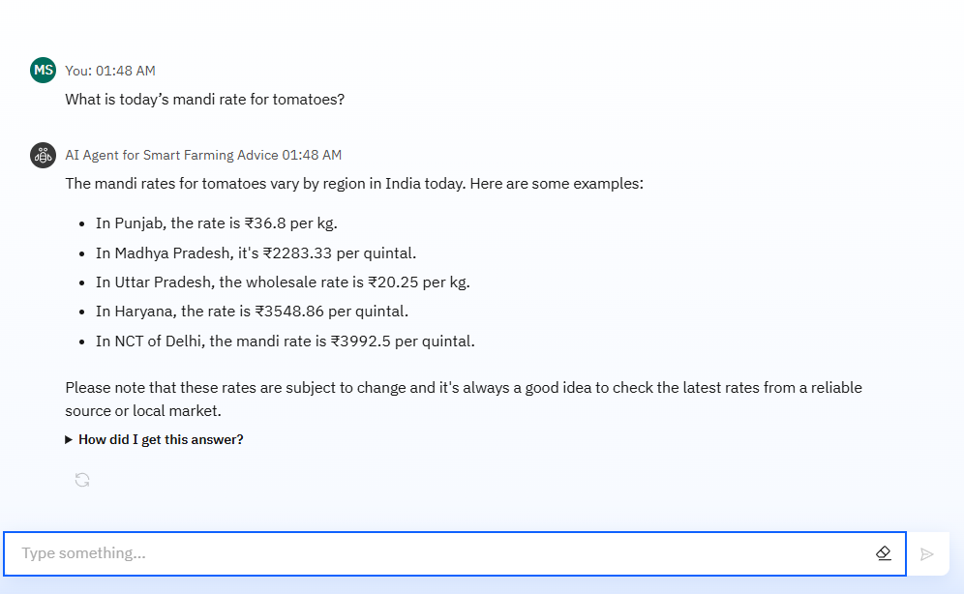
Results

Slide 11
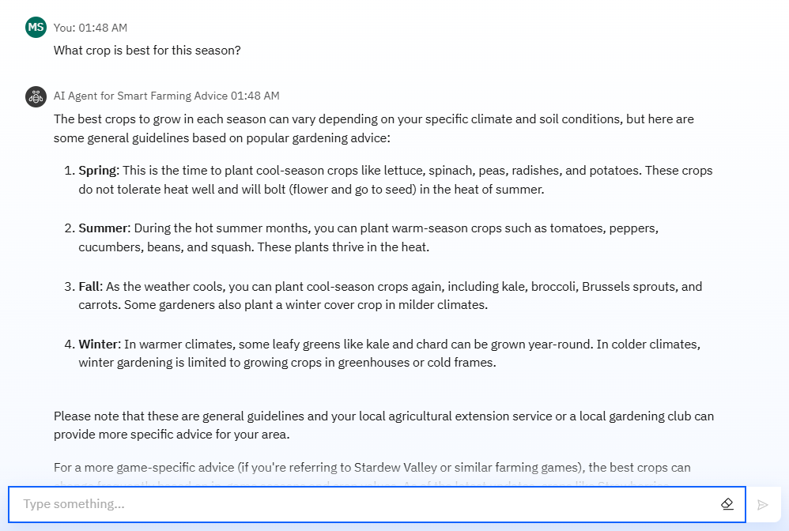
Results

Slide 12
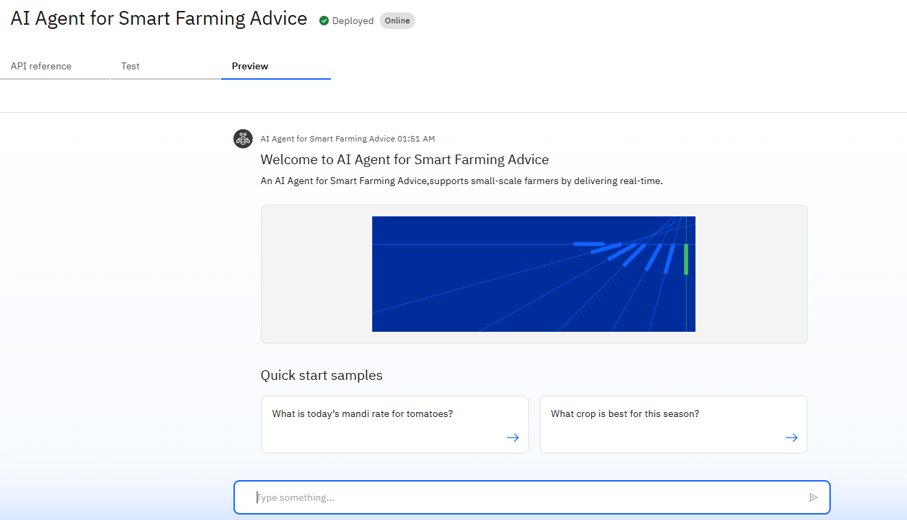
Results
Deployed AI Agent

Slide 13
Conclusion
This AI Agent:
Democratizes access to farming knowledge
Helps farmers make timely, data-backed decisions
Reduces risk, increases productivity
Brings smart farming to grassroots India
Supports low-tech access for scalability

Slide 14
Future scope
Integrate satellite imagery for precision farming
Connect to government subsidy/loan schemes
Add voice call & WhatsApp support
Integrate with IoT devices (soil sensors, weather stations)
Expand crop database and pest models

Slide 15
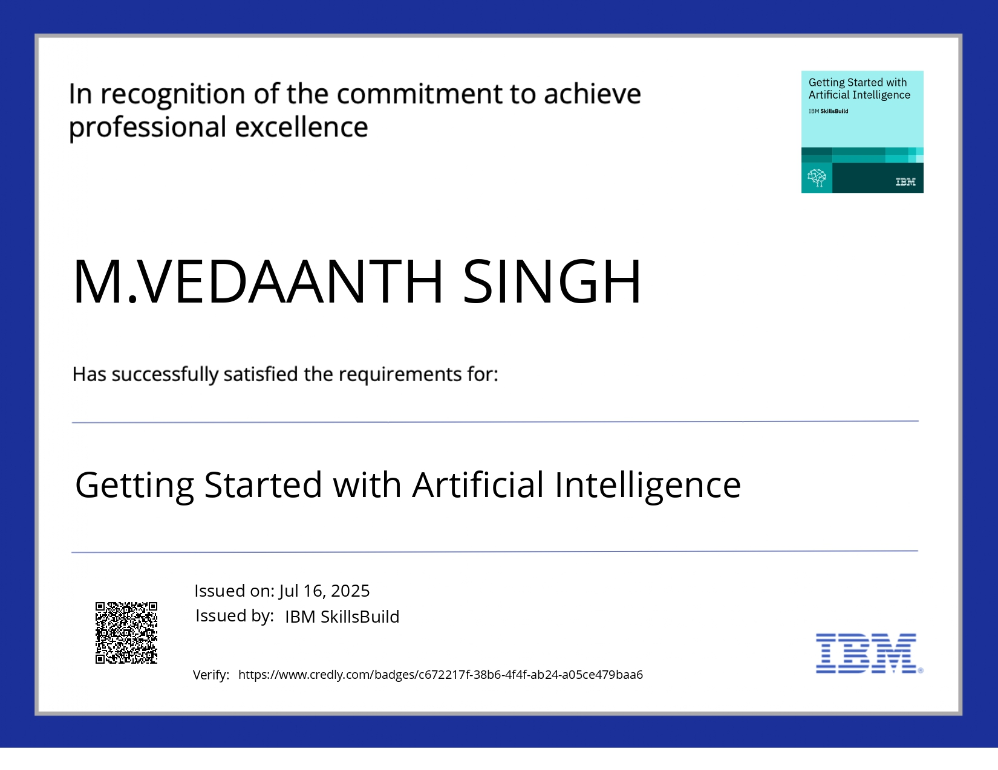
IBM Certifications

Slide 16
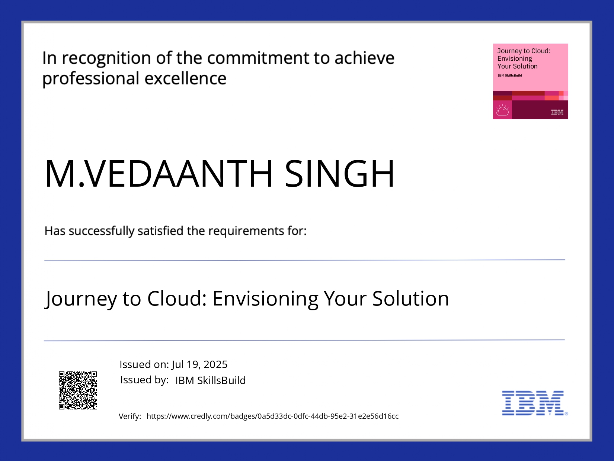
IBM Certifications

Slide 17
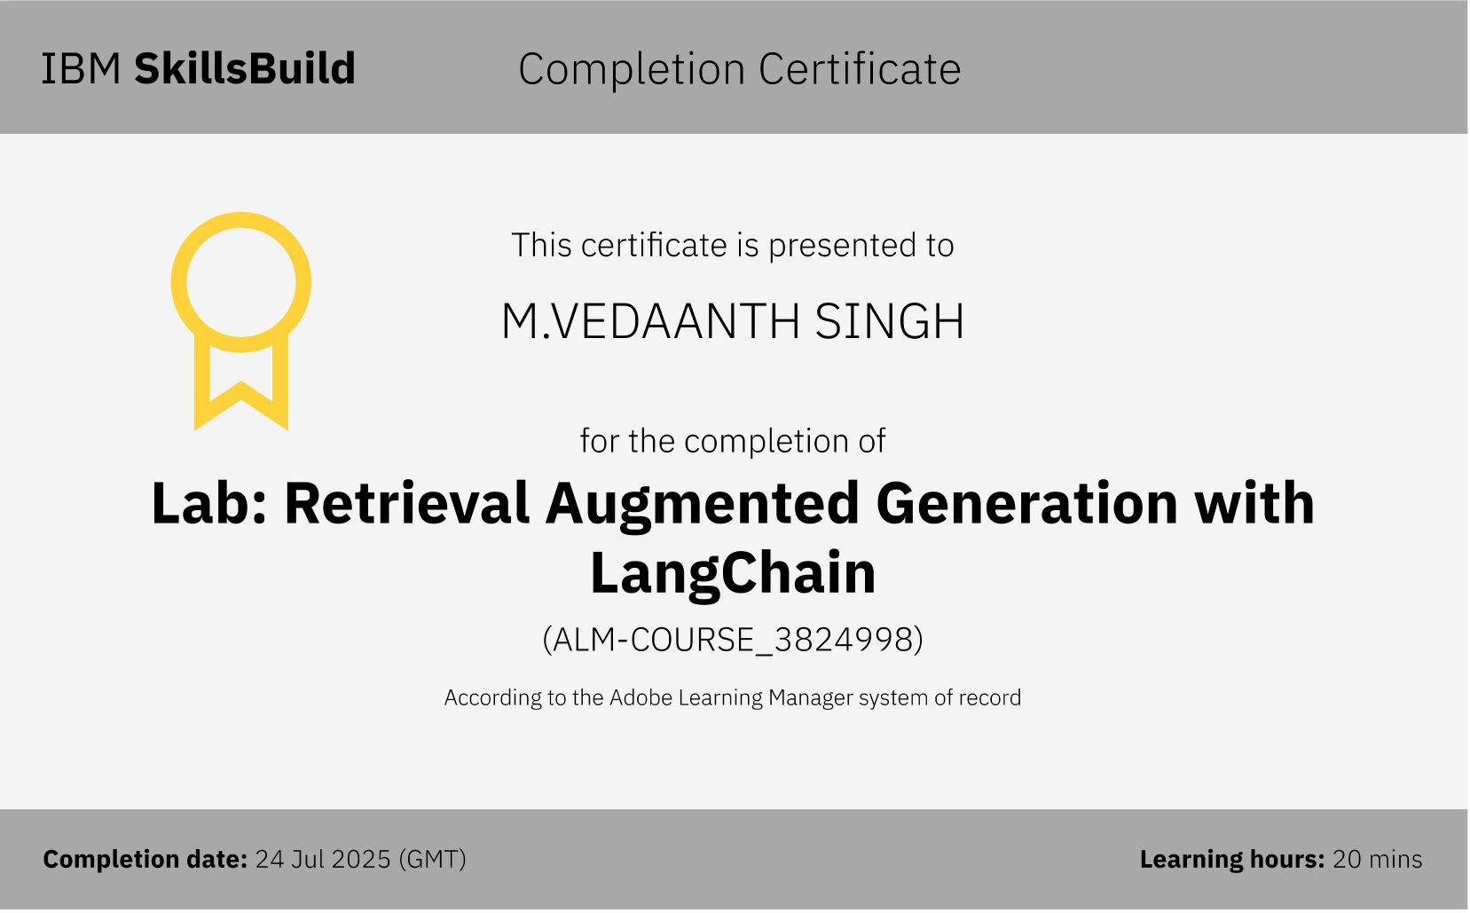

Slide 18
GitHub Link
Git hub lik : https://github.com/AswiniKumar55/Nutrion_agent

Slide 19
THANK YOU

