Slide 1
Object Oriented Design Principles
SOLID DESIGN PRINCIPLES

Slide 2
What and Why
A set of guidelines that help a software engineer design a Better Software System.
What are the attribute of a Well Designed Software System???
Extensible
Maintainable
Reusable
Testable
Understandable
Modular

Slide 3
SOLID…
Software inevitably changes/evolves over time (maintenance, upgrade)
Single responsibility principle (SRP)
Every class should have only one reason to be changed
If class "A" has two responsibilities, create new classes "B" and "C" to handle each responsibility in isolation, and then compose "A" out of "B" and "C"
Open/closed principle (OCP)
Every class should be open for extension (derivative classes), but closed for modification (fixed interfaces)
Put the system parts that are likely to change into implementations (i.e. concrete classes) and define interfaces around the parts that are unlikely to change (e.g. abstract base classes)
Liskov substitution principle (LSP)
Every implementation of an interface needs to fully comply with the requirements of this interface (requirements determined by its clients!)
Any algorithm that works on the interface, should continue to work for any substitute implementation
Interface segregation principle (ISP)
Keep interfaces as small as possible, to avoid unnecessary dependencies
Ideally, it should be possible to understand any part of the code in isolation, without needing to look up the rest of the system code
Dependency inversion principle (DIP)
Instead of having concrete implementations communicate directly (and depend on each other), decouple them by formalizing their communication interface as an abstract interface based on the needs of the higher-level class

Slide 4
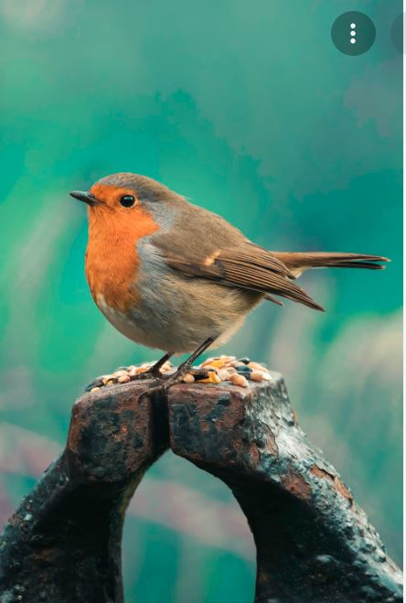
Let’s learn through practice…
Design Bird??

Slide 5
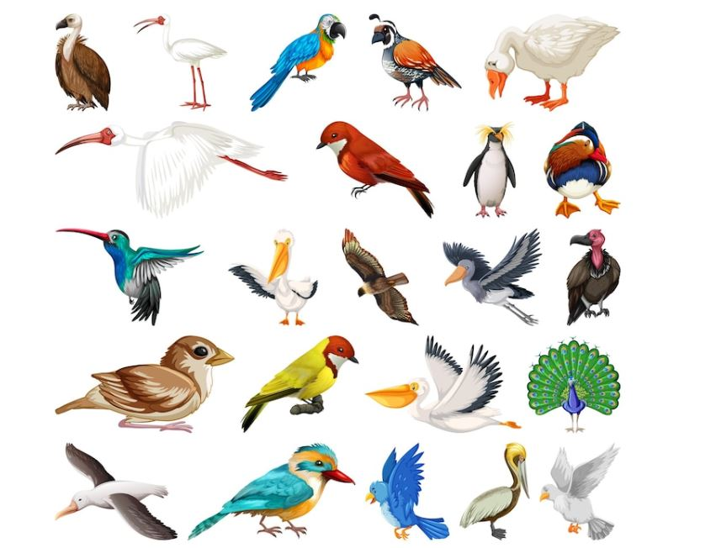
Requirements??
Attributes
Behaviours
Diversity of Birds

Slide 6
Class?
Is this Bird Good??
Bird
Name Type Weight Colour NoOfWings
Fly() MakeSound() Dance() FormatBird() StoreBird()
Bird b1 = new Bird();
B1.type = sparrow;
B1.fyl()
Bird b2 = new Bird();
b2.type = crow;
B2.makeSound();

Slide 7
Issues in Bird??
Handles too many things?
FormatBird?
StoreBird?
Many Birds?
Extensible
Void makeSound(){ If type == sparrow Do ---- If type == crow Do ---- If type == pegion Do ---- }

Slide 8
Many If-else
Understandable
Testability
Difficult to work in case of multiple developers – merge conflicts
Code Duplication
Less Code Reuse
It violates what?
Single responsibility principle (SRP)
Every class should have only one reason to be changed
If class "A" has two responsibilities, create new classes "B" and "C" to handle each responsibility in isolation, and then compose "A" out of "B" and "C"

Slide 9
Make Sound responsible for all birds which make sound
Fly responsible for all birds which fly
Bird responsible for all birds which exist
LLD is subjective
No correct answer
Over Engineer??
Domain knowledge and future requirements

Slide 10
How to identify violations of SRP Multiple If-Else
Multiples if-else
Not always true
If they are part of a business logic than should be fine
If each block of has completely independent code
Void doSomething(){ if op == 1 Sing song If op == 2 Shutdown If op == 2 Print to browser }

Slide 11
How to change – Break into Code units
Void doSomething() If op == 1 singSing(); //invoke another method If op == 2 Shutdown(); If op = 3 printToBrowser();

Slide 12
How to identify violations of SRP Monster Method
Method which has code that does a lot more than it’s name suggest
Extract it into code units
Void storeBird(){ String sql = “Insert into birds ” + values()……;//query construction Connection con = new Connection(); //connection Con.execute(sql); //save bird to DB }

Slide 13
How to identify violations of SRP Commons/Utils
Commons/Utils will become a garbage place for code that a developer doesn’t want spend time to think on where to keep
Com.citi.onb DateUtils TimeUtils SortUtils | Constants UserCosntants AccoutConstants …..
Com.citi.onb.user User userUtils userConstants

Slide 14
OCP
Open/closed principle (OCP)
Every class should be open for extension (derivative classes), but closed for modification (fixed interfaces)
Put the system parts that are likely to change into implementations (i.e. concrete classes) and define interfaces around the parts that are unlikely to change (e.g. abstract base classes)
My codebase should be extensible – easy to add new features
Adding new features should require changes in already existing code
Very less changes ??
Instead add new code units
Why OCP – testing, regression?

Slide 15
Abstract Bird Type,Name,Color Fly();
Pigeon
Sparrow
Crow
Owl
Penguin

Slide 16
Improvements
Add new Bird – Add new Child
Bird has lesser reasons to change
SRP is being followed

Slide 17
Any concerns
Penguins can’t fly??
What to do?
Keep Empty
Throw Exception
Penguin extends Bird{ Fyl(){ Printf(“Dude I can’t fly”); } }
Fly(){ }
Fly(){ Throw Exception(); }

Slide 18
What happens??
Bird b = getBird();
b.fly()
Reduce surprises to client
UberEats and Paytm Case
Penguin extends Bird{ Fyl(){ Printf(“Dude I can’t fly”); } }
Fly(){ }
Fly(){ Throw Exception(); }

Slide 19
Abstract Bird
Flying Bird
Non Flying Bird
Pigeon
Crow
Sparrow
Penguin

Slide 20
Concerns
Class explosion? 2^3 = 8?
How to get all birds which can fly?
Non Flying
Sound
Flying
No Sound

Slide 21
Problem?
Some birds demonstrate a behaviour which other birds don’t
Ideal Solution?
Only birds having the behaviour should have that method
Should be able to create list of birds that have a behaviour
Model the behaviour as interface
Fly interface??
Bird should have only generic attributes and methods which all birds have

Slide 22
Abstract Bird
<<Fly>>
<<Dance>>
penguin
sparrow
crow
pigeon

Slide 23
LSP
Liskov substitution principle (LSP)
Every implementation of an interface needs to fully comply with the requirements of this interface (requirements determined by its clients!)
Any algorithm that works on the interface, should continue to work for any substitute implementation
Object of any child class should be as-is replaceable in it’s parent variable without requiring any code change
Bird b = new Penguin();/new Sparrow();
B.fly()? Throws exception
Try catch
No child should behave in different way from what their parent wants
Sorter – sort
Arrays – sort
Humans – sort

Slide 24
Moving on…
Let’s assume all birds which fly can dance and vice versa
Abstract Bird
<<FlyDance>>
sparrow
crow
pigeon
penguin

Slide 25
Concerns
Let’s assume all birds which fly can dance and vice versa??
May not hold true
Interfaces should be as light as possible
Only one method – Functional interfaces, Lamdas
Can have logical units of methods – If there exists more than one method in interface than all child classes should have that behaviour

Slide 26
ISP
Interface segregation principle (ISP)
Keep interfaces as small as possible, to avoid unnecessary dependencies
Ideally, it should be possible to understand any part of the code in isolation, without needing to look up the rest of the system code
ISP is SRP applied to interfaces

Slide 27
Let’s reach to final…
Let’s assume pigeon and sparrow fly same and crow and owl fly the same
Code duplication?
How to avoid?
Extract pigeon-sparrow, crow-owl fly to somewhere else?

Slide 28
Abstract Bird
PSFB PigeonSparrowFlyBehaviuor
COFB CrowOwlFlyBehaviour
Sparrow
Pigeon
Crow
Owl
Penguin

Slide 29
DIP
Dependency inversion principle (DIP)
Instead of having concrete implementations communicate directly (and depend on each other), decouple them by formalizing their communication interface as an abstract interface based on the needs of the higher-level class
No two concrete classes should depend directly instead they should communicate via interface
Create Fly Behaviour interface
Pigeon{ //concrete class PSFB fb = new PSFB(); //concrete class Fly(){ Fb.fly(); } }

Slide 30
<<Flying Behaviour>>
PSFB PigeonSparrowFlyBehaviour
CFB CrowOwlFlyBehaviour

Slide 31
How Pigeon looks Finally?
Pigeon{ FlyingBehaviour fb = new PFSB(); // Can accept any FlyingBehaviour now Fly(){ Fb.fly(); } }

Slide 32
Abstract Bird
<<FlyingBehaviour>>
<<DancingBehaviour>>
PSFB PigeonSparrowFlyBehaviuor
COFB CrowOwlFlyBehaviour
PSFB PigeonPenguinDancingBehaviour
Sparrow
Pigeon
Crow
Owl
Penguin

Slide 33
Dependency Injection
Constructor Injection/Setter Injection/Containers/@Autowired
Not part of SOLID
Don’t even create the dependency by self, instead let the creator of your class give that

