Slide 1
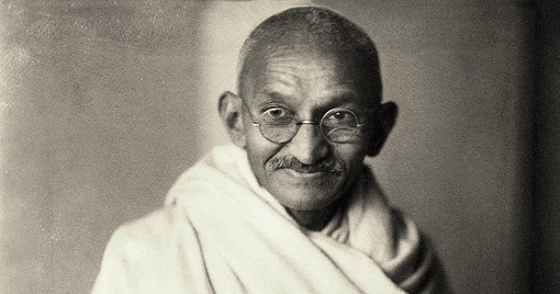
❖
❖ CHAPTER I • 21ST CENTURY INQUIRY
FOLIO I DE X
❖
IS GANDHIAN PHILOSOPHY STILL RELEVANT IN THE 21ST CENTURY?
An Exploration of Truth, Non-Violence, and Moral Courage in the Modern Age
Gandhi Jayanti, 2 October — Commemorating the global heritage of peace and truth.
1
ARCHIVE • CH. I
Mohandas Karamchand Gandhi, 1869–1948 — Leader of India's non-violent freedom movement.
2
Presented by [Your Name] — Examining the enduring relevance of Gandhian ideals today.
3
Mohandas Karamchand Gandhi (1869–1948) — Father of the Nation and apostle of non-violence.
❝ DICTUM MAHATMA GANDHI
"My life is my message."
❖ PRESENTED BY [YOUR NAME] — IN MEMORIAM MAHATMA GANDHI
❖
❖ GANDHI JAYANTI • II OCTOBER
TRUTH • NON-VIOLENCE • PEACE • DIGNITY
FOLIO I / X ❖
❖

Slide 2
❖
❖ CHAPTER II • IDENTITY & LEGACY
FOLIO II DE X
❖
WHO WAS GANDHI?
From a Young Barrister in London to the Leader of a Global Movement
Born 2 October 1869 in Porbandar, Gujarat, India.
ARCHIVE • CH. II
1
Trained as a lawyer in London at the Inner Temple.
2
Led India's historic non-violent freedom struggle against colonial rule.
3
Called Mahatma ('Great Soul') and affectionately revered as Bapu ('Father').
Gandhi, London, 1931
4
The central question: do his ideas and methods still work in today's complex world?
5
❝ DICTUM MAHATMA GANDHI
"In a gentle way, you can shake the world."
❖
❖ GANDHI JAYANTI • II OCTOBER
TRUTH • NON-VIOLENCE • PEACE • DIGNITY
FOLIO II / X ❖
❖

Slide 3
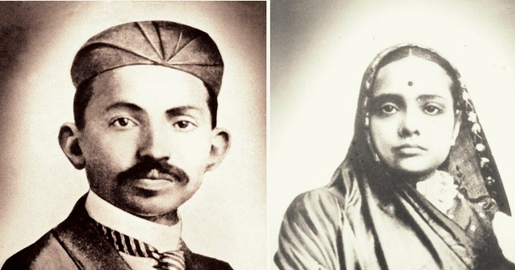
❖
❖ CHAPTER III • PHILOSOPHICAL PILLARS
FOLIO III DE X
❖
THE CORE IDEAS
The Timeless Foundations of Gandhian Philosophy and Ethics
1
Satya (Truth) — Absolute adherence to truth and honesty in thought, word, and deed.
ARCHIVE • CH. III
2
Ahimsa (Non-violence) — Active love, compassion, and refraining from harm against any living being.
3
Satyagraha (Peaceful resistance) — Fearless soul-force standing firm against injustice without malice.
4
Sarvodaya (Welfare of all) — Universal upliftment prioritizing the most vulnerable and marginalized.
Gandhi and Kasturba, South Africa, 1902
5
Swadeshi (Self-reliance) — Fostering local production, community strength, and economic independence.
6
Simple living — Voluntary simplicity, mindful consumption, and harmony with the natural world.
❝ DICTUM MAHATMA GANDHI
"Truth is the sovereign principle, which includes numerous other principles."
❖
❖ GANDHI JAYANTI • II OCTOBER
TRUTH • NON-VIOLENCE • PEACE • DIGNITY
FOLIO III / X ❖
❖

Slide 4
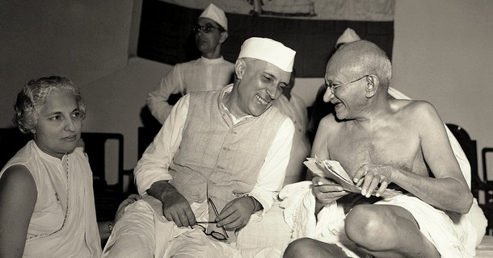
❖
❖ CHAPTER IV • 21ST CENTURY REALITIES
FOLIO IV DE X
❖
THE WORLD WE LIVE IN
The Urgent Humanitarian, Social, and Ecological Crises of Our Era
1
Wars and conflict: Escalating geopolitical hostilities, armed warfare, and global instability.
ARCHIVE • CH. IV
2
Polarisation and hate online: Digital echo chambers, social fragmentation, and rising hostility.
3
Climate crisis: Global environmental degradation, extreme weather, and resource depletion.
4
Inequality: Widening socio-economic divides and unequal access to essential opportunities.
Gandhi and Nehru, Mumbai, 1946
5
Misinformation: Rapid algorithmic dissemination of falsehoods eroding public trust.
❝ DICTUM MAHATMA GANDHI
"The world will live in peace only when the individuals composing it make up their minds to do so."
6
Consumerism and waste: Hyper-materialistic lifestyles straining the planet's finite resources.
❖
❖ GANDHI JAYANTI • II OCTOBER
TRUTH • NON-VIOLENCE • PEACE • DIGNITY
FOLIO IV / X ❖
❖

Slide 5
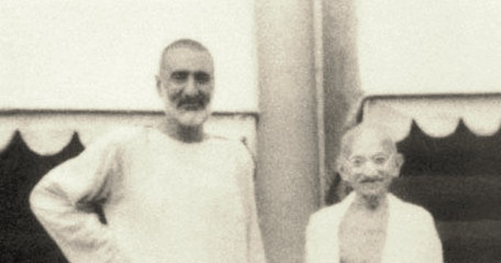
❖
❖ CHAPTER V • POWER OF NON-VIOLENCE
FOLIO V DE X
❖
AHIMSA IN ACTION
How Non-Violent Resistance Transformed Global Civil Rights and History
The US civil rights movement (Martin Luther King Jr.) and South African anti-apartheid struggle (Nelson Mandela) drew deeply on Gandhian ideas.
1
ARCHIVE • CH. V
Chenoweth and Stephan's study (analyzing 323 campaigns from 1900 to 2006) found non-violent campaigns succeeded more often than violent ones.
2
2 October is recognized internationally by the United Nations as the International Day of Non-Violence.
3
Gandhi with Abdul Ghaffar Khan, 1940
❝ DICTUM MAHATMA GANDHI
"Non-violence is the greatest force at the disposal of mankind. — Mahatma Gandhi"
❖
❖ GANDHI JAYANTI • II OCTOBER
TRUTH • NON-VIOLENCE • PEACE • DIGNITY
FOLIO V / X ❖
❖

Slide 6
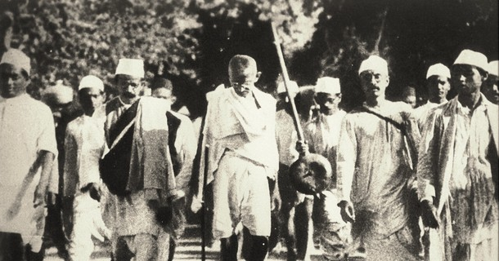
❖
❖ CHAPTER VI • TRUTH IN THE DIGITAL AGE
FOLIO VI DE X
❖
SATYA IN THE AGE OF MISINFORMATION
Practicing Discernment, Integrity, and Civil Dialogue in a Connected Society
Fake news spreads fast: Digital algorithms amplify sensationalism and falsehoods at unprecedented speed.
ARCHIVE • CH. VI
1
Verify before you speak or share: Upholding factual accuracy and critical thinking before disseminating information.
2
Truth-telling as a daily discipline: Living with intellectual honesty and moral transparency.
3
The Salt March, 1930
Dialogue instead of online outrage: Choosing constructive communication and empathy over reactionary anger.
4
❝ DICTUM MAHATMA GANDHI
"Morality is the basis of things, and truth is the substance of all morality."
❖
❖ GANDHI JAYANTI • II OCTOBER
TRUTH • NON-VIOLENCE • PEACE • DIGNITY
FOLIO VI / X ❖
❖

Slide 7
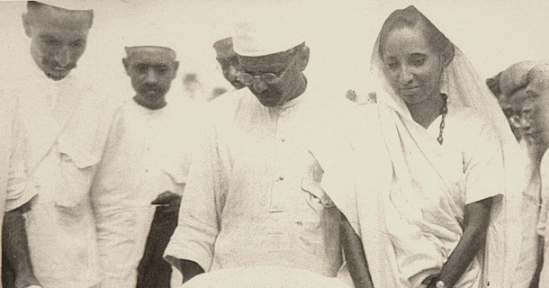
❖
❖ CHAPTER VII • ECOLOGICAL WISDOM
FOLIO VII DE X
❖
SIMPLE LIVING AND THE PLANET
Sustainable Living, Mindful Consumption, and Climate Responsibility
'The earth provides enough for everyone's needs, but not everyone's greed' (attributed to Gandhi).
1
ARCHIVE • CH. VII
Direct links to modern sustainability, conscious minimalism, and circular resource use.
2
India's Mission LiFE (Lifestyle for Environment) actively promotes individual and community eco-friendly lifestyles.
3
Gandhi at Dandi, 5 April 1930
❝ DICTUM MAHATMA GANDHI
"The earth provides enough to satisfy every man's needs, but not every man's greed."
❖
❖ GANDHI JAYANTI • II OCTOBER
TRUTH • NON-VIOLENCE • PEACE • DIGNITY
FOLIO VII / X ❖
❖

Slide 8
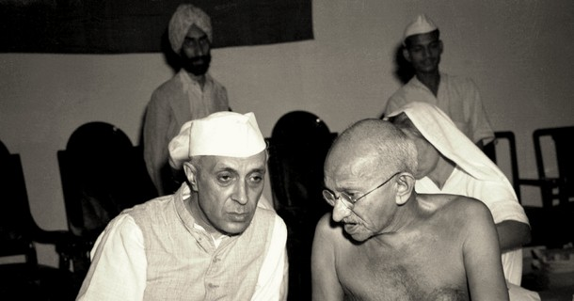
❖
❖ CHAPTER VIII • LOCAL ECONOMIES & DIGNITY
FOLIO VIII DE X
❖
SWADESHI AND SARVODAYA TODAY
Grassroots Empowerment, Inclusive Growth, and Universal Cleanliness
Local economies and self-reliance: Strengthening local supply networks and supporting homegrown enterprise.
ARCHIVE • CH. VIII
1
Khadi and village industries: Empowering rural artisans and promoting eco-conscious handloom textiles.
2
Inclusion and dignity for all: Ensuring that progress uplift the most disadvantaged in society.
3
Gandhi and Nehru, Quit India session, 1942
Swachh Bharat Abhiyan: A nationwide sanitation and cleanliness movement launched on Gandhi Jayanti (2 Oct 2014).
4
❝ DICTUM MAHATMA GANDHI
"Recall the face of the poorest and the weakest person you have seen, and ask if your step will be of any use to them."
❖
❖ GANDHI JAYANTI • II OCTOBER
TRUTH • NON-VIOLENCE • PEACE • DIGNITY
FOLIO VIII / X ❖
❖

Slide 9
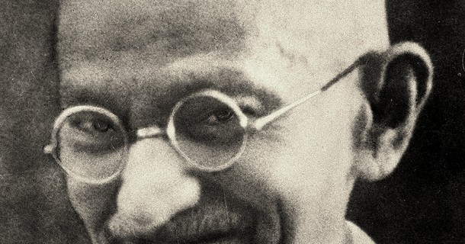
❖
❖ CHAPTER IX • CRITICAL PERSPECTIVE
FOLIO IX DE X
❖
LIMITS AND CRITICISMS
Nuance, Context, and Thoughtful Adaptation in the Modern Era
Non-violence alone may not be enough when confronting extreme violence and ruthless authoritarian regimes.
1
ARCHIVE • CH. IX
Some of Gandhi's views (on caste and race during his early South Africa years) are legitimately criticised.
2
Ideas need thoughtful application and dynamic adaptation, not rigid or blind copying.
3
Portrait, late 1930s
❝ DICTUM MAHATMA GANDHI
"I want the cultures of all lands to be blown about my house as freely as possible, but I refuse to be blown off my feet."
❖
❖ GANDHI JAYANTI • II OCTOBER
TRUTH • NON-VIOLENCE • PEACE • DIGNITY
FOLIO IX / X ❖
❖

Slide 10
❖
❖ CHAPTER X • LIVING RELEVANCE
FOLIO X DE X
❖
THE VERDICT: STILL RELEVANT
A Living Ethical Compass for Contemporary Life and Global Citizenship
A compass, not a rulebook: An enduring framework for moral decision-making in personal and public affairs.
ARCHIVE • CH. X
1
Choose peace, truth, and simplicity in everyday choices, leadership, and community action.
2
"Be the change you wish to see in the world" (attributed to Gandhi) — Individual integrity inspires collective transformation.
3
Gandhi, London, 1931
• Photos: Wikimedia Commons (public domain)
Thank you! Jai Hind!
4
❝ DICTUM MAHATMA GANDHI
"You must be the change you wish to see in the world."
❖ THANK YOU! JAI HIND! — IN MEMORIAM MAHATMA GANDHI
❖
❖ GANDHI JAYANTI • II OCTOBER
TRUTH • NON-VIOLENCE • PEACE • DIGNITY
FOLIO X / X ❖
❖

