Slide 1
Aberrations
Halvor Heier
2009

Slide 2
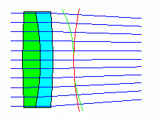
Wavefront error
Aberrated wavefront
Perfect spherical wavefront

Slide 3
Perfect wavefront
"Airy-pattern"

Slide 4
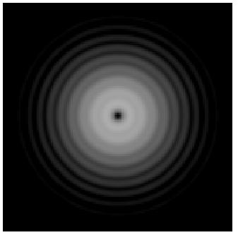
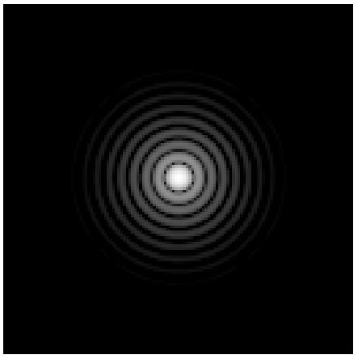
Airy-pattern
Weak rings artificially enhanced
Defocussed patterns almost equal on both sides of focus
Black centre occurs for certain amounts of defocus.
Outside focus
Focus
Inside focus
Notes:
Logarithm has been taken in order to enhance the weak parts of the patterns. Lens diameter 20 mm, f=300 mm, plano convex singlet.

Slide 5
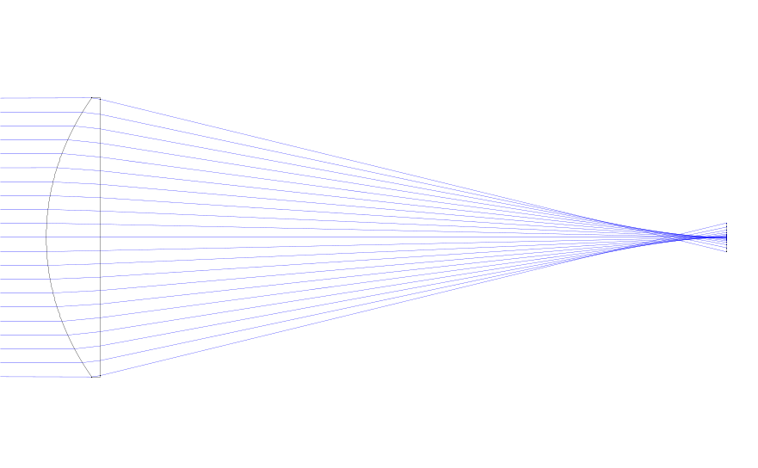
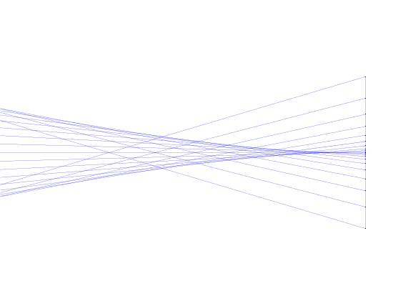
Spherical aberration
Sharp edge
Diffuse edge

Slide 6
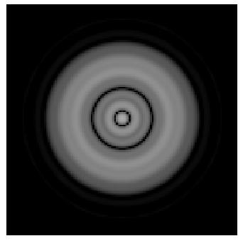
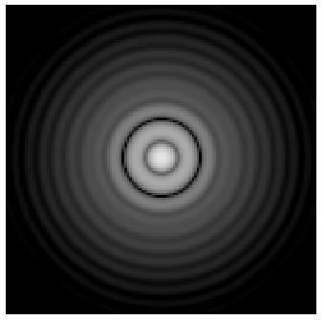
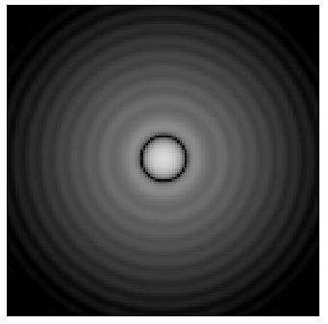
Spherical aberration
Inside focus
Sharp edge
Best focus
Outside focus
Diffuse edge

Slide 7
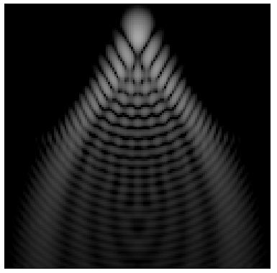
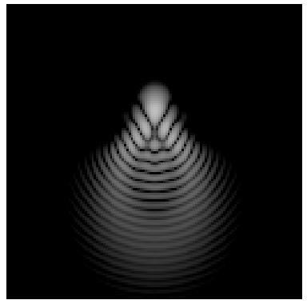
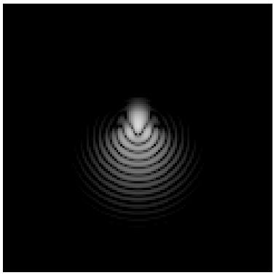
Coma
Best focus, different amounts of coma.

Slide 8
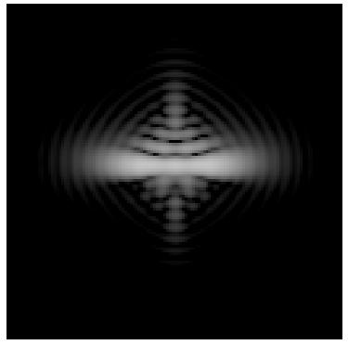
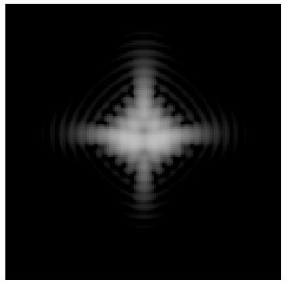
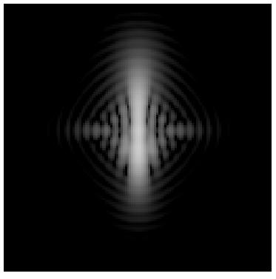
Astigmatism
Different focal planes.

Slide 9
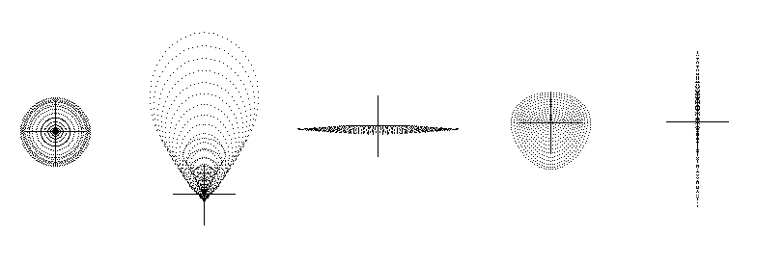
Spotdiagrams
.
.
.
.
.
.
.
.
.
.
.
.
.
.
.
.
.
.
.
.
.
.
.
.
.
.
.
.
.
.
.
.
.
.
.
.
.
.
.
.
.
.
.
.
.
.
.
.
.
.
.
.
.
.
.
.
.
.
.
.
Spherical aberration
Coma
Astigmatism

Slide 10
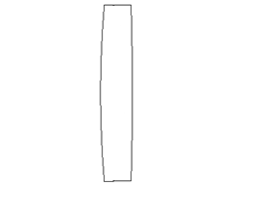
Longitudinal chromatic aberration
Uncorrected singlet

Slide 11
Uncorrected
Wavelength
Focal position

Slide 12
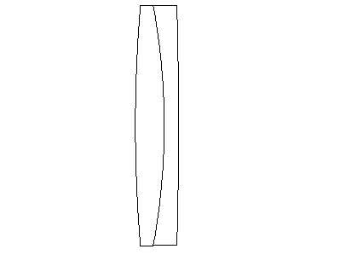
Achromatic doublet

Slide 13
Achromatic
Wavelength
Focal position

Slide 14
Apochromatic
Wavelength
Focal position

