Slide 1
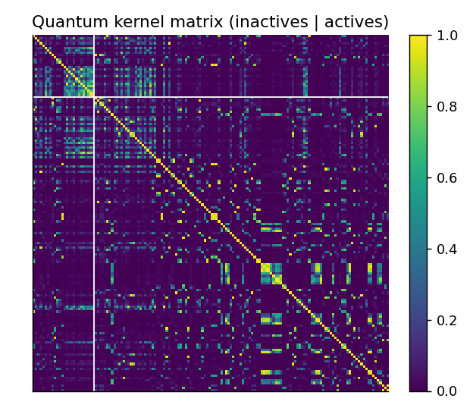
CAPSTONE PROJECT | QUANTUM COMPUTING
QuantumScreen
A quantum computing-based drug screening system to identify promising drug candidates
G Veda Kartik
Roll No. CH.SC.U4CSE24212
Amrita Vishwa Vidyapeetham, Chennai
Quantum kernel matrix of 150 BACE molecules
Notes:
Introduce the project: a hybrid quantum-classical screening system built in Qiskit for BACE-1, an Alzheimer's target. The picture is the quantum kernel: similarity of molecules in an 8-qubit feature space.

Slide 2



Why quantum drug screening?
Screening is the bottleneck
1,513
Virtual screening ranks huge libraries so only the best few compounds are tested in the lab.
molecules, 45.7% active
Target: BACE-1
8 qubits
An Alzheimer's-disease enzyme. Dataset: 1513 inhibitors labelled active or inactive.
one PCA component per qubit, simulated exactly
The quantum idea
3 seeds
Encode a molecule in an n-qubit state and compare molecules in a 2^n-dimensional space.
plus a scaffold split and ablations
Notes:
Motivation and scope. Quantum models are simulated classically; the goal is a fair, honest comparison.

Slide 3
A hybrid quantum-classical pipeline
1
2
3
4
5
SMILES
Fingerprint + PCA
Qiskit feature map
Kernel + SVM
Rank + select
RDKit cleaning, scaffold and random splits
2048-bit Morgan to 8 angles in [0, π]
ZZ circuit loads a molecule into 8 qubits
Fidelity kernel, C and scale tuned by CV
Final score, then QAOA picks a diverse batch of K
Quantum steps
Classical steps
Classical baselines (RBF-SVM, Random Forest) run on the same splits, features and tuning budget. VQC and VQE are separate modules.
Notes:
Walk through the five stages. Stress fairness: identical splits, identical PCA features and the same inner cross-validation for the classical SVM.

Slide 4

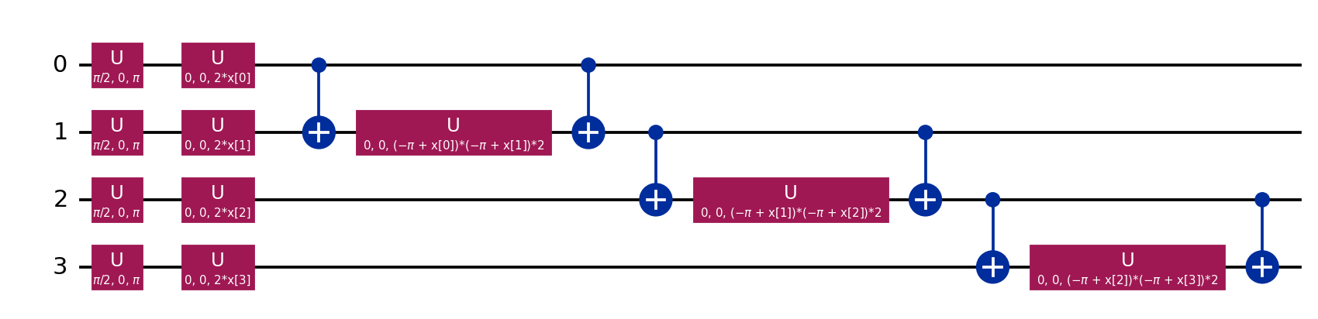
How the quantum kernel works
Encode
|φ(x)⟩ = U(x)|0…0⟩
Design choices
A feature map turns a molecule's 8 angles into a quantum state.
Exact statevector kernel: identical to Qiskit's FidelityQuantumKernel (verified to 1e-12), but fast enough for all 1513 molecules
PCA and scaler fitted on training data only
Kernel scale and C chosen by inner cross-validation
21 automated tests
Compare
k(x, x′) = |⟨φ(x)|φ(x′)⟩|²
Fidelity between two states is the similarity of two molecules.
Classify
SVM on the kernel matrix
A classical SVM uses the quantum similarities to separate actives.
ZZ feature map (4 qubits shown): Hadamards, Z rotations by the data, entangling ZZ rotations.
Notes:
Explain encode, compare, classify. The simulation is exact and noiseless, so there is no speed-up claim.

Slide 5
Quantum matches classical, no advantage
0.873 vs 0.879
quantum vs classical SVM on the same 8 features: gap smaller than one std
2.07
enrichment at 10%, close to the maximum possible 2.2
Full-fingerprint Random Forest wins (0.916): the 2048 → 8 compression, not the kernel, is the bottleneck.
Notes:
Main result. Quantum-kernel SVM AUC 0.873 +/- 0.011 versus 0.879 +/- 0.007 for the classical SVM. No quantum advantage; 8 PCA components keep only about 36% of the variance.

Slide 6
Entanglement and qubits: little effect
The un-entangled Z map (0.877) scores the same as entangling ZZ maps; accuracy plateaus at 8 qubits. Entanglement is not what drives performance here.
Notes:
All five encodings are within 0.012 AUC, inside seed noise. The classical SVM is at least as good at every qubit count.

Slide 7
The hard test: unseen scaffolds
-0.13 to -0.21
AUC drop for every model when test scaffolds are new
0.677 vs 0.667
quantum vs classical SVM, scaffold split
One deterministic split, so no error bars: small differences should not be over-interpreted.
Notes:
Generalisation to new chemotypes is the realistic screening scenario and it is much harder for all models.

Slide 8
VQC: slower and less accurate
0.625
VQC AUC (±0.056) vs 0.811 for the kernel SVM
119 s
VQC fit time vs 1.3 s for the kernel SVM (about 90x)
ZZ map + RealAmplitudes ansatz, COBYLA, 120 iterations, 3 seeds. Not tuned and probably under-trained: it shows the practical cost of variational training.
Notes:
Every optimiser step evaluates all training circuits, so the VQC is trained on a small balanced subset and compared on that same subset.

Slide 9
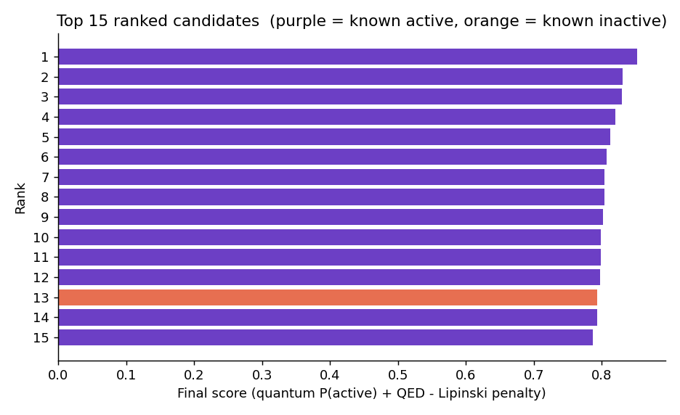
Screening a hold-out library
24 / 25
top-ranked quantum picks that are truly active (classical: 21 / 25)
2.12
EF at 10% (max 2.20); classical 1.90
Single split: the 3-molecule gap to the classical score is suggestive, not significant. The 3-seed EF (2.07 vs 1.98) is the safer comparison.
A model trained on 80% of BACE ranks 303 unseen molecules (46% truly active). Final score = 0.7 P(active) + 0.3 QED, minus a Lipinski penalty.
Notes:
Ranked output is saved to results/ranked_candidates.csv and is browsable in the Streamlit app.

Slide 10
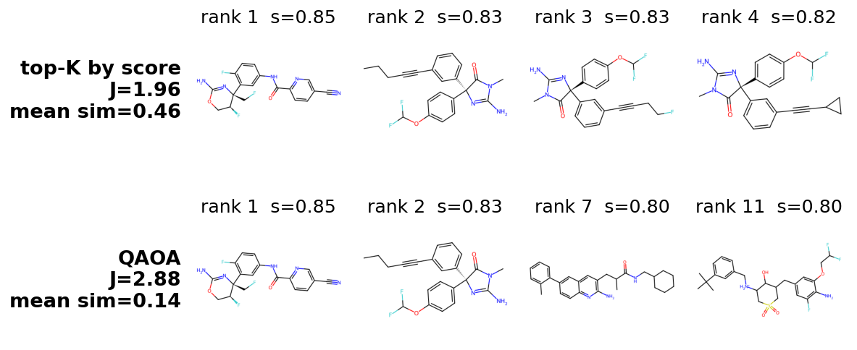
Choosing a diverse batch with QAOA
1.96 → 2.88
objective: score-only top-K vs diversity-aware (exact and QAOA)
0.46 → 0.14
mean pairwise similarity of the chosen batch
Pick 4 of the 12 best-ranked candidates. Maximise J(x) = Σ sᵢxᵢ − λ Σ Sᵢⱼ xᵢxⱼ (score minus Tanimoto redundancy), mapped to an Ising Hamiltonian and solved with QAOA. The exact diversity-aware optimum scores J = 2.88 too.
Top-K picked three near-duplicate analogues. No experimental affinity is used in the score, to avoid leaking the answer.
Notes:
Without the pairwise term this problem is solved exactly by sorting, so QAOA would be pointless. With the diversity term, score-only top-K is not optimal. The Ising mapping is verified exactly in the tests.

Slide 11
QAOA matches random search
1.00x
QAOA output quality vs random feasible subsets (1 = no better than random)
0.0003 vs 0.001
P(optimal) at N=14: QAOA vs uniform sampling of feasible subsets
Best-of-shots reaches 99-100% of the optimum, but only because the spaces are tiny (56 to 1001 feasible subsets). No quantum advantage.
Notes:
Be candid: QAOA with p up to 3 and a small optimiser budget does not beat random sampling of feasible subsets. Only about a third of its probability mass is feasible because the budget is a penalty. A constraint-preserving XY mixer and warm starts are the next step.

Slide 12
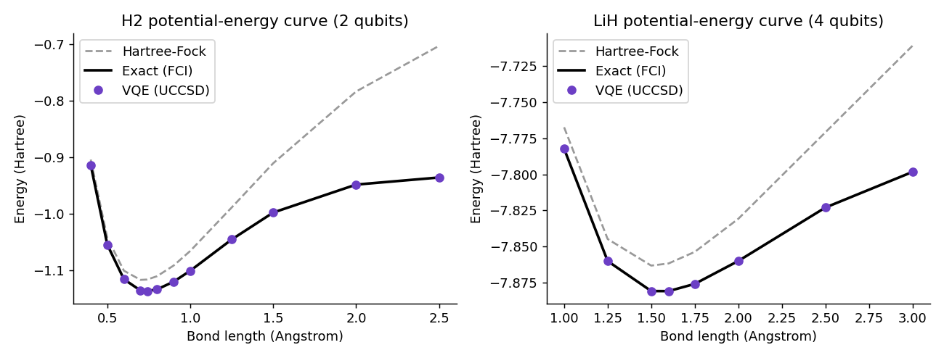
VQE: exact energies for H2 and LiH
< 0.001 mHa
max error vs exact at every bond length (chemical accuracy: 1.6 mHa)
-1.137 Ha
H2 at 0.74 Å, matching the literature STO-3G value
UCCSD ansatz, STO-3G basis, parity mapping: H2 on 2 qubits and LiH on 4 qubits (active space).
Noiseless simulation with exact expectation values, so near-zero error is expected. Real hardware adds shot noise and gate errors.
Notes:
This is the quantum-chemistry route: molecular energies underlie binding. It is a demonstration and is not numerically coupled to the classifier.

Slide 13
Takeaways and next steps
What we found
Next steps
Working, tested, reproducible hybrid pipeline in Qiskit
Quantum kernel SVM: AUC 0.87, EF 2.07 of 2.2, equal to a classical SVM
No quantum advantage: compression to 8 qubits is the bottleneck
QAOA batch selection near-optimal, but equal to random search
VQC far slower and weaker; VQE reproduces exact energies
Run on IBM Quantum hardware with error mitigation
Learned embeddings instead of PCA; trainable feature maps
Add docking and VQE fragment energies to re-rank candidates
XY-mixer / warm-start QAOA on larger shortlists
More targets and seeds, with significance tests
Thank you | Questions?
Notes:
Be upfront that the circuits are simulated and that no quantum advantage was found. The value is the pipeline, the fair benchmark and the analysis.

